Slide 1
High-Availability of YARN
Project presentation by Mário Almeida
Implementation of Distributed Systems
EMDC @ KTH

Slide 2
Outline
What is YARN?
Why is YARN not Highly Available?
How to make it Highly Available?
What storage to use?
Why about NDB?
Our Contribution
Results
Future work
Conclusions
Our Team

Slide 3
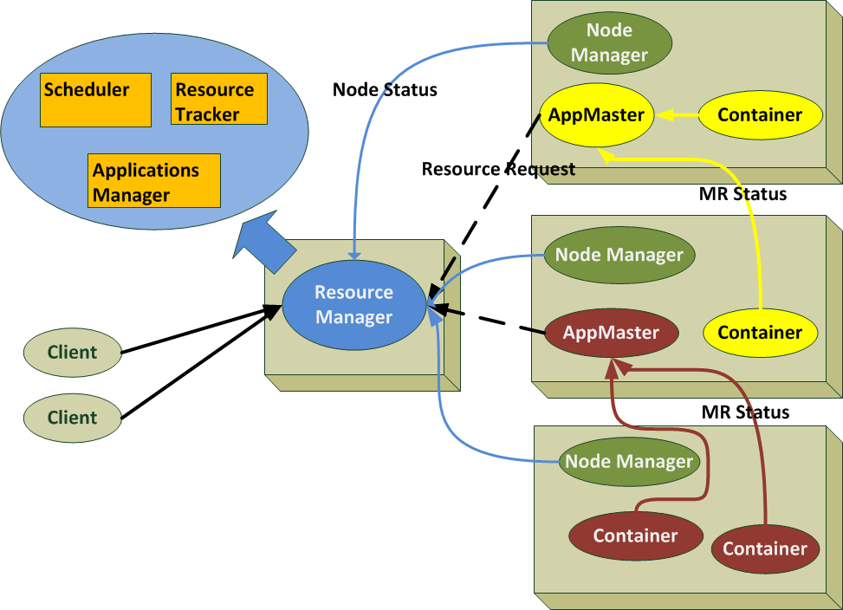
What is YARN?
Yarn or MapReduce v2 is a complete overhaul of the original MapReduce.
No more M/R containers
Split JobTracker
Per-App
AppMaster
Notes:
Guest talks + student presentations

Slide 4
Is YARN Highly-Available?
All jobs are lost!

Slide 5
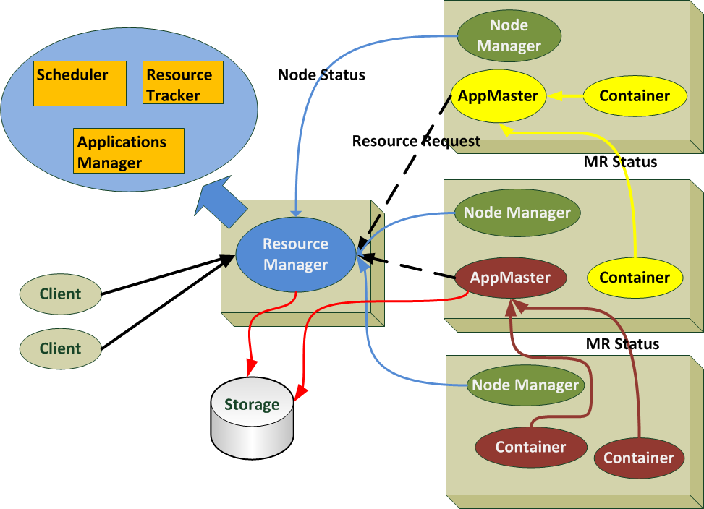
How to make it H.A?
Store application states!

Slide 6
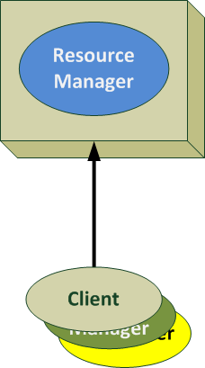
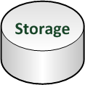
How to make it H.A?
Failure recovery
RM1
Downtime
RM1
store
load

Slide 7
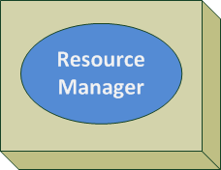
How to make it H.A?
Failure recovery -> Fail-over chain
RM1
No Downtime
RM2
store
load
7

Slide 8

How to make it H.A?
Failure recovery -> Fail-over chain -> Stateless RM
RM1
RM2
RM3
The Scheduler would have to be sync!

Slide 9


What storage to use?
Hadoop proposed:
Hadoop Distributed File System (HDFS).
Fault-tolerant, large datasets, streaming access to data and more.
Zookeeper – highly reliable distributed coordination.
Wait-free, FIFO client ordering, linearizable writes and more.

Slide 10
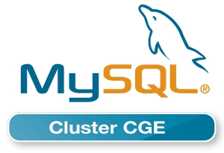
What about NDB?
NDB MySQL Cluster is a scalable, ACID-compliant transactional database
Some features:
Auto-sharding for R/W scalability;
SQL and NoSQL interfaces;
No single point of failure;
In-memory data;
Load balancing;
Adding nodes = no Downtime;
Fast R/W rate
Fine grained locking
Now for G.A!
Notes:
Data nodes manage the storage and access to data. Tables are automatically sharded across the
data nodes which also transparently handle load balancing, replication, failover and self-healing.

Slide 11

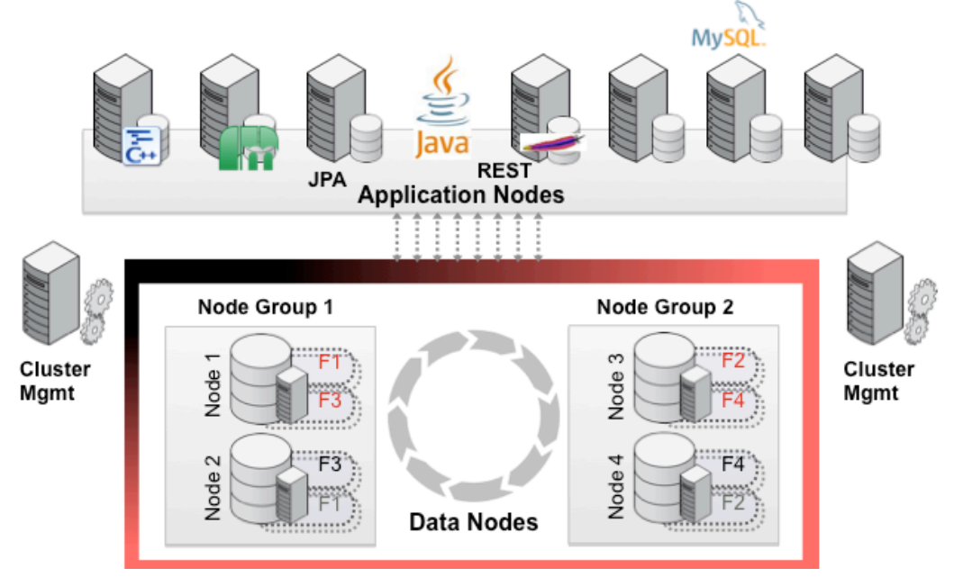
What about NDB?
Connected to all clustered storage nodes
Configuration and network partitioning
Notes:
MySQL Cluster is deployed in the some of the largest web, telecoms
The storage nodes (SN) are the main nodes of the system. All data is stored on the storage nodes.
Data is replicated between storage nodes to ensure data is continuously available in case one or
more storage nodes fail. The storage nodes handle all database transactions.
The management server nodes (MGM) handle the system configuration and are used to change
the setup of the system. Usually only one management server node is used, but there is also a
possibility to run several. The management server node is only used at startup and system reconfiguration,which means that storage nodes are operable without the management nodes.

Slide 12
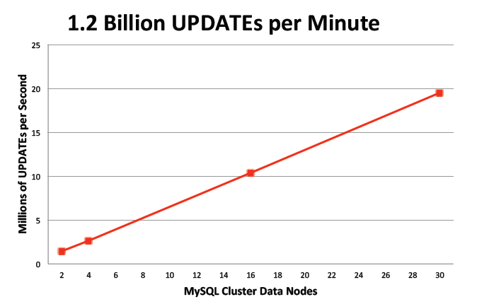
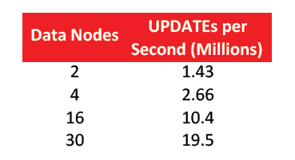
What about NDB?
Linear horizontal scalability
Up to 4.3 Billion reads p/minute!

Slide 13
Our Contribution
Two phases, dependent on YARN patch releases.
Phase 1
Apache
Implemented Resource Manager recovery using a Memory Store (MemoryRMStateStore).
Stores the Application State and Application Attempt State.
We
Implemented NDB MySQL Cluster Store
(NdbRMStateStore) using clusterj.
Implemented TestNdbRMRestart to prove the H.A of YARN.
Not really H.A!
Up to 10.5x faster than openjpa-jdbc

Slide 14
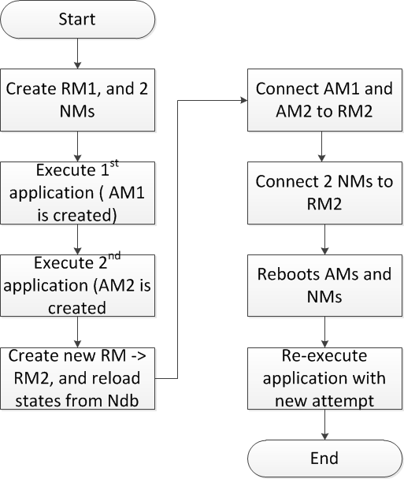
Our Contribution
testNdbRMRestart
Restarts all unfinished jobs

Slide 15
Our Contribution
Phase 2:
Apache
Implemented Zookeeper Store (ZKRMStateStore).
Implemented FileSystem Store (FileSystemRMStateStore).
We
Developed a storage benchmark framework
To benchmark both performances with our store.
https://github.com/4knahs/zkndb
For supporting clusterj

Slide 16
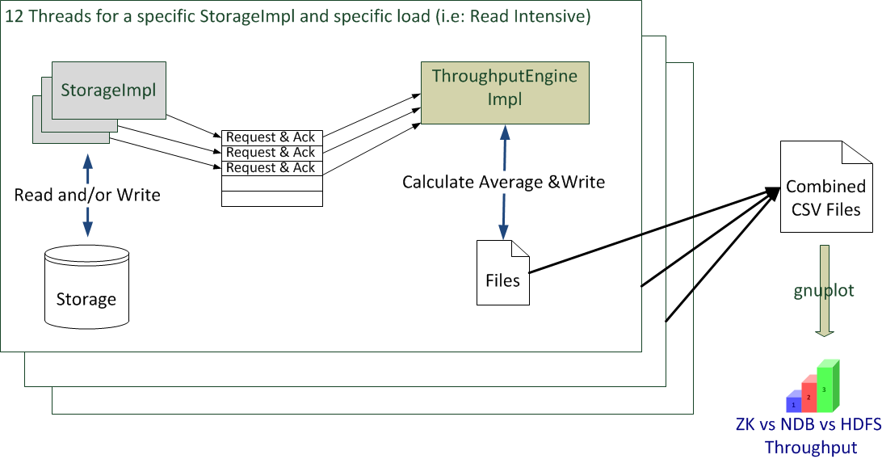
Our contribution
Zkndb architecture:

Slide 17
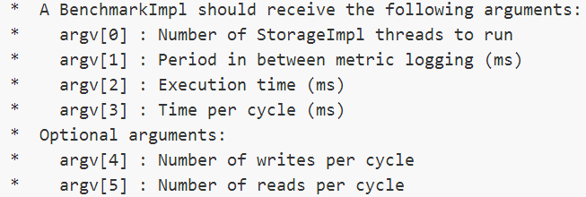
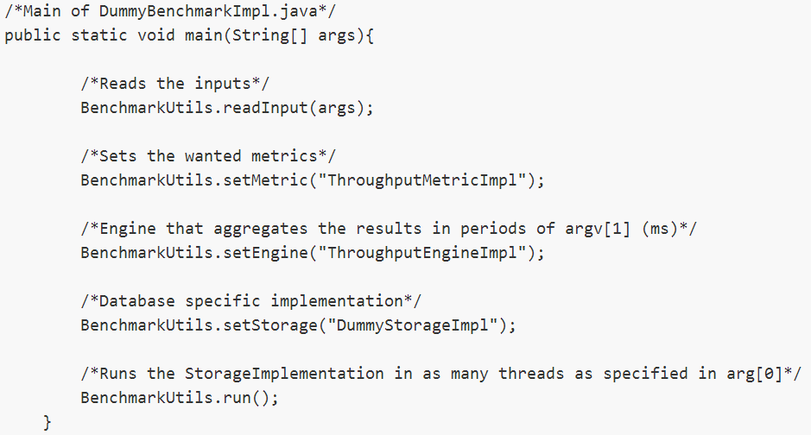
Our Contribution
Zkndb extensibility:

Slide 18
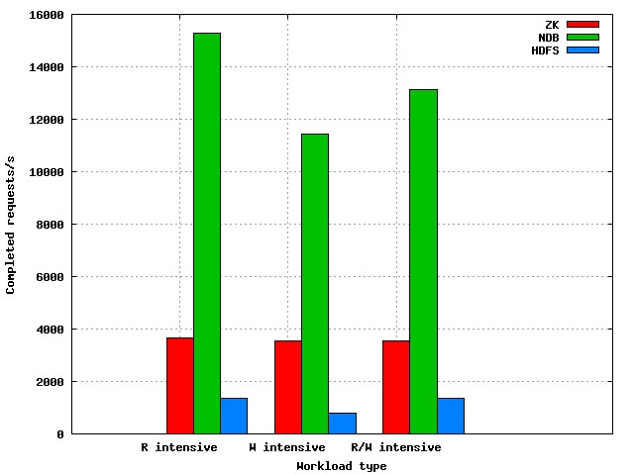
Results
Runed multiple experiments: 1 nodes 12 Threads, 60 seconds Each node with: Dual Six-core CPUs @2.6Ghz All clusters with 3 nodes. Same code as
Hadoop (ZK & HDFS)
ZK is limited by the store
HDFS has problems with creation of files
Not good for small files!

Slide 19
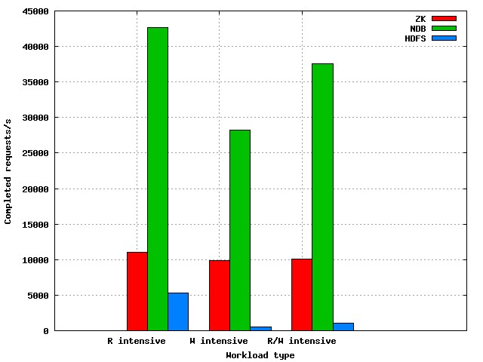
Results
Runed multiple experiments: 3 nodes 12 Threads each, 30 seconds Each node with: Dual Six-core CPUs @2.6Ghz All clusters with 3 nodes. Same code as
Hadoop (ZK & HDFS)
ZK could scale a bit more!
Gets even worse due to root lock in NameNode

Slide 20
Future work
Implement stateless architecture.
Study the overhead of writing state to NDB.

Slide 21
Conclusions
HDFS and Zookeeper have both disadvantages for this purpose.
HDFS performs badly for multiple small file creation, so it would not be suitable for storing state from the Application Masters.
Zookeeper serializes all updates through a single leader (up to 50K requests). Horizontal scalability?
NDB throughput outperforms both HDFS and ZK.
A combination of HDFS and ZK does support apache’s proposal with a few restrictions.

Slide 22
Our team!
Mário Almeida (site – 4knahs(at)gmail)
Arinto Murdopo (site – arinto(at)gmail)
Strahinja Lazetic (strahinja1984(at)gmail)
Umit Buyuksahin (ucbuyuksahin(at)gmail)
Special thanks
Jim Dowling (SICS, supervisor)
Vasia Kalavri (EMJD-DC, supervisor)
Johan Montelius (EMDC coordinator, course teacher)

