Slide 1

Introduction to OpenFlow,
SDN & NFV
IS-IS
Kingston Smiler. S

Slide 2
Content
Why we need new paradigm in networking?.
OpenFlow.
SDN.
NFV.

Slide 3
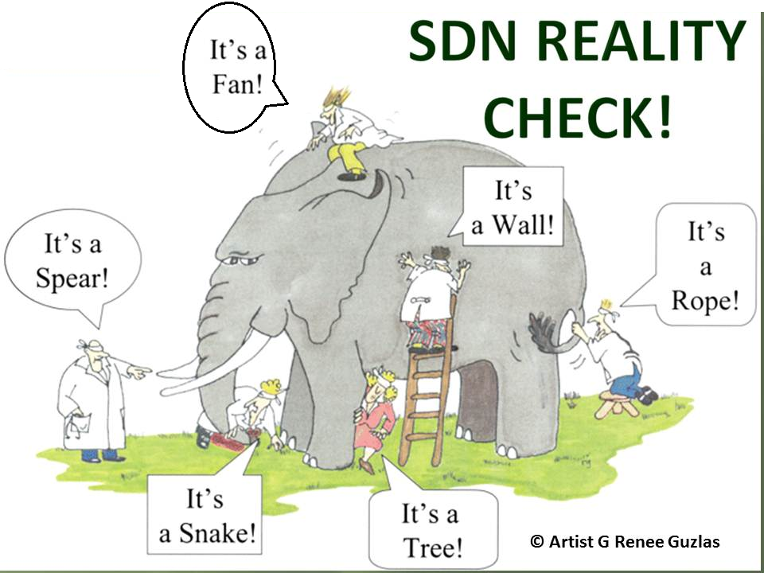
Traditional Computing Vs Modern Computing

Slide 4
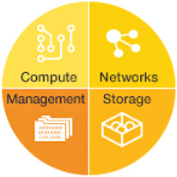
Converged Infrastructure
Compute
Storage
Network

Slide 5
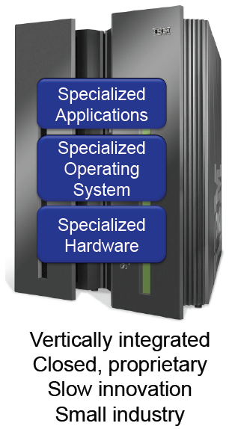
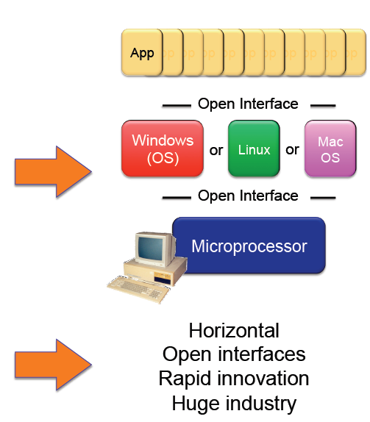
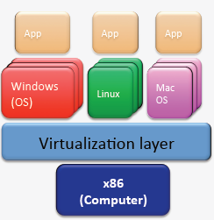

Traditional Computing Vs Modern Computing

Slide 6
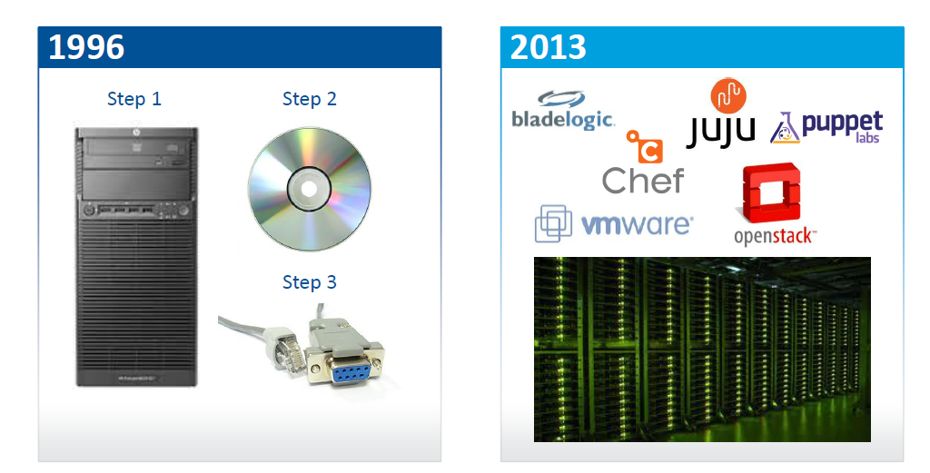
Traditional Vs Modern Computing Provisioning Methods
Source: Adopted from Transforming the Network With Open SDN by Big Switch Network

Slide 7
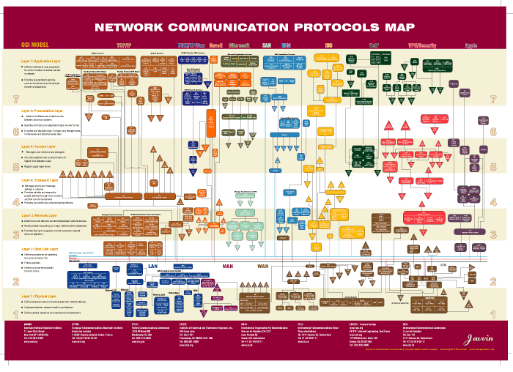
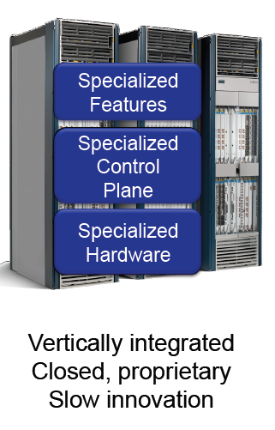
Modern Networking Complexity
Ref: Javvin

Slide 8
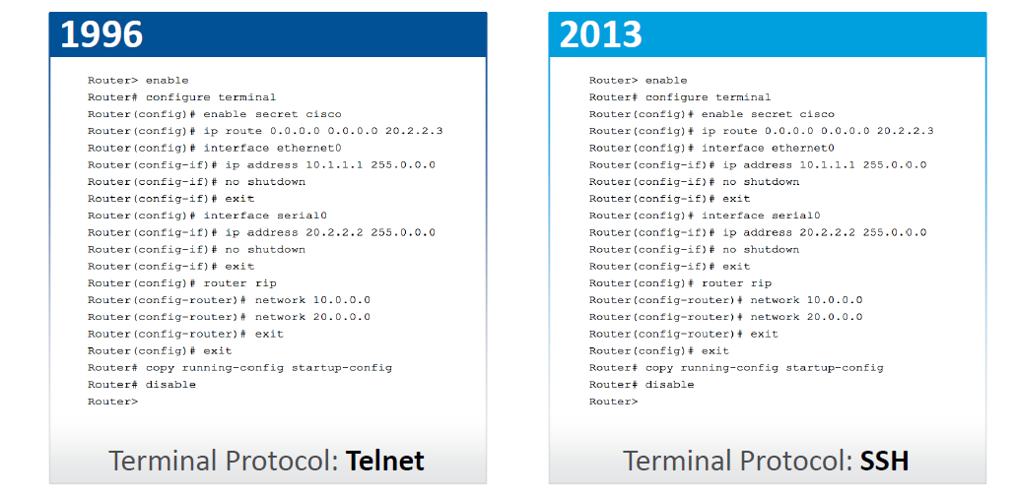
Traditional Vs Modern Networking Provisioning Methods
Source: Adopted from Transforming the Network With Open SDN by Big Switch Network

Slide 9
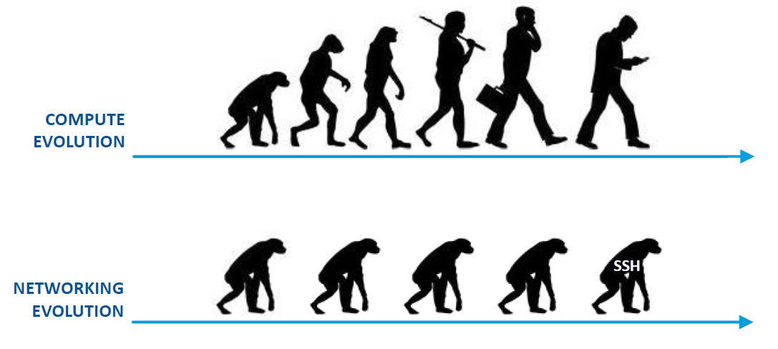
Computing Vs Networking
Source: Adopted from Transforming the Network With Open SDN by Big Switch Network

Slide 10
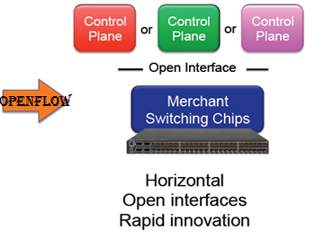
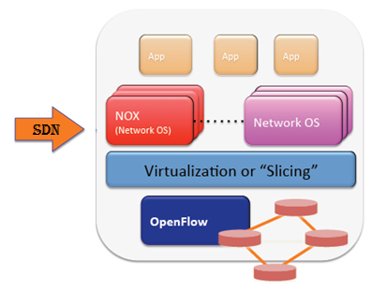
Current Network Vs OpenFlow Network Vs SDN Network

Slide 11
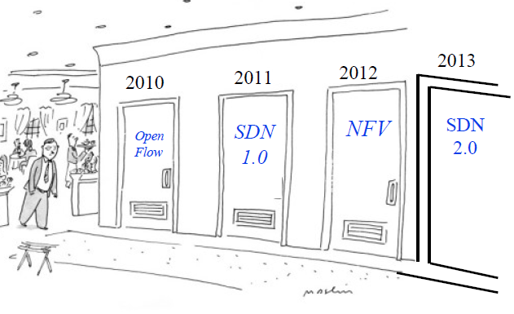
Source: Adopted from SDN and NFV: Facts, Extensions, and Carrier Opportunities by Prof. Raj Jain
OpenFlow, SDN, NFV Evolution

Slide 12
OpenFlow

Slide 13
Problems
Closed Systems with no or very minimal abstractions in the network design.
Hardware centric – usage of custom ASICs with Vendor Specific Software.
Difficult to perform real world experiments on large scale production networks.
No standard abstractions towards north bound and south bound interfaces, even though we have standard abstractions in the east / west bound interface with peer routers / switches.

Slide 14
Need for OpenFlow
Facilitate Innovation in Network
Layered architecture with Standard Open Interfaces
Independent innovation at each layer
More accessibility since software can be easily developed by more vendors
Speed-to-market – no hardware fabrication cycles
More flexibility with programmability and ease of customization and integration with other software applications
Fast upgrades
Program a network vs Configure a network

Slide 15
What is Open Flow
OpenFlow is like an x86 instruction set for the network nodes.
Provides open interface to “black box” networking node (ie. Routers, L2/L3 switch) to enable visibility and openness in network
Separation of control plane and data plane.
The datapath of an OpenFlow Switch consists of a Flow Table, and an action associated with each flow entry
The control path consists of a controller which programs the flow entry in the flow table

Slide 16
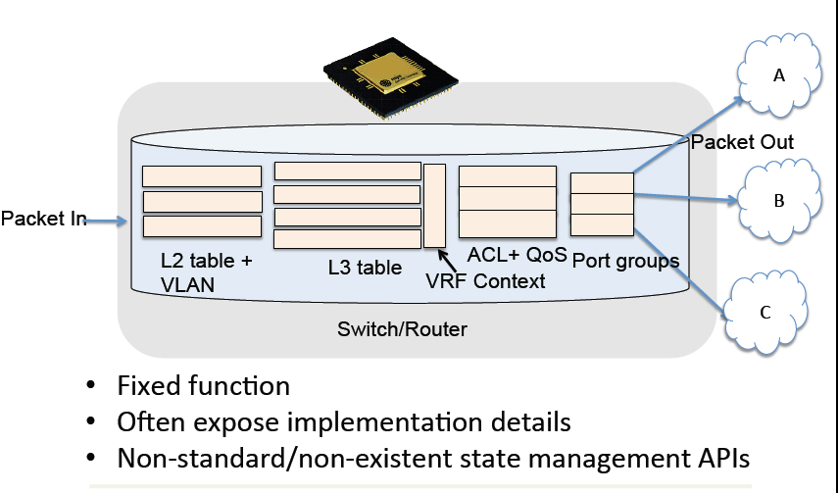
Traditional Switch Forwarding
Source: Adopted from ONF11 presentation by Martin Casado
Notes:
Kasado

Slide 17
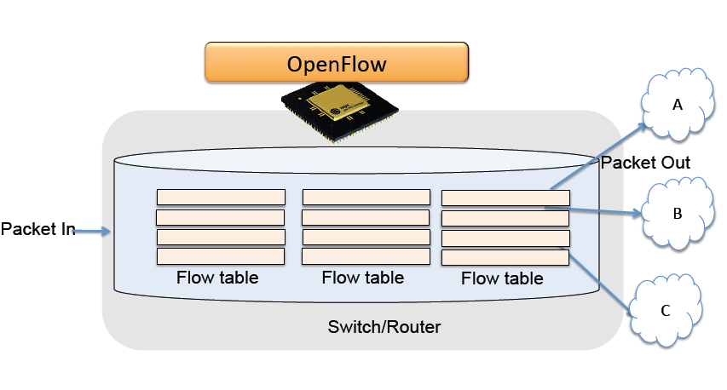
Open Flow Switch Forwarding
Source: Adopted from ONF11 presentation by Martin Casado
Notes:
Kasado

Slide 18
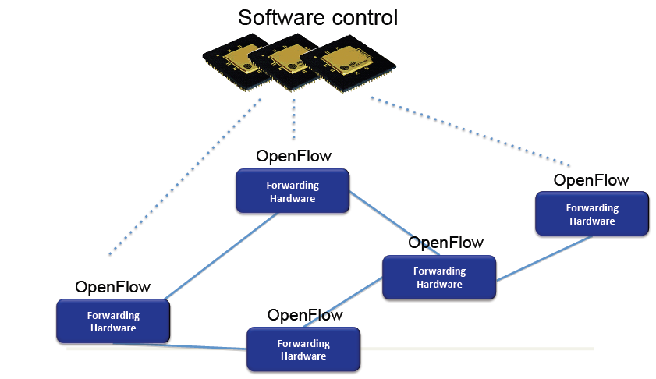
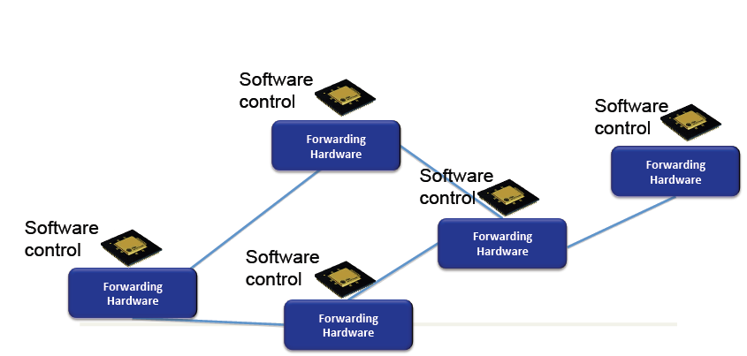
Open Flow Illustration
Source: Adopted from ONF11 presentation by Martin Casado

Slide 19


Components of OpenFlow Network
Controller
OpenFlow Switch
OpenFlow Switch specification
OpenFlow
Protocol
PC
Secure
Channel
TCP / TLS
sw
Flow
Table
hw
* Figure From OpenFlow Switch Specification

Slide 20
OpenFlow Controller
Manages one or more switch via OpenFlow channels.
Uses OpenFlow protocol to communicate with a OpenFlow aware switch.
Acts similar to control plane of traditional switch.
Provides a network wide abstraction for the applications on north bound.
Responsible for programming various tables in the OpenFlow Switch.
Single switch can be managed by more than one controller for load balancing or redundancy purpose. In this case the controller can take any one of the following roles.
Master.
Slave.
Equal.

Slide 21
OpenFlow Channel
Used to exchange OpenFlow message between switch and controller.
Switch can establish single or multiple connections to same or different controllers (auxiliary connections).
A controller configures and manages the switch, receives events from the switch, and send packets out the switch via this interface
The SC connection is a TLS/TCP connection. Switch and controller mutually authenticate by exchanging certificates signed by a site-specific private key

Slide 22
OpenFlow Switch
Consists of one or more flow tables, group table and meter table.
A single switch can be managed by one or more controllers.
The flow tables and group table are used during the lookup or forwarding phase in order to forward the packet to appropriate port.
Meter table is used to perform simple QOS operations like rate-limiting to complex QOS operations like DiffServ etc

Slide 23
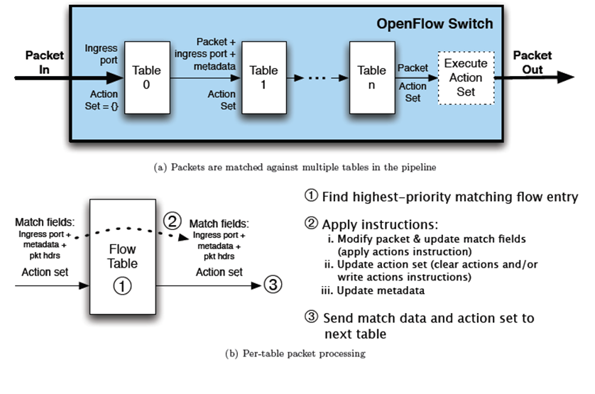
Pipeline Processing
* Figure From OpenFlow Switch Specification

Slide 24
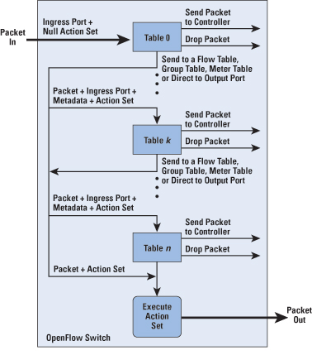
Packet Flow in OpenFlow Switch
* Figure From OpenFlow Switch Specification

Slide 25
Open Flow
General Myth
SDN is Open Flow
Reality
OpenFlow is an open API that provides a standard interface for programming the data plane switches

Slide 26
SDN

Slide 27
What is SDN?
SDN Definition
Centralization of control of the network via the
Separation of control logic to off-device compute, that
Enables automation and orchestration of network services via
Open programmatic interfaces
SDN Benefits
Efficiency: optimize existing applications, services, and infrastructure
Scale: rapidly grow existing applications and services
Innovation: create and deliver new types of applications and services and business models

Slide 28
Need for SDN
Network Virtualization (Data Center & Cloud)– Use network resource without worrying about where it is physically located, how much it is, how it is organized, etc.
Orchestration (Cloud) - Automated arrangement, coordination, and management of complex computer systems, middleware, and services.
Programmable (Enterprise) - Should be able to change behavior on the fly.
Dynamic Scaling (Cloud) - Should be able to change size, quantity
Automation - To lower OpEx minimize manual involvement
Troubleshooting
Reduce downtime
Policy enforcement
Provisioning/Re-provisioning/Segmentation of resources
Source: Adopted from Introduction to Software Defined Software Defined Networking (SDN) Networking (SDN) by Prof. Raj Jain

Slide 29
Need for SDN (Contd..)
Visibility - Monitor resources, connectivity.
Performance - Optimize network device utilization
Traffic engineering/Bandwidth management
Capacity optimization
Load balancing
High utilization
Multi-tenancy (Data Center / Cloud)- Tenants need complete control over their addresses, topology, and routing, security
Service Integration (Enterprise)- Load balancers, firewalls, Intrusion Detection Systems (IDS), provisioned on demand and placed appropriately on the traffic path
Source: Adopted from Introduction to Software Defined Software Defined Networking (SDN) Networking (SDN) by Prof. Raj Jain

Slide 30
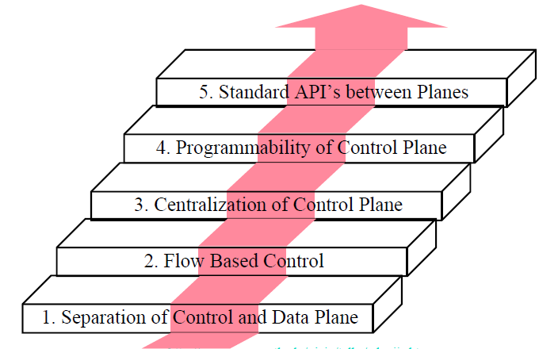
SDN Innovation & Components
App
App
App
App
Well-defined Open API
SDN Controller/ Network Operating System
OpenFlow
OpenFlow compliant OS
Packet-Forwarding Hardware
OpenFlow compliant OS
OpenFlow compliant OS
Packet-Forwarding Hardware
Packet-Forwarding Hardware
Source: Adopted from SDN Central (Software-Defined Networking (SDN) Use Cases)

Slide 31
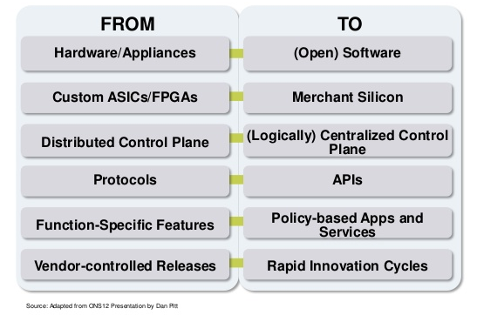
SDN Approach

Slide 32
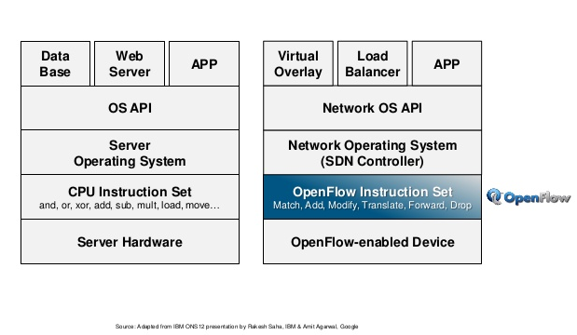
Server Abstraction Vs SDN Abstraction

Slide 33
SDN – Game changer?
Complete removal of control plane may be harmful. Exact division of control plane between centralized controller and distributed forwarders is yet to be worked out.
SDN is easy if control plane is centralized but not necessary. Distributed solutions may be required for legacy equipment and for fail-safe operation.
Source: Adopted from Introduction to Software Defined Software Defined Networking (SDN) Networking (SDN) by Prof. Raj Jain

Slide 34
Key Attributes for SDN Success
Architecture for a Networked Operating System with a service/application oriented namespace
Resource virtualization, elasticity and aggregation (pooling to achieve scaling)
Appropriate abstractions to foster simplification
Decouple topology, traffic and inter-layer dependencies
Dynamic multi-layer networking

Slide 35
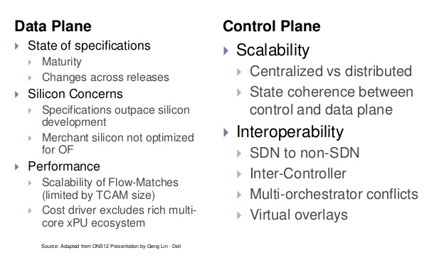
SDN – Challenges

Slide 36
NFV

Slide 37
What is NFV?
Network Functions Virtualization (NFV) is a network architecture concept that proposes using IT virtualization related technologies, to virtualize entire classes of network node functions into building blocks that may be connected, or chained, together to create communication services.
Concept of NFV originated from SDN.
NFV and SDN are complementary. One does not depend upon the other. You can do SDN only, NFV only, or SDN and NFV together.
Specification comes from ETSI Industry Specification Group.

Slide 38
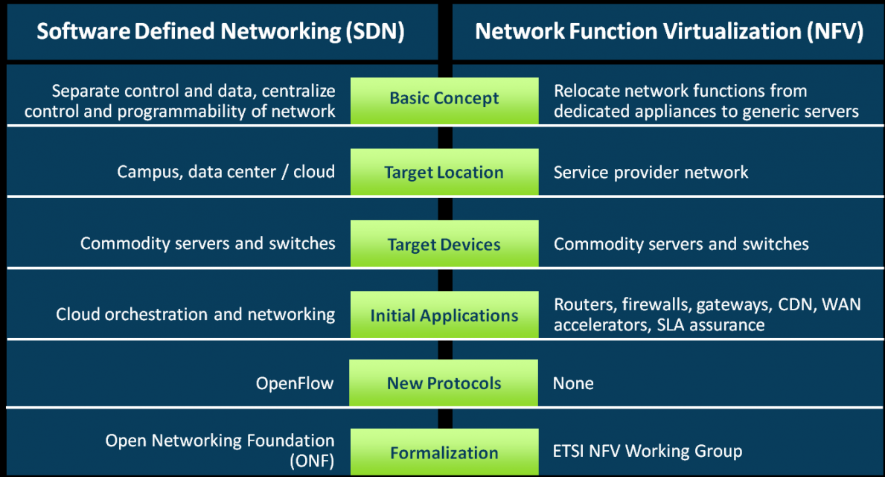
NFV vs SDN
Part III - Open Flow Applications
Source: Adopted from http://www.overturenetworks.com/blog/2013/04/12/network-function-virtualization-and-software-defined-networking-whats-difference

Slide 39
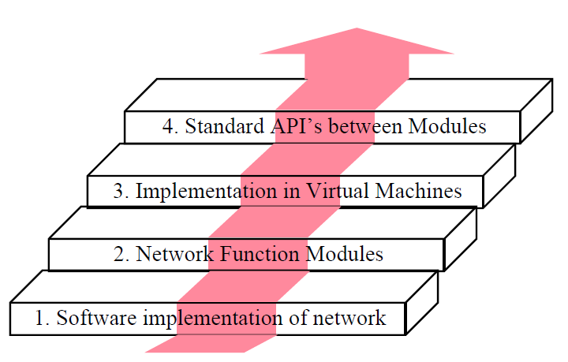
NFV Innovations
Source: Adopted from SDN and NFV: Facts, Extensions, and Carrier Opportunities by Prof. Raj Jain

Slide 40
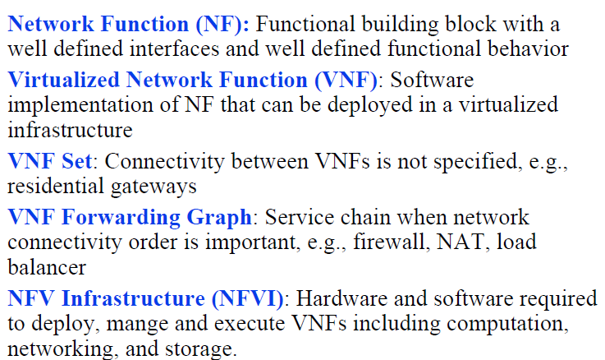
NFV Components
Source: Adopted from SDN and NFV: Facts, Extensions, and Carrier Opportunities by Prof. Raj Jain

Slide 41
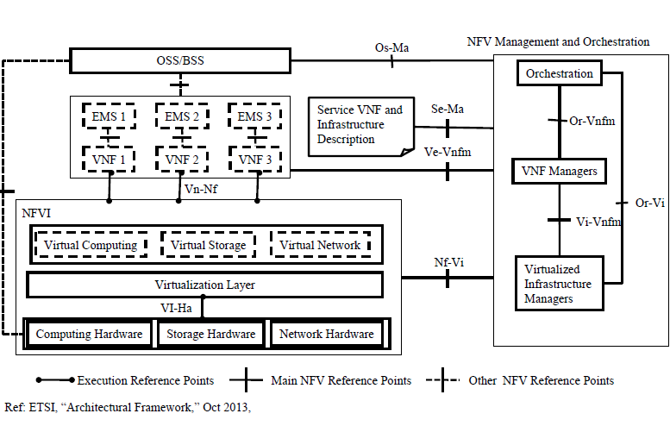
NFV Architecture
Source: Adopted from SDN and NFV: Facts, Extensions, and Carrier Opportunities by Prof. Raj Jain

Slide 42
Summary
NFV provides virtualization, orchestration, scaling, automation, hardware independence etc..
NFV and SDN are complementary and independent frameworks.
NFV doesn’t mandata control plane and Data plane separation and hence OpenFlow is not mandated in NFV.
Lot of Network function has been demonstrated by carriers already.

Slide 43
References / Reading List
B. Martinussen (Cisco), “Introduction to Software Defined Networks (SDN),” April 2013, http://www.cisco.com/web/europe/ciscoconnect2013/pdf/DC_3_SDN.pdf
http://www.sdncentral.com/sdn-use-cases /
Open Data Center Alliance Usage Model: Software Defined Networking Rev 1.0,” http://www.opendatacenteralliance.org/docs/Software_Defined_Networking_Master_Usage_Model_Rev1.0.pdf
SDN and NFV: Facts, Extensions, and Carrier Opportunities by Prof. Raj Jain
OpenFlow Switch Specication V 1.4.
Software Defined Software Defined Networking (SDN) Networking (SDN) by Prof. Raj Jain
ETSI, “NFV - Update White Paper,” Oct 2013, http://portal.etsi.org/NFV/NFV_White_Paper2.pdf
ETSI, “Architectural Framework,” Oct 2013
ETSI, “NFV Use Cases,”
Intel, “Open simplified Networking Based on SDN and NFV,” 2013, 7 pp., http://www.intel.com/content/dam/www/public/us/en/documents/whitepapers/sdn-part-1-secured.pdf
SDN Central (Software-Defined Networking (SDN) Use Cases)

