Slide 1
SQL Server 2014 – Features Drilldown
DBI311
Dandy Weyn Sr. Technical Product Mkt. Manager
dandyw@microsoft.com
@ilikesql

Slide 2
The Evolution of Microsoft Data Platform
Modern DB platform
Mission
Critical
Performance & Productivity
Self-Service BI
Cloud-Ready
Mission Critical & Cloud Performance
XML ● KPIs
SQL Server
2000
Management Studio ● Mirroring
SQL Server
2005
Compression ● Policy-Based Mgmt ● Programmability
SQL Server
2008
PowerPivot ● SharePoint Integration ● Master Data Services
SQL Server
2008 R2
AlwaysOn ● ColumnStore Index ● Data Quality Services ● Power View ● Cloud Connectivity
SQL Server
2012
In-Memory Across Workloads ● Performance & Scale ● Hybrid Cloud Optimized ● HDInsight ● Cloud BI
SQL Server
2014

Slide 3




SQL Server 2014 and the Data Platform
Mission Critical Performance
Faster Insights from Any Data
Platform for Hybrid Cloud

Slide 4

Mission Critical Performance
In-Memory Built-In
Average 10x faster for new and existing SQL Server apps
Secure & Scalable
Most secure with enterprise scale using Windows Server
High Availability
The 9’s you need, with AlwaysOn
Mission Critical Support
Live support designed for mission critical solutions
Notes:
Key capabilities at a high level when it comes to mission critical include In-memory capabilities across all workloads including OLTP, DW and BI.
When it comes to security SQL Server has consistently been ranked the most secure with the least amount of vulnerabilities 5 years in a row including this year according to National Institute of Standards and Technology Comprehensive Vulnerability Database. SQL Server 2014 with WS 2012 and WS 2012 R2 can provide to cost effective mission critical scale across physical and virtual environments.
We know mission critical is all about the 9’s when it comes to High Availability and with SQL Server 2014 we have made the customer favorite AlwaysOn feature even better to give you the 9’s you need for your mission critical applications.
Finally none of these features matter unless we are there to support you in case of issues or failures and we certainly offer the live mission critical support you expect for your mission critical workloads.

Slide 5


In-Memory Built-In
Built-in
On average 10x faster, without having rewrite entire app
Leverage full SQL Server capabilities
Key Features
New In-Memory OLTP
Enhanced In-Memory ColumnStore for DW
In-Memory BI with PowerPivot
Buffer Pool Extension to SSDs & Enhanced Query Processing
Flexible
Select only highly utilized tables to be in-memory
Optimize in-memory to fit existing hardware
Before
16x Faster With In-Memory
Bwin Game Application
Bwin Game Application
Spans All Workloads
In-memory performance across OLTP, DW and BI
All in a single SKU
15,000 requests/sec
250,000 requests/sec
OLTP
SQL Server 2008
SQL Server 2014 with In-Memory

Slide 6

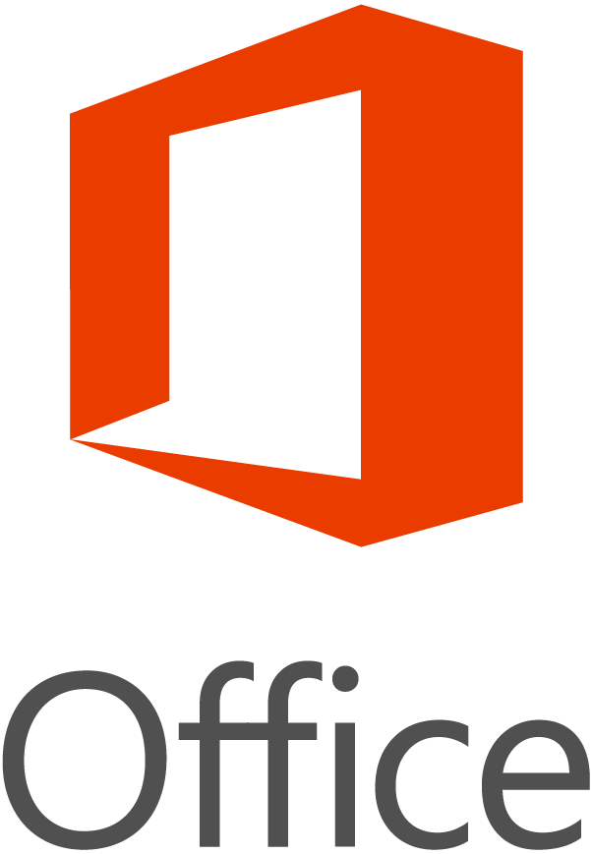

Microsoft In-Memory Technologies
Analytics
Streaming Data
OLTP
In-Memory Analytics in PowerPivot for Excel
In-Memory Analytics in SQL Server Analysis Services
In-Memory Columnstore Index in SQL Server 2012, Fast Track Data Warehouse, and Parallel Data Warehouse
StreamInsight
In-Memory OLTP
In-Memory Columnstore Index (in SQL Server 2014)
2014
2014
2014
2012
2012

Slide 7
In-Memory for OLTP
New high-performance, memory-optimized OLTP engine integrated into SQL Server and designed for modern hardware trends
Integrated into SQL Server relational database
Full ACID support
Memory-optimized indexes (no B-trees or buffer pools)
Non-blocking multiversion optimistic concurrency control (no locks or latches)
T-SQL compiled to native code
Customer benefits
Low latency
Up to 10x improvement in performance
2–5x improvement in scalability
Takes advantage of investments in SQL Server
Notes:
Move this to Futures section

Slide 8
In-Memory OLTP architecture
Benefits
High-performance data operations
Frictionless scale-up
Efficient, business-logic processing
Hybrid engine and integrated experience
In-Memory OLTP Tech Pillars
Main-memory optimized
High concurrency
T-SQL compiled to machine code
SQL Server integration
Optimized for in-memory data
Indexes (hash and range) exist only in memory
No buffer pool
Stream-based storage for durability
Multiversion optimistic concurrency control with full ACID support
Core engine uses lock-free algorithms
No lock manager, latches, or spinlocks
T-SQL compiled to machine code via C code generator and Visual C compiler
Invoking a procedure is just a DLL entry-point
Aggressive optimizations at compile time
Same manageability, administration, and development experience
Integrated queries and transactions
Integrated HA and backup/restore
Drivers
Hardware trends
Business
Steadily declining memory price, NVRAM
Many-core processors
Stalling CPU clock rate
TCO

Slide 9
Columnstores: clustered and updatable The next generation
Fast execution for data warehouse queries
Speedups of 10x and more
No need for separate base table
Saves space
Data can be inserted, updated, or deleted
Simpler management
Eliminate need for other indexes
Saves space and simpler management
More data types supported
Removes many limitations from non-clustered columnstores in SQL Server 2012

Slide 10
Comparing space savings 101-million row table and index space

Slide 11
Secure
Least vulnerable database
5years in a row
Most utilized database in the world
46%
Market share
Key Features
Redefined Engineering Security Processes
CC certification at High Assurance Level
Enhanced Separation of Duty
Transparent Data Encryption
Encryption Key Management
Support for Windows Server Core
Database Vulnerabilities
*National Institute of Standards and Technology Comprehensive Vulnerability Database 4/17/2013, Market share from IDC 2013
Notes:
When it comes to security the results speak for how important we feel providing the best security is for our customers. As you can see per the latest NIST Comprehensive Vunererability Database published on 4/17/2013 we continue to lead the way 5 years in a row as the least vulnerable database amongst the Top data platforms tracked. In addition it is important to note that we ware the most utilized paid database in the market per IDC with 42% market share.
When it comes to security features we have achieved CC certification at High Assurance level for SQL Server.
When it comes to separation of duties, SQL Server 2014 now separates Database Administrator role from System Administrator role for greater security. In addition you can even create more granular DBA roles, with different access rights for greater compliance. For example you could have a DBA roles that can manage database but cannot see user data.
SQL Server offers Transparent Data Encryption capabilities that are becoming even more important in multi-tenant environments like cloud. Encryption key management allows you to store you encryption keys on a separate server than the one running the SQL Server instance for greater security. Also if you want to reduce the attack surface area even further SQL Server 2014 also support Windows Server Core and finally the last item is not a feature but critical when it comes to achieving these great results. We have redefined our entire SQL Server engineering security processes about 6 years ago when SLAMMER hit and it is a big part of why you see the results that you do. Security is a mantra in SQL Server engineering across all disciplines from development to test.
Notes: Update as of 4/17/2013 inclusive. Chart counts NIST CVE – Reported Software Flaws by
---------
“published” date, utilizing the NIST ND. SQL Server Query = Vendor Name: Microsoft Corporation; Product Names: sql_server, sql_server, sql_server_desktop_engine, sql_server_express_edition, sql_server_reporting services, sql_srvsql_srv_desktop_engine; Oracle Query = Vendor Name: Oracle; Product Name: ‘Any’, all CVEs where “Vulnerable software and versions” lists a database product; DB2 Query = Vendor Name: IBM; Product Names: db2, db2_content_manager, db2_content_manager_toolkit, db2_server, db2_universal_database; MySQL Query = Vendor Name: mysql, mysql-ocaml, mysql_auction, mysql_eventum, mysql_quick_admin, mysqldumper, mysqlnewsengine; Product Name: ‘Any’
CC certification at High Assurance Level
Transparent Data Encryption
Encryption Key Management – (note for talktrk- mean keys can live on a separate machine than the machine running SQL Server for greater security)
Redefined Engineering Security Processes

Slide 12
Separation of Duties Enhancements
What’s being delivered
Three new permissions (CONNECT ANY DATABASE, IMPERSONATE ANY LOGIN, and SELECT ALL USER SECURABLES)
Main benefit
Greater role separation
Ability to create new roles for database administrators who are not sysadmin (super user)
Ability to create new roles for users or apps with specific purposes
Examples:
Database administrators but cannot see user data
Database administrators but cannot modify logins
Database administrators but cannot impersonate any logins
New roles (for example, auditors) to read all data but not database administrators
New roles to read all metadata for monitoring purposes (for example, SCOM) but cannot see user data
New roles for middle tier app to impersonate any login except sa, sysadmin, or other high privilege logins

Slide 13
Scalable
Scale Compute
Up 640 logical processors
64 vCPUs/VM
1 TB memory/VM
64 nodes/cluster
SQL Server 2014 Resource Governance
Key Features
SQL Server 2014
Resource Governor adds IO governance
SysPrep at cluster level
Windows Server 2012 R2
Hyper-V
Storage Spaces
NIC Teaming
Online VHDX Resize
Network & Storage QoS
Pool 1
CPU 20% | Memory 10% | IO 30%
App 1
Scale Networking
Network virtualization provides flexibility and isolation
Assign minimum and maximum bandwidth
Pool 2
CPU 30% | Memory 50% | IO 30%
App 2
App 3
Scale Storage
Storage virtualization
Enterprise-class network storage on standard hardware
Storage tiering for higher performance
Pool 3
CPU 50% | Memory 40% | IO 40%
App 4
App 5
App 6
100% | 100% | 100%
Notes:
Lets take a look at SQL Server Scalability and how new capabilities in Windows Server 2012 and Windows Server 2012 R2 enable SQL Server to scale.
When it comes to scaling compute, Windows Server 2012 not only provide scale for large mission critical databases in a physical environment but also in a virtual environment. WS 2012 supports up to 640 logical processers to tackle the largest applications. In a virtual environment you can utilize up to 64 virtual CPUs per VM and up to 1TB of memory per VM. In addition you have now have up to 64 nodes in a SQL Server cluster.
You can also scale networking with network virtualization capabilities in WS 2012 R2. This helps SQL Server because it also you to move on workload from one datacenter to another without having to worry about the underlying network. With the Nic Teaming feature in WS 2012 you can pool multiple NICs with allows for greater network flexibility for SQL Server databases. You can also assign minimum and maximum bandwidth criteria to improve Network QoS.
With WS2012 you can also virtualize storage allowing you to accumulate all of your storage and assign pieces to different workloads. You can also tier the storage for higher performance for example a mix of SSDs and standard disks allowing you to create tiers so you can keep hot data in the fastest tier and less utilized data in lower tiers improving performance without increasing costs.
Just like WS2012 allows you to create pools of infrastructure and refine and tier those pools, SQL Server take that a step further and provides this type of tiering at the SQL Server instance level with Resource Governor. In addition to being able to pool CPU and Memory you can now with SQL Server 2014 pool IO and tier the pool per your criteria ensuring greater scale and performance predictability for your SQL Server workloads.

Slide 14
SSD Buffer Pool Extension and scale up
What’s being delivered
Use of non-volatile drives (SSD) to extend buffer pool
NUMA-Aware large page and BUF array allocation
Main benefits
BP extension for SSDs
Improve OLTP query performance with no application changes
No risk of data loss (using clean pages only)
Easy configuration optimized for OLTP workloads on commodity servers (32 GB RAM)

Slide 15
Online Operations Enhancements
What’s being delivered
Single partition online index rebuild
Managing Lock Priority for table SWITCH and online index rebuild
Built-in diagnostics
Main benefits
Increased concurrency and application availability
New partition-level granularity for online index rebuild enables lower resource (CPU/memory) usage for customers who need uninterrupted access
Provide customers with greater control over impacting running transactions if using switch partition or online index rebuild commands

Slide 16

Faster Insights from Any Data
Easy access to data, big & small
Search, access, and shape internal and external data, and combine with unstructured data
Powerful insights with familiar tools
Speed up analysis and time to insight with the familiarity of Excel in Office and Office 365 and access via mobile devices
Complete BI platform
Scale your BI models and enrich and secure your data with a complete platform spanning cloud and on-premises

Slide 17

Microsoft Power BI for Office 365
Insights in Excel
Collaborate in Office 365
Discover
Search, access, and transform public and internal data sources with Power Query
Share
Share data views and workbooks refreshable from on-premises and cloud based data sources, with Power BI Sites
Analyze
Easy data modeling and lightning fast in-memory analytics with Power Pivot
Find
Ask questions and get immediate answers with natural language query
Q&A
Visualize
Bold new interactive data visualizations with Power View and Power Map
Mobile
Mobile access through HTML5 and touch optimized apps for Windows 8, RT and iOS tablets
Scalable | Manageable | Trusted

Slide 18

Platform for Hybrid Cloud
Hybrid Cloud Solutions
Enable new hybrid scenarios like cloud backup and cloud DR to reduce costs and improve on-premises DR
Easy On-Ramp to Cloud
Easily migrate and run SQL Server in the cloud to gain benefits of cloud computing
Complete & Consistent
Deploy a complete and consistent data platform from on-premises to cloud
Notes:
SQL Server 2014 provides a great platform for Hybrid Cloud as it enable new hybrid cloud solution such as backup to cloud, HA to cloud as well as other hybrid scenarios that can help you reduce costs and improve on-premises DR. We have also made it much easier for DBAs who may not be familiar with Windows Azure to easily deploy and manage SQL Server workloads to it. Finally one key reason we believe we offer a unique value proposition when it comes to building hybrid cloud solutions is our Cloud OS strategy of ensure a great and consistent experience no matter where you are running your data platform with a common set of tools across the entire application lifecycle.

Slide 19

Hybrid Cloud Solutions
Simplified Cloud Backup
Manual or Automatic
At an instance level with point in time restore
Measures DB usage patterns to set backup frequency
Reduce CAPEX & OPEX with Cloud Backup
Windows Azure
Geo Replication
Restore to VM
Cloud Disaster Recovery
Fast disaster recovery (low RTO)
Easy to deploy & manage
Azure Storage
Periodic Snapshot (automatic/manual)
On-Premise Network
Extend On-Prem Apps
Cloud bursting
Greater global reach
Better isolation of internal assets
Domain Controller
SQL Server
Notes:
SQL Server 2014 enable new hybrid cloud solutions that can help you reduce CAPEX and OPEX while improving things like DR.
Lets take a look at the first hybrid scenario enabled, which is the ability to backup your on-premises database to Windows Azure and do this in an easy and efficient manner. You can enable policy based backup directly to Azure Storage and all you need is the URL and storage key. The backup is policy based and at an instance level meaning all of your databases within the instance follow the policy set and the backup can be implemented both manually or automated. In addition you gain the benefits of Windows Azure storage which offers Geo Replication that replicates the backups stored in multiple datacenters so you have even better DR for your backups. Also in the case of an on-premises failure you can restore the backups in Windows Azure Virtual Machines.
<Click to see Cloud HA Diagram>:
You can also enable an even better disaster recovery scenario with lower RTO (recovery time objective) and better RPO (recovery point objective) over the backup with the Cloud HA scenario. In this scenario you are can now with SQL Server 2014 add asynchronous replicas to Windows Azure Virtual Machines and do them simply with an Add Replica wizard that makes it a point and click experience directly in SSMS (SQL Server Management Studio). As soon as a transaction is committed on-premises it is sent asynchronously to the Windows Azure replica. We still recommend you keep your synchronous replica on-premises, but by having the additional replicas in Windows Azure again you gain improved DR and can reduce your CAPEX and OPEX costs of physically maintiaing additional hardware in additional data centers. Also the replicas in Azure can be efficiently utilized to take care of read functionality like BI reporting or also utilized for doing backups, speeding up the backup to Azure process as the secondary is in Azure already.
Finally you can create additional hybrid application scenarios by extending your on-premises applications to Windows Azure, much like Flavorus did to gain scale on demand in a cost effective manner.

Slide 20
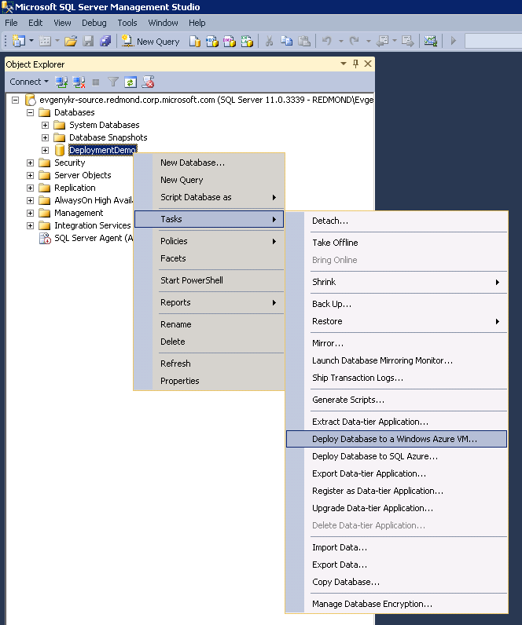
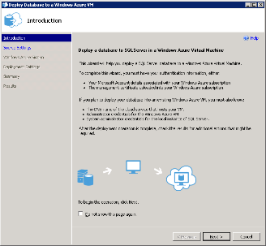

Easy On-Ramp to Cloud
New Migration Wizard
Easily migrate on-prem SQL Server to a Windows Azure VM
Designed for users unfamiliar with Windows Azure
Cloud Migration Wizard
SQL Server in a Windows Azure VM
Ideal for existing apps & dev/test new apps
Full SQL Server functionality
Full VM control
Windows Azure SQL Database service
Ideal for new variable-demand apps
Dynamic scale-out of database
No patching of OS or DB
HA built-in with 99.9% SLA
DB
Notes:
Not only are we enabling new unique hybrid scenarios, we are also simplify cloud adoption for our customers. With SQL Server 2014 we will also ship a new migration wizard that will help DBAs easily migrate their on-premises SQL Server instance to Windows Azure and again directly through SSMS as you can see in the screen shot there, point and click and you instance will be up and running in Azure in no time.
Once you become familiar with Windows Azure you can start to take advantage of the Windows Azure Virtual Machine to run many scenarios in the cloud including fast dev/test of your SQL Server applications, moving existing applications, doing hybrid scenarios like we talked about, BI scenarios in the cloud because you have full SQL Server functionality including all of the BI services. In addition you have full control over the VM so if you want to put your coroporate anti-virus on the VM you can.
Once you have become comfortable with the Windows Azure environment you can take advantage of Windows Azure SQL Database service offering that will speed development of your new database application even faster because you don’t have to manage the database, it is a service, you don’t have to patch the OS or database we take care of that, all you do is develop your application using the service. The SQL Database service also has unique cloud features like dynamic scalability of the database using Federations like Flavorus did to achieve their business goals. In addition this database service also offers an SLA for the database running inside the VM and you don’t have think about setting up high availability because it is built-in to the database service by default. This is where we see cloud applications doing fast development, less maintenance and faster time to market.

Slide 21

Complete & Consistent Data Platform
On-Premises Data Center
Off-Premises
Traditional
NON-VIRTUALIZED
Private
CLOUD
Microsoft Cloud
3rd Party
Windows Azure
Office 365
Service Provider
CLOUD
Microsoft Data Platform
SQL Server on Windows Server
HD Insight Server
PDW Appliance
SQL Server in a Windows Server VM
SQL Server in a Windows Azure VM
SQL Database service
HDInsight
Tables
Blobs
Power BI features in O365
SQL Server in a Windows Server VM

Slide 22
Call to action
Download SQL Server 2014 CTP
www.microsoft.com/sqlserver
Register for Power BI Preview
www.powerbi.com
Get on Windows Azure
www.windowsazure.com

Slide 23

Related content
DBI317 – Order from Chaos – Structuring Unstructured Data with Microsoft BI
DBI323 - Cloud OS for Databases
DBI222 – Big Data, Small Data and Visualization via sentiment Analysis with HDInsight
DBI226 In-Memory OLTP for the DBA
DBI331 – How to Become the DBA of the future?
ILL-DBI208 – Installing SQL Server on Windows Server Core
DBI335 Overview, Best Practices and Lessons Learned on Microsoft SQL Server in Windows Azure Virtual Machines

Slide 24
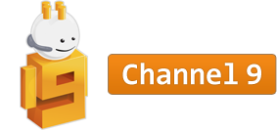
Resources
Learning
Sessions on Demand
Virtual Academy
http://channel9.msdn.com/Events/TechEd/Australia/2013
http://www.microsoftvirtualacademy.com/
TechNet
Developer Network
Resources for IT Professionals
Resources for Developers
http://technet.microsoft.com/en-au/
http://msdn.microsoft.com/en-au/

Slide 25

Track Resources
Download the CTP for SQL Server 2014 and accelerate your queries using In-Memory OLTP - http://technet.microsoft.com/en-us/evalcenter/dn205290.aspx
Get into the cloud with an Azure account - use SQL database in Windows Azure or take your workload into Azure VM - www.windowsazure.com
Get big with big data – HDInsight on Azure and grab the latest Power BI features http://www.windowsazure.com/en-us/documentation/services/hdinsight/?fb=en-us Power BI - www.powerbi.com

Slide 26

© 2013 Microsoft Corporation. All rights reserved. Microsoft, Windows and other product names are or may be registered trademarks and/or trademarks in the U.S. and/or other countries.
The information herein is for informational purposes only and represents the current view of Microsoft Corporation as of the date of this presentation. Because Microsoft must respond to changing market conditions, it should not be interpreted to be a commitment on the part of Microsoft, and Microsoft cannot guarantee the accuracy of any information provided after the date of this presentation. MICROSOFT MAKES NO WARRANTIES, EXPRESS, IMPLIED OR STATUTORY, AS TO THE INFORMATION IN THIS PRESENTATION.

