Slide 1


Core Team:
xxx
Introduction to HANA
Manoj Ketha
NA SBO Competency Center

Slide 2
Agenda
Introduction to HANA: Vision and Strategy
Solution Overview & Roadmap
Business Value
HANA Modeling Studio
Connecting from BOE
Real time Examples

Slide 3
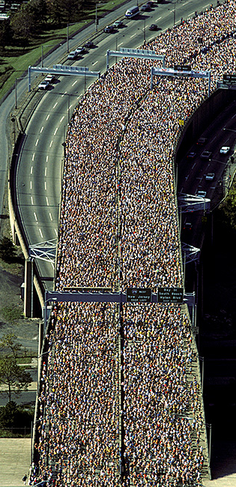
In-Memory Computing
Technology that allows the processing of massive quantities of real time data in the main memory of the server to provide immediate results from analyses and transactions
Notes:
Business users of all levels are empowered to conduct immediate ad hoc data analyses and transaction processing using massive amounts of real time data for expanded business insight.
It frees up IT resources and lowers the cost of operations.

Slide 4
Vision: In-Memory Computing
Technology Constrained Business Outcome
Current Scenario
Sub-optimal execution speed
Lack of responsiveness due to data latency and deployment bottlenecks
Inability to update demand plan with greater than monthly frequency
Increasing Data Volumes
Lack of business transparency
Sales & Operations Planning based on subsets of highly aggregated information, being several days or weeks outdated.
Calculation Speed
Information Latency
Type and # of Data Sources
Reactive business model
Missed opportunities and competitive disadvantage due to lack of speed and agility
Utilities: daily- or hour-based billing and consumption analysis/simulation.

Slide 5
Vision: In-Memory Computing
Leapfrogging Current Technology Constraints
Future State
Flexible Real Time Analytics
Real-time customer profitability
Effective marketing campaign spend based on large-volume data analysis
TeraBytes of Data In-Memory
Improve Business Performance
IT rapidly delivering flexible solutions enabling business
Speed up billing and reconciliation cycles for complex goods manufacturers
Planning and simulation on the fly based on actual non-aggregated data
100 GB/s data througput
Real Time
Freedom from the data source
Competitive Advantage E.g. Utilities Industry:
Sales growth and market advantage from demand/cost driven pricing that optimizes multiple variables – consumption data, hourly energy price, weather forecast, etc.

Slide 6








In-Memory Computing – The Time is NOW Orchestrating Technology Innovations
The elements of In-Memory computing are not new. However, dramatically improved hardware economics and technology innovations in software has now made it possible for SAP to deliver on its vision of the Real-Time Enterprise with In-Memory business applications
HW Technology Innovations
SAP SW Technology Innovations
Multi-Core Architecture (8 x 8core CPU per blade)
Massive parallel scaling with many blades
Row and Column Store
Compression
Partitioning
64bit address space – 2TB in current servers
100GB/s data throughput
Dramatic decline in price/performance
No Aggregate Tables
Real-Time Data Capture
Insert Only on Delta

Slide 7





SAP Strategy for In-Memory
TECHNOLOGY INNOVATION → BUSINESS VALUE
Real-Time Analytics, Process Innovation, Lower TCO
HEART OF FUTURE APPLICATIONS
Packaged Business Solutions for Industry and Line of Business
GUIDING PRINCIPLES
CUSTOMER CO-INNOVATION
Design with customers
INNOVATION WITHOUT DISRUPTION
New Capabilities For Current Landscape
EXPAND PARTNER ECOSYSTEM
Partner-built applications, Hardware partners

Slide 8
Agenda
Introduction to HANA: Vision and Strategy
Solution Overview & Roadmap
Business Value
HANA Modeling Studio
Connecting from BOE
Real time Examples

Slide 9
In-Memory Computing Product “SAP HANA” SAP High Performance Analytic Appliance
What is SAP HANA?
SAP HANA is a preconfigured out of the box Appliance
In-Memory software bundled with hardware delivered from the hardware partner (HP, IBM, CISCO, Fujitsu)
In-Memory Computing Engine
Tools for data modeling, data and life cycle management, security, operations, etc.
Real-time Data replication via Sybase Replication Server
Support for multiple interfaces
Content packages (Extractors and Data Models) introduced over time
Capabilities Enabled
Analyze information in real-time at unprecedented speeds on large volumes of non-aggregated data.
Create flexible analytic models based on real-time and historic business data
Foundation for new category of applications (e.g., planning, simulation) to significantly outperform current applications in category
Minimizes data duplication
3rd Party
BI Clients
SQL
MDX
BICS
SAP HANA
SAP HANA modeling
In-Memory
SAP Business
Suite
replicate
3rd Party
ETL
SAP BW

Slide 10
Technical Overview
Calculation models – Extreme Performance and Flexibility with Calculations on the fly
Calculation Model
A calc model can be generated on the fly based on input script or SQL/MDX
A calc model can also define a parameterized calculation schema for highly optimized reuse
A calc model supports scripted operations
SQL
MDX
SQL Script
Plan Model
other
In-Memory Computing Engine
Parse
Compile & Optimize
Calculation Model
Calculation Engine
Data Storage
Row Store - Metadata
Column Store – 10-20x Data Compression
Logical Execution Plan
Distributed Execution Engine
Physical Execution Plan
Row Store
Column Store

Slide 11
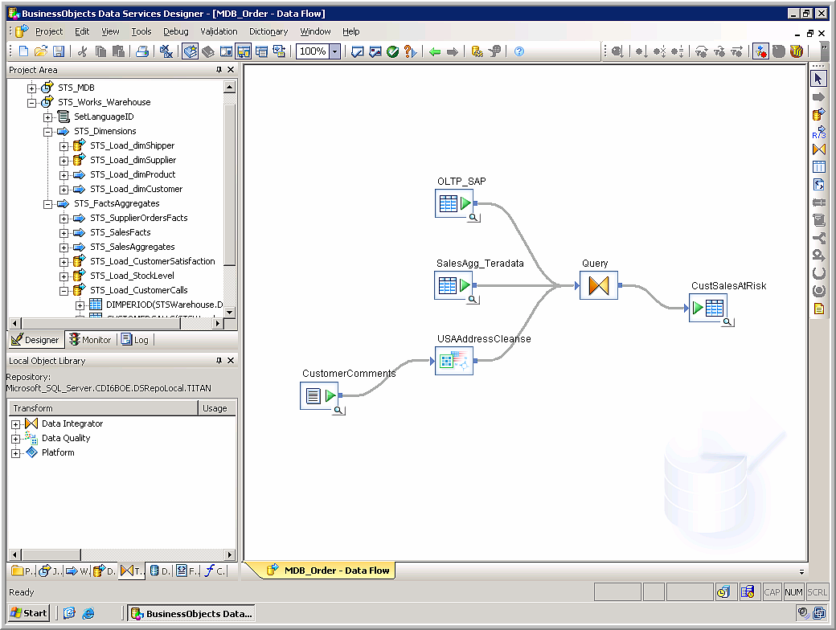
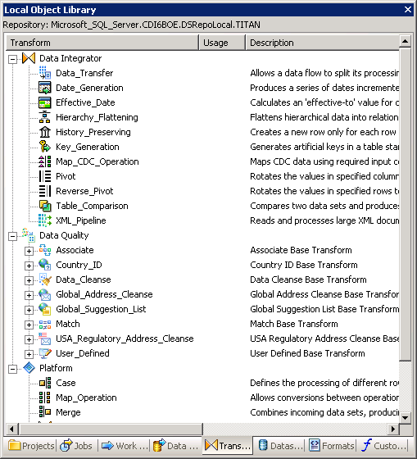
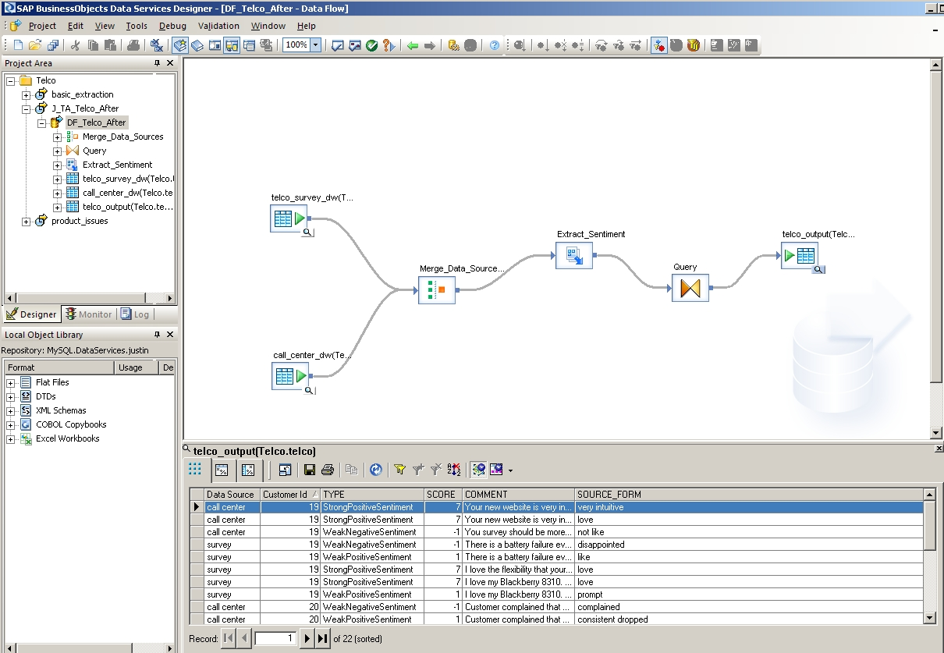
SAP BusinessObjects Data Services Platform
Rich Transforms
Integrate heterogeneous data into BWA
Integrated Data Quality
Text Analytics
Extract From Any Data Source into HANA
Syndicate From HANA to Any Consumer
© SAP 2007/Page 11

Slide 12
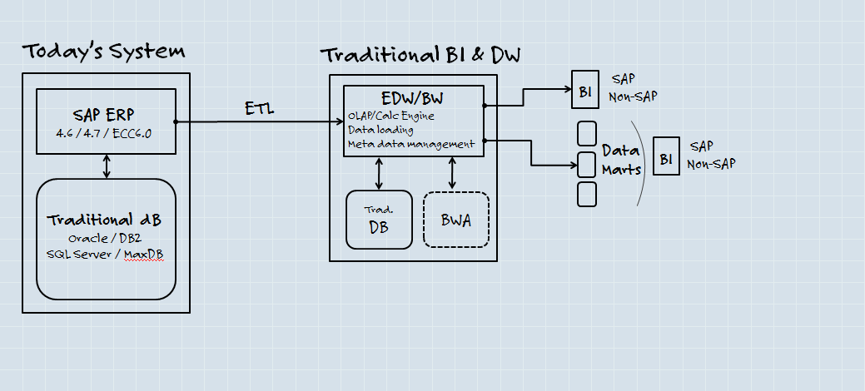
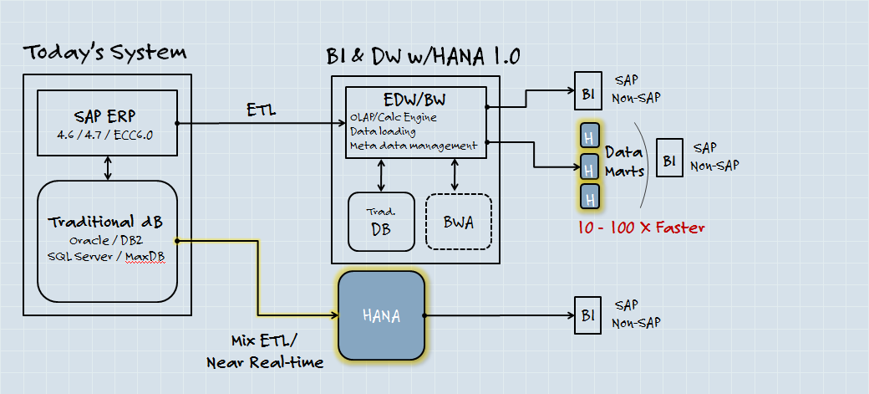
SAP HANA Road Map: In-Memory Introduction
Today‘s System Landscape
ERP System running on traditional database
BW running on traditional database
Data extracted from ERP and loaded into BW
BWA accelerates analytic models
Analytic data consumed in BI or pulled to data marts
Step 1 – In-Memory in parallel (Q4 2010)
Operational data in traditional database is replicated into memory for operational reporting
Analytic models from production EDW can be brought into memory for agile modeling and reporting
Third party data (POS, CDR etc) can be brought into memory for agile modeling and reporting

Slide 13
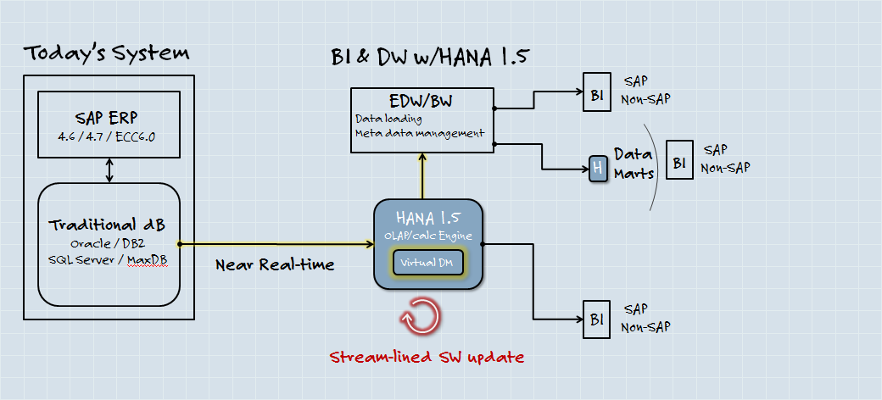
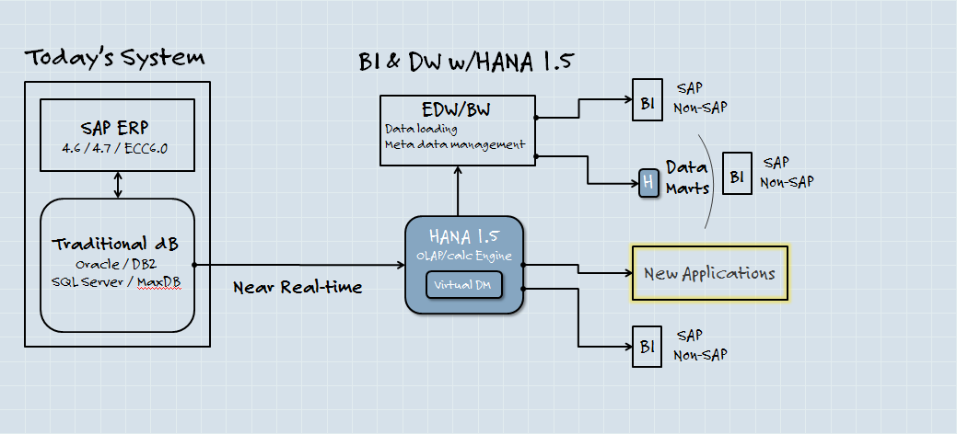
SAP HANA Road Map: Renovation of DW and Innovation of Applications
Step 2 – Primary Data Store for BW (Planned for Q3 2011)
In-Memory Computing used as primary persistence for BW
BW manages the analytic metadata and the EDW data provisioning processes
Detailed operational data replicated from applications is the basis for all processes
SAP HANA 1.5 will be able to provide the functionality of BWA
Step 3 – New Applications (Planned for Q3 2011)
New applications extend the core business suite with new capabilities
New applications delegate data intense operations entirely to the in-memory computing
Operational data from new applications is immediately accessible for analytics – real real time

Slide 14
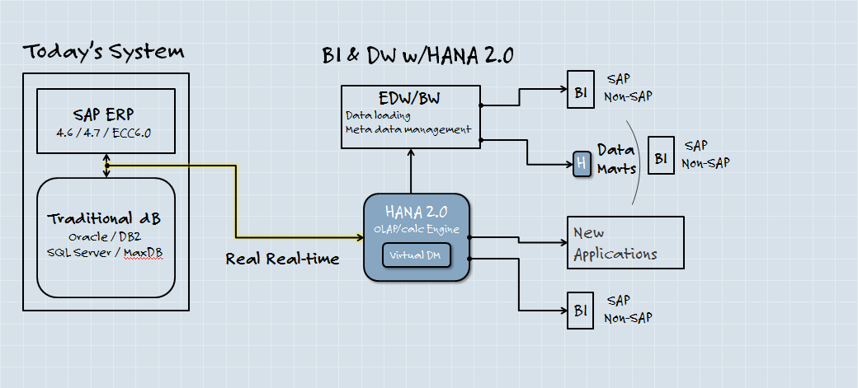
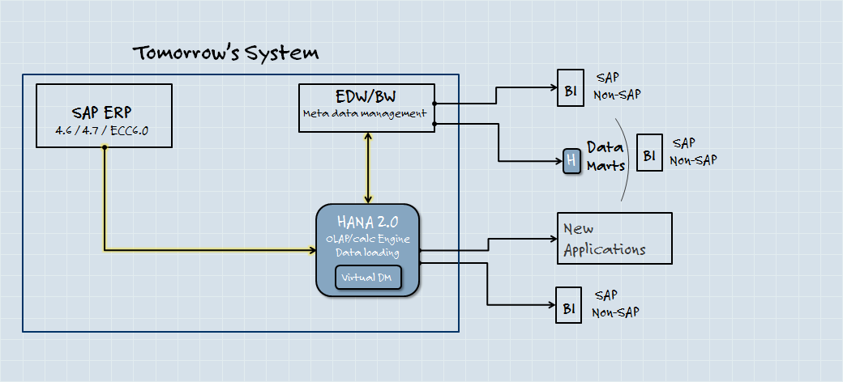
SAP HANA Road Map: Transformation of application platforms
Step 4 – Real Time Data Feed (2012/2013)
Applications write data simultaneously to traditional databases as well as the in-memory computing
Step 5 – Platform Consolidation
All applications (ERP and BW) run on data residing in-memory
Analytics and operations work on data in real time
In-memory computing executes all transactions, transformations, and complex data processing

Slide 15
Agenda
Introduction to HANA: Vision and Strategy
Solution Overview & Roadmap
Business Value
HANA Modeling Studio
Connecting from BOE
Real time Examples

Slide 16
Real Time Enterprise: Value Proposition Addressing Key Business Drivers
Real-Time Decision Making
Fast and easy creation of ad-hoc views on business
Access to real time analysis
Accelerate Business Performance
Increase speed of transactional information flow in areas such as planning, forecasting, pricing, offers…
Unlock New Insights
Remove constraints for analyzing large data volumes - trends, data mining, predictive analytics etc.
Structured and unstructured data
Improve Business Productivity
Business designed and owned analytical models
Business self-service → reduce reliance on IT
Use data from anywhere
Improve IT efficiency
Manage growing data volume and complexity efficiently
Lower landscape costs
There is a significant interest from business to get agile analytic solutions.
„In a down economy, companies focus on cash protection. The decision on what needs to be done to make procurement more efficient is being made in the procurement department“.
CEO of a multinational transportation company
Flexibility to analyse business missed by LoB.
„First performance, and the other is flexibility on a business analyst level, who need to do deep diving to better understand and conclude. The second would be that also front-end tools are not providing flexibility“.
Executive of a global retail company
Traditional data warehouse processes are too complex and consume too much time for business departments.
„ The companies […] were frustrated with usual problems […] difficulty to build new information views. These companies were willing to move data […] into another proprietary file format […]. “
Analyst

Slide 17
Real Time Enterprise: Value Proposition
The Value Blocks
Value Elements
In-Memory Enablers
Process Transformation
“Real-Time” Business Insights
Transactional and Infrastructure
New business models → based on real-time information and execution
Improved business agility → Dramatically improve planning, forecasting, price optimization and other processes
New business opportunities → faster, more accurate business decisions based on complex, large data volumes
Run performance-critical applications in-memory
Combine analytical and transactional applications
No need for planning levels or aggregation levels
Multi-dimensional simulation models updated in one step
Internal and external data securely combined
Batch data loads eliminated
Sense and respond faster → Apply analytics to internal and external data in real-time to trigger actions (e.g., market analytics)
Business-driven “What-If” → Ask ad-hoc questions against the data set without IT
Right information at the right time
High performance “real-time” analytics
Support for trending, simulation (“what-if”)
Business-driven data models
Support for structured and un-structured data
Analysis based on non-aggregated data sets
Lower infrastructure costs → server, storage, database
Lower labor costs → backup/restore, reporting, performance tuning
Eliminate BW database
Empower business self-service analytics – reduce shadow IT
Consolidate data warehouses and data marts
In-memory business applications (eliminate database for transactional systems)

Slide 18
Agenda
Introduction to HANA: Vision and Strategy
Solution Overview & Roadmap
Business Value
HANA Modeling Studio
Connecting from BOE
Real time Examples

Slide 19
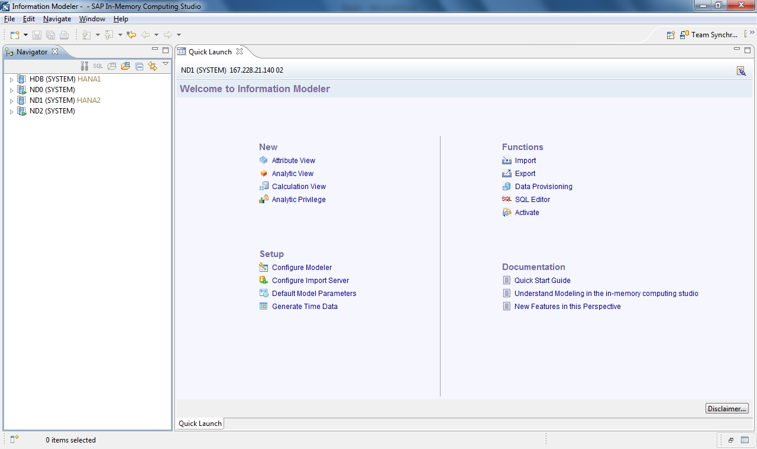
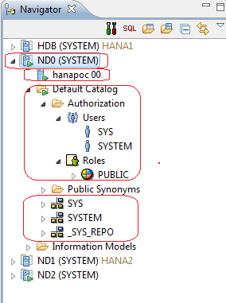
HANA Information Modeler

Slide 20
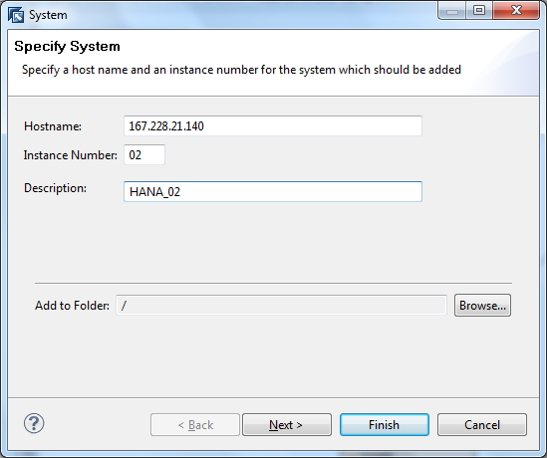
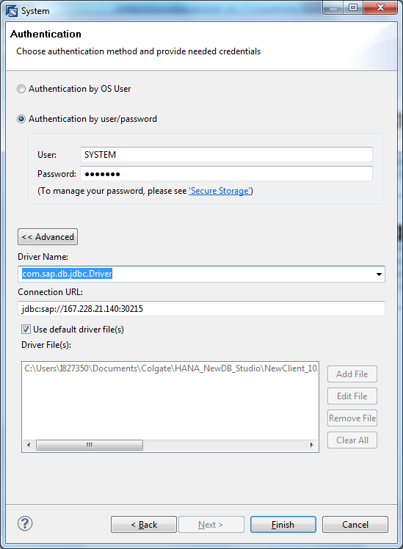
HANA Information Modeler Creating Connectivity to a new system

Slide 21
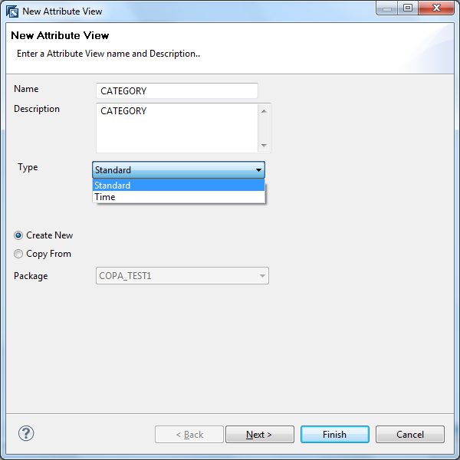
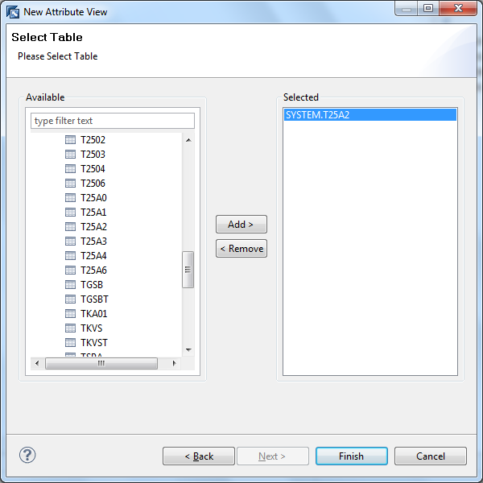
HANA Information Modeler Creating Attribute View

Slide 22
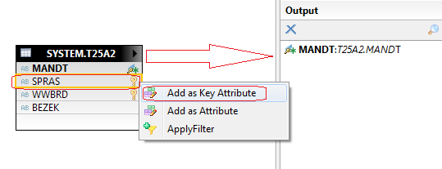
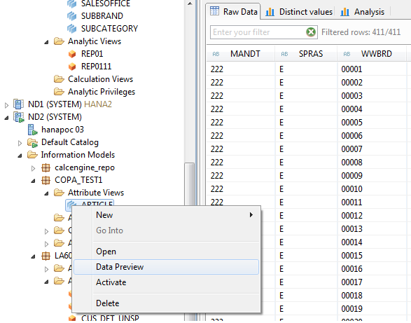
HANA Information Modeler Defining Attributes (Key Attribute, Attribute, Filter and Measure (for numeric data types)
Notes:
Defining Attributes (Key Attribute, Attribute, Filter and Measure (for numeric data types)
Right click → Data Preview
Right click → Activate: This action will activate the Attribute View with selected fields as key figures and associated measures.

Slide 23
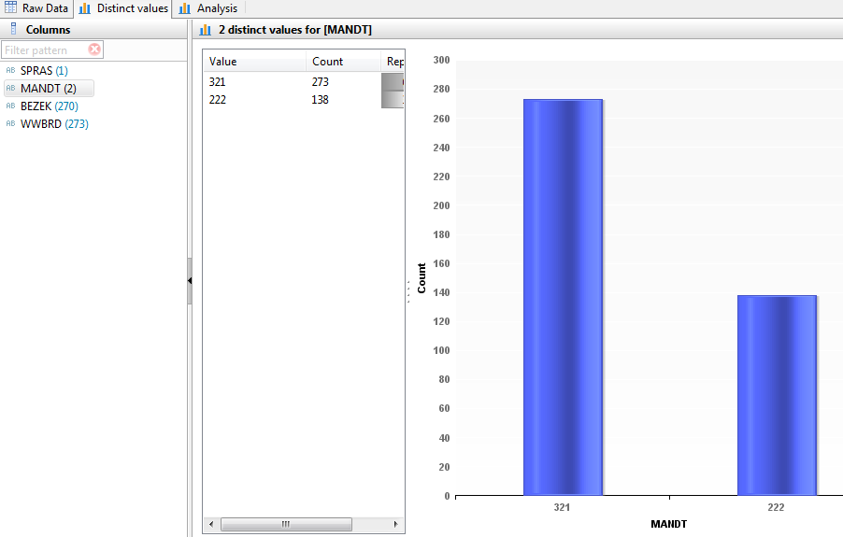
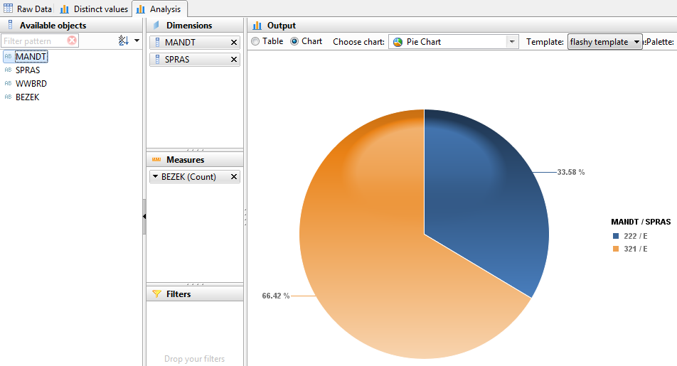
HANA Information Modeler Data Preview
Notes:
We can also view distinct values in each of these fields and perform a quick analysis (data disbursement in graphical format)
Analyzing the data present in an attribute: (By selecting Dimensions, Measures and applying filters) Also, we can change the type of chart we want to use depending on the type of data.

Slide 24
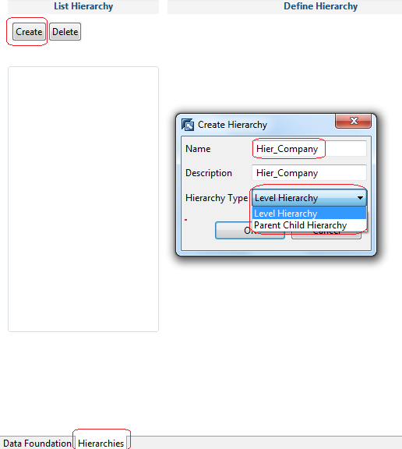
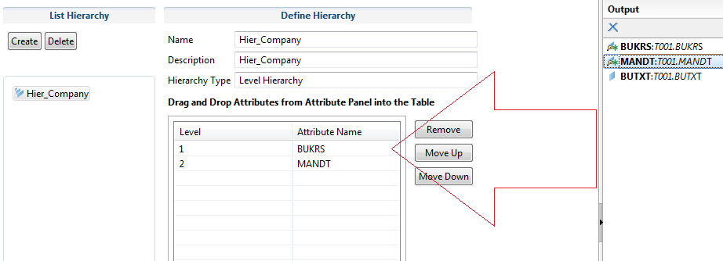
HANA Information Modeler Creating Hierarchies
Notes:
Creating Attribute Hierarchies:
From the Attribute properties window → Click on Hierarchies Tab → Create New hierarchy → We can create two types here (Level Hierarchy and Parent Child hierarchy.
Drag and Drop the attributes from the list available as shown:

Slide 25
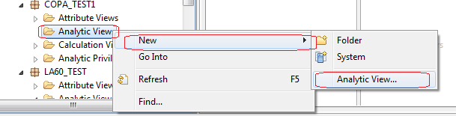
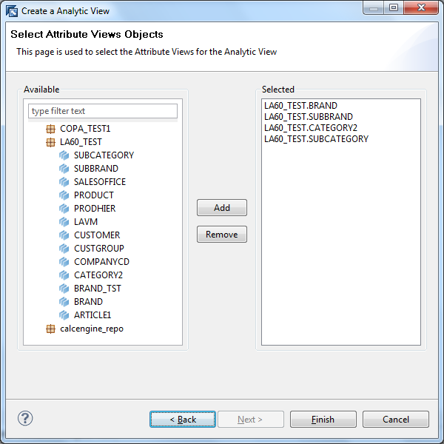
HANA Information Modeler Creating Analytic View
Notes:
We can create Analytic views from either a table imported into HANA
or
from Attribute Views that were created
Or
By duplicating existing views and further edit for a different purpose

Slide 26
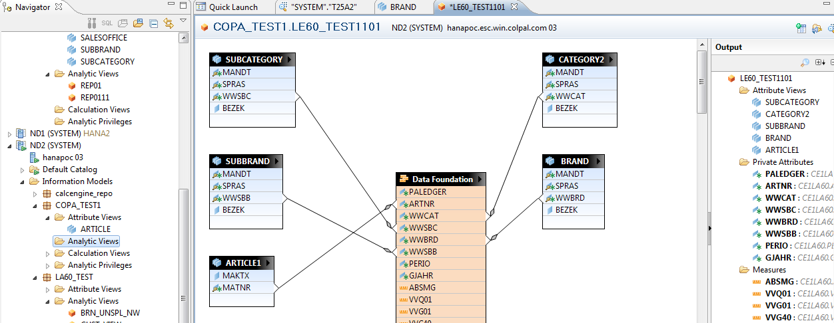
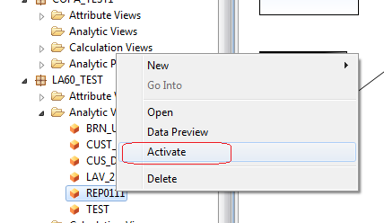
HANA Information Modeler Creating Analytic View
Notes:
The model of Attributes and Analytic View will appear as below after establishing the relationships:
Activate the view by right clicking in the studio
Now the Analytic View is ready to be accessed by the Explorer.

Slide 27
Agenda
Introduction to HANA: Vision and Strategy
Solution Overview & Roadmap
Business Value
HANA Modeling Studio
Connecting from BOE
Real time Examples

Slide 28
Connectivity from BO Enterprise Tools
Crystal Reports Enterprise - (ODBC, JDBC, Universe)
IDT (Information Design Tool) - JDBC
Explorer – Connection configuration in CMC
Advanced Analysis for Office (Q1 2011 release)
Web Intelligence – Universe
Xcelsius - Universe

Slide 29
Agenda
Introduction to HANA: Vision and Strategy
Solution Overview & Roadmap
Business Value
HANA Modeling Studio
Connecting from BOE
Real time Examples

Slide 30
Learning Resources
RKT Material
https://websmp208.sap-ag.de/rkt-hana
Navigation:
Consulting → SAP High-Performance Analytic Appliance 1.0 →
Application Consultant s
Technology Consultants

Slide 31
THANK YOU

