Slide 1
High Performance Analytic Appliance: HANA
Understanding the Basics as a PM
John Choate Chair
Suzanne Passante Program Chair
Program Management & Maintenance Strategies (PMMS) SIG

Slide 2





Key Learning Points for SAP HANA®

Slide 3

Table of Contents
SAP HANA
What is HANA?
Why the Need for HANA?
IT and Business
Why Use HANA?
Top 10 Reasons Companies Use HANA
Technology Basics
Key Terminology
HANA Architecture
The “Heart” of HANA
In-Memory Computing Engine
What is In-Memory?
In-Memory Computing
HANA Column Storage vs. Row-Based Storage
Column Storage Opportunities
Multiple Engines
What is Ad Hoc Analysis

Slide 4



Table of Contents
Applying SAP HANA
Where can I use HANA?
Use cases for HANA
Key takeaways about HANA

Slide 5

What is SAP HANA?
SAP HANA is the latest in-memory analytics product. Using HANA, companies can do ad hoc analysis of large volumes of big data in real time
SAP HANA is a completely re-imagined platform for real-time business
SAP HANA transforms businesses by streamlining transactions, analytics, planning, and predictive data processing on a single in-memory database so business can operate in real time

Slide 6

Why the Need for SAP HANA?
IT Challenges:
“Big Data” (volume) growing and challenge for real-time access to Operational Enterprise Systems
Costly for IT to purchase and maintain hardware to handle increasing data volumes
IT not the hero – dissatisfied business users
Processing and analysis results delayed
Data not in real time

Slide 7
Why the Need for SAP HANA?
Challenges for Business:
Inadequate access to real-time operational information
Need to react faster to events impacting business
Need to quickly uncover trends and patterns by functional users – empower users/organizations
Need to improve business processes

Slide 8


Why Use SAP HANA?
HANA enables businesses to make smarter, faster decisions through real-time analysis and reporting, combined with dramatically accelerated business processes
Lack of delay between insight and action turns business into a “real time business”

Slide 9
Top 10 Reasons Why Companies Choose SAP HANA
Speed – Manage massive volumes at high speed
Agility – Enable real-time interactions across Value Chain
Any Data – Gain insights from structured and unstructured data
Insight – Unlock new insights with predictive, complex analysis
Applications – Run next-generation applications
Cloud – Step up to next advanced platform
Innovation – Deploy ultimate platform for business innovation
Simplicity – Manage fewer layers and landscapes for lower costs
Value – Innovate without disruption and add value to legacy investments
Choice – Work with preferred partner at every level

Slide 10





Technology Basics for SAP HANA

Slide 11

Key Terminology
Aggregation: To enable the calculation of key figures, the data from the info provider has to be aggregated to the detail level of the query, and formulas may also need to be calculated. The system has to aggregate using multiple characteristics.
BICS: Business Intelligence Consumer Services (BICS) is SAP's proprietary interface for queries.
BusinessObjects: One can visualize SAP® BusinessObjects™ as "black boxes" that encapsulate data and business processes, thus hiding the details of the structure and implementation of the underlying data.
Business Warehouse (BW): SAP BW provides standard application data for program usage over various systems.
Compression: Compression features help reduce space requirement dramatically, resulting in lower storage cost and improved input and output performance.
Data Stripping: Technique of segmenting logically sequential data, such as a file, in a way that accesses of sequential segments are made to different physical storage devices. Striping is useful when a processing device requests access to data more quickly than a storage device can provide access.
In Memory Computing Engine (IMCE): The heart of Hana solution is the In-memory Computing Engine (IMCE) allowing to create and perform accelerated calculations on data.
Multi-Dimensional Expressions (MDX): MDX is a language developed by Microsoft for queries using multi-dimensional data.
Online Analytical Processing (OLAP): OLAP makes multi-dimensionally formatted data available using special interfaces.
Partitioning: You use partitioning to split the total dataset for an info provider into several smaller, physically independent and redundancy-free units. This separation improves system performance.
Structured Query Language (SQL): SQL is a special-purpose programming language designed for managing data.

Slide 12
HANA Architecture

Slide 13

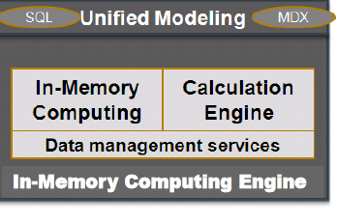
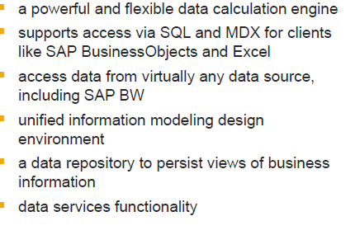
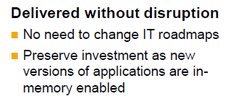
The “Heart” of SAP HANA

Slide 14

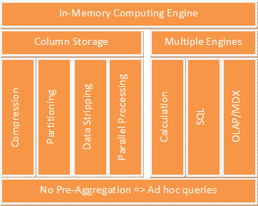
In-Memory Computing Engine (Simplified)

Slide 15

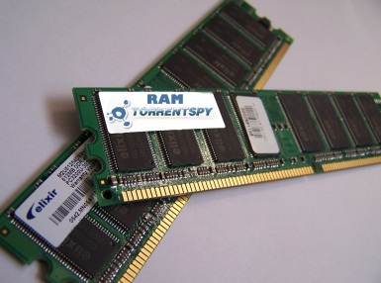
What is In-Memory?
In-memory means all the data is stored in the memory (RAM)
There is no time wasted in loading the data from hard disk to RAM, or while processing, keeping some data in RAM and some data on disk temporarily
Everything is in-memory all the time, which gives the CPUs quick access to data for processing

Slide 16
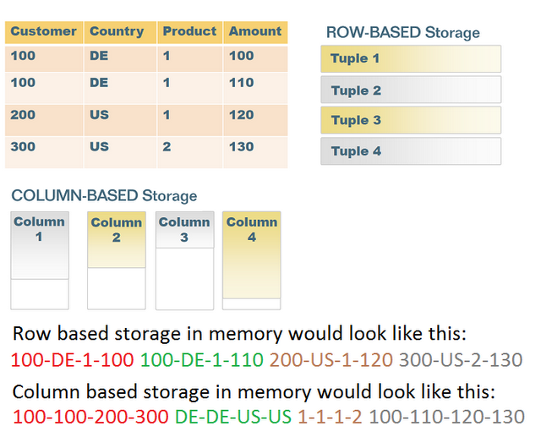
SAP HANA Column Storage Vs. Row-Based Storage
Storing data in columns is not a new technology, but it has not been leveraged to its full potential, yet
The columnar storage is read-optimized, that is, the read operations can be processed very fast. However, it’s not write-optimized, as new insert might lead to moving a lot of data to create a place for new data
HANA handles this well with delta merge. The columnar storage performs very well while reading and the write operations are taken care of by the In-Memory Computing Engine (IMCE) in some other ways

Slide 17

Column Storage Opportunities
Compression: As the data written next to each other is of same type, there is no need to write the same values again and again
Partitioning: HANA supports two types of partitioning. A single column can be partitioned to many HANA servers, and different columns of a table can be partitioned in different HANA servers. Columnar storage easily enables this partitioning
Data stripping: When querying a table, there are often times where a lot of columns are not used
Parallel Processing: It is always performance-critical to make full use of the resources available. With the current boost in the number of CPUs, the more work they can do in parallel, the better the performance

Slide 18

Multiple Engines
HANA has multiple engines inside its computing engine for better performance
HANA supports both SQL & OLAP reporting tools; there are separate engines to perform operations respectively
There is a separate calculation engine to do calculations. There is also a planning engine used for functional reporting. Above all sits something like a controller which breaks incoming requests into multiple pieces and sends sub queries to these engines. There are separate row and column engines to process operations between tables stored in rows and tables stored in column format

Slide 19
What is Ad Hoc Analysis?
In traditional data warehouses, such as SAP BW, a lot of pre-aggregation is done for quick results
The IT administrator decides which information might be needed for analysis and prepares the result for the end users
Results in fast performance but the end user has no flexibility
With SAP HANA and its speedy engine, no pre-aggregation is required. The user can perform any kind of operation in reports and does not have to wait hours to get the data ready for analysis in real time.

Slide 20

Where Can I Use SAP HANA? Anywhere there are large volumes of data
Aerospace & Defense
Automotive
Banking
Chemical
Consumer Products
Cross Industry
Customer Service
Finance
Healthcare
High Tech
Industrial Machinery & Components
Insurance
Life Sciences
Manufacturing
Marketing
Media
Mill Products
Mining
Oil & Gas
Professional Services
Public Sector
Retail
Sales
Supply Chain
Telecommunications
Transportation
Utilities
Wholesale Distribution
Top Functional Areas of Data Usage

Slide 21
Use Cases For Using SAP HANA
Sales Reporting (CRM):
Quickly identify top customers and products by channel – with real-time sales reporting. Improve order fulfillment rates and accelerate
Key sales processes at the same time, with instant analysis of credit memo and billing list
Financial Reporting (FICO)
Obtain immediate insights across your business – into revenue, accounts payable and receivable, open, and overdue items
Top general ledger transaction and days sales outstanding (DSO). Make the right financial decisions, armed with real-time information
Shipping Reporting (LE-SHP)
Rely on real-time shipping reporting for complete stock overview analysis. One can better plan/monitor outbound delivery
Assess and optimize stock levels – with accurate information at one’s fingertips
Purchasing Reporting (P2P/SRM)
Gain timely insights into purchase orders, vendors, and the movement of goods – with real-time purchasing reporting
Make better purchasing decisions based on a complete analysis of order history
Master Data Reporting (DG/MDM)
Obtain real-time reporting on main master data, including customer, vendor, and materials lists for improved productivity and accuracy

Slide 22
Key Takeaways About SAP HANA
Empowers Your Organization
Reduced reliance on IT resources
Real-time visibility to complete data for transaction and analytics processing
Enable a 360 degree view of your business
Real-Time Analytics for Operational Data
Go from “what happened yesterday” to real time
Close to zero latency
Ability to leverage and analyze large volumes of data
Low Total Cost of Ownership (TCO)
Non-disruptive to existing Enterprise Data Warehousing (EDW) Strategy
Low TCO by leveraging the latest technology and delivery as pre-configured appliance

Slide 23

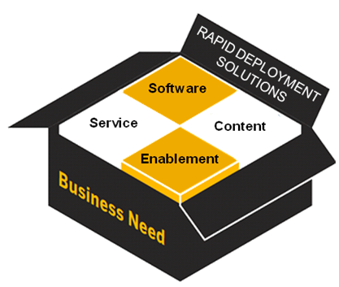

First in a New Series by PMMS SIG
Session Topic
1 HANA
2 RDS
3 RDS + HANA
4 RDS + HANA & CLOUD

Slide 24

Sneak Preview – Coming in 2013
AVOID THE MAZE!
Rapid Deployment Solutions
(RDS)
Fast
Addresses specific needs quickly
Accelerates time-to-value
Speeds end-user adoption
Simple
Business outcome-focused
Modular, yet integrated
All environments (on-premise, cloud, and mobile)

Slide 25

]
Thank you for participating.
For ongoing education in this area of focus, visit www.asug.com.

