Slide 1

Financial Reporting and Advanced Analytics
SAP S/4 HANA Use Case for Oil & Gas
SAP S/4 HANA is THE Path to Simplify Finance
Big Data & Analytics Webinar
Webinar Details
Date : 06/22/2015
Time : 12:00 PM EST
Webinaire Host
Jothi Periasamy
Chief Finance Transformation Architect
Chief SAP HANA Architect

Slide 2

Financial Reporting and Advanced Analytics
Oil & Gas Use Case for SAP S/4 HANA
Webinar Registration
https://attendee.gotowebinar.com/register/3189054678444726018
Webinar Objectives
In this webinar, we will be demonstrating the key capabilities of SAP S/4 HANA, including
Approach, strategy and roadmap to modernize analytics and data platform through SAP S/4 HANA
Steps to enable OLTP and OLAP functions together in a single S/4 HANA platform
Review the simplified data access steps for integrated planning, forecasting , reporting and analytics
Discuss the simplified and accelerated financial processes for operational finance and financial close
Options to leverage Internet of Things(IoT), Business Network, and Social Network as a data source for S/4 HANA based analytics
Learn Beyond Concepts - Watch Our Live System Demo

Slide 3
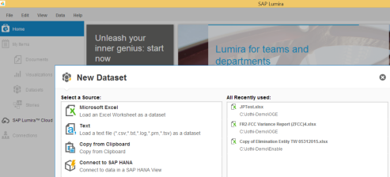
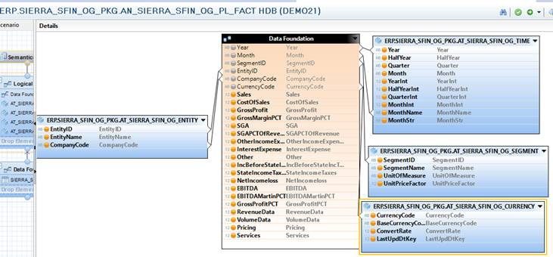
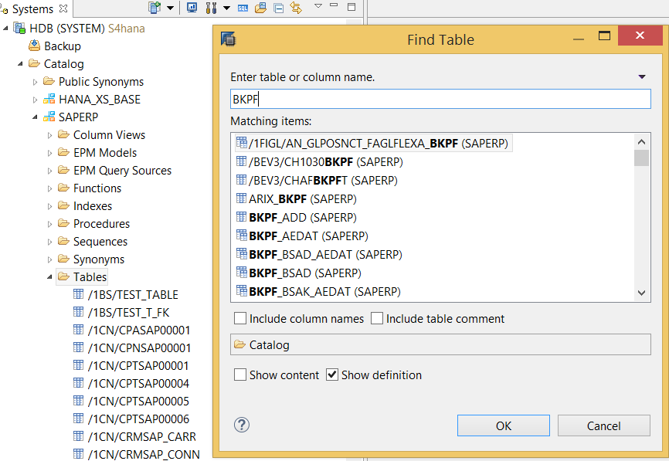
Financial Reporting and Advanced Analytics
Oil & Gas Use Case for SAP S/4 HANA
SAP Lumira Analytics & Data Visualization
Predictive Analytics
Forecasting
Interactive Analysis
H
O
W
I
T
W
O
R
K
S
?
SAP S/4 HANA Information Model
Simplified business process specific financial model
Self-servicing - reporting and data analysis
No physical data storage
Massive amount of In-memory data processing and complex calculations
Out of box support to
Data Science
Advanced Analytics
SAP S/4 HANA Data Provisioning
Simplified data provisioning regardless of data format, structure, and source. Out of the box support to
Big Data
Internet of Things (IoT)
Single platform for both OLTP and OLAP
Empowers business with real-time data
Support to open source technologies
HADOOP
R
Python

Slide 4
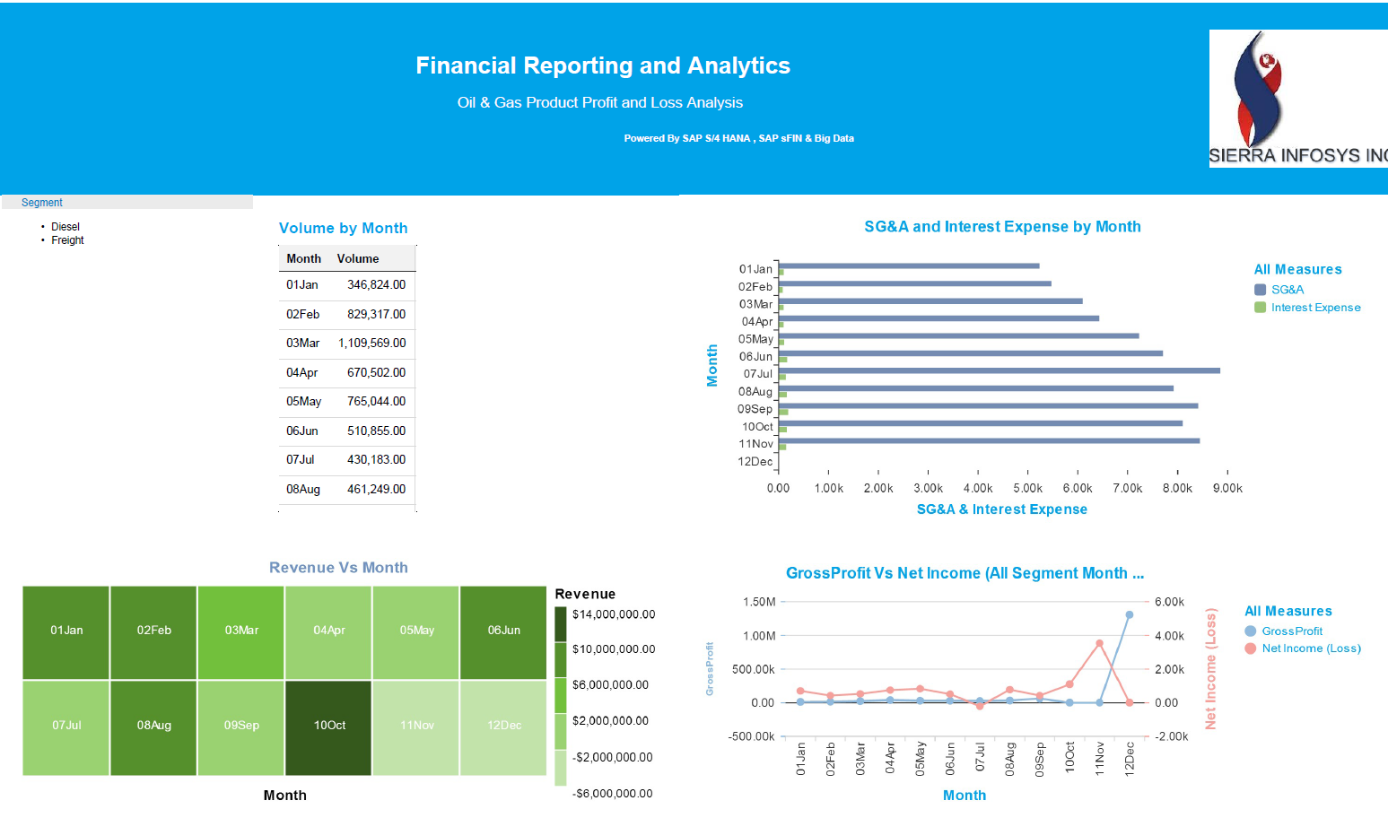
Financial Reporting and Advanced Analytics
Oil & Gas Use Case for SAP S/4 HANA
Simplified Profit & Loss
Revenue by Month - Conventional Gas, Diesel, Freight, Lubricants, and others
Expense by Month
Analyze Gross Profit
Compare Gross Profit vs. Net Income

Slide 5
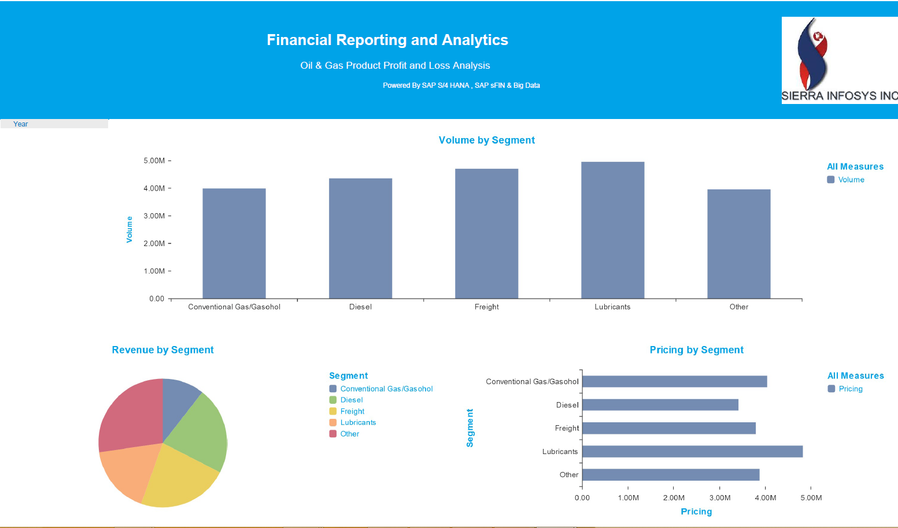
Financial Reporting and Advanced Analytics
Oil & Gas Use Case for SAP S/4 HANA
Visual Profit & Loss Analysis
Revenue trend by segment - Conventional Gas, Diesel, Freight, Lubricants, and others
Pricing analysis per segment
Volume forecast by segment
Predict revenue and cost by segment based on volume and prices

Slide 6
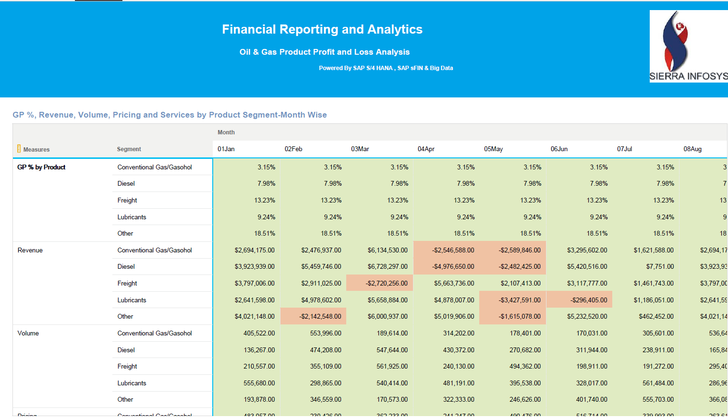
Financial Reporting and Advanced Analytics
Oil & Gas Use Case for SAP S/4 HANA
Real-time Profit & Loss
Revenue by Month - Conventional Gas, Diesel, Freight, Lubricants, and others
Pricing analysis per segment
Volume forecast by segment
Predict revenue and cost by segment based on volume and prices

Slide 7
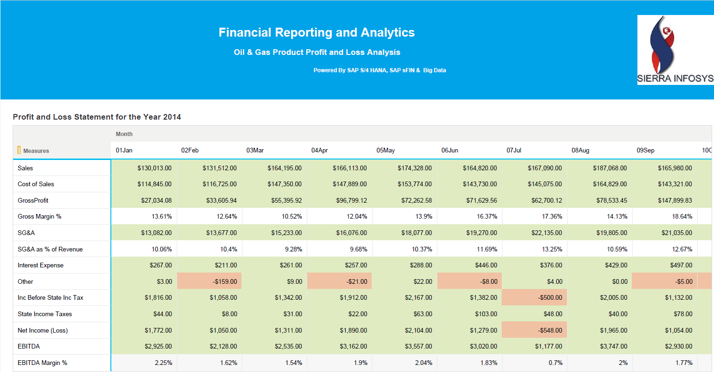
Financial Reporting and Advanced Analytics
Oil & Gas Use Case for SAP S/4 HANA
Real-time Profit & Loss
Sales by Month - Conventional Gas, Diesel, Freight, Lubricants, and others
Cost of Sales Analysis
Gross Profit Analysis
Gross Margin %

Slide 8
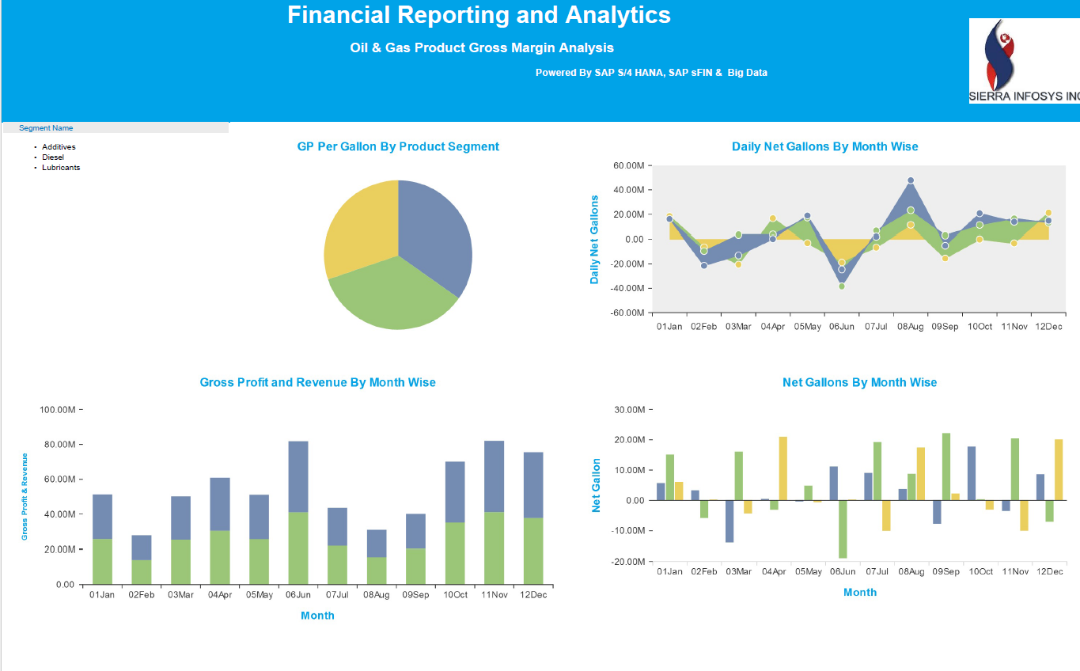
Financial Reporting and Advanced Analytics
Oil & Gas Use Case for SAP S/4 HANA
Product Gross Margin Analysis
Gross Profit and Revenue by Month - Conventional Gas, Diesel, Freight, Lubricants, and others
Daily Net Gallon
Gross Profit Per Net Gallon
Gross Margin %

Slide 9
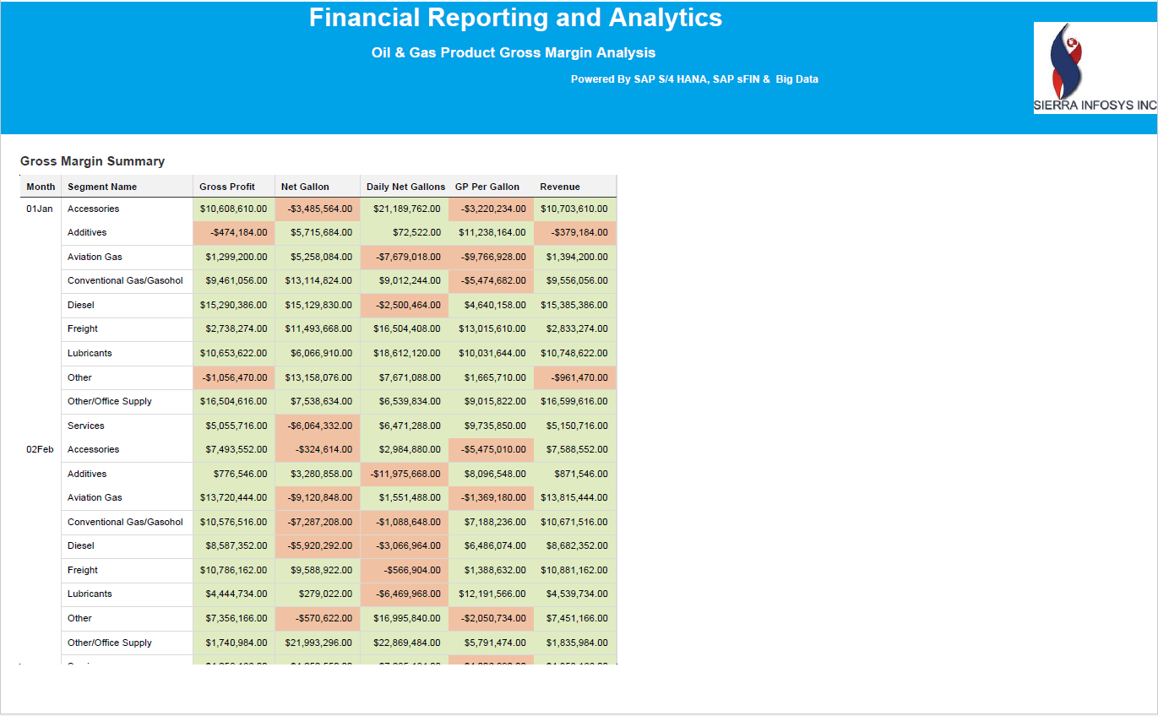
Financial Reporting and Advanced Analytics
Oil & Gas Use Case for SAP S/4 HANA
Product Gross Margin Analysis
Gross Profit and Revenue by Month - Conventional Gas, Diesel, Freight, Lubricants, and others
Daily Net Gallon
Gross Profit Per Net Gallon
Gross Margin %

Slide 10
Financial Reporting and Advanced Analytics
Oil & Gas Use Case for SAP S/4 HANA
Looking forward to a discussion during our Webinar
Thank You !
Jothi Periasamy
Chief Finance Transformation Architect
Chief SAP HANA Architect
(916)-600-6628
Jothi.P@Sierratec-us.com

