Slide 1
SAP HANA on Power Big Data Infrastructure comes to HANA
Arthur Fontaine
Offering Manager,
SAP HANA on Power
afontaine@us.ibm.com

Slide 2
Agenda – HANA on Power (HoP)
The IBM and SAP Partnership
IBM core advantages for in-memory databases and Big Data apps
SAP HANA and the SAP vision
Why customers are demanding HoP
IBM Power Solution Editions for SAP HANA

Slide 3







IBM is a multi-faceted SAP Partner
CUSTOMER
All Platforms Certified for SAP – over 41,000 installations
All Platforms Deliver Lowest possible TCO for SAP
Large Investment in Optimizing SAP Environments
IBM Achieved Proven Low Risk for SAP Installations
HANA – on IBM Power
# 1 SAP SD Benchmark
SAP’s Premier Preferred HANA Cloud Provider
Global Alliance partner since 1989
Over 26,000 SAP-focused resources in 160 countries
Dedicated HANA practice
Rated #1 System Integrator by Gartner, AMR, Aberdeen
#1 in SAP upgrades
AMS services
IBM’s Internal SAP implementation
Will provide common global processes across IBM SAP
Driving interoperability between SAP and IBM SW
IBM and SAP Consulting partnered to provide implementation services
Proven IBM technology infrastructure
IBM’s DB2 is optimized for SAP
SAP Cloud Solutions are integrated with IBM’s Cloud tools
Integrated System Management with SAP LVM
Cheaper, better, faster!
In the last 12 years SAP has awarded IBM 20 Pinnacle Awards
2002
2003
2004
2005
2006
2007
2008
2009
2010
2011
2012
2013
2014
Customer Loyalty and Satisfaction
ERP Development/ Innovation
Incremental Revenue, Best Total
Technology Award: Development/Innovation
Incremental Revenue Contribution Award
SME Global Top Volume Reseller
Technology Award: Go-to-Market
Service Award: Landscape Upgrade
Service Award: Leader in Customer Satisfaction (Original Title - Customer Satisfaction of the Year )
Technology Award: Global Technology Partner of the Year
Technology Award: Global Technology Partner of the Year
Service Award: Transformational Award - Rapid Time to Value
Reseller Award: Global Value-Added Reseller of the Year
Service Award: Quality Partner of the Year
Special Achievement Award, Incremental Revenue Generation
Special Achievement Award, Incremental Quality Program
Special Achievement Award
ERP Innovation/ Development Award
Channels award
Regional Excellence Award
Enterprise SOA: Migration Excellence
Service Award: Upgrade
Service Award: Ramp Up
Service Award: Customer Satisfaction
Outsourcing Award: Business Process Outsourcing
Service Award: Quality Partner of the Year
Communities Award: Community Leadership and Social Commerce Engagement
Technology Award: Database and Technology / HANA Co-innovation Partner of the Year
Service Award: Service Expansion Award
Reseller Award: VAR/Reseller of the Year and Service Expansion Award
Notes:
3
3
3
The SAP IBM relationship is a truely unique business alliance. Not just within SAP and IBM, but in the technology industry. Our relationship is multi-faceted. It is not just about HW, SW, services or a being customer. It is about all four of these.
Customers have to make important decisions: who will implement my SAP environment, what will be the infrastructure look like and who will run and support my environment. IBM is the only partner of SAPs who can stand side-by-side along with you and work through all of those answers, in an integrated, optimized fashion.
Pinnacle Awards – in 2009 we won in the following areas. 1) Upgrade 2) Ramp-Up 3) Customer Satisfaction 4) Business Process Outsourcing
Since 2006, Dell, Sun, Oracle, Hewlett-Packard, Microsoft, and EMC have not won a single SAP Pinnacle Award.
JW: IBM GBS has had the same leadership team in place since 1995. We are the stable and steady partner with proven talent. You hopefully recognize our team... People such as John Leffler, Tom Rosinski, Bob Tomlin, Steve Owens,Mike Hart to name a few.

Slide 4

Providing the Full Breadth & Depth of Services for SAP
Strategy & Assessment
Level 1 Help Desk
Cloud Consulting
Global Business Services (GBS)
SAP Assessment
SAP Functional Application Support
One IBM
Business Process Transformation
Minor Enhancements & Customizations
Outsourcing
Functional & Development Services
SAP Basis Application Level 2/3 Support
IBM Cloud
SAP Application Operations/DB Mgmt
Our clients decide on the scope of IBM’s services & offerings
Infrastructure
DB2 Database & IBM Middleware
OS, Backup, Security and Network Management
Servers, Storage, DC Management & Maintenance

Slide 5
























































Over 6000 successful SAP Implementations worldwide

Slide 6




RUN SIMPLE
First processer designed for Big Data with massive parallelism and bandwidth for real-time Analytics results
Consolidate and reduce number of systems to eliminate complexity, minimize points of failure, reduce latency and simplify management
RUN FAST
Faster business decisions through complex analytics
Maximize performance and response with latest POWER8
RUN SMART
On premise, elastic computing resources with Capacity on Demand
Pre-emptively migrate workloads before failures by using advanced self-monitoring and predictive failure alerts

Slide 7

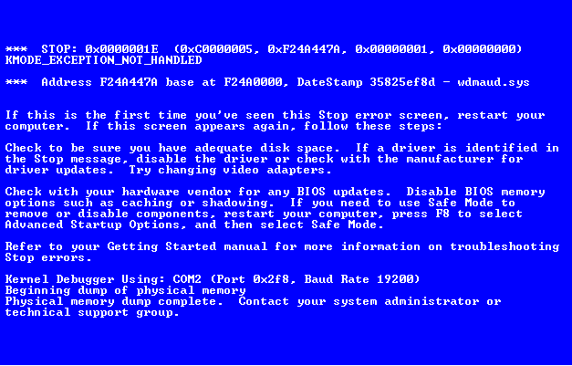
Run Simple: IBM Power Systems consolidates server sprawl
Reduced complexity
Reduced latency
Reduced points of failure
Improved manageability
Improved reliability
Improved availability
Improved security
Notes:
7

Slide 8
Run Fast: IBM Power Systems – designed for Big Data
4X
threads per core vs Intel
(up to 1536 threads per system)
4X
memory bandwidth vs Intel
(up to 16TB of memory)
5X
more cache vs Intel (up to 224MB cache per socket)
Processors
flexible, fast execution of analytics algorithms
Memory
large, fast workspace to maximize business insight
Cache
ensure continuous data load for fast responses
Notes:
8

Slide 9
Run Fast: POWER8 faster memory bandwidth is ideal for in-memory applications like SAP HANA
4X
memory bandwidth vs Intel
(up to 16TB of memory)
POWER8
POWER7+
Memory
large, fast workspace to maximize business insight
IvyBridge EX
IvyBridge EP
Min / Max
SandyBridge EP
0
100
200
300
400
Memory Bandwidth GB/s
Source: IBM CPO

Slide 10
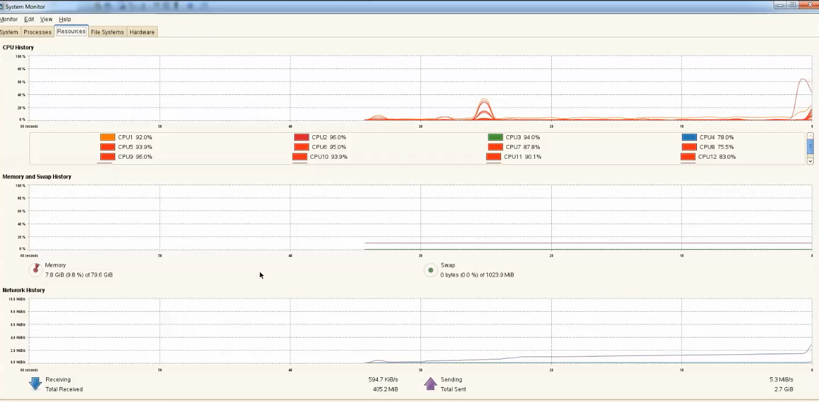
Run Fast: POWER8 has more threads per core which is ideal for in-memory applications like SAP HANA
4X
threads per core vs Intel
(up to 1536 threads per system)
Big Data Workload is DONE!
YOU are the Winner!
Processors
flexible, fast execution of analytics algorithms

Slide 11
Run Smart: IBM Power Systems delivers advanced capabilities
Capacity on Demand (CoD) for POWER8 enterprise systems – E870, E880
Capacity Upgrade on Demand
Upgrade system by activating CoD cores and/or memory
No special contracts, no required monitoring – activated capacity is purchased.
Elastic Capacity on Demand
Temporary use of CoD cores or memory as required – capacity is rented by the day
Usage captured monthly for quarterly billing
Utility Capacity on Demand
CPU only – measured by processor minutes. Automatically delivers additional CPU core capacity from the shared pool temporarily
Utility CoD cores are available to uncapped partition (VM) and charges for utility capacity used
Prepaid or post-paid, renewable every 365 days
Trial Capacity on Demand
Allow clients to test impact of additional processors and/or memory
Partial or total processors and memory activation, available for fixed time
No formal commitment required
Notes:
11

Slide 12










All Roads Lead to HANA
Today and Moving Forward
SAP ERP, CRM, SCM
Business Suite, S/4HANA
Analytics
SAP BW
SAP Business Suite
HANA
Notes:
This is Nirvana for an SAP account…

Slide 13
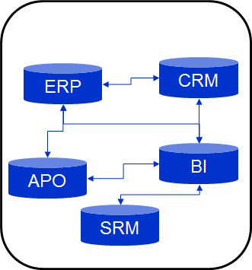
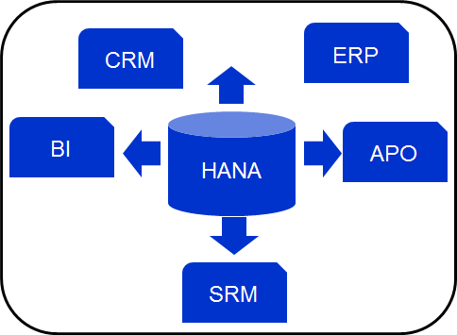
SAP strategy for HANA
From:
One DB per application
Point-to-point integration
Long running queries, e.g. in batch mode
To:
One DB per landscape
No integration necessary
Real time execution

Slide 14

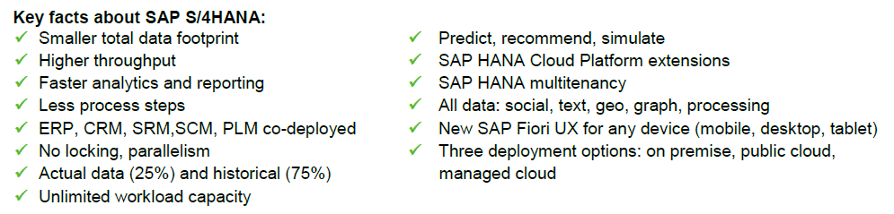
SAP S/4HANA SAP Business Suite 4 SAP HANA
SAP’s next-generation business suite
A new product fully built on SAP HANA
Modern design principles with the SAP Fiori user experience (UX)
Massive simplifications:
Customer adoption, data model, user experience, decision making, business processes, and models
Massive innovations:
Internet of Things, Big Data, business networks, and mobile-first

Slide 15

Customer value: HANA on Power
Intended for mission critical 7X24 Enterprise customer operations
Implemented as a Tailored Data Center Integration (TDI) offering (not an appliance)
Highest Reliable, Available, Serviceable (RAS) in the market
On-Demand Capacity
Can be integrated into and tailored to a Power customer’s environment
Up to 4x throughput per core
Significant Power SMT-8 throughput advantages
Value: fewer cores, fewer footprints, and lower operating costs
Virtualization out of the box
Lower virtualization layer overhead on multi-threaded HANA workloads
Value: fewer cores, fewer footprints, and lower operating costs

Slide 16

HANA on Power is aligned to HANA standards
From a coding and software manufacturing perspective, IBM Power Systems and Linux on Power distributions are a mainstream HANA development platform with comparable SAP solution support as Intel platforms.
Therefore we adhere to and comply with identical HANA system KPI requirements, tools and processes defined by SAP SE:
SAP HANA Quicksizer and SAP DB sizing tools
SAP application and sizing related documentation
SAP tools like QuickSizer, Hardware Configuration Check Tool (HWCCT) etc.
Customer defect support and services offerings follow established SAP and IBM processes and organizations
Can leverage the new SAP HANA ”single point of contact” strategy with end-to-end support from IBM.

Slide 17

IBM Systems Lab Services and SAP HANA
IBM Systems Lab Services has experienced consultants worldwide ready now to help clients deploy solutions for SAP HANA in the SAP Ramp Up Program and at GA
Lab Services installations leverage trusted best practices and deep experience of Linux on Power performance, infrastructure optimization and resiliency planning
Lab Services Offering | Description
SAP HANA on Power Installation and PoC | Conduct pre-installation review of solution prerequisites and dependencies. Install, verify and update hardware, software and network components based on best practices from SAP and IBM. Verify SAP KPI-compliance of the deployed system using Hardware Configuration Check Tool (HWCCT). Install SAP HANA and hand over to SAP team or client for additional software configuration and data migration. Perform solution validation and testing. Provide post-installation documentation.

Slide 18
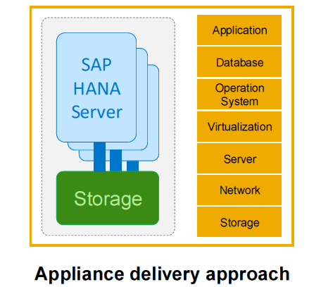
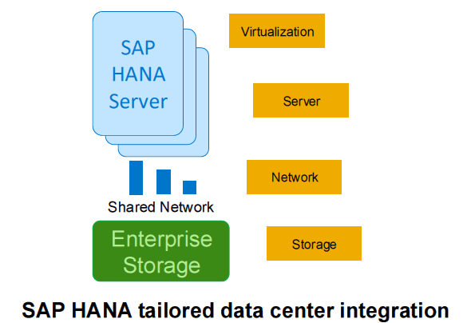
SAP HANA Deployment
HANA Appliance
POWER8 System
Fast Implementation
Support fully provided by SAP
More Flexibility
Save IT budget and existing investment
Solution validation done by SAP and partner
Preconfigured hardware set-up
Preinstalled software
Installation needs to be done by customer
Customer aligns with the hardware partner on individual support mode

Slide 19
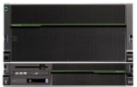


Power Solution Editions for SAP HANA
NOTE: HANA licenses sold separately by SAP
4TB
9119-MME
#CCCC
2TB
E870
8408-E8E
# BBBB
1TB
E850
POWER8 E850
32 cores @ 3.7GHz
Min 1TB (fully active)
SLES 11 for HANA
POWER8 E870
40 / 80 cores @ 4.19GHz
Min 1TB (fully active)
SLES 11 for HANA
8286-42A
# AAAA
512GB
S824
Purchase 2 units
for 2-drawer configuration
POWER8 S824
24 cores @ 3.5GHz
Min 512GB
SLES 11 for HANA

Slide 20
Key Messages
IBM Power RAS option available for current and new IBM clients
Business Warehouse to start, Business Suite in 2015
A core platform going forward for S/4HANA and cloud deployments
Power scale-up is the ideal model for HANA
More data space, high-reliability CPU, memory, backplane
Fewer cores, fewer footprints, and lower operating costs
Reduced complexity and system overhead
Virtualization advantages for multiple workloads
Combine SAP workloads on single machine
Mix operating systems, databases, applications with extreme performance
Power value is available to HANA customers NOW!
POP03768-USEN-00

