Slide 1
PASS Virtual Chapter presentation
March 27, 2014
SQL Server 2014: In-memory technologies integrated to optimize workload performance
Kevin Liu
Principal Lead Program Manager
SQL Server Engine
Notes:
Teams have a lot of latitude and options in their decks and discussion with customers. This event is about getting the feedback and building customer readiness. That said, there are a few items that ALL teams need to keep in mind:
DO NOT USE THE TERM “WINDOWS BLUE”, “BLUE’ OR ANY OTHER CODE NAME
DO NOT MENTION ANY TIMELINES FOR RELEASE!
DO NOT COMMIT TO ANYTHING THAT IS BEING DISCUSSED. EVERYTHING IS VERY EARLY AND SUBJECT TO CHANGE
DO NOT GIVE ANY CUSTOMER CONTENT TO TAKE WITH THEM.
We will need to review all slide decks prior to presentation for disclosure coverage and to watermark.

Slide 2
SQL Server 2014 Investments
In-Memory Technologies
Enhanced
High Availability
New Hybrid
Scenarios
Other investments
In-Memory OLTP
5-25X performance gain for OLTP integrated into SQL Server
In-Memory DW
5-25X performance gain and high data compression
Updatable and clustered
SSD Buffer Pool Extension
4-10X of RAM and up to 3X performance gain transparently for apps
Always On Enhancements
Increased availability and improved manageability of active secondaries
Online Database Operations
Increased availability for index/partition maintenance
Backup to Azure
Easy to implement and cost effective Disaster Recovery solution to Azure Storage
HA to Azure VM
Easy to implement and cost effective high availability solution with Windows Azure VM
Deploy to Azure
Deployment wizard to migrate database
Better together with Windows Server
WS2012 ReFS support
Online resizing VHDx
Hyper-V replica
Windows “Blue” support
Extending Power View
Enable Power View on existing analytic models and support new multi-dimensional models.
2
Notes:
Per our prior conversation, for SQL Server “14”, we will have a focused feature set for the release in order to deliver those key capabilities to market in a more accelerated timeframe. The four key areas of innovation are:
xVelocity In-Memory Technologies
Enhancements to High Availability
Support for New hybrid scenario
Extending Immersive Experiences
xVelocity – Two primary capabilities being brought to market
Project Hekaton
Extending our in-memory technologies for the OLTP workload to deliver tremendous performance enhancements to market
A key customer Bwin at the PASS Summit 2012 was able to demonstrate 15x performance for their workload and there is a customer video for more information Project Hekaton was announced publish at the PASS Summit 2012 last November, although there is no public information on release timing
Greater performance for existing and new applications
Updateable column store
As we have discussed with PDW V2, the next generation of our column store technology will deliver performance benefits as well as compression benefits and will be updateable for new updates to the table
HA Enhancements
Rolling update with online operations
Fit and finish with HA
New Hybrid Scenarios – Smart Backup and Active Secondaries
DAX-MD

Slide 3
In-memory Technologies
In-Memory Technologies
Applicable to
Transactional workloads:
Concurrent data entry, processing and retrieval
In-Memory OLTP
5-25X performance gain for OLTP integrated into SQL Server
In-Memory DW
5-30X performance gain and high data compression
Updatable and clustered
SSD Buffer Pool Extension
4-10X of RAM and up to 3X performance gain transparently for apps
Applicable to
Decision support workloads:
Large scans and aggregates
Applicable to
Disk-based transactional workloads:
Large working (data)set
Notes:
Talking point on BI (vertipaq in desktop as well as in AS)
Azure distributed cache (velocity)

Slide 4
Overview of In-Memory OLTP

Slide 5
Why In-Memory OLTP (Hekaton)
Market need for higher throughput and predictable lower latency OLTP at a lower cost
Hardware trends demand architectural changes on RDBMS
In-Memory OLTP is:
High performance,
Memory-optimized OLTP engine,
Integrated into SQL Server and
Architected for modern hardware trends

Slide 6
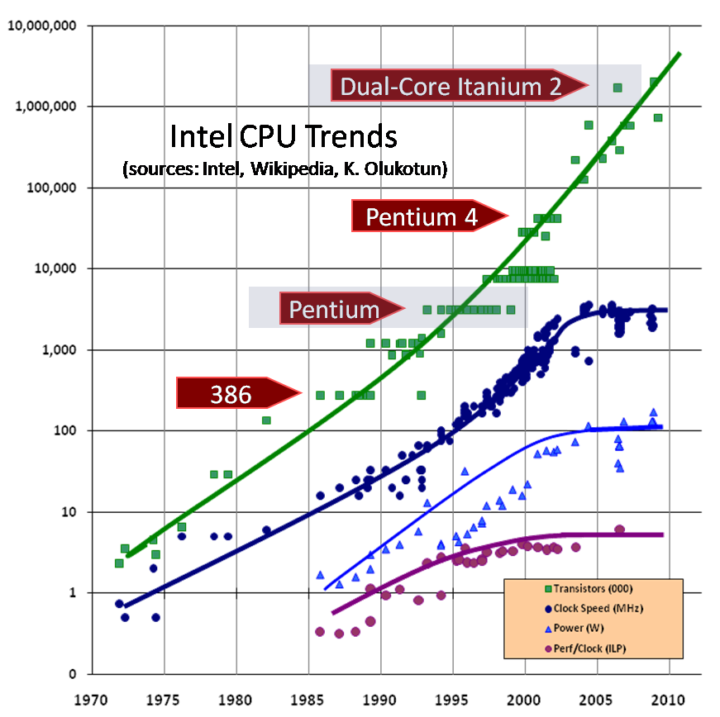
Hardware trends
Moore’s Law on total CPU processing power holds but in parallel processing…
CPU clock rate stalled…
Decreasing RAM cost
Notes:
Actually while some of these are increasing the key point is that they are not increasing exponentially any longer.

Slide 7
In-Memory OLTP: architected to enable new real-time applications
Customer Benefits
High performance data operations
Efficient, business-logic processing
Frictionless scale-up
Hybrid engine and integrated experience
Hekaton Tech Pillars
Main-Memory Optimized
T-SQL Compiled to Machine Code
High Concurrency
SQL Server Integration
Direct pointers to rows
Indexes exist only in memory
No buffer pool
No write-ahead logging
Stream-based storage
T-SQL compiled to machine code leveraging VC compiler
Procedure and its queries, becomes a C function
Aggressive optimizations @ compile-time
Multi-version optimistic concurrency control with full ACID support
Lock-free data structures
No locks, latches or spinlocks
No I/O during transaction
Same manageability, administration & development experience
Integrated queries & transactions
Integrated HA and backup/restore
Drivers
Hardware trends
Business
Steadily declining memory price, NVRAM
Stalling CPU clock rate
Many-core processors
TCO
Notes:
By taking advantage of modern HW trends, we will enable new applications with higher real-time processing needs, and hence increase the addressable market size.

Slide 8
In-Memory OLTP: built into SQL Server 2014
Application
No V1 improvements in comm layers
TDS Handler and Session Management
Key
SQL Server.exe
Existing SQL Component
Parser, Catalog, Optimizer
Execution Plan cache for ad-hoc T-SQL and SPs
Hekaton Compiler
Native-Compiled SPs and Schema
T-SQL Interpreter
Hekaton Component
20-40x more efficient
Real Apps see 2-30x
Access Methods
Hekaton Engine: Memory_optimized Tables & Indexes
Generated .dll
Non-durable Table
Query Interop
Buffer Pool
T1
T2
T3
Tables
Reduced log contention; Low latency still critical for performance
T1
T2
T3
Indexes
Memory-optimized Table Filegroup
Transaction Log
Data Filegroup
T1
T2
T3
T1
T2
T3
Checkpoints are background sequential IO
T1
T2
T3
T1
T2
T3

Slide 9
Early customer performance gains
Apps that take full advantage: e.g. web app session state
Apps with periodic bulk updates & heavy random reads
Existing apps typically see 4-7x improvement
Despite 20 years of optimizing for existing OLTP benchmarks – we still get 2x on a workload derived from TPC-C

Slide 10
Demo
Table and Stored Procedure Performance Gain
Notes:
Show case performance gain with table memory optimization and stored procedure native compilation gains.

Slide 11
Memory-optimized Data Structures
Rows
New row format
Structure of the row is optimized for memory residency and access
No data page containers
Rows are versioned (payload never updated in place)
Indexes
Nonclustered Indexes only
Indexes point to rows, they do not duplicate them
<nonclustered hash> index for point lookups
<nonclustered> index for range (inequality) and ordered scans
Not logged and do not exist on disk – maintained online or recreated during recovery

Slide 12
Memory-optimized Table: Row Format
Row header
Payload (table columns)
8 bytes * (IdxLinkCount)
Begin Ts
End Ts
StmtId
IdxLinkCount
8 bytes
8 bytes
4 bytes
2 + 2 (padding)
bytes
Key Points
Begin/End timestamp determines row’s version validity and visibility
No data pages; just rows
Row size limited to 8060 bytes (@table create time) to allow data to be moved to disk-based table
Not every SQL table schema is supported (for example LOB and sqlvariant)
Notes:
Total index count: hash+range <=8

Slide 13
Lightweight hash index data structure and MVCC
Transaction 99: Running compiled query
SELECT City WHERE Name = ‘John’
Simple hash lookup returns direct pointer to ‘John’ row
Hash index on Name
Hekaton Principle:
Performance like a cache
Functionality like a RDMBS
Note: HANA still use 16KB pages for its row store (optimized for disk IO)
50, ∞
John
Paris
Background operation will unlink and deallocate the old ‘John’ row after transaction 99 completes.
100
f(John)
100, ∞
John
Prague
Transaction 100:
UPDATE City = ‘Prague’ where Name = ‘John’
No locks of any kind, no interference with transaction 99
90, ∞
Susan
Bogota
Timestamps
Chain ptrs
Name
City

Slide 14
Range index
Page size- up to 8K. Sized to the row
Logical pointers
Indirect physical pointers through Page Mapping table
Page Mapping table grows (doubles) as table grows
Sibling pages linked one direction
Require two indexes for ASC/DSC
No in-place updates on index pages
Handled thru delta pages or building new pages
No covering columns (only the key is stored)
Page Mapping Table
0
PAGE
Physical
Logical
1
PAGE
Root
2
10
20
28
PageID-0
3
PageID-3
PageID-2
5
8
10
11
15
18
21
24
27
Non-leaf pages
PageID -14
1
2
4
6
7
8
25
26
27
leaf pages
Data rows
14
200, ∞
1
50, 300
2
15
Key
Key
100,200
1

Slide 15

Hekaton data needs to fit in memory
Available Memory
Memory Optimized Tables
Memory Optimized Tables
Memory Optimized Tables
Memory Optimized Tables
Max Server Memory
Memory Internal Structures
Memory Internal Structures
Memory Internal Structures
Buffer Pool
Buffer Pool
Memory Internal Structures
Buffer Pool
Buffer Pool
Notes:
(1) Memory-optimized tables are memory-hungry. They don’t give the memory away under pressure.

Slide 16
Memory Management with Resource Governor
Data resides in memory at all times
Must configure SQL Server with sufficient memory to store memory-optimized tables
Failure to allocate memory will fail transactional workload at run-time
Integrated with SQL Server memory manager and reacts to memory pressure for GC (Garbage Collection)
Guidance for SQL Server 2014 is not to exceed 256GB of in-memory table user data
Integrated with Resource Governor
Recommend using dedicated resource pool to ensure performance stability for disk-based table workloads
“Bind” a database to a resource pool
Memory-optimized tables in a database cannot exceed the limit of the resource pool
Hard top limit (function of the physical memory) to ensure system remains stable under memory pressure
Notes:
Describe
Memory allocated to the rows can’t be released. The memory is released when the row is stale (i.e. update or deleted)
Memory allocation is done in chunks of 64K (confirm with the team)

Slide 17
Estimating Memory Consumption
Memory Size = Table Size + SUM(Index Size)
Table Size = Row Size * Row Count
Row Size = SUM(Column Sizes) + Row Header Size
Row Header Size = 24 + 8 * Index Count
Column Size = Dependent on column type and associated padding/overhead
Hash Index Size = Bucket_Count * 8 bytes
Nonclustered Index Size = Row Count * (Key Size + 8) bytes
Guidance:
Provision memory ~2 times Memory Size due to row versioning overhead
Notes:
See http://msdn.microsoft.com/en-us/library/dn205318(v=sql.120).aspx for details on actual sizes
Emphasize that this is actually a rough estimate
Field Sizes:
Numerical: 1 byte to 8 bytes, varying by length
NUMERIC and DECIMAL: 8 to 16 bytes, varying by precision
Date and Time: 8 bytes
CHAR, VARCHAR and VARBINARY: 8 bytes * length
NCHAR and NVARCHAR: 8 bytes * 2 * length

Slide 18
Durability : Data and Delta Files
0
100
Transaction Timestamp Range
Data File
TS (ins)
RowId
TableId
Row pay load
TS (ins)
RowId
TableId
Row pay load
TS (ins)
RowId
TableId
Row pay load
Data file contains rows inserted
within a given transaction range
Checkpoint File Pair
Delta File
TS (ins)
RowId
TS (del)
TS (ins)
RowId
TS (del)
TS (ins)
RowId
TS (del)
Delta file contains deleted rows
within a given transaction range

Slide 19
Populating Data/Delta files via sequential IO only
SQL Transaction log
(from LogPool)
Del Tran1 (row TS150)
Log in disk Table
Del Tran2 (TS 450)
Del Tran3 (row TS 250)
Insert into Hekaton T1
Del Tran1(TS150)
Del Tran2 (row TS 450)
Del Tran3 (TS 250)
Insert into T1
Data file has pre-allocated size (128 MB or 16 MB on smaller systems)
Engine switches to new data file when the current file is full
Transaction does not span data files
Once a data file is closed, it becomes read-only
Row deletes are tracked in delta file
Files are append only
Offline Checkpoint Thread
Delete 150 TS
Delete 250 TS
Delete 450 TS
New Inserts
Memory-optimized Table Filegroup
Range 100-200
Range 200-300
Range 300-400
Range 400-500
Range 500-
Data file with rows generated in timestamp range
IDs of Deleted Rows (height indicates % deleted)
Notes:
Most of the time, the checkpoint will be reading log from memory
Rows inserted as part of 1 transaction is contained in 1 data files and deletes across multiple delta

Slide 20
Merge to Minimize Checkpoint File Size
What is a Merge Operation?
Merges one or more adjacent data/delta files pairs into 1 pair
Need for Merge
Deleting rows causes data files to have stale rows
DMV: sys.dm_xtp_checkpoint_files can be used to find inserted/deleted rows and freespace
Benefits of Merge
Reduces storage (i.e. fewer data/delta files) required to store active data rows
Improves the recovery time as there will be fewer files to load
Merge is a (non-blocking) background operation
Merge does not block concurrent deletes in the affected file pairs

Slide 21
Merge Operation Internals
Files as of Time 500
Files as of Time 600
Memory-optimized data Filegroup
Memory-optimized data Filegroup
Range 100-200
Range 200-300
Range 300-400
Range 400-500
Range 100-200
Range 200-300
Range 200-400
Range 400-500
Range 500-600
Range 200-299
Range 300-399
Range 300-400
Merge
200-400
Data file with rows generated in timestamp range
IDs of Deleted Rows (height indicates % deleted)
Files Under Merge
Deleted Files

Slide 22
Efficient Logging for Memory-Optimized Tables
Uses SQL Server transaction log to store content
Each In-Memory OLTP log record contains a log record header followed by opaque memory optimized-specific log content.
All logging for memory-optimized tables is logical
No log records for physical structure modifications.
No index-specific / index-maintenance log records.
No UNDO information is logged
Recovery Models
All three recovery models (Simple, Full, Bulk) are supported

Slide 23
In-Memory OLTP Recovery – Speed of IO
Impact on Recovery Time Objective (RTO)
Load speed (IO) of data & Size of durable tables
Hash index with heavy collision (bucket count too low) and large non-clustered (Range) index have additional recovery overhead.
Memory
Optimized Tables
Recovery Data Loader
Recovery Data Loader
Recovery Data Loader
filter
filter
filter
Delta map
Delta map
Delta map
Data
File1
Delta
File1
Data
File2
Delta
File2
Data
File3
Delta
File3
Memory Optimized Container - 1
Memory Optimized Container - 2

Slide 24
Suitable scenarios for V1 (in SQL Server 2014)
Key factor in performance benefits: processing closer to data, i.e. Ideal for applications with data processing in the DB layer
 | Optimal for V1 | Not Optimal for V1
Business logic | In database (as SPs) | In mid-tier
Latency and contention locations | Concentrated on a sub-set of tables/SPs | Spread across the database
Client server communication | Less frequent | Chatty
T-SQL surface area | Basic | Complex
Log IO | Not limiting factor | Limiting factor
Data size | Hot data fit in memory | Unbounded hot data size

Slide 25
Overview of In-Memory DW

Slide 26
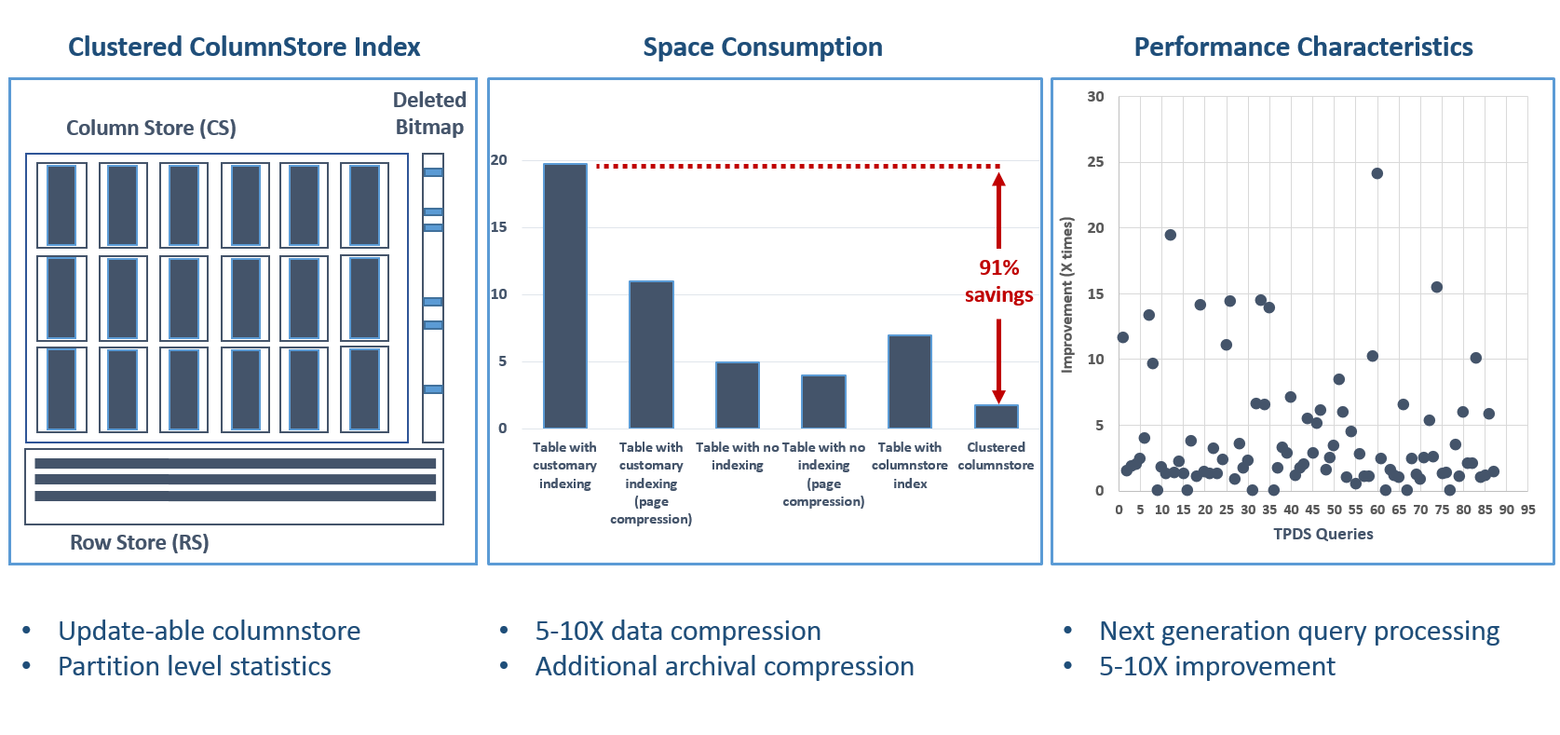
In-Memory DW overview

Slide 27

Columnstore internals
Data stored as rows
Data stored as columns
C1
C2
C3
C4
C5
Benefits:
Improved compression:
Data from same domain compress better
Reduced I/O:
Fetch only columns needed
Improved Performance:
More data fits in memory
Can exceed memory size (not so for HANA)
…

Slide 28
Columnstore Index Example
OrderDateKey | ProductKey | StoreKey | RegionKey | Quantity | SalesAmount
20101107 | 106 | 01 | 1 | 6 | 30.00
20101107 | 103 | 04 | 2 | 1 | 17.00
20101107 | 109 | 04 | 2 | 2 | 20.00
20101107 | 103 | 03 | 2 | 1 | 17.00
20101107 | 106 | 05 | 3 | 4 | 20.00
20101108 | 106 | 02 | 1 | 5 | 25.00
20101108 | 102 | 02 | 1 | 1 | 14.00
20101108 | 106 | 03 | 2 | 5 | 25.00
20101108 | 109 | 01 | 1 | 1 | 10.00
20101109 | 106 | 04 | 2 | 4 | 20.00
20101109 | 106 | 04 | 2 | 5 | 25.00
20101109 | 103 | 01 | 1 | 1 | 17.00

Slide 29
1. Horizontally Partition (create Row Groups)
OrderDateKey | ProductKey | StoreKey | RegionKey | Quantity | SalesAmount
20101107 | 106 | 01 | 1 | 6 | 30.00
20101107 | 103 | 04 | 2 | 1 | 17.00
20101107 | 109 | 04 | 2 | 2 | 20.00
20101107 | 103 | 03 | 2 | 1 | 17.00
20101107 | 106 | 05 | 3 | 4 | 20.00
20101108 | 106 | 02 | 1 | 5 | 25.00
~1M rows
OrderDateKey | ProductKey | StoreKey | RegionKey | Quantity | SalesAmount
20101108 | 102 | 02 | 1 | 1 | 14.00
20101108 | 106 | 03 | 2 | 5 | 25.00
20101108 | 109 | 01 | 1 | 1 | 10.00
20101109 | 106 | 04 | 2 | 4 | 20.00
20101109 | 106 | 04 | 2 | 5 | 25.00
20101109 | 103 | 01 | 1 | 1 | 17.00

Slide 30
2. Vertically Partition (create Segments)
OrderDateKey
20101107
20101107
20101107
20101107
20101107
20101108
ProductKey
106
103
109
103
106
106
StoreKey
01
04
04
03
05
02
RegionKey
1
2
2
2
3
1
Quantity
6
1
2
1
4
5
SalesAmount
30.00
17.00
20.00
17.00
20.00
25.00
OrderDateKey
20101108
20101108
20101108
20101109
20101109
20101109
ProductKey
102
106
109
106
106
103
StoreKey
02
03
01
04
04
01
RegionKey
1
2
1
2
2
1
Quantity
1
5
1
4
5
1
SalesAmount
14.00
25.00
10.00
20.00
25.00
17.00

Slide 31
3. Compress Each Segment
OrderDateKey
20101107
20101107
20101107
20101107
20101107
20101108
ProductKey
106
103
109
103
106
106
StoreKey
01
04
04
03
05
02
RegionKey
1
2
2
2
3
1
Quantity
6
1
2
1
4
5
SalesAmount
30.00
17.00
20.00
17.00
20.00
25.00
OrderDateKey
20101108
20101108
20101108
20101109
20101109
20101109
RegionKey
1
2
1
2
2
1
ProductKey
102
106
109
106
106
103
StoreKey
02
03
01
04
04
01
Quantity
1
5
1
4
5
1
SalesAmount
14.00
25.00
10.00
20.00
25.00
17.00
Some segments will compress more than others
*Encoding and reordering not shown

Slide 32
4. Read The Data
SELECT ProductKey, SUM (SalesAmount)
FROM SalesTable
WHERE OrderDateKey < 20101108
OrderDateKey
20101107
20101107
20101107
20101107
20101107
20101108
ProductKey
106
103
109
103
106
106
StoreKey
01
04
04
03
05
02
RegionKey
1
2
2
2
3
1
Quantity
6
1
2
1
4
5
SalesAmount
30.00
17.00
20.00
17.00
20.00
25.00
OrderDateKey
20101108
20101108
20101108
20101109
20101109
20101109
RegionKey
1
2
1
2
2
1
ProductKey
102
106
109
106
106
103
StoreKey
02
03
01
04
04
01
Quantity
1
5
1
4
5
1
SalesAmount
14.00
25.00
10.00
20.00
25.00
17.00
Segment
Elimination
Column Elimination

Slide 33
Updatable Columnstore Index in SQL Server 2014
Table consists of column store and row store
DML (update, delete, insert) operations leverage delta store
INSERT Values
Always lands into delta store
DELETE
Logical operation
Data physically remove after REBUILD operation is performed.
UPDATE
DELETE followed by INSERT.
BULK INSERT
if batch < 100k, inserts go into delta store, otherwise columnstore
SELECT
Unifies data from Column and Row stores - internal UNION operation.
“Tuple mover” converts data into columnar format once segment is full (1M of rows)
REORGANIZE statement forces tuple mover to start.
C1
C2
C3
C4
C5
C6
Delta (row)
store
C1
C2
C3
C4
C5
C6
Column
Store
tuple mover

Slide 34
Demo
CCI
(Clustered Columnstore Index)

Slide 35
Appendix
Optional materials

Slide 36
Overview of Buffer Pool Extension

Slide 37
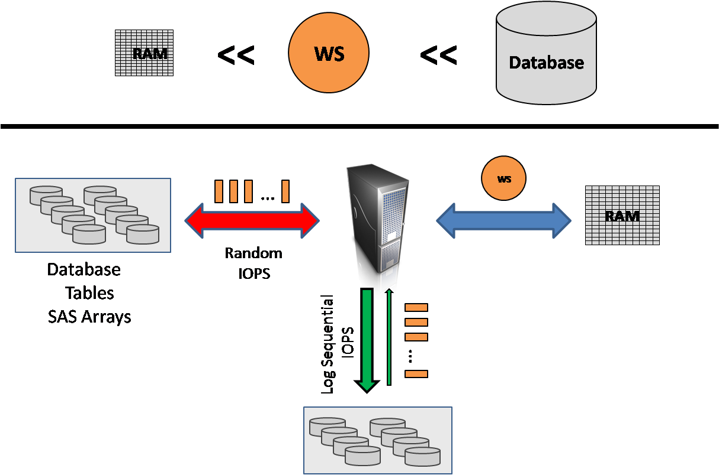
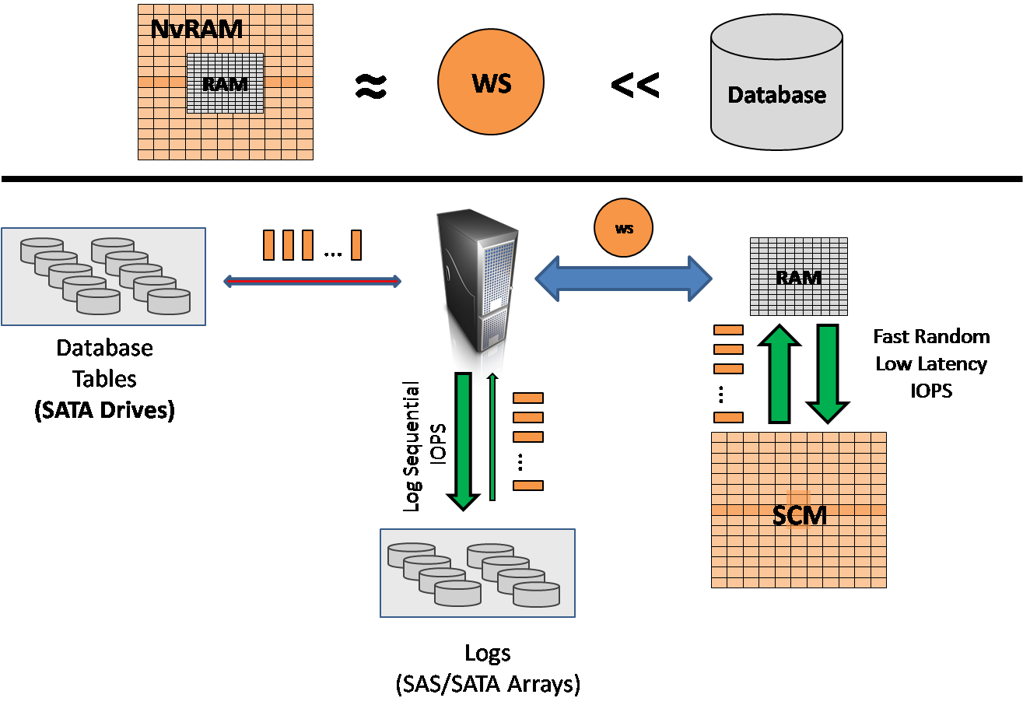
SSD Buffer Pool Extension: to fit WS in NvRAM
RANDOM IOPS to Mechanical Drives
IOPS Offload to SCM
Goal: Use nonvolatile storage devices for increasing amount of memory available for buffer pool consumers. This allows usage of SSD as an intermediate buffer pool pages thus getting price advantage over the memory increase.

Slide 38
SSD Buffer Pool Extension - summary
Use of cheaper SSD to reduce SQL memory pressure
No risk of data loss – only clean pages are involved
Observed up to 3x performance improvement for OLTP workloads during the internal testing
Available on SQL Server Enterprise and STD (memory doubled in 2014)
Sweet spot machine size:
High throughput and endurance SSD storage (ideally PCI-E) sized 4x-10x times of RAM size
Not optimized for DW workloads *
Not applicable to In-memory OLTP
* DW workload data set is so large that table scan will wash out all the cached pages.
Notes:
real DW workload data set is so huge that table scan will wash out all the cached pages anyway meaning other workloads will be affected.

Slide 39
How it works
Buffer Pool
Clean Page
Dirty Page
SSD
DB
ALTER SERVER CONFIGURATION
SET BUFFER POOL EXTENSION
{ ON ( FILENAME = 'os_file_path_and_name' , SIZE = <size> [ KB | MB | GB ] )
| OFF }
Evict
Clean Page
ɸ

Slide 40
Customer Experiences
Customer | Workload | Results
Edgenet – SaaS provider for retailers and product delivery for end consumers | •Availability Project: Provide real-time insight into product price/availability for retailers and end-consumers. Used by retailers in-stores and to end-consumers via search engines. | • 8x-11x in performance gains for ingestion of data • Consolidated from multi-tenant, multi-server to single database/server. • Removed application caching layer (additional latency) from client tier. • Case Study
BWin.party - Largest regulated online gaming site | • Running ASP.NET session state using SQL Server for repository • Critical to end-user performance and interaction with the site | • Went from 15,000 batch request/sec per SQL Server to over 250,000. • Lab testing achieved over 450,000 batch requests/sec • Consolidate 18 SQL Server instances to 1. • Case Study
SBI Liquidity Market - Japanese Foreign currency exchange trading platforms. Includes high volume and low latency trading. | • Expecting 10x volume increase • System had latency (up to 4 sec) at scale • Goal is improved throughput and under 1sec latency | • Redesigned application for In-Memory OLTP, 2x throughput (get over 3x in testing) and reduced latency from 4 seconds to 1 per business transaction. • Case study

Slide 41
Additional resources
Hekaton whitepaper: http://t.co/T6zToWc6y6
Hekaton blog series: http://blogs.technet.com/b/dataplatforminsider/archive/2013/06/26/sql-server-2014-in-memory-technologies-blog-series-introduction.aspx
CCI blog: http://blogs.technet.com/b/dataplatforminsider/archive/2013/07/17/what-s-new-for-columnstore-indexes-in-sql-server-2014.aspx
SSD BP Ext: http://blogs.technet.com/b/dataplatforminsider/archive/2013/07/25/buffer-pool-extension-to-ssds-in-sql-server-2014.aspx

Slide 42
More Hekaton Information
SIGMOD 2013 paper
Kalen Delaney Whitepaper (CTP 2)
David DeWitt’s SQL PASS 2013 keynote:
Video (26 minutes from beginning),
Slides.
MSDN
Blog series

