Slide 1
TensorFlow Internal
Hyunghun Cho
(webofthink@snu.ac.kr)

Slide 2
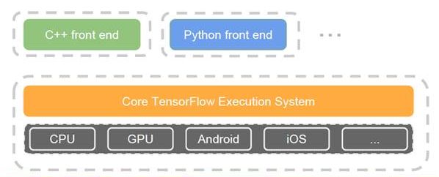
Overview
Dataflow-like model
Runs on a wide variety of different H/W platform
※ Source: github.com/zer0n/deepframeworks
※ Source: tensorflow.org

Slide 3
Basic concepts
Tensor
definition: an array with more than two axes
arbitrary dimensionality array
Directed graph describes T/F computation
node: instantiation of an Operation
Operation
an abstract computation
have attribute(s)
Kernel
particular implementation of an Operation
run on a type of device (e.g. CPU, GPU)
Variable
special Operation to persistent mutable Tensor
Session
Created to interact with T/F system
in
0…*
node
0…*
out
※ Source: T/F white paper

Slide 4
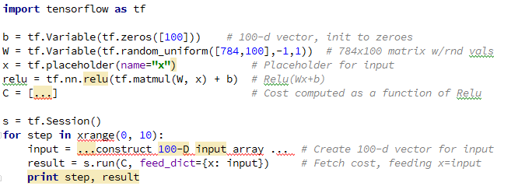
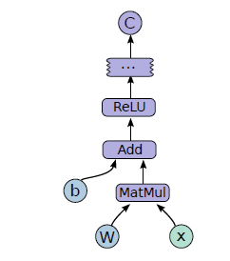
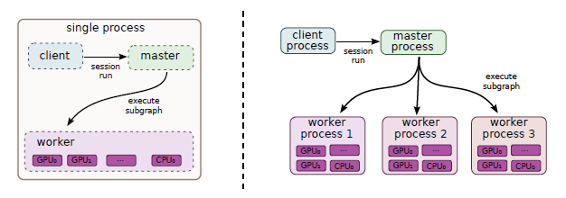
Programming Model
Example T/F code and corresponding computation graph
Single machine and distributed system architecture
※ Source: T/F white paper

Slide 5
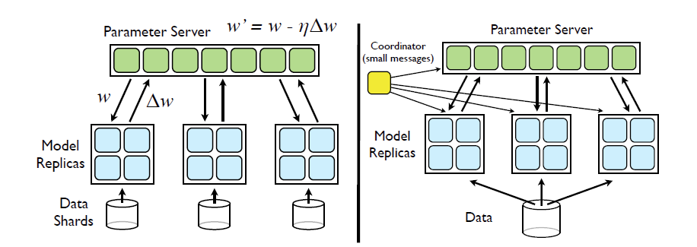
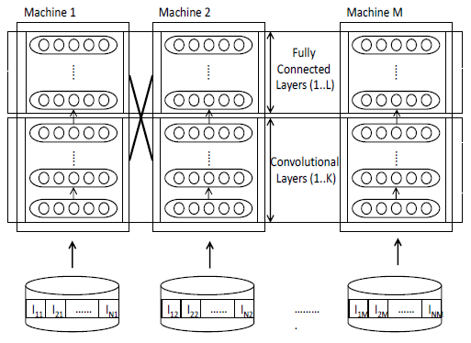
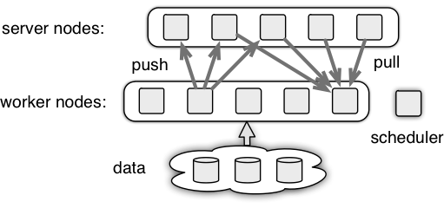
Previous work
DistBelief
Downpour SGD
Sandblaster L-BFGS
Related to
Project Adam
MSR
Parameter Server project
※ Source: Large Scale Distributed Deep Networks
※ Source: parameter server architecture github wiki
※ Source: Project Adam paper

Slide 6
Feature Comparison
For detail, refer to Wikipedia
Feature | Tensor Flow | Theano | Torch | Caffe | Chainer | CNTK
Run on Single Machine | O | O | O | O | O | O
Run on Distributed Machines | O | X | X | X | X | O
Symbolic differentiation | O | O | X | X | O | X
Implemented by C++ | O | X | X | O | X | X
※ Source: T/F white paper

Slide 7
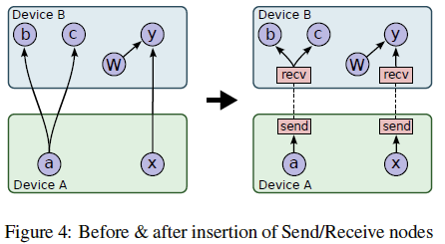
Execution Mode
Single Device
Multi Device
Node placement
Cross-Device Communication
Distributed
Fault Tolerance
Error handling between Send-Receive node pair
Periodic health check to worker process

Slide 8
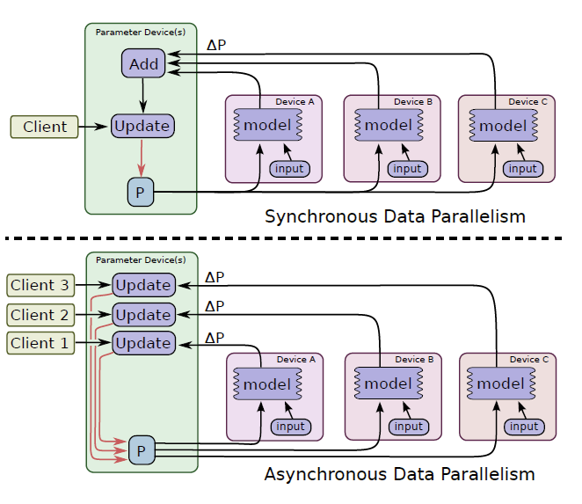
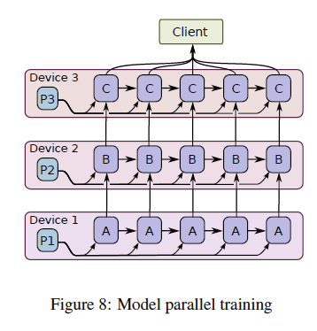
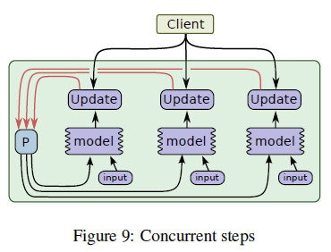
Programming Idioms
Programming Idioms
Data Parallel Training
sequential SGD
Model Parallel Training
Recurrent deep LSTM
Concurrent Steps

Slide 9
Code Metrics
Source
https://github.com/tensorflow/tensorflow
Code Summary
Total 114MB
3373 files including C/C++, python, HTML, …
Top 5 languages for implementation
C++ and Python are the major languages
Protocol Buffers: provide mechanism for serializing structured data
language | files | blank | comment | code
C++ | 1092 | 46473 | 43399 | 276160
C/C++ Header | 779 | 23457 | 44727 | 86274
Python | 641 | 27622 | 46660 | 97570
Protocol Buffers | 179 | 2217 | 7294 | 8724
Java | 167 | 8296 | 17325 | 49374
C# | 116 | 4285 | 8653 | 34347

Slide 10
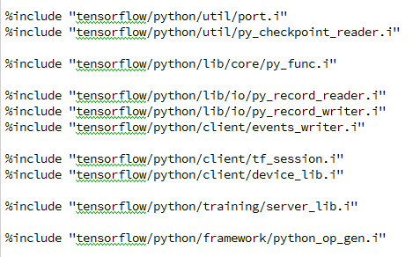
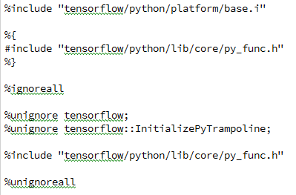
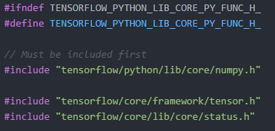
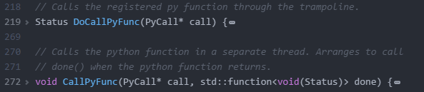
How it works
Python-C++ connection with SWIG wrapper
v
v
[tensorflow.i]
[py_func.i]
[py_func.h]
[py_func.cc]

Slide 11
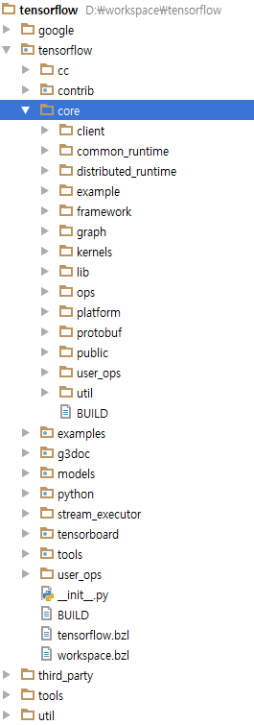
Code Structure
C++ implementation under /core folder
Folder | C/C++ Header | C++ | Protocol Buffers | 총합계
./tensorflow/core/client/ |  | 511 |  | 511
./tensorflow/core/common_runtime/ | 1384 | 8526 |  | 9910
./tensorflow/core/common_runtime/gpu/ | 644 | 3674 |  | 4318
./tensorflow/core/distributed_runtime/ | 581 | 2579 |  | 3160
./tensorflow/core/distributed_runtime/rpc/ | 434 | 2759 |  | 3193
./tensorflow/core/example/ | 116 | 209 | 45 | 370
./tensorflow/core/framework/ | 3539 | 14022 | 451 | 18012
./tensorflow/core/graph/ | 952 | 5586 |  | 6538
./tensorflow/core/kernels/ | 9180 | 42188 | 11 | 51379
./tensorflow/core/lib/core/ | 573 | 1240 | 25 | 1838
./tensorflow/core/lib/gtl/ | 1452 | 1943 |  | 3395
./tensorflow/core/lib/hash/ | 36 | 400 |  | 436
./tensorflow/core/lib/histogram/ | 60 | 324 |  | 384
./tensorflow/core/lib/io/ | 340 | 2134 |  | 2474
./tensorflow/core/lib/jpeg/ | 78 | 767 |  | 845
./tensorflow/core/lib/png/ | 37 | 311 |  | 348
./tensorflow/core/lib/random/ | 690 | 856 |  | 1546
./tensorflow/core/lib/strings/ | 532 | 3111 |  | 3643
./tensorflow/core/lib/wav/ | 13 | 166 |  | 179
./tensorflow/core/ops/ |  | 9346 |  | 9346
./tensorflow/core/ops/compat/ | 25 | 204 |  | 229
./tensorflow/core/platform/ | 805 | 738 |  | 1543
./tensorflow/core/platform/default/ | 349 | 290 |  | 639
./tensorflow/core/platform/posix/ | 31 | 656 |  | 687
./tensorflow/core/protobuf/ |  |  | 333 | 333
./tensorflow/core/public/ | 202 |  |  | 202
./tensorflow/core/user_ops/ |  | 20 |  | 20
./tensorflow/core/util/ | 1354 | 4426 | 170 | 5950
./tensorflow/core/util/ctc/ | 600 | 298 |  | 898
./tensorflow/core/util/sparse/ | 504 | 498 |  | 1002
총합계 | 24511 | 107782 | 1035 | 133328

Slide 12
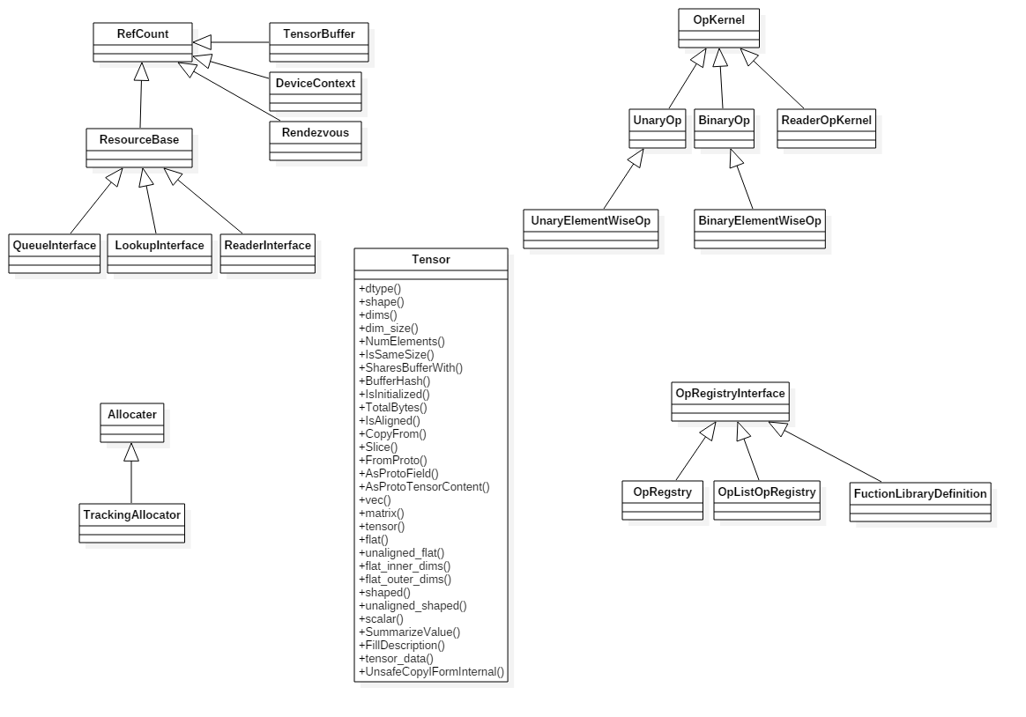
C++ framework
Key classes

Slide 13
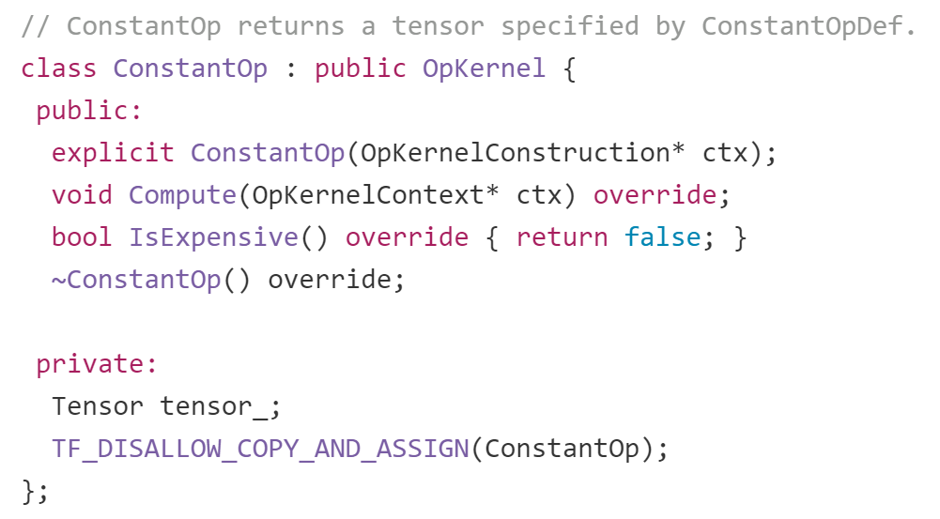
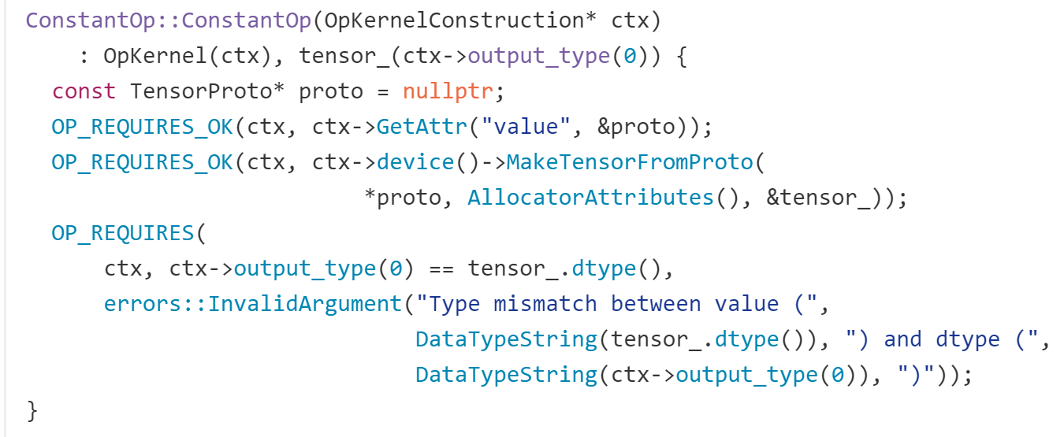
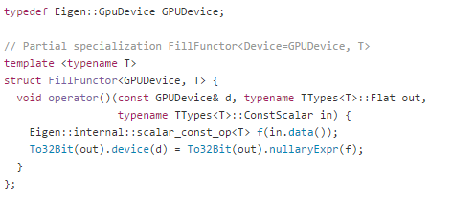
C++ kernels
Inherit from OpKernel
Kernel is implemented per CPU / GPU [How to]
GPU version uses CUDA library
[constant_op.h]
[constant_op.cc]
[constant_op_gpu.cu.cc]

Slide 14
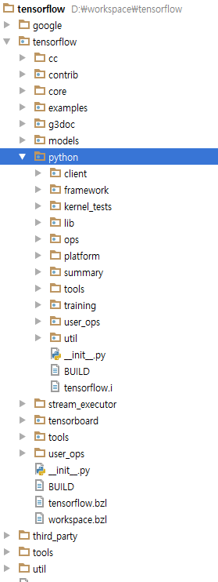
Code Structure
Python implementation under /python folder
Folder | C/C++ Header | C++ | Protocol Buffers | Python | 총합계
./tensorflow/python/ |  |  |  | 168 | 168
./tensorflow/python/client/ | 33 | 475 |  | 2031 | 2539
./tensorflow/python/framework/ | 13 | 686 |  | 7097 | 7796
./tensorflow/python/kernel_tests/ |  |  |  | 25391 | 25391
./tensorflow/python/lib/core/ | 26 | 316 |  |  | 342
./tensorflow/python/lib/io/ | 52 | 75 |  | 31 | 158
./tensorflow/python/ops/ |  |  |  | 14995 | 14995
./tensorflow/python/platform/ |  |  |  | 888 | 888
./tensorflow/python/platform/default/ |  |  |  | 389 | 389
./tensorflow/python/summary/ |  |  |  | 1168 | 1168
./tensorflow/python/summary/impl/ |  |  |  | 693 | 693
./tensorflow/python/tools/ |  |  |  | 280 | 280
./tensorflow/python/training/ |  |  | 6 | 7732 | 7738
./tensorflow/python/user_ops/ |  |  |  | 7 | 7
./tensorflow/python/util/ |  |  |  | 51 | 51
총합계 | 124 | 1552 | 6 | 60921 | 62603

Slide 15
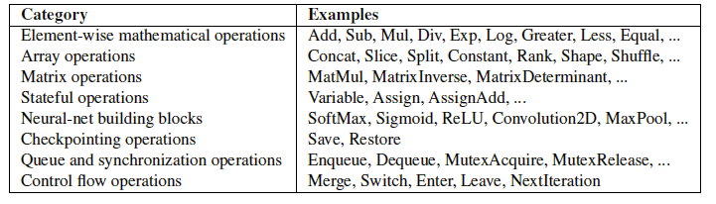
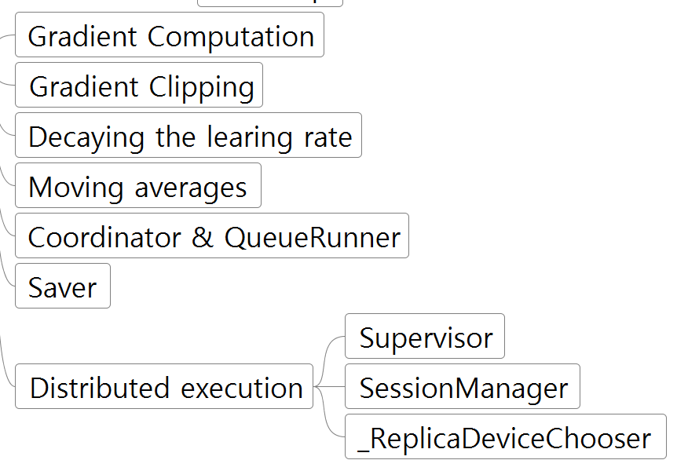
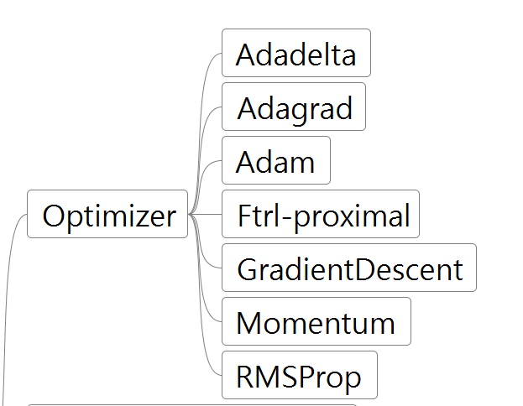
Python Implementation
Operations
Trainings

Slide 16
Code Summary
The Python part
Various operations and trainings
API:
the most complete and the easiest to use
The C++ part
Framework and kernel functions
API:
offer some performance advantages
supports deployment to small devices such as Android

Slide 17
Meta Framework
Keras
TensorFlow Slim
a lightweight library for defining, training and evaluating models
Skflow
provide Scikit Learn style API
PrettyTensor
support a chainable object syntax to quickly define neural networks
TFLearn
a modular and transparent deep learning library

