Slide 1
18-447 Computer Architecture Lecture 16: SIMD Processing (Vector and Array Processors)
Prof. Onur Mutlu
Carnegie Mellon University
Spring 2014, 2/24/2014

Slide 2
Lab 4 Reminder
Lab 4a out
Branch handling and branch predictors
Lab 4b out
Fine-grained multithreading
Due March 21st
You have 4 weeks!
Get started very early – Exam and S. Break are on the way
Finish Lab 4a first and check off
Finish Lab 4b next and check off
Do the extra credit

Slide 3
Readings for Today
SIMD Processing
Basic GPU Architecture
Other execution models: VLIW, Dataflow
Lindholm et al., "NVIDIA Tesla: A Unified Graphics and Computing Architecture," IEEE Micro 2008.
Fatahalian and Houston, “A Closer Look at GPUs,” CACM 2008.
Stay tuned for more readings…

Slide 4
SIMD Processing: Exploiting Regular (Data) Parallelism

Slide 5
Flynn’s Taxonomy of Computers
Mike Flynn, “Very High-Speed Computing Systems,” Proc. of IEEE, 1966
SISD: Single instruction operates on single data element
SIMD: Single instruction operates on multiple data elements
Array processor
Vector processor
MISD: Multiple instructions operate on single data element
Closest form: systolic array processor, streaming processor
MIMD: Multiple instructions operate on multiple data elements (multiple instruction streams)
Multiprocessor
Multithreaded processor

Slide 6
Data Parallelism
Concurrency arises from performing the same operations on different pieces of data
Single instruction multiple data (SIMD)
E.g., dot product of two vectors
Contrast with data flow
Concurrency arises from executing different operations in parallel (in a data driven manner)
Contrast with thread (“control”) parallelism
Concurrency arises from executing different threads of control in parallel
SIMD exploits instruction-level parallelism
Multiple “instructions” (more appropriately, operations) are concurrent: instructions happen to be the same

Slide 7
SIMD Processing
Single instruction operates on multiple data elements
In time or in space
Multiple processing elements
Time-space duality
Array processor: Instruction operates on multiple data elements at the same time
Vector processor: Instruction operates on multiple data elements in consecutive time steps

Slide 8

Array vs. Vector Processors
ARRAY PROCESSOR
VECTOR PROCESSOR
Instruction Stream
Same op @ same time
LD VR ← A[3:0]
ADD VR ← VR, 1
MUL VR ← VR, 2
ST A[3:0] ← VR
Different ops @ time
LD0
LD1
LD2
LD3
LD0
AD0
AD1
AD2
AD3
LD1
AD0
MU0
MU1
MU2
MU3
LD2
AD1
MU0
ST0
ST1
ST2
ST3
LD3
AD2
MU1
ST0
Different ops @ same space
AD3
MU2
ST1
MU3
ST2
Time
Same op @ space
ST3
Space
Space

Slide 9
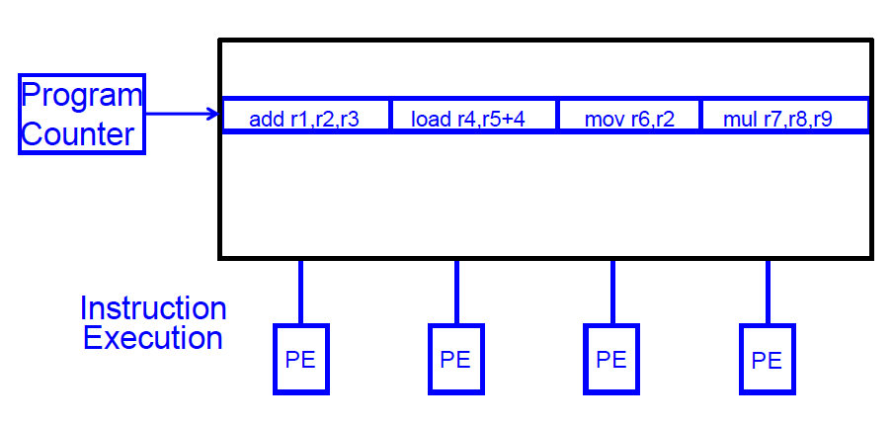
SIMD Array Processing vs. VLIW
VLIW

Slide 10
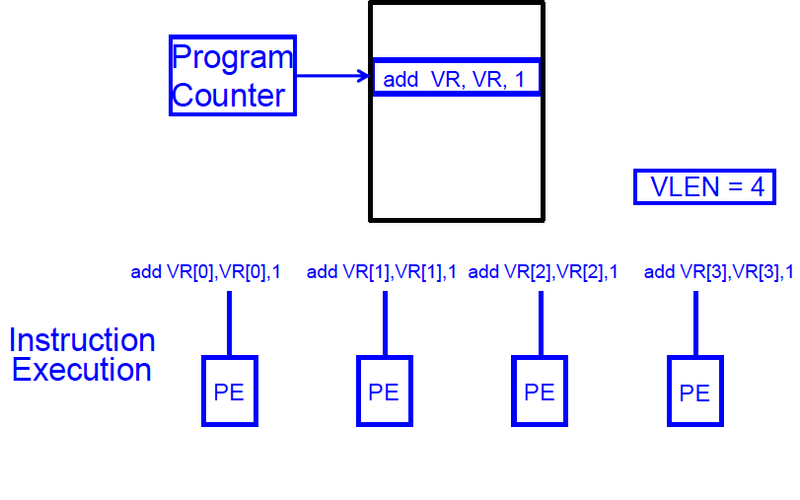
SIMD Array Processing vs. VLIW
Array processor

Slide 11
Vector Processors
A vector is a one-dimensional array of numbers
Many scientific/commercial programs use vectors
for (i = 0; i<=49; i++)
C[i] = (A[i] + B[i]) / 2
A vector processor is one whose instructions operate on vectors rather than scalar (single data) values
Basic requirements
Need to load/store vectors → vector registers (contain vectors)
Need to operate on vectors of different lengths → vector length register (VLEN)
Elements of a vector might be stored apart from each other in memory → vector stride register (VSTR)
Stride: distance between two elements of a vector

Slide 12
Vector Processors (II)
A vector instruction performs an operation on each element in consecutive cycles
Vector functional units are pipelined
Each pipeline stage operates on a different data element
Vector instructions allow deeper pipelines
No intra-vector dependencies → no hardware interlocking within a vector
No control flow within a vector
Known stride allows prefetching of vectors into cache/memory

Slide 13
Vector Processor Advantages
+ No dependencies within a vector
Pipelining, parallelization work well
Can have very deep pipelines, no dependencies!
+ Each instruction generates a lot of work
Reduces instruction fetch bandwidth
+ Highly regular memory access pattern
Interleaving multiple banks for higher memory bandwidth
Prefetching
+ No need to explicitly code loops
Fewer branches in the instruction sequence

Slide 14
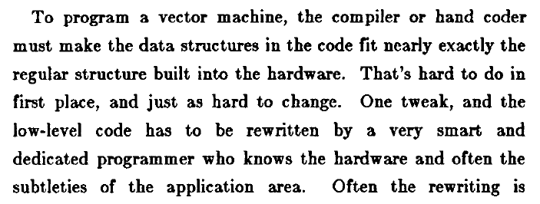
Vector Processor Disadvantages
-- Works (only) if parallelism is regular (data/SIMD parallelism)
++ Vector operations
-- Very inefficient if parallelism is irregular
-- How about searching for a key in a linked list?
Fisher, “Very Long Instruction Word architectures and the ELI-512,” ISCA 1983.

Slide 15
Vector Processor Limitations
-- Memory (bandwidth) can easily become a bottleneck, especially if
1. compute/memory operation balance is not maintained
2. data is not mapped appropriately to memory banks

Slide 16
Vector Processing in More Depth

Slide 17
Vector Registers
Each vector data register holds N M-bit values
Vector control registers: VLEN, VSTR, VMASK
Maximum VLEN can be N
Maximum number of elements stored in a vector register
Vector Mask Register (VMASK)
Indicates which elements of vector to operate on
Set by vector test instructions
e.g., VMASK[i] = (V_{k}[i] == 0)
M-bit wide
M-bit wide
V0,0
V1,0
V0,1
V1,1
V0,N-1
V1,N-1

Slide 18
Vector Functional Units
Use deep pipeline (=> fast clock) to execute element operations
Simplifies control of deep pipeline because elements in vector are independent
V1
V2
V3
Six stage multiply pipeline
V3 <- v1 * v2
Slide credit: Krste Asanovic

Slide 19
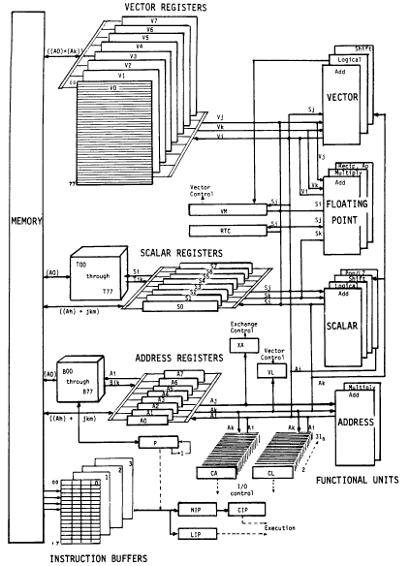
Vector Machine Organization (CRAY-1)
CRAY-1
Russell, “The CRAY-1 computer system,” CACM 1978.
Scalar and vector modes
8 64-element vector registers
64 bits per element
16 memory banks
8 64-bit scalar registers
8 24-bit address registers

Slide 20
Memory Banking
Memory is divided into banks that can be accessed independently; banks share address and data buses
Can start and complete one bank access per cycle
Can sustain N parallel accesses if they go to different banks
Bank
0
Bank
1
Bank
2
Bank
15
MDR
MAR
MDR
MAR
MDR
MAR
MDR
MAR
Data bus
Address bus
CPU
Slide credit: Derek Chiou

Slide 21
Vector Memory System
Base
Stride
Vector Registers
Address Generator
+
0
1
2
3
4
5
6
7
8
9
A
B
C
D
E
F
Memory Banks
Slide credit: Krste Asanovic

Slide 22
Scalar Code Example
For I = 0 to 49
C[i] = (A[i] + B[i]) / 2
Scalar code (instruction and its latency)
MOVI R0 = 50 1
MOVA R1 = A 1
MOVA R2 = B 1
MOVA R3 = C 1
X: LD R4 = MEM[R1++] 11 ;autoincrement addressing
LD R5 = MEM[R2++] 11
ADD R6 = R4 + R5 4
SHFR R7 = R6 >> 1 1
ST MEM[R3++] = R7 11
DECBNZ --R0, X 2 ;decrement and branch if NZ
304 dynamic instructions

Slide 23
Scalar Code Execution Time
Scalar execution time on an in-order processor with 1 bank
First two loads in the loop cannot be pipelined: 2*11 cycles
4 + 50*40 = 2004 cycles
Scalar execution time on an in-order processor with 16 banks (word-interleaved: consecutive words are stored in consecutive banks)
First two loads in the loop can be pipelined
4 + 50*30 = 1504 cycles
Why 16 banks?
11 cycle memory access latency
Having 16 (>11) banks ensures there are enough banks to overlap enough memory operations to cover memory latency

Slide 24
Vectorizable Loops
A loop is vectorizable if each iteration is independent of any other
For I = 0 to 49
C[i] = (A[i] + B[i]) / 2
Vectorized loop:
MOVI VLEN = 50 1
MOVI VSTR = 1 1
VLD V0 = A 11 + VLN - 1
VLD V1 = B 11 + VLN – 1
VADD V2 = V0 + V1 4 + VLN - 1
VSHFR V3 = V2 >> 1 1 + VLN - 1
VST C = V3 11 + VLN – 1
7 dynamic instructions

Slide 25
Basic Vector Code Performance
Assume no chaining (no vector data forwarding)
i.e., output of a vector functional unit cannot be used as the direct input of another
The entire vector register needs to be ready before any element of it can be used as part of another operation
One memory port (one address generator)
16 memory banks (word-interleaved)
285 cycles

Slide 26
Vector Chaining
Vector chaining: Data forwarding from one vector functional unit to another
V1
V2
V3
V4
V5
LV v1
MULV v3,v1,v2
ADDV v5, v3, v4
Chain
Chain
Load Unit
Mult.
Add
Memory
Slide credit: Krste Asanovic

Slide 27
Vector Code Performance - Chaining
Vector chaining: Data forwarding from one vector functional unit to another
182 cycles
Strict assumption:
Each memory bank
has a single port
(memory bandwidth
bottleneck)
These two VLDs cannot be
pipelined. WHY?
VLD and VST cannot be
pipelined. WHY?

Slide 28
Vector Code Performance – Multiple Memory Ports
Chaining and 2 load ports, 1 store port in each bank
79 cycles

Slide 29
Questions (I)
What if # data elements > # elements in a vector register?
Need to break loops so that each iteration operates on # elements in a vector register
E.g., 527 data elements, 64-element VREGs
8 iterations where VLEN = 64
1 iteration where VLEN = 15 (need to change value of VLEN)
Called vector stripmining
What if vector data is not stored in a strided fashion in memory? (irregular memory access to a vector)
Use indirection to combine/pack elements into vector registers
Called scatter/gather operations

Slide 30
Gather/Scatter Operations
Want to vectorize loops with indirect accesses:
for (i=0; i<N; i++)
A[i] = B[i] + C[D[i]]
Indexed load instruction (Gather)
LV vD, rD # Load indices in D vector
LVI vC, rC, vD # Load indirect from rC base
LV vB, rB # Load B vector
ADDV.D vA,vB,vC # Do add
SV vA, rA # Store result

Slide 31
Gather/Scatter Operations
Gather/scatter operations often implemented in hardware to handle sparse matrices
Vector loads and stores use an index vector which is added to the base register to generate the addresses
Index Vector Data Vector Equivalent
0 3.14 3.14
2 6.5 0.0
6 71.2 6.5
7 2.71 0.0
0.0
0.0
71.2
2.71

Slide 32
Conditional Operations in a Loop
What if some operations should not be executed on a vector (based on a dynamically-determined condition)?
loop: if (a[i] != 0) then b[i]=a[i]*b[i]
goto loop
Idea: Masked operations
VMASK register is a bit mask determining which data element should not be acted upon
VLD V0 = A
VLD V1 = B
VMASK = (V0 != 0)
VMUL V1 = V0 * V1
VST B = V1
Does this look familiar? This is essentially predicated execution.

Slide 33
Another Example with Masking
for (i = 0; i < 64; ++i)
if (a[i] >= b[i]) then c[i] = a[i]
else c[i] = b[i]
Steps to execute loop
1. Compare A, B to get
VMASK
2. Masked store of A into C
3. Complement VMASK
4. Masked store of B into C
A B VMASK
1 2 0
2 2 1
3 2 1
4 10 0
-5 -4 0
0 -3 1
6 5 1
-7 -8 1

Slide 34
Masked Vector Instructions
Simple Implementation
execute all N operations, turn off result writeback according to mask
Density-Time Implementation
scan mask vector and only execute elements with non-zero masks
M[7]=1
A[7]
B[7]
M[7]=1
M[6]=0
A[6]
B[6]
M[6]=0
A[7]
B[7]
M[5]=1
A[5]
B[5]
M[5]=1
M[4]=1
A[4]
B[4]
M[4]=1
M[3]=0
A[3]
B[3]
M[3]=0
C[5]
M[2]=0
C[4]
M[1]=1
M[2]=0
C[2]
M[0]=0
M[1]=1
C[1]
C[1]
Write data port
M[0]=0
C[0]
Write Enable
Write data port
Slide credit: Krste Asanovic

Slide 35
Some Issues
Stride and banking
As long as they are relatively prime to each other and there are enough banks to cover bank access latency, consecutive accesses proceed in parallel
Storage of a matrix
Row major: Consecutive elements in a row are laid out consecutively in memory
Column major: Consecutive elements in a column are laid out consecutively in memory
You need to change the stride when accessing a row versus column

Slide 36
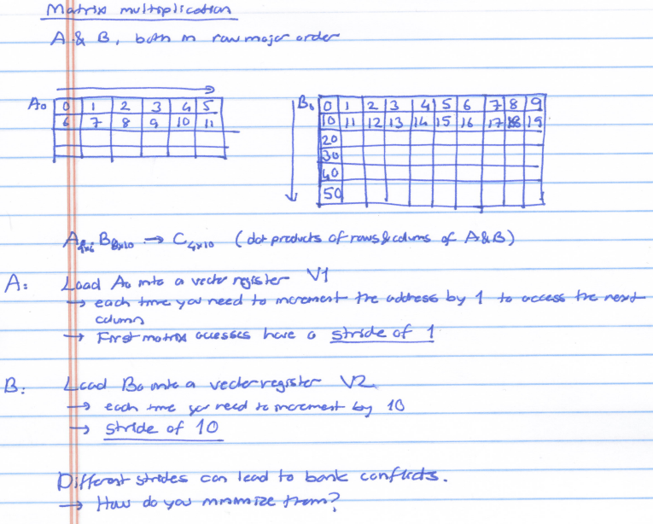

Slide 37
Array vs. Vector Processors, Revisited
Array vs. vector processor distinction is a “purist’s” distinction
Most “modern” SIMD processors are a combination of both
They exploit data parallelism in both time and space

Slide 38
Remember: Array vs. Vector Processors
ARRAY PROCESSOR
VECTOR PROCESSOR
Instruction Stream
Same op @ same time
LD VR ← A[3:0]
ADD VR ← VR, 1
MUL VR ← VR, 2
ST A[3:0] ← VR
Different ops @ time
LD0
LD1
LD2
LD3
LD0
AD0
AD1
AD2
AD3
LD1
AD0
MU0
MU1
MU2
MU3
LD2
AD1
MU0
ST0
ST1
ST2
ST3
LD3
AD2
MU1
ST0
Different ops @ same space
AD3
MU2
ST1
MU3
ST2
Time
Same op @ space
ST3
Space
Space

Slide 39
Vector Instruction Execution
ADDV C,A,B
Execution using one pipelined functional unit
Execution using four pipelined functional units
A[6]
B[6]
A[24]
B[24]
A[25]
B[25]
A[26]
B[26]
A[27]
B[27]
A[5]
B[5]
A[20]
B[20]
A[21]
B[21]
A[22]
B[22]
A[23]
B[23]
A[4]
B[4]
A[16]
B[16]
A[17]
B[17]
A[18]
B[18]
A[19]
B[19]
A[3]
B[3]
A[12]
B[12]
A[13]
B[13]
A[14]
B[14]
A[15]
B[15]
C[2]
C[8]
C[9]
C[10]
C[11]
C[1]
C[4]
C[5]
C[6]
C[7]
C[0]
C[0]
C[1]
C[2]
C[3]
Slide credit: Krste Asanovic

Slide 40
Vector Unit Structure
Functional Unit
Vector
Registers
Elements 0, 4, 8, …
Elements 1, 5, 9, …
Elements 2, 6, 10, …
Elements 3, 7, 11, …
Lane
Memory Subsystem
Slide credit: Krste Asanovic

Slide 41
Vector Instruction Level Parallelism
Can overlap execution of multiple vector instructions
example machine has 32 elements per vector register and 8 lanes
Complete 24 operations/cycle while issuing 1 short instruction/cycle
Load Unit
Multiply Unit
Add Unit
load
mul
add
time
load
mul
add
Instruction issue
Slide credit: Krste Asanovic

Slide 42
Automatic Code Vectorization
for (i=0; i < N; i++)
C[i] = A[i] + B[i];
Scalar Sequential Code
Vectorized Code
load
load
load
Iter. 1
load
load
load
Time
add
add
add
store
store
store
load
Iter. 1
Iter. 2
Iter. 2
load
Vector Instruction
add
Vectorization is a compile-time reordering of operation sequencing
⇒ requires extensive loop dependence analysis
store
Slide credit: Krste Asanovic

Slide 43
Vector/SIMD Processing Summary
Vector/SIMD machines are good at exploiting regular data-level parallelism
Same operation performed on many data elements
Improve performance, simplify design (no intra-vector dependencies)
Performance improvement limited by vectorizability of code
Scalar operations limit vector machine performance
Amdahl’s Law
CRAY-1 was the fastest SCALAR machine at its time!
Many existing ISAs include (vector-like) SIMD operations
Intel MMX/SSEn/AVX, PowerPC AltiVec, ARM Advanced SIMD

Slide 44
SIMD Operations in Modern ISAs

Slide 45
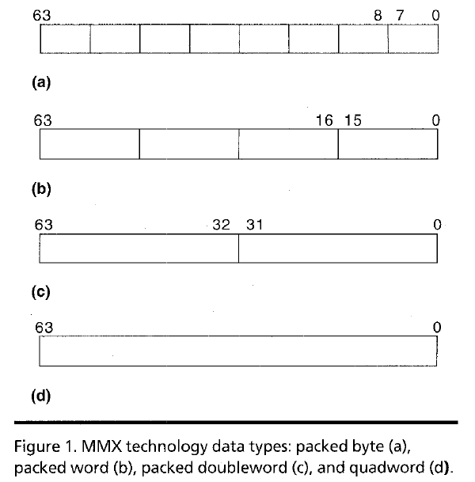
Intel Pentium MMX Operations
Idea: One instruction operates on multiple data elements simultaneously
Ala array processing (yet much more limited)
Designed with multimedia (graphics) operations in mind
No VLEN register
Opcode determines data type:
8 8-bit bytes
4 16-bit words
2 32-bit doublewords
1 64-bit quadword
Stride always equal to 1.
Peleg and Weiser, “MMX Technology
Extension to the Intel Architecture,”
IEEE Micro, 1996.

Slide 46
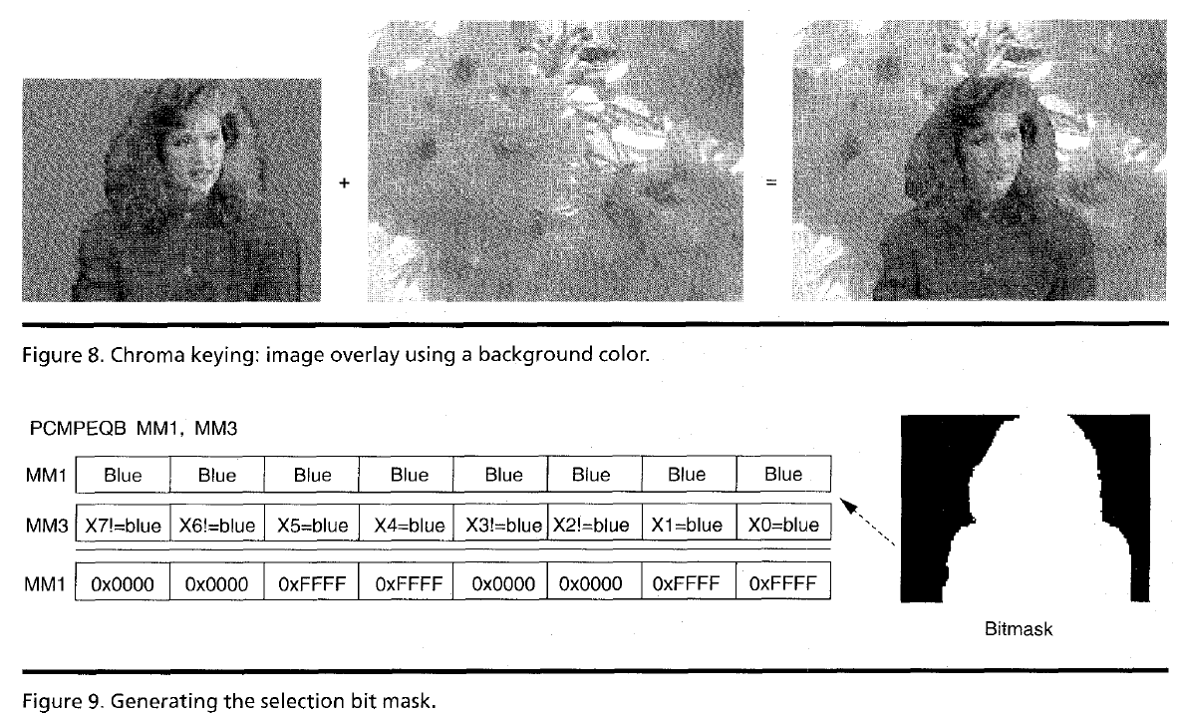
MMX Example: Image Overlaying (I)

Slide 47
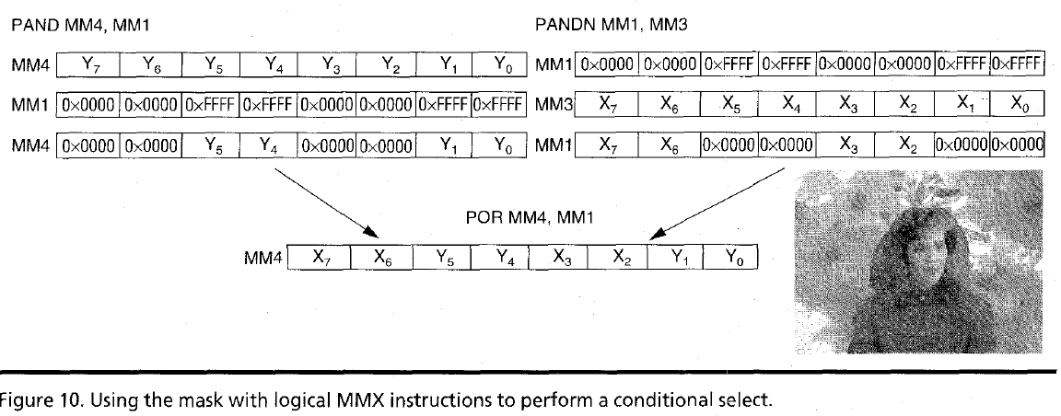
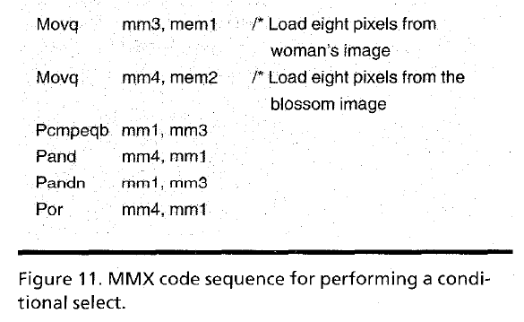
MMX Example: Image Overlaying (II)

