Slide 1
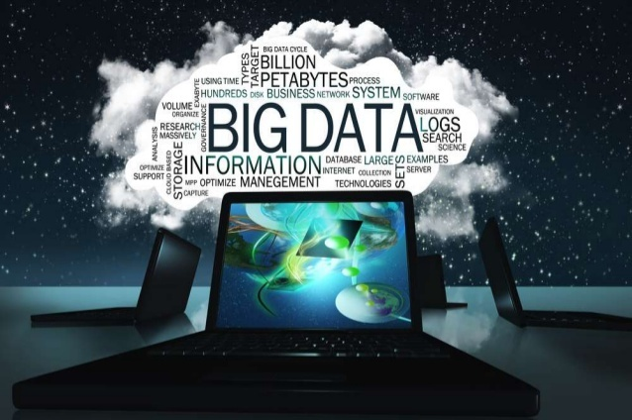
Tyson Condie

Slide 2

Data is Everywhere
Easier and cheaper than ever to collect
Data grows faster than Moore’s law
(IDC report*)
Notes:
Thanks to Hadoop, today it is easier and cheaper than ever to collect data.
The data we collect is not only massive but it is projected to grow exponentially. According to an IDC report that data we produce is expected to grow faster than the Moore’s law.

Slide 3
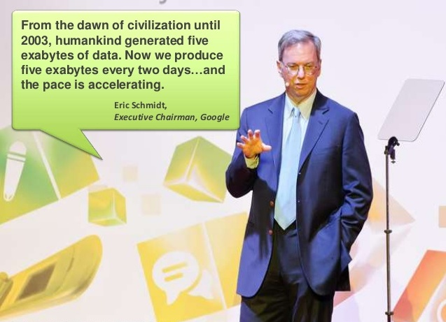

Slide 4

The New Gold Rush
Everyone wants to extract value from data
Big companies & startups alike
Huge potential
Already demonstrated by Google, Facebook, …
But, untapped by most organizations
“We have lots of data but no one is looking at it!”
Notes:
Everyone collects data with one goal in mind: extract value from it.
However, there is a big gap between this aspirational goal and reality.
On one hand, companies like Google, Facebook, and others have demonstrated that there can be huge value in the data.
On the other hand, most companies do little with their data, if anything, or at least not as much as they would like.

Slide 5
Extracting Value from Data Hard
Data is massive, unstructured, and dirty
Question are complex
e.g., Predict the future.
Processing, analysis tools still in their “infancy”
Need tools that are
Faster
More sophisticated
Easier to use
Notes:
This is because it is fundamentally hard to extract value from data.
Data is masive, ….

Slide 6
Turning Data into Value
Insights, diagnosis, e.g.,
Why is user engagement dropping?
Why is the system slow?
Detect spam, DDoS attacks
Decisions, e.g.,
What feature to add to a product
Personalized medical treatment
What ads to show
What actors to cast for the “House of Cards”
Data only as useful as the decisions it enables
Notes:
Let be more concrete about what people mean by turning data into value.
First, they use it to generate reports to track and better understand business processes, ransactions
Second, they use it to diagnose and answer questions such as Why the user engagement dropping?, why is the system slow? Or to detect spam, worms, or DDoS attacks
But most importantly they use it to make decisions, such us improving the business process, deciding what features to add to the product, deciding what ad to show, or, once it identifies a spam, to block it.
Thus, the development of the BDAS stack is driven by the believe that “data is as useful as the decisions you can take based on that data”

Slide 7

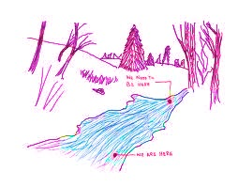

What do We Need?
Interactive queries: enable human in the loop decisions
Big Data Workbench
Explore data in real-time
Streaming queries: enable automated real-time decisions
E.g., fraud detection, detect DDoS attacks
Sophisticated data processing: enable “better” decisions
E.g., anomaly detection, trend analysis
Notes:
So what does this mean?
Well, this means that we want low response-time on historical data since the faster we can make a decision the better.
We want the ability to perform queries on live data since decisions on real-time data are better than on stale data.
Finally, we want to perform sophisticated processing on massive data as, in principle, processing more data will lead to better decisions.

Slide 8







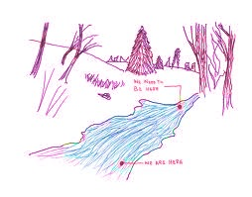
The Need For Unification
Today’s state-of-art analytics stack
Interactive
queries
Interactive queries
on historical data
Data
(e.g., logs)
Ad-Hoc queries
on historical data
Batch
Real-Time
Analytics
Streaming
Challenge 1: need to maintain three stacks
Expensive and complex
Hard to compute consistent metrics across stacks

Slide 9
The Need For Unification
Today’s state-of-art analytics stack
Interactive
queries
Interactive queries
on historical data
Data
(e.g., logs)
Ad-Hoc queries
on historical data
Batch
Real-Time
Analytics
Streaming
Challenge 2: hard/slow to share data, e.g.,
Hard to perform interactive queries on streamed data

Slide 10
Our Goal: Unified Big Data runtime
Batch
Single
Framework!
Interactive
Streaming
Support batch, streaming, and interactive computations…
… in a unified framework
Easy to develop sophisticated algorithms (e.g., graph, ML algos)

Slide 11
Resource Managers: Cloud Operating System
Manage machine cluster (cloud) resources
Tenants coordinate with the RM to allocate resources for running tasks
E.g., a MapReduce job would execute its map/reduce tasks
A few alternative designs
Apache YARN: also known as Hadoop version 2
Apache Mesos
Google Omega
Facebook Corona
Goal: broaden the scope of Big Data applications

Slide 12
The Challenge
Batch
(MapReduce)
Streaming
(Storm)
Interactive
Machine
Learning
!?!?!?!
YARN / HDFS

Slide 13
The Challenge
Batch
(MapReduce)
Streaming
(Storm)
Interactive
Machine
Learning
Fault Tolerance
High-throughput networking
YARN / HDFS

Slide 14
The Challenge
Batch
(MapReduce)
Streaming
(Storm)
Interactive
Machine
Learning
Load spikes
Elastic resource needs
YARN / HDFS

Slide 15
The Challenge
Batch
(MapReduce)
Streaming
(Storm)
Interactive
Machine
Learning
User friendly Toolkits
Low Latency Networking
YARN / HDFS

Slide 16
The Challenge
Batch
(MapReduce)
Streaming
(Storm)
Interactive
Machine
Learning
Complex functions/data
Iterative Dataflow
YARN / HDFS

Slide 17
REEF: Retainable Evaluator Execution Framework
Batch
(MapReduce)
Streaming
(Storm)
Interactive
Machine
Learning
REEF
YARN / HDFS

Slide 18
Unified Big Data Runtime Stack
Batch
(MapReduce)
Streaming
(Storm)
Interactive
Machine
Learning
Domain Specific Language (DSL)
Physical Data Parallel Operators
REEF
YARN / HDFS

Slide 19
REEF: http://reef-project.org Centralized control plane for building a distributed data plane
Control Plane
Data Plane
Storage
Big Buffer Manager
Operator Access Methods
Network
Message passing (sending statistics)
Bulk Transfers (large-scale shuffle)
State Management
Checkpoints
Data lineage
Job Driver
User code executed on YARN’s Application Master (control plane)
Task
User code executed within an Evaluator (data plane)
Evaluator
Execution Environment for Tasks. One Evaluator is bound to one YARN Container

Slide 20
Summary
Everyone collects but few extract value from data
Unification of comp. and prog. models to
Efficiently analyze data
Make sophisticated, real-time decisions
REEF provides OS functionalities
Used to develop higher-level Big Data applications
Long term goal is to…
Unify batch, interactive, streaming computation models
Provide domain specific toolkits to data scientists
Batch
REEF
Interactive
Streaming

Slide 21
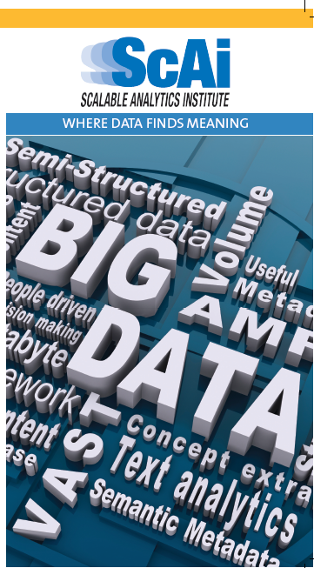


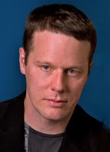
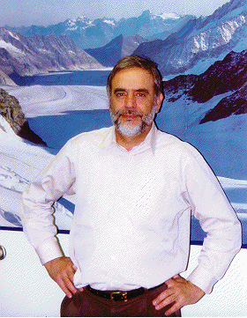
Scalable Analytics Institute
http://scai.cs.ucla.edu

Slide 22
ScAI Projects
Big Data systems
Graph based analytics
Language design for Big Data and data streams
Mining high dimensional data
User and quality modeling in Big Data

