Slide 1


SWIMs: From Structured Summaries to Integrated Knowledge Base
ScAi Lab, CSD, UCLA
May 2014

Slide 2
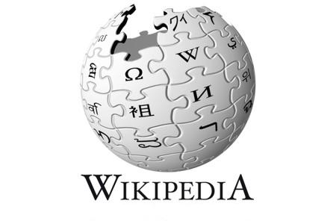








Immense Knowledge From Web
Wikipedia:
280 + languages
20M + articles
1B+ edits
DBpedia:
110 + languages
2B+ facts
4M+ subjects (en)
…
…

Slide 3
Semantic Applications explored at UCLA
Semantic Search
By-Example Query supported by SWiPE
Multilingual Knowledge Base
Knowledge Maintenance
Essay Grading
Text Summarization
Reviewing summarization in systems such as Yelp and Amazon

Slide 4
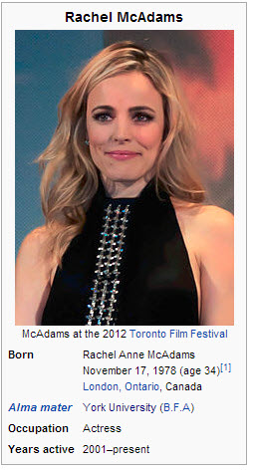

But there are several challenges
Various sources of knowledge
inconsistency in format/content, inaccurate
DBpedia Facts
Rachel Anne McAdams (born November 17, 1978) is a Canadian actress. … … She was hailed by the media as Hollywood's new "it girl"and received a BAFTA nomination for Best Rising Star … …
Wikipedia Text
Wikipedia InfoBox

Slide 5
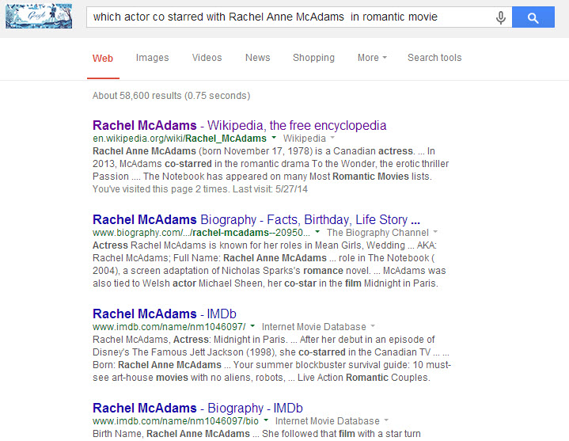
Not easy to search
Keyword search
easy
inaccurate
SPARQL
hard for user
need knowledge of terminology

Slide 6
Main Challenges
A lot of knowledge are available in the web, but not usable!
Current knowledge bases suffer from:
Limit Coverage
Inconsistency in terminology
Hard to maintain
Expensive search

Slide 7
SWIMs: Large Scale Knowledge Integration
Semantic Web Information Management system
Collaborative Project in UCLA ScAi Lab
Our objective: a better knowledge base by performing the following tasks
A. Integrate existing knowledge bases,
B. Resolve inconsistencies,
C. Provide user friendly interface for knowledge browsing and editing,
D. Support query-by-example search over our KB

Slide 8



Integrate Existing Knowledge Bases
Collecting public KBs, unifying knowledge representation format, and integrating KBs into the IKBstore
represented in RDF format <Subject, Attribute, Value>
IKBStore
NELL

Slide 9
Knowledge Alignment
Align Subject: (i) DBpedia interlinks; (ii) links in Wikipedia (e.g. redirect and sameAs); (iii) synonyms from WordNet and OntoMiner.
Align Attribute: employing CS³ (Context Aware Synonym Suggestion System) to discover attribute synonyms
DBpedia: Rachel, birthdate, 1978-11-17
Wikipedia: Rachel, born, 1978-11-17
Combine
Rachel, birthdate (born), 1978-11-17
Attribute Synonym from CS³ : birthdate <==> born
Align Category: (i) name matching (ii) category similarity based on the number of shared subjects

Slide 10
Initial Integrated Knowledge Base
KB Name | No. of Subjects (10⁶) | No. of InfoBoxes(10⁶)
DBPedia | 2.5 | 63.82
Yago2 | 4.14 | 23.21
MusicBrainz | 0.69 | 1.71
NELL | 0.35 | 0.4
GeoNames | 5.31 | 29.2
WikiData | 1.44 | 2.54
IKBStore | 9.18 | 105.4
*To improve the performance of online browsing (IBKB), we skip some rarely used facts in domain specific KBs (e.g. MusicBrainz).

Slide 11
Further Integration: Learn From Text
To convert textual documents to knowledge, we employ our newly proposed text mining system IBMiner which can generate structured summaries from free text.
Attribute
Mapping
NLP
Rachel is a Canadian actress.
Rachel, is, actress
Rachel, is, Canadian
Rachel, occupation, actress
Rachel, nationality, Canadian
Free Text
Semantic Links
Infobox Triples
Integrated to IKBStore

Slide 12
Knowledge Browsing and Revising
IBminer and other tools are automatic and scalable—even when NLP is required. But human intervention is still required to validate and/or improve the results obtained in terms of Correctness, Significance, and Relevance.
Tools for knowledge browsing and revising (VLDB’13):
InfoBox Knowledge-Base Browser (IBKB)
InfoBox Editor (IBE).

Slide 13
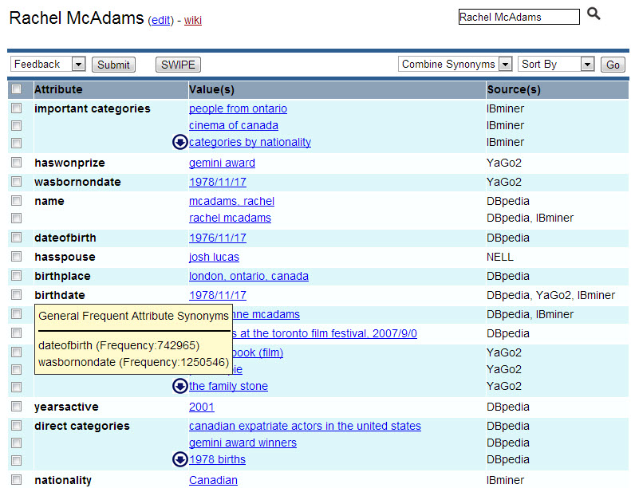
InfoBox Knowledge-Base Browser
Feedback
Ranking
Search
Provenance
Synonyms

Slide 14
InfoBox Editor
Similar UI with IBKB
IBE allows users to add more textual information and extract InfoBoxes from input text by using IBMiner.
IBE also suggests candidate category and attribute names for generated InfoBoxes, which will make the knowledge editing much easier.
With the help of IBE, the generated summaries will follow a standard terminology.

Slide 15

Provenance of Knowledge
We annotate each piece of knowledge with provenance IDs and propagate the annotations during semantic integration.
Triple | Prov
Rachel, born, 1978 | p1
Rachel, born, 1978 | p2
Rachel, gender, female | p3
remove duplicates
Triple’ | Prov
Rachel, born, 1978 | p1 + p2
Rachel, gender, female | p3
$$π_{Triple}$$
p1,p2,p3: provenance id
p1 + p2: provenance polynomial, encodes how the result is generated
(We use + to represent projection, · to represent join)

Slide 16
Provenance of Knowledge
We can use provenance polynomial to compute any type of provenance by
replacing provenance id with different annotations
replacing +, · with different operators
Provenance | p1 | p2 | +
Lineage | {DBpedia} | {Yago2} | U (Union)
Reliability | 0.8 | 0.6 | max
Thus, for triple <Rachel, born, 1978> with provenance polynomial (p1 + p2), we can compute its provenance as follows:
Lineage: {DBpedia} U {Yago2} = {DBpedia, Yago2}
Reliability: max(0.8, 0.6) = 0.8

Slide 17
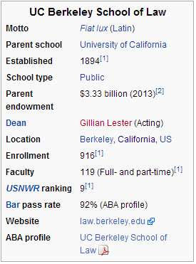
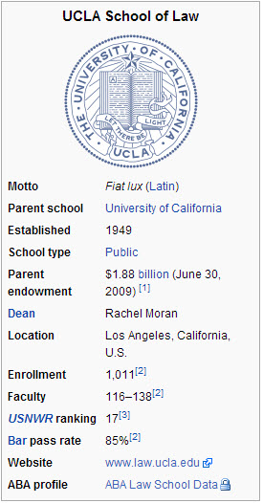
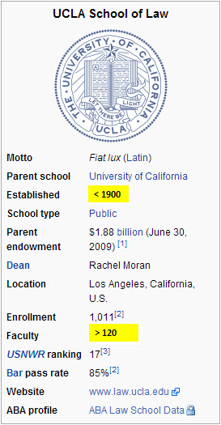
Semantic Search
A law school with more than 120 faculty members and established before 1900?

Slide 18

Semantic Search
The power of the knowledge base via SPARQL engines is only available to those who can write SPARQL queries.
Solution: Query-By-Example
Exploits the InfoBoxes as input query from the very InfoBox of a representative page.
Cities in CA with > 10000 population?
Los Angeles
State: CA
Population:
3,904,657
Time Zone:
PST
Los Angeles
State: CA
Population:
> 10000
Time Zone:
PST
Anaheim
Bakersfield
Berkeley
San Diego
San Francisco
San Jose
… …

Slide 19
Multilingual Semantic Search
WikiData: a free collaborative knowledge base to link multilingual wikipages and unify their InfoBoxes.
Unfortunately, it is very difficult for users to query these rich multilingual databases since this will require the knowledge of SPARQL and internal WikiData name for attributes.
Solution: Combine SWiPE with WikiData
Cities in Sardinia with > 10000 population?
Rome
Region: Lazio
Population:
2,645,907
TimeZone:
CET
Rome
Region: Sardinia
Population:
> 10000
Time Zone:
CET
Roma
Regione: Sardegna
popolazione :
> 10000
Fuso Orario:
CET
WikiData

Slide 20
Domain-Specific KB Management
Help expert users in advanced applications focused on more specific domains.
For instance, consider a medical center where information is usually available in many different formats: plain text, forms, images, tables, structured information.
Challenge: complexity and heterogeneity of data
What we can do:
IBMiner: extract structured information from free text
OnMiner: identify important terms in free text
IKBStore: enrich medical knowledge base
SWiPE: support precise structured search over medical data

Slide 21
Conclusion
We propose SWIMs, an integrated set of systems and tools, to merge existing knowledge bases into a more complete and consistent knowledge base.
Ongoing work:
IBMiner for Large Text Corpora
By-Example Structured Query (BEStQ)
Multilingual Extension based on WikiData

Slide 22
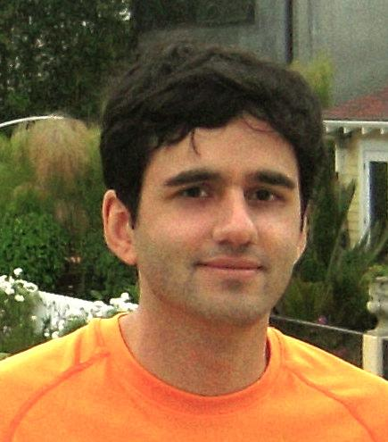
More Details about IBMiner and Text Mining Techniques
Harvesting Wikipedia and Large Text Corpora

