Slide 1

Scalable Approximate Query Processing through Scalable Error Estimation
Kai Zeng
UCLA
Advisor: Carlo Zaniolo
Notes:
Hello everyone, today I am gonna talk about a project I am currently working on.
The title is analytical bootstrap method for fast error estimation in approximate ….

Slide 2
Why Approximate Query Processing?
AQP is critical for massive data
Ever-growing size of big data
Need for timely and cost-effective analysis
Widely applied
RDBMSs (e.g., online aggregation)
MapReduce systems (e.g., BlinkDB)
Data stream systems (load shedding)
Notes:
disciplines, ranging from business to science, are generating bigger and bigger data
At the same time, the need for timely and cost-effective analysis is also growing.
AQP can return fast analysis on massive data, thus it is a critical tech to cope with massive data
Actually AQP is already widely applied across many different platforms,
For example, in RDBMS, research on online aggregation has started more than 20 years ago
Recently, there are Mapreduce systems specifically designed for AQP, such as BlinkDB
And also in data stream systems, where aka
Ever-growing size of big data: data size exceeds system resource limit
Need for timely and cost-effective analysis: Time (money) / accuracy trade-off
Database as a service - some cloud platforms offer options for using a database as a service, without physically launching a virtual machine instance for the database. In this configuration, application owners do not have to install and maintain the database on their own. Instead, the database service provider takes responsibility for installing and maintaining the database, and application owners pay according to their usage.
For example, Amazon Web Services provides three database services as part of its cloud offering, SimpleDB, a NoSQL key-value store,Amazon Relational Database Service, an SQL-based database service with a MySQL interface, and DynamoDB.
Blinkdb has 2 scenarios:
Given time return results with error bars
direcly applicable
Given error bars select a size to run
requires prediction. One of our future work.
Two possible approaches:
Treat total size n as variable, compute the error as a function of size n. May be not very accurate
Extrapolation. Try several size, and extrapolate

Slide 3
Sampling & Quality assessment
Sampling: widely-used in AQP
Error estimation: fundamental in AQP
Analytic error estimation
Bootstrap
Need to assess the quality!
What is the error of this approx. mean?
Approx.
Mean
Sample
sample
AVG
Massive
Data
(6, 2, 7, 8, 5, 1, 3, 4, 9, 10)
5.5

Slide 4
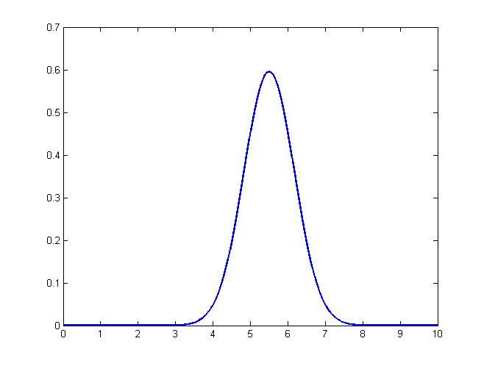
Analytic Error Estimation
Use closed-form formulas
Pro: very fast
Con: restricted to simple aggregates
Approx.
Mean
Sample
What if I want to estimate?
Complex SQL queries
Data mining tasks
….
sample
query: AVG
Massive
Data
(1, 2, 3, 4, 5, 6, 7, 8, 9, 10)
5.5
collect
Central Limit Theorem
# of tuples, Variance
Notes:
The basic idea of analytic error estimation is to derive closed-form formulas for error bounds

Slide 5
Bootstrap [Efron 1979]
Resample with replacement from the sample
Run the query on the resample
Repeat many times, typically 100s or even 1000s of times
Sample
Mean
query: AVG
(6, 2, 7, 8, 5, 1, 3, 4, 9, 10)
5.5
Same Size
resample
(9, 10, 2, 10, 7, 1, 3, 6, 10, 10)
(9, 10, 2, 10, 7, 1, 3, 6, 10, 10)
(9, 10, 2, 10, 7, 1, 3, 6, 10, 10)
(9, 10, 2, 10, 7, 1, 3, 6, 10, 10)
(9, 10, 2, 10, 7, 1, 3, 6, 10, 10)
6.8
collect
(2, 10, 10, 5, 9, 2, 5, 10, 8, 10)
7.1
(8, 1, 2, 1, 1, 9, 7, 4, 10, 1)
4.5
……
……

Slide 6
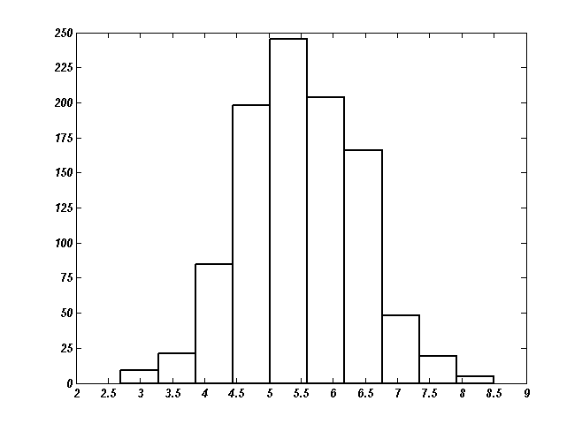
Compute the error from the empirical distribution of all the query results
95%

Slide 7
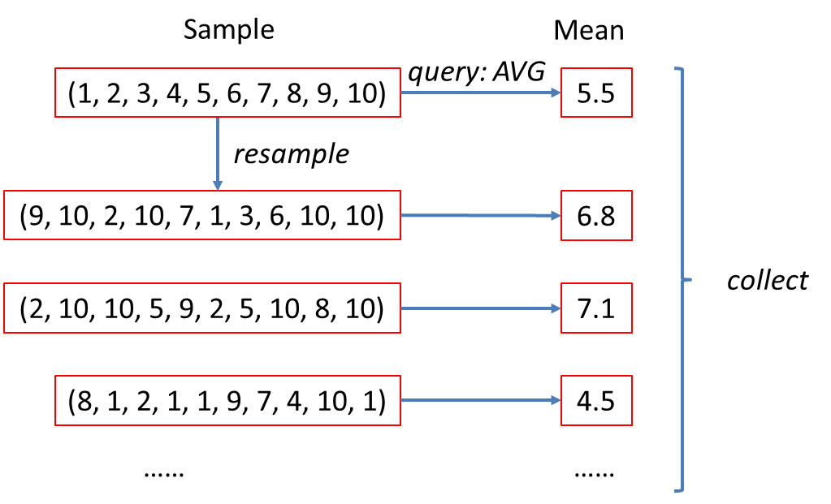
Notes on Bootstrap
Bootstrap treats Q as a black-box
Can handle (almost) arbitrarily complex queries including UDFs!
Embarrassingly Parallel
Computational demanding
Use too much resources

Slide 8
Error Estimation
Analytic error estimation
Fast but limited to simple aggregates
Bootstrap (Monte Carlo simulation):
Expensive but general
Fast and General?
Notes:
basic idea of ABM is to annotate a tuple in the database with an integer-valued random variable that represents the possi- ble multiplicity with which this tuple would appear in the simu- lated datasets generated by bootstrap. The small annotated database so obtained from the initial sample is called probabilistic multiset database (PMDB for short). Thus, PMDB succinctly models all

Slide 9
How To Make Bootstrap Faster
Optimize the Monte-Carlo simulation process
EARL system [VLDB12][ICDE13]
Bypass the Monte-Carlo simulation process
Analytical Bootstrap method (ABM) [SIGMOD14]
Notes:
All these previous approaches can only alleviate but cannot totally avoid the simulation cost,
Therefore, we want to try a totally new direction, which is bypassing…
And this is currently what I’m working on, and I will focus on this in the remaining part of the talk

Slide 10
Early Accurate Result Library (EARL project)

Slide 11
Motivation
Existing systems (e.g. Hadoop) use batch processing
High latency
Waste of resources
Goals: a general driver that can
Return approximate results
With accuracy guarantee
For a wide range of tasks

Slide 12
Incremental Computation
A small sample → a larger sample → ……
Use Bootstrap to test accuracy
Time efficient: Enable early returns
Resource efficient: Do not waste resources
sample
Sample
enlarge
Sample
enlarge
Sample
Massive
Data
bootstrap
bootstrap
Accurate enough?
……
Accurate enough?

Slide 13







Basic Ideas: Optimization
Intra-iteration optimization
We have to repeat the same computation on all resamples
Many data are shared!
Compute the shared part once
Iteration $i$
$$f$$
Shared
$$S$$
$$f$$
Non-shared
$$S_{1}$$
$$f$$
$$S_{2}$$
……

Slide 14











Basic Ideas: Optimization
Inter-iteration optimization
Reuse the old computation
Cannot simply merge for randomness
Keep a small sample in memory for adjustment
Iteration $i$
Iteration $i+1$
$$S$$
$$S$$
$$∆S$$
$$S_{1}$$
$$S_{1}^{′}$$
Adjustment is small
$$S_{1}$$
$$ΔS_{1}$$
$$S_{2}$$
$$S_{2}^{′}$$
……
……

Slide 15
Analytical Bootstrap

Slide 16
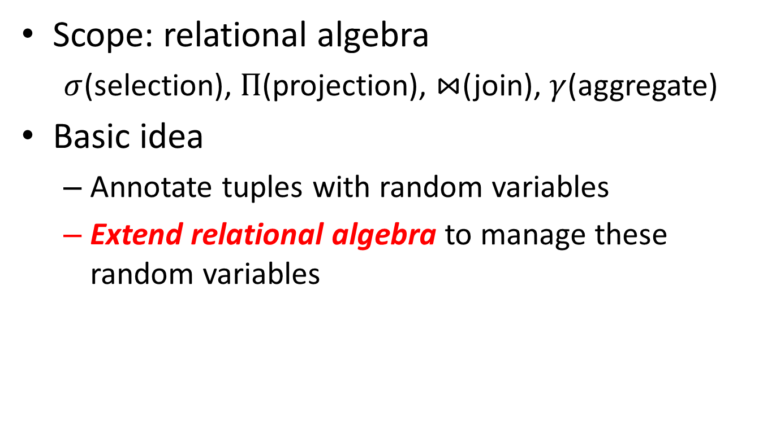
Analytical Bootstrap
Scope: relational algebra
$σ$(selection), $Π$(projection), $⋈$(join), $γ$(aggregate)
Basic idea
Annotate tuples with random variables
Extend relational algebra to manage these random variables
# of times a tuple will be drawn in a bootstrap trial
A single-round evaluation = 100s/1000s of bootstrap trials!
Notes:
In This analytical bootstrap research we want to take an operator approach,
So as a first step, we focus on relational algebras, in particular, we focus on conju….
a single-round query evaluation will accurately estimate the empirical distribution of all query results given by 100s/1000s of bootstrap trials
We want to remain almost as general as bootstrap, but achieve much better time performance
The advantages are obvious

Slide 17
Bootstrap Resamples As Multiset DB
Bootstrap generates multiset relations
Tuples annotated with multiplicities
Query processing manipulate these multiplicities
sample
ID | Product | Qty
1 | A | 2
2 | B | 3
2 | B | 3
4 | A | 4
ID | Product | Qty
1 | A | 2
2 | B | 3
3 | A | 2
4 | A | 4
ID | Product | Qty
1 | A | 2
2 | B | 3
4 | A | 4
4 | A | 4
resample
ID | Product | Qty
1 | A | 2
3 | A | 2
3 | A | 2
4 | A | 4
ID | Product | Qty | #
1 | A | 2 | 1
2 | B | 3 | 0
3 | A | 2 | 2
4 | A | 4 | 1
……
Notes:
Next I will explain the intuitions behind our anlytical model
Recall that bootstrap uses resampling to generate many multiset relations,
To explain this, let’s go through this small example,
Thus, we can see that “tuples are annotated …”

Slide 18
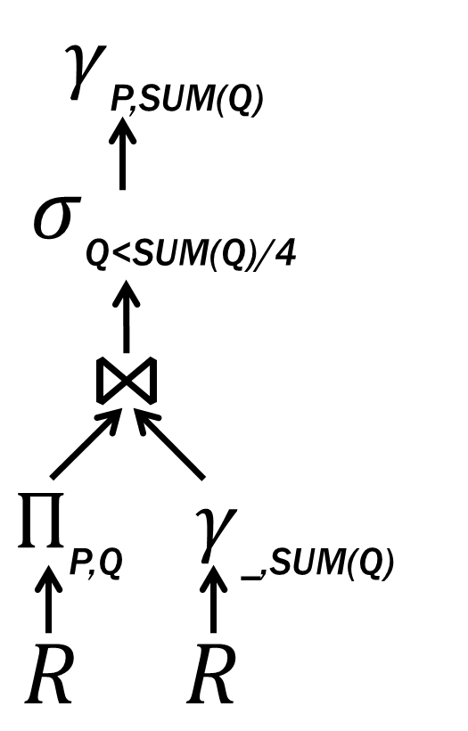

Querying Multiset DB: Projection
Projection takes sum of multiplicities
How many products are ordered by small quantity orders?
SELECT Product, SUM(Qty)
FROM Orders
WHERE Qty < (SELECT SUM(Qty) / 4
FROM Orders)
GROUP BY Product
ID | Product | Qty | #
1 | A | 2 | 1
2 | B | 3 | 0
3 | A | 2 | 2
4 | A | 4 | 1
Product | Qty | #
A | 2 | 3
B | 3 | 0
A | 4 | 1
$$1+2=3$$
Notes:
Let’s go through the query plan operator by operator
This is the original table, on the right is the table after projection,
We can see that besides the change of the tuples, the multiplicities also changed
And the change is very straightforward, we simply add the multiplicities of corresponding tuples
We still keep the second tuple although its multiplicity is 0. acutally it’s not necessary,
But for explanation reason, I keep it here

Slide 19
Querying Multiset DB: Aggregate
Aggregate takes weighted sum of multiplicities
ID | Product | Qty | #
1 | A | 2 | 1
2 | B | 3 | 0
3 | A | 2 | 2
4 | A | 4 | 1
SUM(Qty) | #
10 | 1
$$2×1+3×0+2×2+4×1=10$$
Notes:
[briefly], aggregate is very similar to projection, actually it just adds some extra computation during projection
Here we simply take a weighted sum of the qty column, where the weight is the multiplicity

Slide 20

Querying Multiset DB: Join
Join takes product of multiplicities
Product | Qty | #
A | 2 | 3
B | 3 | 0
A | 4 | 1
Product | Qty | SUM(Qty) | #
A | 2 | 10 | 3
B | 3 | 10 | 0
A | 4 | 10 | 1
SUM(Qty) | #
10 | 1
$$3×1=3$$

Slide 21


Querying Multiset DB: Selection
Selection takes product of multiplicities
Product | Qty | SUM(Qty) | #
A | 2 | 10 | 3
B | 3 | 10 | 0
A | 4 | 10 | 1
Product | Qty | SUM(Qty) | #
A | 2 | 10 | 3
B | 3 | 10 | 0
A | 4 | 10 | 0
$$3×1=3$$
$$1×0=0$$
Notes:
[briefly], similarly, selection also requires multiplication,
But this time we multiply the multiplicities with 1 or 0
Whenever the selection predicate is true, we multiply by 1
……………….

Slide 22

Bootstrap Resamples As Multiset DB
Bootstrap generates multiset relations
Tuples annotated with multiplicities
Query processing manipulate these multiplicities
$Π, γ∼+$, $⋈, σ∼×$
Notes:
Next I will explain the intuitions behind our anlytical model
Recall that bootstrap uses resampling to generate many multiset relations,
To explain this, let’s go through this small example,
Thus, we can see that “tuples are annotated …”

Slide 23



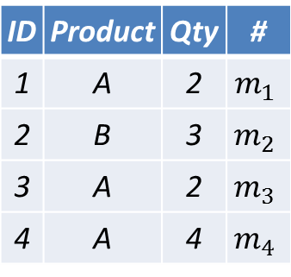

Probabilistic Multiset DB
Multiset DB
Tuples are annotated with $ℕ$
Probabilistic Multiset DB (PMDB)
Random Variables on $ℕ$
ID | Product | Qty | #
1 | A | 2 | 2
2 | B | 3 | 1
3 | A | 2 | 1
4 | A | 4 | 0
ID | Product | Qty | #
1 | A | 2 | 1
2 | B | 3 | 1
3 | A | 2 | 0
4 | A | 4 | 2
ID | Product | Qty | #
1 | A | 2 | 1
2 | B | 3 | 0
3 | A | 2 | 2
4 | A | 4 | 1
ID | Product | Qty | #
1 | A | 2 | $$m_{1}$$
2 | B | 3 | $$m_{2}$$
3 | A | 2 | $$m_{3}$$
4 | A | 4 | $$m_{4}$$
$$\left(m_{1} ,m_{2} ,m_{3} ,m_{4}\right)$$
0.25
$$∼Multinomial\left(4, \left(0.25,0.25,0.25,0.25\right)\right)$$
$$∼Multinomial\left(4, \left(0.25,0.25,0.25,0.25\right)\right)$$
$$∼Multinomial\left(4, \left(0.25,0.25,0.25,0.25\right)\right)$$
0.25
0.25
0.25
Similar to Tossing Coins
Notes:
We have seen that each bootstrap resample is a multiset relation, and different bootstrap trials could generate many different multiset relations.
Therefore, to model all the bootstrap resamples, instead of a multiset db, we use a probabilistic multiset db to model

Slide 24
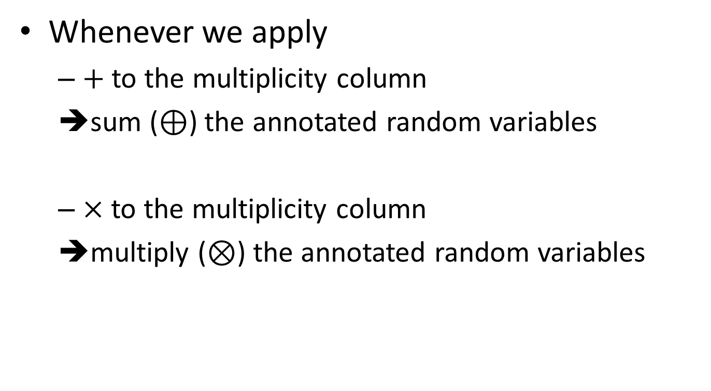
Querying PMDB
Whenever we apply
$+$ to the multiplicity column
➔sum ($⊕$) the annotated random variables
$×$ to the multiplicity column
➔multiply ($⊗$) the annotated random variables

Slide 25
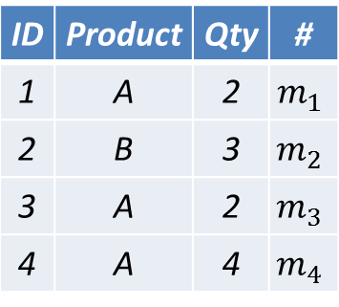
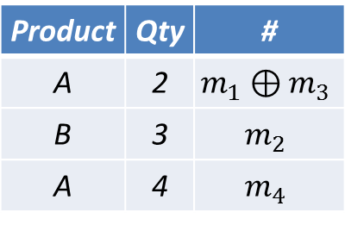
Querying PMDB: Projection
Projection takes convolution sum of multiplicities
ID | Product | Qty | #
1 | A | 2 | $$m_{1}$$
2 | B | 3 | $$m_{2}$$
3 | A | 2 | $$m_{3}$$
4 | A | 4 | $$m_{4}$$
Product | Qty | #
A | 2 | $$m_{1}⊕m_{3}$$
B | 3 | $$m_{2}$$
A | 4 | $$m_{4}$$
Notes:
Let’s go over the previous example query again to show how we do query evaluation in analytical bootstrap
Remember to first explain the annotation

Slide 26

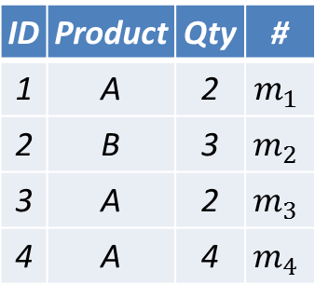
From Theory To Practice
Annotated random variables
Marginal distribution
Numeric Form!
ID | Product | Qty | #
1 | A | 2 | $$m_{1}$$
2 | B | 3 | $$m_{2}$$
3 | A | 2 | $$m_{3}$$
4 | A | 4 | $$m_{4}$$
ID | Product | Qty | #
 |  |  | n | 0 | 1
1 | A | 2 | 4 | 0.75 | 0.25
2 | B | 3 | 4 | 0.75 | 0.25
3 | A | 2 | 4 | 0.75 | 0.25
4 | A | 4 | 4 | 0.75 | 0.25
0.25
$$∼Multinomial\left(4, \left(0.25,0.25,0.25,0.25\right)\right)$$
0.25
$$∼Multinomial\left(4, \left(0.25,0.75\right)\right)$$
0.25
0.75
0.25
Notes:
The solution is from a very simple observation.
How these random variables are generated
Here is the previous probabilistic multiset relation shown in a symbolic way.
If we only care about tuple 1 here, then every time we randomly choose a tuple, there are only 2 outcomes,
That is, it’s either we pick tuple 1 or we don’t. the probability that we don’t pick tuple 1 is simply 75%
Thus, tuple 1’s multiplicity m1 follows this multinomial distribution
We can see that we only need 3 numbers, the number of experiments, the probablity of we pick and don’t pick a tuple, to represent this distribution, following this way, we can get this numeric way to represent a PMDB

Slide 27
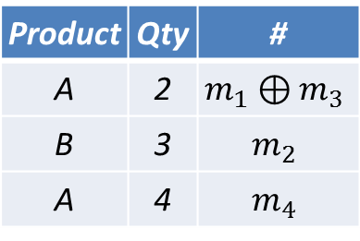
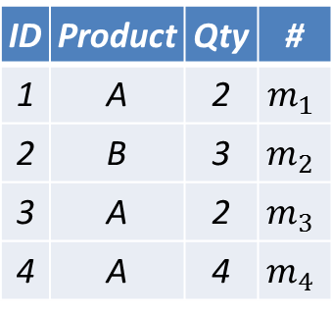

Querying PMDB: an Example
$Π$: $⊕$ works with the numeric forms
ID | Product | Qty | #
 |  |  | n | 0 | 1
1 | A | 2 | 4 | 0.75 | 0.25
2 | B | 3 | 4 | 0.75 | 0.25
3 | A | 2 | 4 | 0.75 | 0.25
4 | A | 4 | 4 | 0.75 | 0.25
Product | Qty | #
 |  | n | 0 | 1
A | 2 | 4 | 0.5 | 0.5
Product | Qty | #
 |  | n | 0 | 1
A | 2 | 4 | 0.5 | 0.5
B | 3 | 4 | 0.75 | 0.25
A | 4 | 4 | 0.75 | 0.25
ID | Product | Qty | #
1 | A | 2 | $$m_{1}$$
2 | B | 3 | $$m_{2}$$
3 | A | 2 | $$m_{3}$$
4 | A | 4 | $$m_{4}$$
Product | Qty | #
A | 2 | $$m_{1}⊕m_{3}$$
B | 3 | $$m_{2}$$
A | 4 | $$m_{4}$$
Notes:
Before answering this question, let’s first
Remember the numeric representation actually models the resampling process

Slide 28
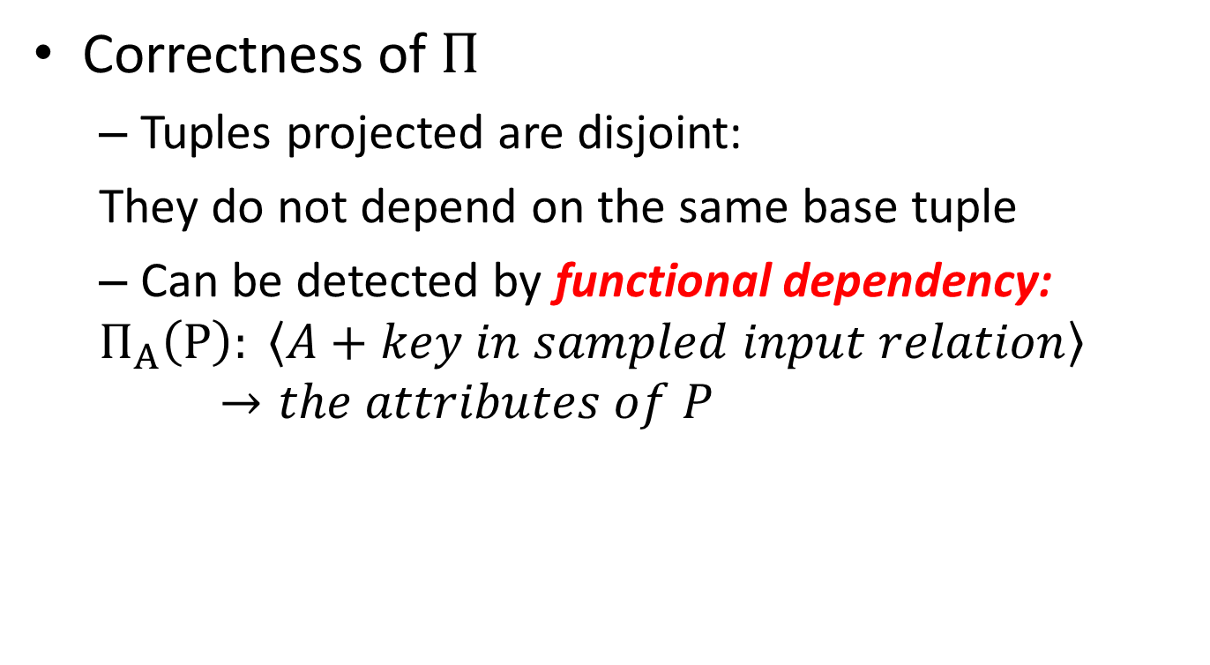
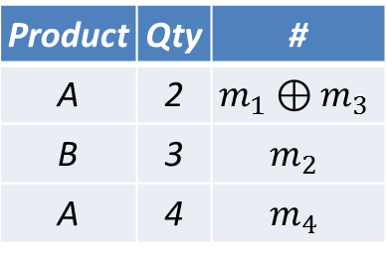

Querying PMDB: an Example
Correctness of $Π$
Tuples projected are disjoint:
They do not depend on the same base tuple
Can be detected by functional dependency:
$$Π_{A}\left(P\right): \left\langle A+key in sampled input relation\right\rangle →the attributes of P$$
ID | Product | Qty | #
1 | A | 2 | $$m_{1}$$
2 | B | 3 | $$m_{2}$$
3 | A | 2 | $$m_{3}$$
4 | A | 4 | $$m_{4}$$
Product | Qty | #
A | 2 | $$m_{1}⊕m_{3}$$
B | 3 | $$m_{2}$$
A | 4 | $$m_{4}$$

Slide 29
Querying PMDB in Numeric Form
ABM is correct for queries with eligible plans
A large subset of queries can be evaluated by ABM in DBPTIME
Eligible plans can be tested at compile time
Functional Dependency Rules
Notes:
In general, for each relational operator, the corresponding convolution operations can operate on the numeric representations
Of those annotated random variables

Slide 30
Coverage of Various Techniques
Analytic error estimation
TPCH (9/22); Conviva Log (36.9 %)
ABM DBPTIME eligible
TPCH (15/22); Conviva Log (81.0 %)
ABM eligible
TPCH (19/22); Conviva Log (98.6 %)
ABM
TPCH (19/22); Conviva Log (99.1 %)
Bootstrap
TPCH (19/22); Conviva Log (99.1 %)
Over 6660 queries

Slide 31
Experimental evaluation

Slide 32
Experimental Setting
Synthetic and real-life datasets and queries:
TPC-H: 100 GB
Skewed-TPC-H: 1 GB
Customer: 52 GB
Compare relative error
Of: mean, standard-deviation, quantile, KS-distance, confidence interval, existence probability
Between: Analytical Bootstrap Method (ABM), bootstrap (BS), ground truth (GT)

Slide 33
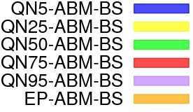
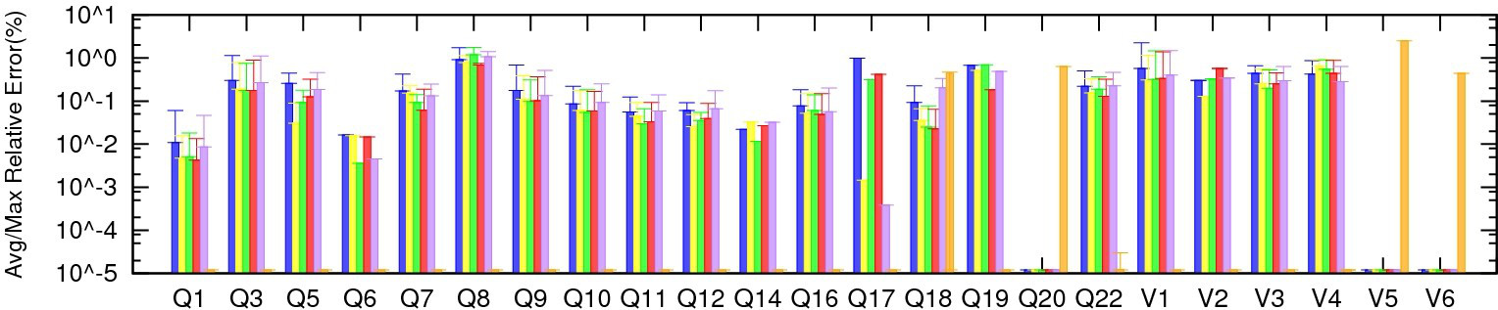
Accuracy of ABM
1%
Comparing the distributions given by ABM & bootstrap on quantiles & existence probability (1% sample)
ABM models Bootstrap accurately

Slide 34
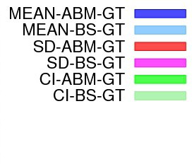
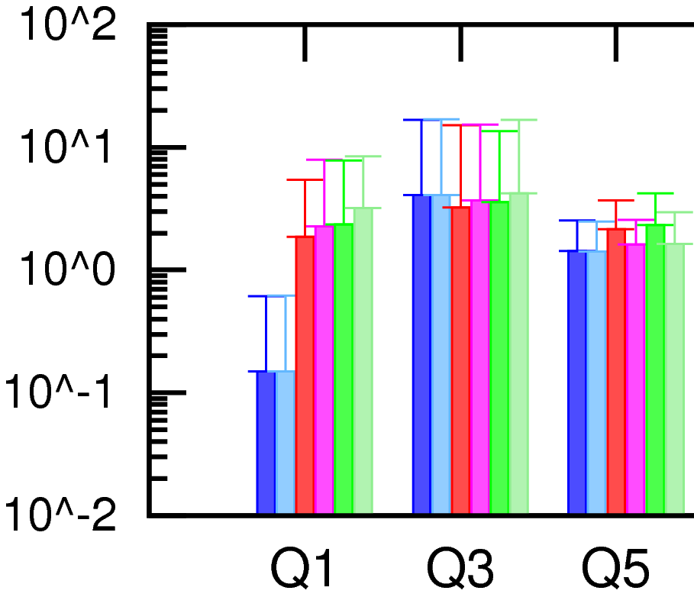
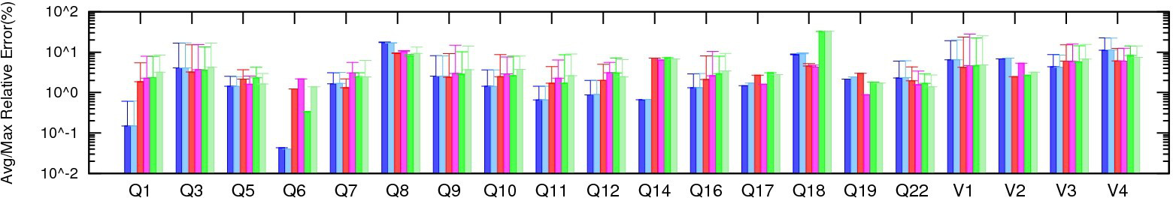

Accuracy of ABM
Comparing user-defined measures given by ABM & bootstrap to ground truth (1% sample)
ABM is consistent with Bootstrap
Notes:
One important message here is that since ABM can accurately model the empirical distriubtions given by bootstrap,
It can accurately predict the bootstrap predication.
Here we can see that ABM performs very consistent with bootstrap.
Whenever bootstrap’s prediction is close to the ground truth, that of ABM is close to the ground truth,
Whenever ……

Slide 35
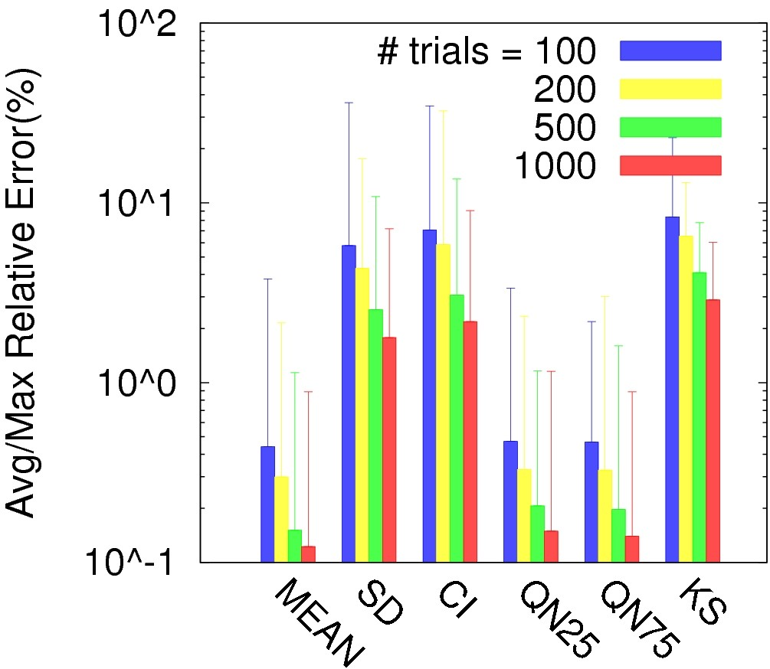
Accuracy of ABM
Bootstrap converges to ABM
Comparing predictions given by ABM & bootstrap
when varying number of bootstrap trials (TPC-H 1%)

Slide 36
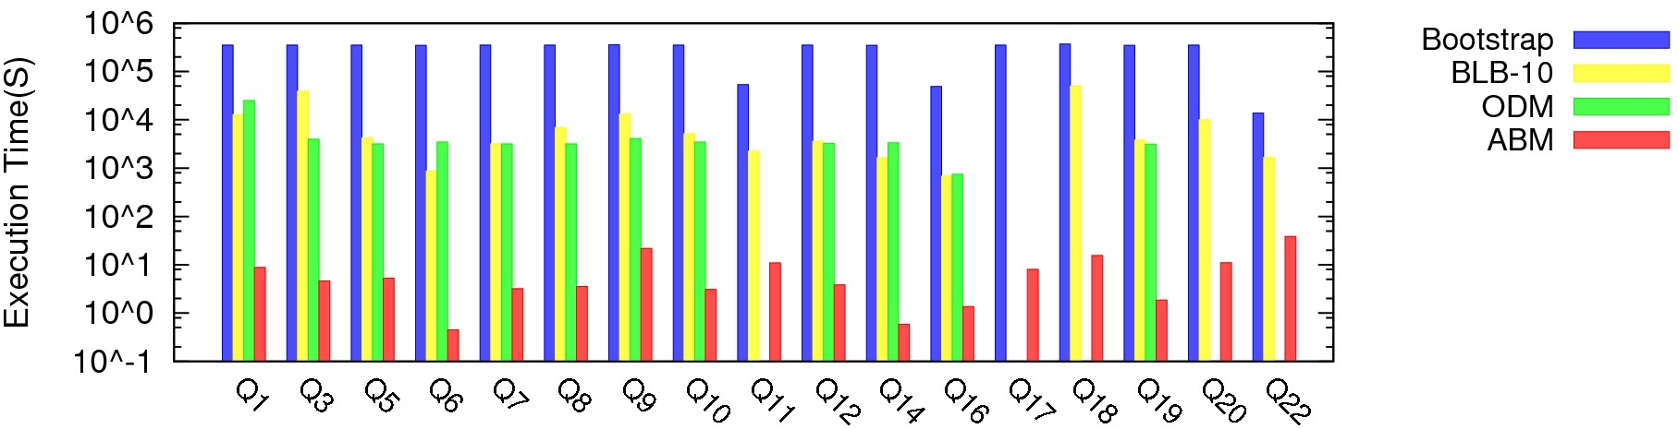
Time Performance of ABM
Comparing time performance of ABM & bootstrap variants (TPC-H 10%)
ABM is 3-4 orders of magnitude faster than sequential/parallel bootstrap variants
Bootstrap: Original bootstrap
BLB-10: Bag of Little Bootstrap using 10 machines
ODM: On-Demand Materialization
Notes:
Two messages:
super faster
Little overhead

Slide 37
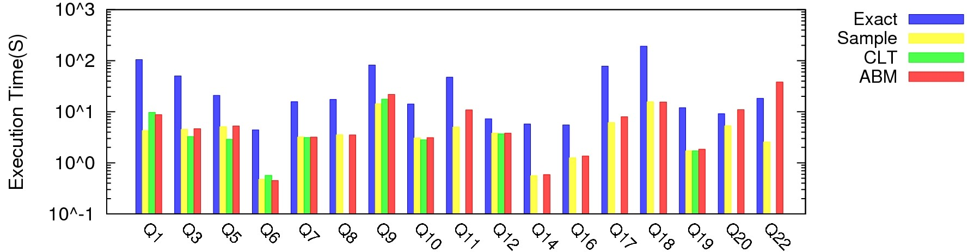
Time Performance of ABM
Comparing time performance of ABM & various techniques (TPC-H 10%)
Exact: Run the query on the original data
Sample: Run the query on the sample
CLT: Analytic error estimation using Central Limit Theorem
ABM introduces little overhead
Notes:
Two messages:
super faster
Little overhead

Slide 38
Conclusion & Future Work
Bootstrap is critical for scalable AQP
ABM provides an analytical model for bootstrap, and achieves significant speed-up
ABM+EARL: a bootstrap-based system that can automatically choose/combine error estimation methods
Integrating ABM into Hive/Shark
Notes:
Post-GRES-Q-L

