Slide 1
Toward a Universal Unsupervised Clustering Method
Giuseppe M. Mazzeo
joint work with Elio Masciari and Carlo Zaniolo

Slide 2
Why a new clustering algorithm?
U²-Clubs offers major advantages over current clustering algorithms
Totally unsupervised
Significantly faster
High quality results
Can be used for
Clustering around centroids
Fast and accurate k-means seeding
Density-based clustering
Noise detection

Slide 3
U²-Clubs
U²-Clubs (Universal Unsupervised Clustering using binary splits) can obtain the high quality of hierarchical clustering algorithms, working in two phases
Divisive: creates a partition of data obtaining a number of clusters typically larger than the number of natural clusters
Agglomerative: merges previously obtained clusters into natural clusters
It works much faster than traditional hierarchical methods by exploiting the analytical properties of SSQ (a.k.a. SSE, SSD, etc.)

Slide 4
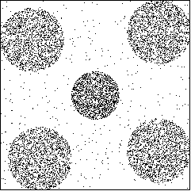

How U²-Clubs works: example
Find the best split, i.e., the split that
yields the maximum SSQ reduction
If marginal distributions are pre-computed, the ΔSSQ of each split can be computed in constant time (O(d))
Complexity of finding the best split is O(n), where n is the number of points in the block

Slide 5
How U²-Clubs works: example
Find the best split, i.e., the split that
yields the maximum SSQ reduction
If marginal distributions are pre-computed, the ΔSSQ of each split can be computed in constant time (O(d))
Complexity of finding the best split is O(n), where n is the number of points in the block

Slide 6
How U²-Clubs works: example
Find the best split, i.e., the split that
yields the maximum SSQ reduction
If marginal distributions are pre-computed, the ΔSSQ of each split can be computed in constant time (O(d))
Complexity of finding the best split is O(n), where n is the number of points in the block

Slide 7
How U²-Clubs works: example
At this point, the divisive phase ends
but
some clusters do not reflect natural clusters: they are merged
during the agglomerative phase

Slide 8
How U²-Clubs works: example
The pair of clusters whose merge minimize the SSQ increment is chosen

Slide 9
How U²-Clubs works: example
The two clusters are merged into one cluster
and so on…

Slide 10
How U²-Clubs works: example

Slide 11
How U²-Clubs works: example
At this point the agglomerative phase is stopped, and five clusters are returned as result of the clustering

Slide 12
When stopping the divisive phase?
We tried several indices (used in statistics) for estimating the number of clusters
Calinski-Harabasz index was found to be the best (among those which can be efficiently computed)
CH-index take into account within-clusters and between-clusters SSQ
Use of the CH-index
Typically, the first splits make the index increase
When further splits would make the index decrease, we stop the divisive phase
Cannot be used to decide for the first split (the index is not defined for one cluster)

Slide 13
When stopping the divisive phase?
The fourth split make the CH-index decrease by 2%
We need more flexibility, in order to recover initial “wrong” splits

Slide 14


Evaluating local effectiveness of splits
Despite the global variation of WCSSQ and BCSSQ, if a block contains skewed data, it is still worth to be split
The local effectiveness of a split can be evaluated by comparing the ΔSSQ of the split with the ΔSSQ of the same split applied to the same number of points uniformly distributed over the same domain
To this aim, we devised some formulas that can be efficiently computed
w_{i} is the width of the i-th dimension, w_{s,1} and w_{s,2} are the widths of the splitting dimension of the blocks after the split

Slide 15
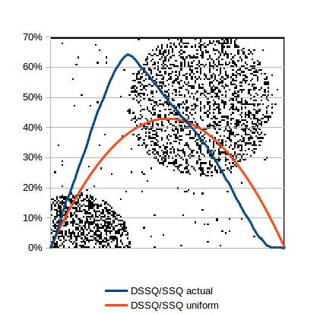

Stopping condition for the divisive phase
CLUBS makes the k-th split iff
When k=1 (i.e., CLUBS needs to decide whether to make the first split) only the ΔSSQ/SSQ is taken into account)

Slide 16
Agglomerative phase
More flexible than the divisive phase (no constraints on the choice of clusters that can be merged)
No need to access the data, since summary information on clusters can be used
Iteratively
The pair of clusters (c₁, c₂) whose merge yields the least SSQ increase is chosen
If the merge of c₁ and c₂ makes the CH-index decrease, then stop merging, otherwise merge c₁ and c₂

Slide 17
U²-Clubs applications
Finding “around-centroids” clusters (Clubs original application)
Fast and accurate seeding for k-means
Finding clusters with arbitrary shapes (by changing the stopping condition of the divisive phase and the merging phase)
Noise detection (by analyzing the density of clusters and their internal data distribution)

Slide 18
K-means seeding
K-means is the most studied clustering algorithm (over 6k scientific publications contain “k-means” in their title, source Google Scholar)
Deciding the number of desired clusters, k, and their initializations limit k-means practical usability
The centroids of clusters detected by Clubs can be used as seeds for k-means
The best known technique for initializing k-means centroids is k-means++: seeds are iteratively chosen among points with probability proportional to the distance from already chosen seeds

Slide 19
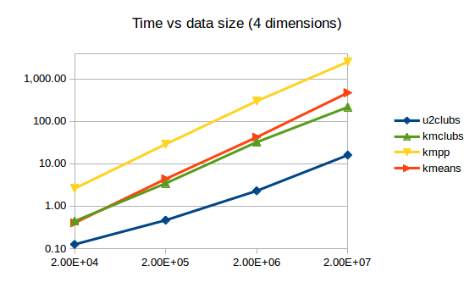
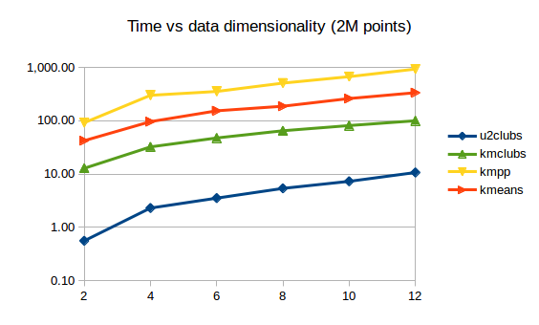
U²-Clubs performances
All datasets contain 20 clusters and 10% noise – clusters are spherical with center and radius chosen randomly in the data domain

Slide 20
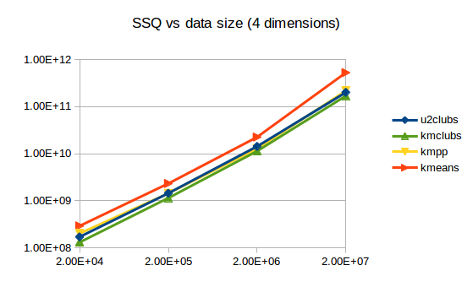
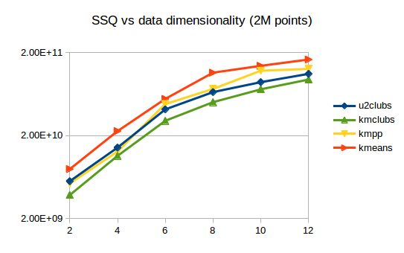
U²-Clubs performances
All datasets contain 20 clusters and 10% noise – clusters are spherical with center and radius chosen randomly in the data domain

Slide 21
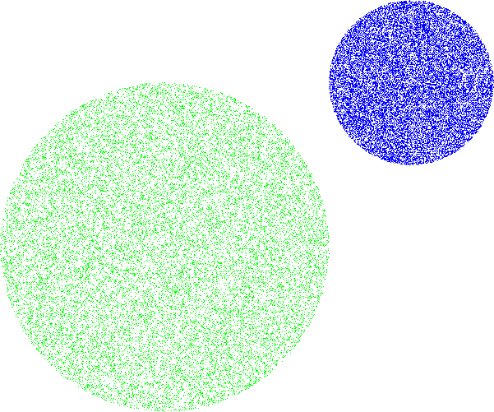
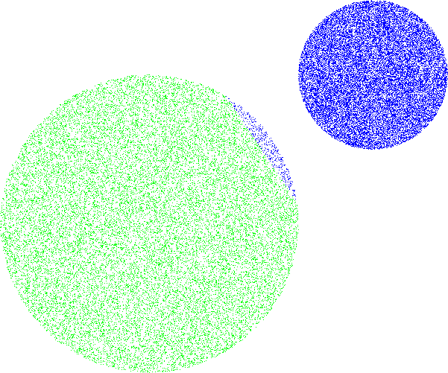
K-means and clusters of different radius
Voronoi partition is more flexible than our binary partition, thus running k-means after U²-Clubs typically reduces the global SSQ
But k-means can move points to the wrong natural cluster, when two clusters with different radius are near one another
We can prevent this situation by considering the distance from the border, instead of centroid, of clusters (it can be simply done by subtracting the radius of the cluster form the distance between points and centroids computed while executing k-means)

Slide 22
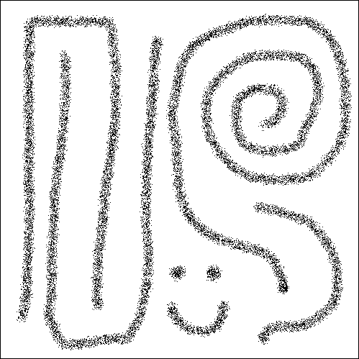
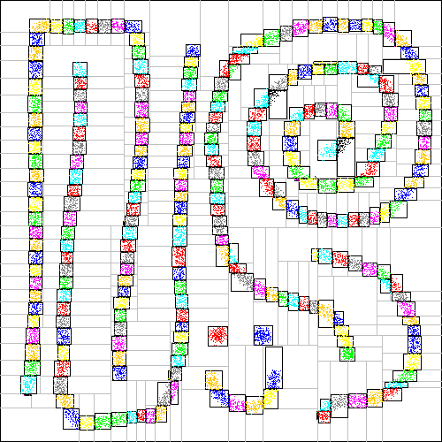

Finding clusters with arbitrary shapes
A finer partition of data is obtained by relaxing the stopping condition
Merging is performed according to a density/proximity metric

Slide 23
Noise detection
Noise can be detected by analyzing the density of the clusters and the density restricted to the clusters’ radii (square root of the SSQ divided by the number of points)
High global density:
non-noise points
Low global density,
restricted density much larger than global density:
non-noise points
Low global density,
restricted density not larger than global density:
noise points

Slide 24
Conclusions and current/future work
U²-Clubs is a parameter-free algorithm which can isolate natural “around-centroid” clusters with very good accuracy
U²-Clubs is much faster than hierarchical clustering algorithms by exploiting the analytical properties of SSQ
Also faster than k-means
U²-Clubs can be adopted for supporting other clustering tasks
K-means seeding
Identifying clustering with arbitrary shapes
Identifying noise points
Future work
Analyzing U²-Clubs performances for high dimensional data
Parallelizing U²-Clubs
Applying U²-Clubs to data streams

Slide 25

Questions?

