Slide 1
Graph-based Analytics
Wei Wang
Department of Computer Science
Scalable Analytics Institute
UCLA
weiwang@cs.ucla.edu

Slide 2
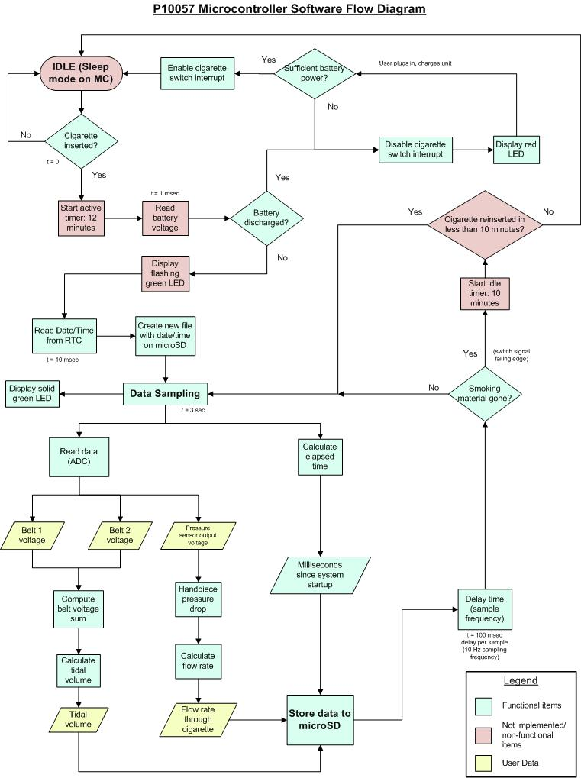
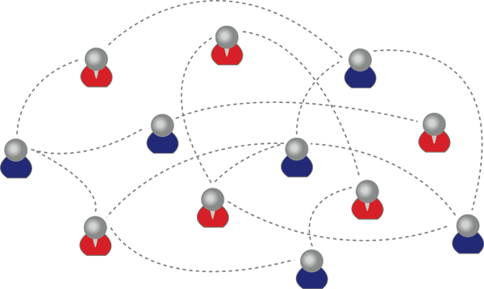
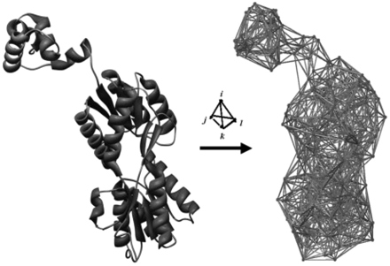
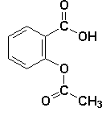
Graphs are everywhere
Graphs/Networks
FFSM (ICDM03), SPIN (KDD04),
GDIndex (ICDE07)
MotifMining (PSB04, RECOMB04, ProteinScience06, SSDBM07, BIBM08)
COM(CIKM09), GAIA (SIGMOD10), LTS (ICDE11)
CGC (KDD13)
Frequent subgraphs
Discriminative subgraphs
Graph classification
Graph clustering

Slide 3
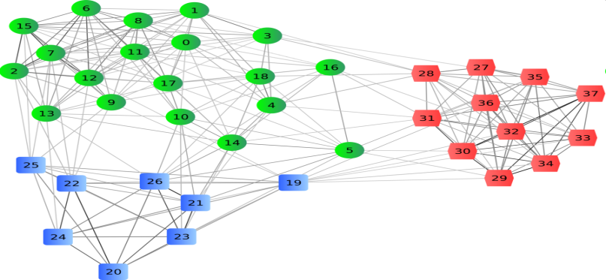
Graph Clustering
Graphs clustering
Decompose a network into sub-networks based on some topological properties
Usually we look for dense sub-networks

Slide 4
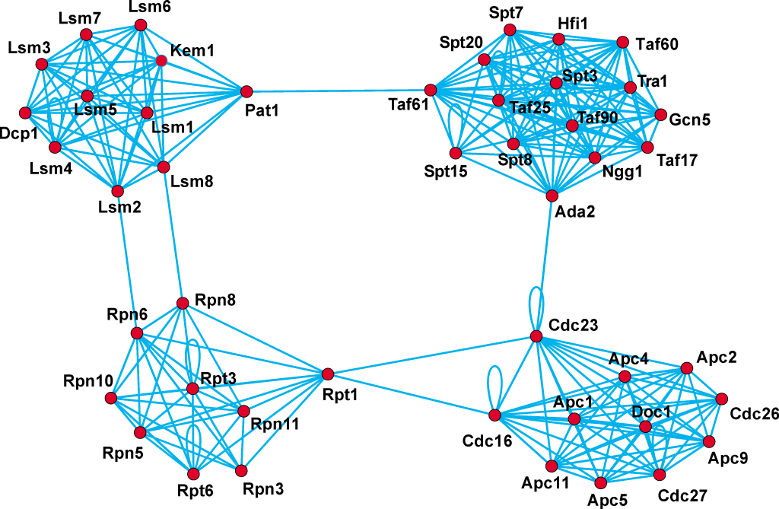
Detect protein functional modules in a PPI network
from Nataša Pržulj – Introduction to Bioinformatics. 2011.

Slide 5
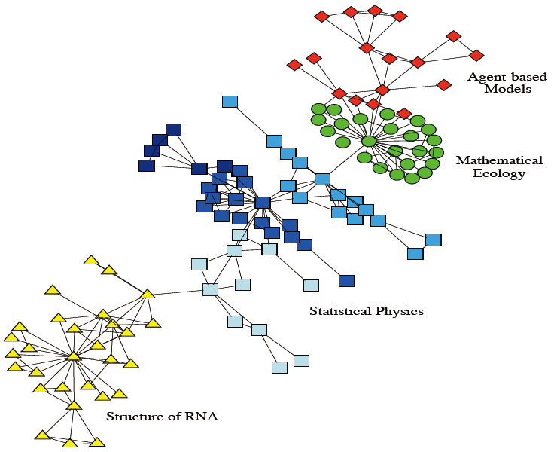
Community Detection in Social Network
Collaboration network between scientists
from Santo Fortunato –Community
detection in graphs

Slide 6
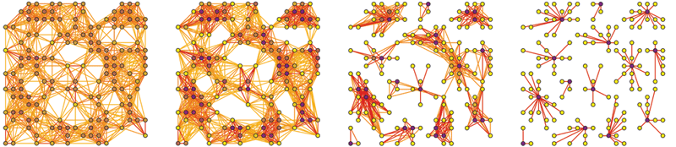
Multi-view Graph clustering
Graphs collected from multiple sources/domains
Multi-view graph clustering
Refine clustering
Resolve ambiguity
Notes:
In many applications, graph data may be collected from heterogeneous sources). For example, the gene expression levels may be reported by different techniques or on different sample sets. By exploiting multi-domain information to refine clustering and resolve ambiguity, multi-view graph clustering methods have
the potential to dramatically increase the accuracy of the final results.

Slide 7
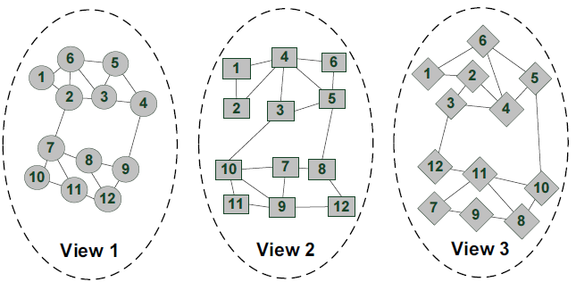
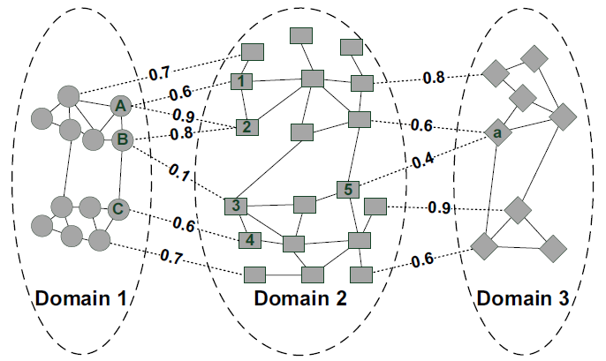
Motivation
Multi-view
Exact one-to-one
Complete mapping
The same size
More common cases
Many-to-many
Tolerate partial mapping
Different sizes
Mappings are associated with weights(confidence)
Notes:
The key assumption of these methods is that the same set of data instances may have multiple representations, and different views are generated from the same underlying distribution. This implies that some properties of the multi-view graph clustering.
In many real-life applications, it is common to have cross-domain
relationship as shown in Figure below.

Slide 8
Motivation
Objective: design algorithm which is
Flexibility
Robustness
Flexibility and Robustness
Suitable for common cases :
Many-to-many weighted partial mappings for multi-domain graph clustering.
Noisy graphs have little influence on others

Slide 9
Problem Formulation
affinity matrix
A⁽¹⁾
A⁽²⁾
A⁽³⁾
S_{a,b}^{(i,j)} denotes the weight between the a-th instance in D_{j} and the b-th instance in D_{i}.
To partition each A^{(π)} into k_{π} clusters while considering the co-regularized constraints implicitly encoded in cross-domain relationships in S.

Slide 10
Co-regularized multi-domain graph clustering (CGC)
Single-domain Clustering
Symmetric Non-negative matrix factorization (NMF).
Minimizing:
Here, , where each
represents the cluster assignment of the a-th instance in domain D_{π}

Slide 11
Co-regularized multi-domain graph clustering (CGC)
Cross-domain Co-regularization
Residual sum of squares (RSS) loss (when the number of clusters is the same for different domains).
Clustering disagreement (CD) loss (when the number of clusters is the same or different).

Slide 12
Co-regularized multi-domain graph clustering (CGC)
Residual sum of squares (RSS) loss
Directly compare the H^{(π)} inferred in different domains.
To penalize the inconsistency of cross-domain cluster partitions for the l-th cluster in D_{i}, the loss for the b-th instance is
where
denotes the set of indices of instances in D_{i} that are mapped to , and is its cardinality.
The RSS loss is
e
Notes:
Row/column cluster splitting monotonically increases

Slide 13
S^{(1,2)}
 | A | B | … | C
1 | 0.6 | 0 | … | 0
2 | 0.9 | 0.8 | … | 0
… | … | … | … | …
3 | 0 | 0.1 | … | 0
4 | 0 | 0 | … | 0.6
5 | 0 | 0 | … | 0
H⁽²⁾
 | C1 | C2
1 | 0.8 | 0.2
2 | 0.7 | 0.3
… | … | …
3 | 0.1 | 0.9
4
5
S^{(3,2)}
 | 1 | 2 | … | 3 | 4 | 5
a | 0 | 0 | … | 0 | 0 | 0.4
… | … |  | … | … | … | …
H⁽¹⁾
 | C1 | C2
A | 0.8 | 0.2
B | 0.7 | 0.3
… | … | …
C | 0.1 | 0.9
H⁽³⁾
 | C1 | C2
a | 0.8 | 0.2
.. | … | ..

Slide 14
Co-regularized multi-domain graph clustering (CGC)
Clustering disagreement (CD)
Indirectly measure the clustering inconsistency of cross-domain cluster partitions .
Intuition:
A⃝ and B⃝ are mapped to 2⃝, and C⃝ is mapped to 4⃝ . Intuitively, if the similarity between cluster assignments for 2⃝ and 4⃝ is small, then the similarity of clustering assignments between A⃝ and C⃝ and the similarity between B⃝ and C⃝ should also be small.
The CD loss is

Slide 15
Co-regularized multi-domain graph clustering (CGC)
Objective function (Joint Matrix Optimization):
Can be solved with an alternating scheme: optimize the objective with respect to one variable while fixing others.
Notes:
We can integrate the domain-specific objective and the loss function quantifying the inconsistency of cross-domain partitions into a unified objective function.

Slide 16
Experimental Study
Data sets:
UCI (Iris, Wine, Ionosphere, WDBC)
Construct two cross-domain relationships: Iris-Wine, Ionosphere-WDBC, (positive/negative instances only mapped to positive/negative instances in another domain)
Newsgroups data (from 20 Newsgroups)
comp.os.ms-windows.misc, comp.sys.ibm.pc.hardware, comp.sys.mac.hardware
rec.motorcycles, rec.sport.baseball, rec.sport.hockey
protein-protein interaction (PPI) networks (from BioGrid), gene co-expression networks (from Gene Expression Ominbus), genetic interaction network (from TEAM)
Notes:
Newsgroup data (6 groups from 20 Newsgroups)
comp.os.ms-windows.misc, comp.sys.ibm.pc.hardware, comp.sys.mac.hardware, (3 comp)
rec.motorcycles, rec.sport.baseball, rec.sport.hockey (3 rec)

Slide 17
Experimental Study
Effectiveness (UCI data set)
Notes:
Firstly, we evaluate the two-way partition case with UCI data set. We use four data sets with class
label information. They are from four different domains. After preprocessing, each data set contains two labels.
For each data set, we compute the affinity matrix using the RBF Kernel. We construct two cross-domain relationships: Wine-Iris and Ionosphere-WDBC. The relationships are generated based on the class labels, i.e., positive-positive and negative-negative.
From the figure, we have several observations. First, the proposed model significantly outperforms all single-domain graph clustering methods, even though single-domain methods may perform differently on different data sets. When the percentage of available relationships is 0, CGC degrades to symmetric NMF. The proposed model outperforms all alternative methods when cross-domain relationships are available. This demonstrates the effectiveness of the proposed method. We also notice that the performance of CGC dramatically improves when the available relationships increase from 0 to 40%, suggesting that our method can effectively improve the clustering result even with limited information on cross-domain relationship.

Slide 18
Experimental Study
Robustness Evaluation (UCI)
Notes:
We add inconsistency into matrix S . The results are shown in the figure. Single-domain symmetric NMF is used as a reference method. We observe that, even when the inconsistency ratio is close to 60%, The proposed model still outperforms the single-domain method. This indicates that our method is robust
to noisy relationships.

Slide 19
Experimental Study
Performance Evaluation

Slide 20
Experimental Study
Protein Module Detection by Integrating Multi-Domain Heterogeneous Data
490032 genetic markers across 4890 (1952 disease and 2938 healthy) samples.
We use 1 million top-ranked genetic marker pairs to construct the network and the test statistics as the
weights on the edges
5412 genes

Slide 21
Experimental Study
Protein Module Detection:
Evaluation: standard Gene Set Enrichment Analysis (GSEA)
we identify the most significantly enriched Gene Ontology categories
significance (p-value) is determined by the Fisher’s exact test
raw p-values are further calibrated to correct for the multiple testing problem

Slide 22
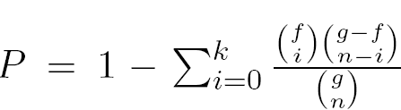
GSEA
The hypergeometric distribution is used to model the probability of observing at least k genes from a cluster of size n by chance in a category containing f genes from a total genome size of g genes.
For example, if the majority of genes in a cluster appear from one category, then it is unlikely that this happens by chance and the category’s p-value would be close to 0.

Slide 23
Experimental Study
Protein Module Detection:
Comparison of CGC and single-domain graph clustering (k = 100)

Slide 24
Experimental Study
Protein Module Detection:

Slide 25
Summary
In this project,
we developed a flexible co-regularized method, CGC, to tackle the many-to-many, weighted, partial mappings for multi-domain graph clustering.
CGC utilizes cross-domain relationship as co-regularizing penalty to guide the search of consensus clustering structure.
CGC is robust even when the cross-domain relationships based on prior knowledge are noisy.
SIGKDD’13

Slide 26
Comments and Questions
weiwang@cs.ucla.edu

Slide 27
ScAi Projects
Big data systems
Graph based analytics
Language design for big data and data streams
Mining high dimensional data
User and quality modeling in big data

