Slide 1
SHadoop: Improving MapReduce Performance by Optimizing Job Execution Mechanism in Hadoop Clusters
Rong Gu, Xiaoliang Yang, Jinshuang Yan, Yuanhao Sun,
Chunfeng Yuan, Yihua Huang
J. Parallel Distrib. Comput. 74 (2014)
13 February 2014
SNU IDB Lab.
Namyoon Kim

Slide 2
Outline
Introduction
SHadoop
Related Work
MapReduce Optimizations
Evaluation
Conclusion

Slide 3
Introduction
MapReduce
Parallel computing framework proposed by Google in 2004
Simple programming interfaces with two functions, map and reduce
High throughput, elastic scalability, fault tolerance
Short Jobs
No clear quantitative definition, but generally means MapReduce jobs taking few seconds - minutes
Short jobs compose the majority of actual MapReduce jobs
Average MapReduce runtime at Google is 395s (Sept. 2007)
Response time is important for monitoring, business intelligence, pay-by-time environments (EC2)

Slide 4
High Level MapReduce Services
High-level MapReduce services (Sawzall, Hive, Pig, …)
More important than hand coded MapReduce jobs
95% of Facebook’s MapReduce jobs are generated by Hive
90% of Yahoo’s MapReduce jobs are generated by Pig
Sensitive to execution time of underlying short jobs

Slide 5
The Solutions
SHadoop
Optimized version of Hadoop
Fully compatible with standard Hadoop
Optimizes the underlying execution mechanism of each tasks in a job
25% faster than Hadoop on average
State Transition Optimization
Reduce job setup/cleanup time
Instant Messaging Mechanism
Fast delivery of task scheduling and execution messages between JobTracker and
TaskTrackers

Slide 6
Related Work
Related work have focused on one of the following:
Intelligent or adaptive job/task scheduling for different circumstances^{[1,2,3,4,5,6,7,8]}
Improve efficiency of MapReduce with aid of special hardware or supporting
Software^{[9,10,11]}
Specialized performance optimizations for particular MapReduce applications^{[12,13,14]}
SHadoop
This work is on optimizing the underlying job and task execution
mechanism
Is a general enhancer to all MapReduce jobs
Can complement the job scheduling optimizations

Slide 7
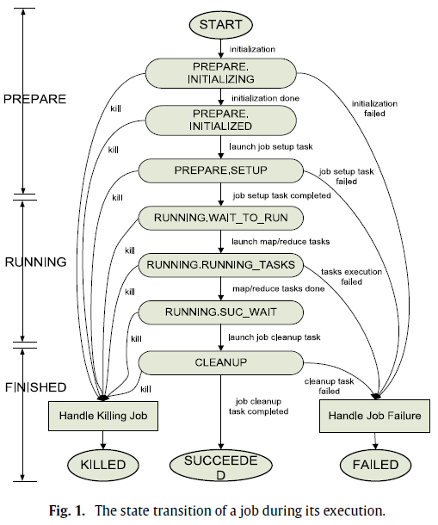
State Transition in a MapReduce Job
Notes:
PREPARE phase: START – PREPARE.INITIALIZING (reading input data splits from HDFS, generating map/reduce tasks) – launch job setup task
RUNNING phase: RUNNING.WAIT_TO_RUN (job waits to be scheduled for execution) – RUNNING.RUNNING_TASKS (execute tasks)
FINISHED phase: in RUNNING.SUC_WAIT, cleanup task is scheduled to a TaskTracker. After cleanup is done, job is SUCCEEDED

Slide 8
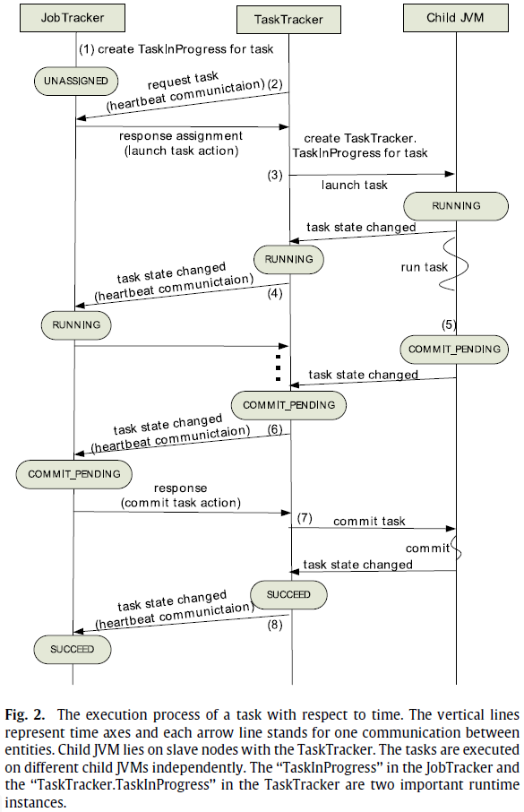
Task Execution Process
Notes:
Tasks are created – JobTracker generates “TaskInProcess” instance for each task
Each TaskTracker sends heartbeat to JobTracker to request tasks. JobTracker allocates one or more tasks to each TaskTracker. This happens during the 1st round of heartbeat
After receiving a task, TaskTracker creates a “TaskTracker.TaskInProgress” instance, runs independent child JVM to run task, state changes to RUNNING
Each TaskTracker sends report to JobTracker, changes state to RUNNING (2nd round of heartbeat)
When task is done in child JVM, TaskTracker sends heartbeat, state changes to COMMIT_PENDING
JobTracker changes state to COMMIT_PENDING, allowing TaskTrackers to commit
TaskTrackers then submit results and change state to SUCCEED
TaskTrackers report to JobTracker in next heartbeat. Task is completed.

Slide 9
The Bottleneck: setup/cleanup [1/2]
Launch job setup task
After job is initialized, JobTracker needs to wait for TaskTracker saying its
map/reduce slot is free (1 heartbeat) Then, the JobTracker schedules setup
task to this TaskTracker
Job setup task completed
TaskTracker responsible for setup processes the task, keeps reporting state
information of task to JobTracker by periodical heartbeat messages
(1 + n heartbeats)
Job cleanup task
Before the job really ends, a cleanup job must be scheduled to run on a
TaskTracker (2 heartbeats)

Slide 10
The Bottleneck: setup/cleanup [2/2]
What happens in each TaskTracker
Job setup task
Simply creates a temporary directory for outputting temporary data during job execution
Job cleanup task
Delete the temporary directory
These two operations are light weighted, but are each taking at least two heartbeats (6 seconds)
For a two minute job, this is 10% of the total execution time!
Solution
Execute the job setup/cleanup task immediately on the JobTracker side
Notes:
When the JobTracker initializes a job, a setup task will be immediately executed one time in the JobTracker
After all map/reduce tasks of the job are completed, cleanup task of the job will be immediately executed one time on the JobTracker

Slide 11
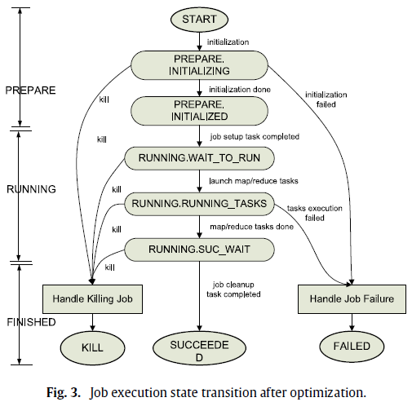
Optimized State Transition in Hadoop
Immediately execute one setup/cleanup task on JobTracker side

Slide 12
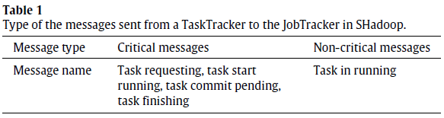
Event Notification in Hadoop
Critical vs. non-critical messages
Why differentiate message types?
1) JobTracker has to wait for TaskTrackers to request tasks passively – delay
between submitting job and scheduling tasks
2) Critical event messages cannot be reported immediately
Short jobs usually have a few dozen tasks – each task is effectively being delayed

Slide 13
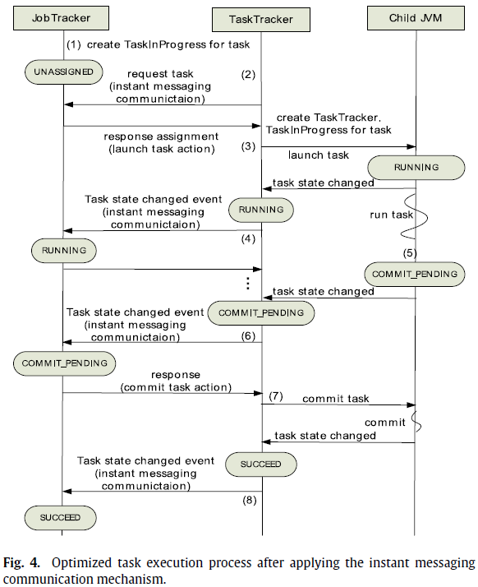
Optimized Execution Process

Slide 14
Test Setup
Hadoop 1.0.3
SHadoop
One master node (JobTracker)
2× 6-core 2.8 GHz Xeon
36 GB RAM
2× 2 TB 7200RPM SATA disks
36 compute nodes (TaskTracker)
2× 4-core 2.4 GHz Xeon
24 GB RAM
2× 2 TB 7200RPM SATA disks
1 Gbps Ethernet
RHEL6 w/ kernel 2.6.32 OS
Ext3 file system
8 map/reduce slots per node
OpenJDK 1.6
JVM heap size 2 GB

Slide 15
Performance Benchmarks
WordCount benchmark
4.5 GB input data size, 200 data blocks
16 reduce tasks
20 slave nodes with 160 slots in total
Grep
Map-side job
Output from map side is much smaller than input, little work for reduce
10 GB input data
Sort
Reduce-side job
Most execution time is spent on reduce phase
3 GB input data

Slide 16
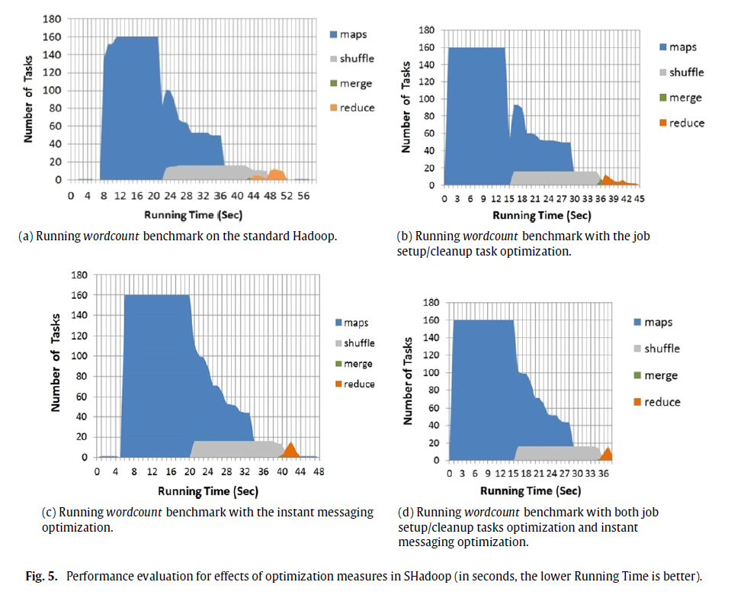
WordCount Benchmark

Slide 17
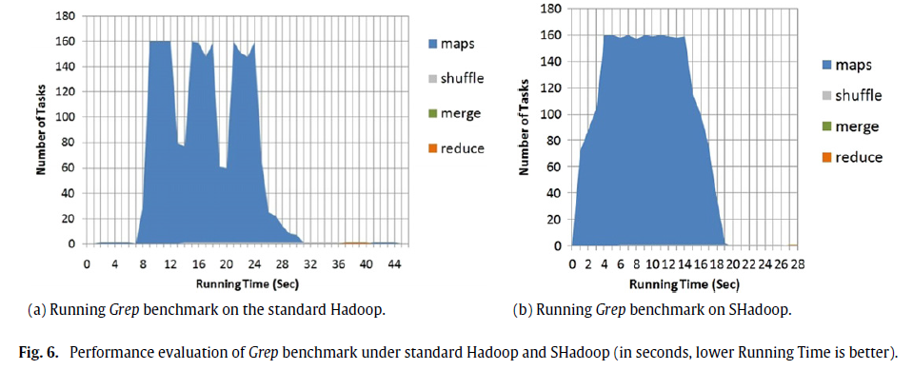
Grep

Slide 18
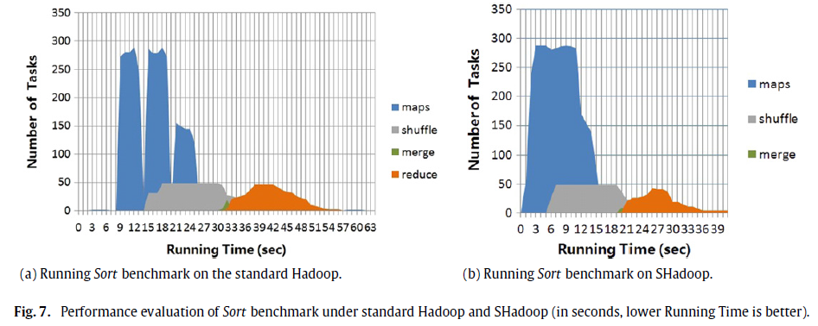
Sort

Slide 19
Comprehensive Benchmarks
HiBench
Benchmark suite used by Intel
Synthetic micro-benchmarks
Real world Hadoop applications
MRBench
Benchmark carried in the standard Hadoop distribution
Sequence of small MapReduce jobs
Hive benchmark
Assorted group of SQL-like functions such as join, group by

Slide 20
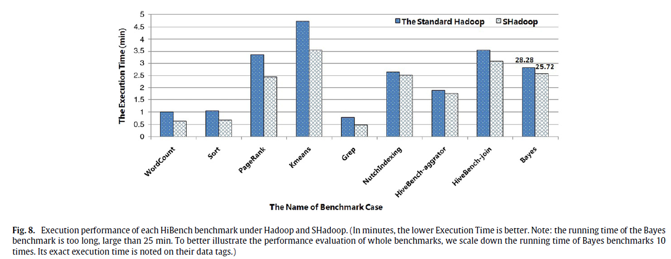
HiBench [1/2]

Slide 21
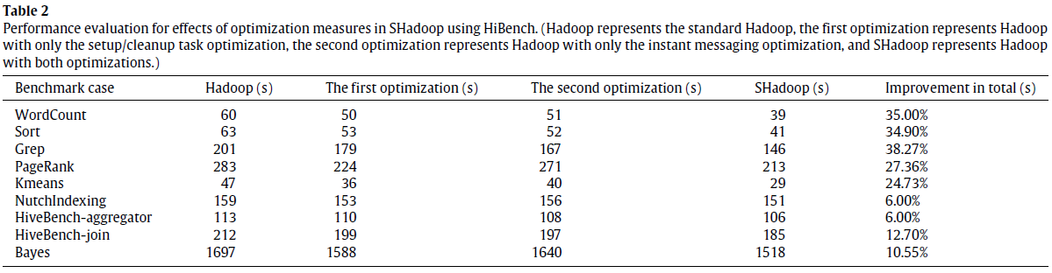
HiBench [2/2]
First optimization: setup/cleanup task only
Second optimization: instant messaging only
SHadoop: both

Slide 22
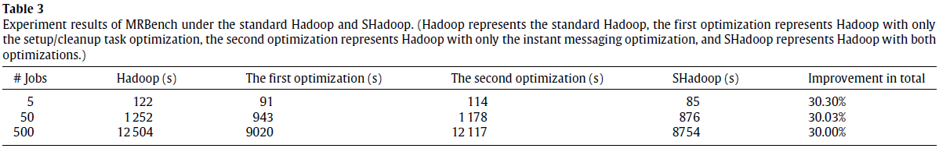
MRBench
First optimization: setup/cleanup task only
Second optimization: instant messaging only
SHadoop: both

Slide 23
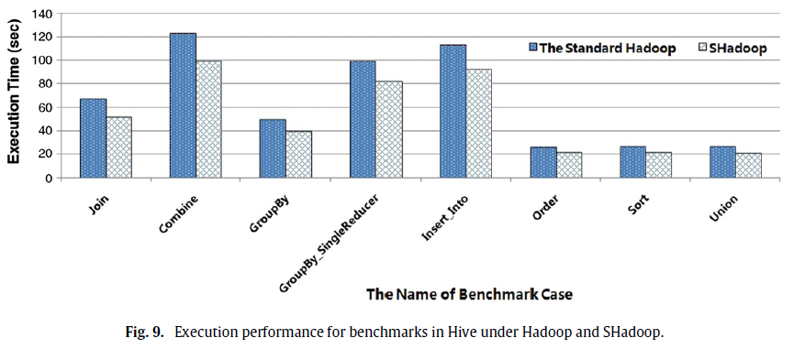
Hive Benchmark [1/2]

Slide 24
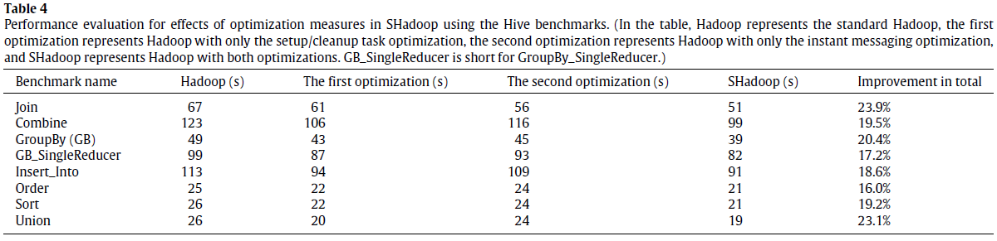
Hive Benchmark [2/2]
First optimization: setup/cleanup task only
Second optimization: instant messaging only
SHadoop: both

Slide 25
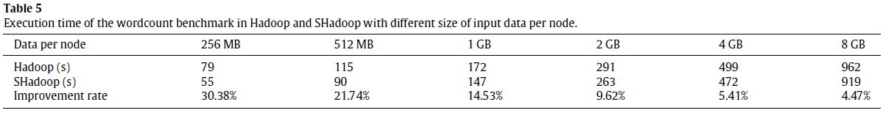
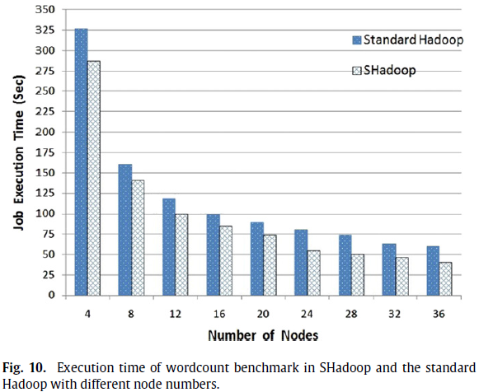
Scalability
Data Scalability
Machine Scalability

Slide 26
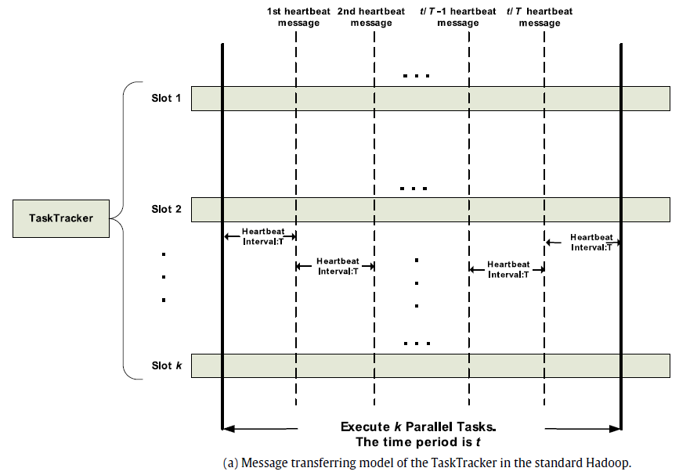
Message Transfer (Hadoop)
Notes:
k: number of slots in a TaskTracker (usually the number of cores on a machine)
T: heartbeat period interval
c: size of heartbeat message
t: lifespan of a task on a slot
m: number of slaves on Hadoop cluster

Slide 27
Optimized Execution Process (Revisited)
For each
TaskTracker slot,
These four messages are no longer heartbeat-timed messages

Slide 28
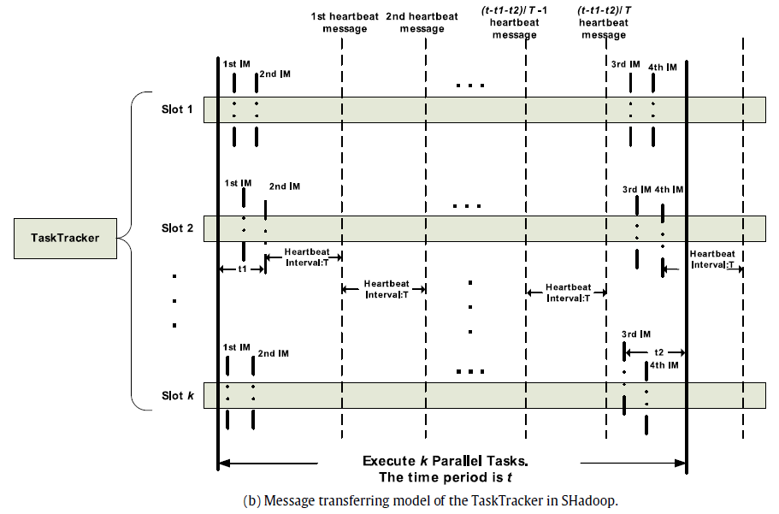
Message Transfer (SHadoop)

Slide 29
Added System Workload
Each TaskTracker has k slots
Each slot has four more messages to send
For a Hadoop cluster with m slaves, this means there are no more than
4 × m × k extra messages to send
For a heartbeat message of size c,
The increased message size is 4 × m × k × c in total
The instant message optimization is a fixed overhead, no matter how long the task

Slide 30
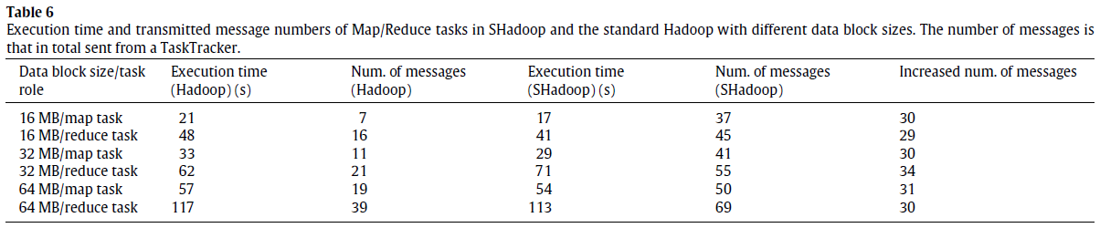
Increased Number of Messages
Regardless of different runtimes,
increased number of messages is fixed at around 30,
for a cluster with 20 slaves (8 cores each, 8 map / 4 reduce slots)

Slide 31
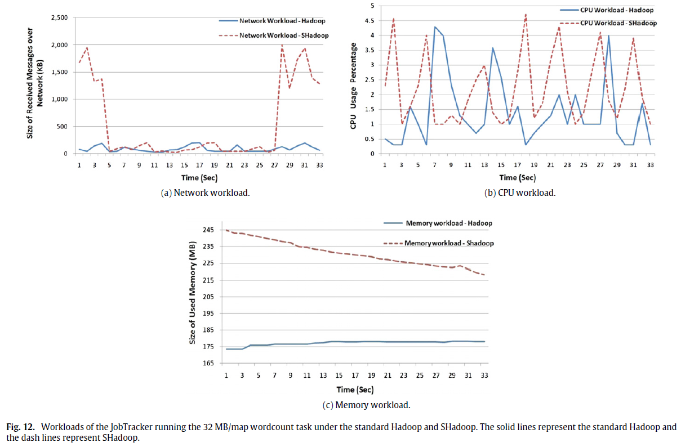
JobTracker Workload
Increased network traffic is only several MBs

Slide 32
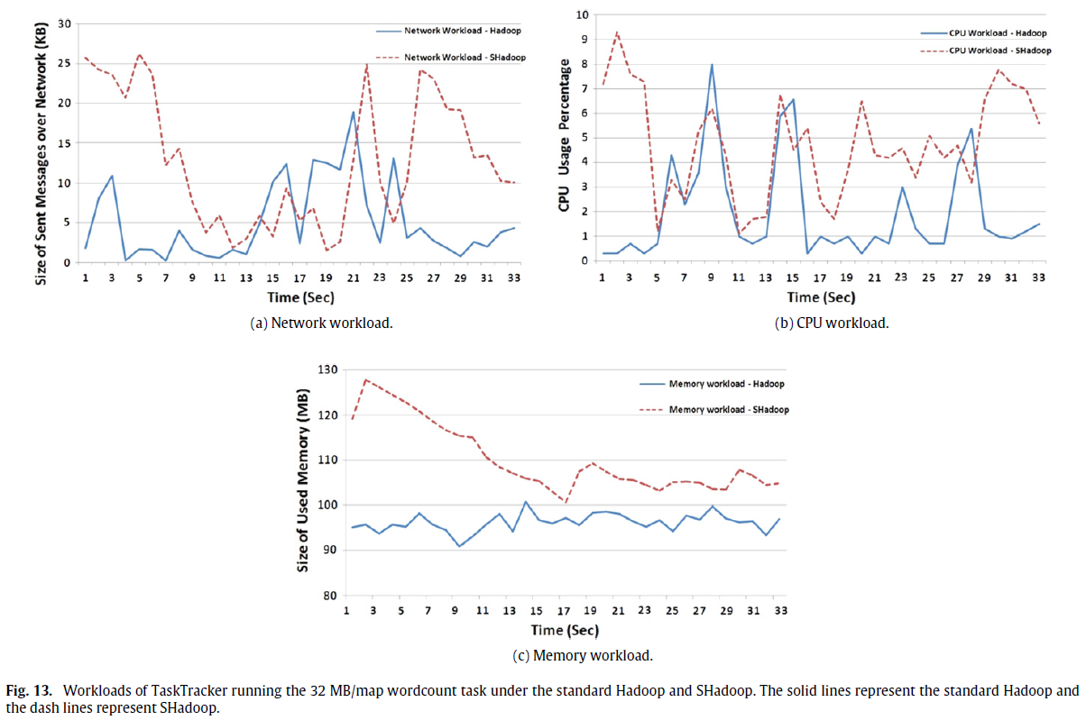
TaskTracker Workload
Optimizations do not add much overhead

Slide 33
Conclusion
SHadoop
Short MapReduce jobs are more important than long ones
Optimized job and task execution mechanism of Hadoop
25% performance improvement on average
Passed production test, integrated into Intel Distributed Hadoop
Brings a little more burden on the JobTracker
Little improvement on long jobs
Future Work
Dynamic scheduling of slots
Resource context-aware optimization
Optimizations for different types of applications (computation / IO / memory intensive jobs)
Notes:
JobTracker needs to create and delete an empty temporary directory for each job

Slide 34
References
[1] M. Zaharia, A. Konwinski, A.D. Joseph, R. Katz, I. Stoica, Improving mapreduce performance in heterogeneous environments, in: Proceedings of the 8th USENIX Conference on Operating Systems Design and Implementation, OSDI, 2008, pp. 29–42.
[2] H.H. You, C.C. Yang, J.L Huang, A load-aware scheduler for MapReduce framework in heterogeneous cloud environments, in: Proceedings of the 2011 ACM Symposium on Applied Computing, 2011, pp. 127–132.
[3] R. Nanduri, N. Maheshwari, A. Reddyraja, V. Varma, Job aware scheduling algorithm for MapReduce framework, in: 3rd IEEE International Conference on Cloud Computing Technology and Science, CloudCom, 2011, pp. 724–729.
[4] M. Hammoud, M. Sak, Locality-aware reduce task scheduling for MapReduce, in 3nd IEEE International Conference on Cloud Computing Technology and Science, CloudCom, 2011, pp. 570–576.
[5] J. Xie, et al. Improving MapReduce performance through data placement in heterogeneous Hadoop clusters, in: 2010 IEEE International Symposium on Parallel & Distributed Processing, Workshops and Ph.D. Forum, IPDPSW, 2010, pp. 1–9.
[6] C. He, Y. Lu, D. Swanson, Matchmaking: a new MapReduce scheduling technique, in: 3rd International Conference on Cloud Computing Technology and Science, CloudCom, 2011, pp 40–47.
[7] H. Mao, S. Hu, Z. Zhang, L. Xiao, L. Ruan, A load-driven task scheduler with adaptive DSC for MapReduce, in: 2011 IEEE/ACM International Conference on Green Computing and Communications, GreenCom, 2011, pp 28–33.
[8] R. Vernica, A. Balmin, K.S. Beyer, V. Ercegovac, Adaptive MapReduce using situation-aware mappers, in: Proceedings of the 15th International Conference on Extending Database Technology, 2012, pp 420–431.
[9] S. Zhang, J. Han, Z. Liu, K. Wang, S. Feng, Accelerating MapReduce with distributed memory cache, in: 15th International Conference on Parallel and Distributed Systems, ICPADS, 2009, pp. 472–478.
[10] Y. Becerra Fontal, V. Beltran Querol, P, D. Carrera, et al. Speeding up distributed MapReduce applications using hardware accelerators, in: International Conference on Parallel Processing, ICPP, 2009, pp. 42–49.
[11] M. Xin, H. Li, An implementation of GPU accelerated MapReduce: using Hadoop with OpenCL for data-and compute-intensive jobs, in: 2012 International Joint Conference on Service Sciences, IJCSS, 2012, pp. 6–11.
[12] B. Li, E. Mazur, Y. Diao, A. McGregor, P. Shenoy, A platform for scalable onepass analytics using MapReduce, in: Proceedings of the 2011 ACM SIGMOD international conference on Management of data, 2011, pp. 985–996.
[13] S. Seo, et al. HPMR: prefetching and pre-shuffling in shared MapReduce computation environment, in: International Conference on Cluster Computing and Workshops, CLUSTER, 2009, pp. 1–8.
[14] Y. Wang, X. Que, W. Yu, D. Goldenberg, D. Sehgal, Hadoop acceleration through network levitated merge, in: Proceedings of 2011 International Conference for High Performance Computing, Networking, Storage and Analysis, 2011, pp. 57–67.

