Slide 1


4 Best Practices for Analyzing Healthcare Data
Russ Staheli
Technical Director

Slide 2
Analyzing Healthcare Data
Data undergoes three stages before it can be used for sustainable, meaningful analytics:
DATA CAPTURE
Acquire key data elements
Assure data quality
Integrate data capture into operational workflow
DATA ANALYSIS
DATA PROVISIONING
Interpret data
Discover new information in the data (data mining)
Evaluate data quality
Move data from transactional systems into the EDW
Build visualization for use by clinicians

Slide 3



Data Capture
How does data get into your system?
Exactly how people, processes and devices produce data determines:
Appropriateness of data (capture the right stuff)
Discreteness of data (capture in the right format)
How easy it is to extract the data (capture in an accessible way)
People
Processes
Devices

Slide 4
Data Provisioning
Meaningful healthcare analytics today generally need data from multiple source systems to help address the triple aim cost, quality, and patient satisfaction.
POPULATION HEALTH
EXPERIENCE OF CARE
PER CAPITA COST
Triple Aim
Improving the individual experience of care
Improving the health of populations
Reducing the per capita cost of care for populations
SOURCE: IHI TRIPLE AIM

Slide 5




Data Provisioning Example
For example, as an analyst helps a team of clinicians work through a quality improvement issue, the process generally requires:
EMR data for clinical observations, lab results, and ADT information
Billing data to help identify cohorts using diagnosis and procedure codes and charges and revenue
Cost data (if available) to view the improvement’s impact on margins
Patient Satisfaction data

Slide 6

Breaking Down Data Analysis
Divide data analysis tasking into four sections
Data quality evaluation
Data Discovery
Interpretation
Presentation

Slide 7

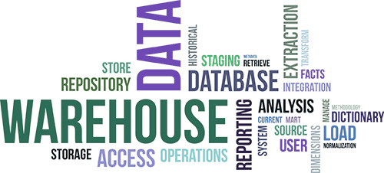
Provide Your Analysts with a Data Warehouse
analysis
1
best practices
Healthcare data tends to reside in many departments in multiple formats; from different source systems, like EMRs or HR software, and varying clinical systems.

Slide 8

Provide Your Analysts with a Sandbox
analysis
2
best practices
Within your data warehouse, your analysts need to build, break, and rebuild datasets. In short, they need to use the data warehouse like a sandbox.

Slide 9

Provide Your Analysts with Discovery Tools
analysis
3
best practices
These tools make it easy for analysts to do data discovery that allows for the slicing, dicing, and the drilling needed to find trends and meaningful correlations.

Slide 10

Provide Your Analysts with Direction
analysis
4
best practices
When analysts get requests, those requests should have enough meat to get them in the ballpark but enough vagueness that gets them asking questions. Give a good analyst some direction, a little time to drill into the problem, and a forum to ask detailed questions.

Slide 11
More about this topic
Link to original article for a more in-depth discussion.
4 Ways to Enable Healthcare Data Analysts to Provide Their Full Value
The Changing Role of Healthcare Data Analysts (Executive Report) Dr. John Haughom, Senior Advisor; Paul Horstmeier, SVP; John Wadsworth, VP; Russ Staheli, Technical Director; and Leslie Falk, VP
The ROI of investing in a healthcare data analyst — a real example of saving millions John Wadsworth, VP of Client Technical Operations
Advanced Analytics Holds the Key to Triple Aim and Value-based Purchasing Russ Staheli, Vice President, Analytics
How to Avoid the 3 Most Common Pitfalls in Healthcare Analytics Russ Staheli, Vice President, Analytics
The Best Organizational Structure for Healthcare Analytics John Wadsworth, VP of Client Technical Operations

Slide 12
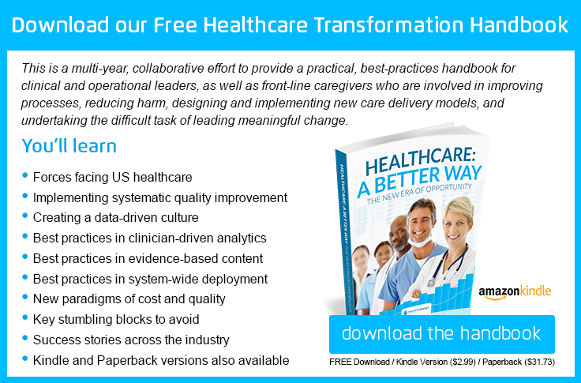
For more information:

Slide 13

Other Clinical Quality Improvement Resources
Click to read additional information at www.healthcatalyst.com
Russ Staheli joined Catalyst as a data architect in October 2011. He started his career as an Intern and later Outcomes Analyst at Intermountain Healthcare in the Institute for Health Care Delivery Research supporting the Advanced Training Program for Executives & QI Leaders (ATP) and the Primary Care Clinical Program. Before coming to Catalyst he worked as a Management Engineer Programmer Analyst for
the Duke University Health System in their Performance Services department supporting their Infection Control and Epidemiology efforts. While there, he also worked as an external consultant to advance the analytical work of the Duke Infection Control Outreach Network (DICON), a collaborative of over 30 community hospitals. Russ holds an Master of Public Health in Health Policy and Administration from University of North Carolina Chapel Hill and a Bachelor’s degree in Health Services Research from the University of Utah.

