Slide 1
Main Memory Databases
6.830/6.814 Lecture 12
October 15, 2014

Slide 2
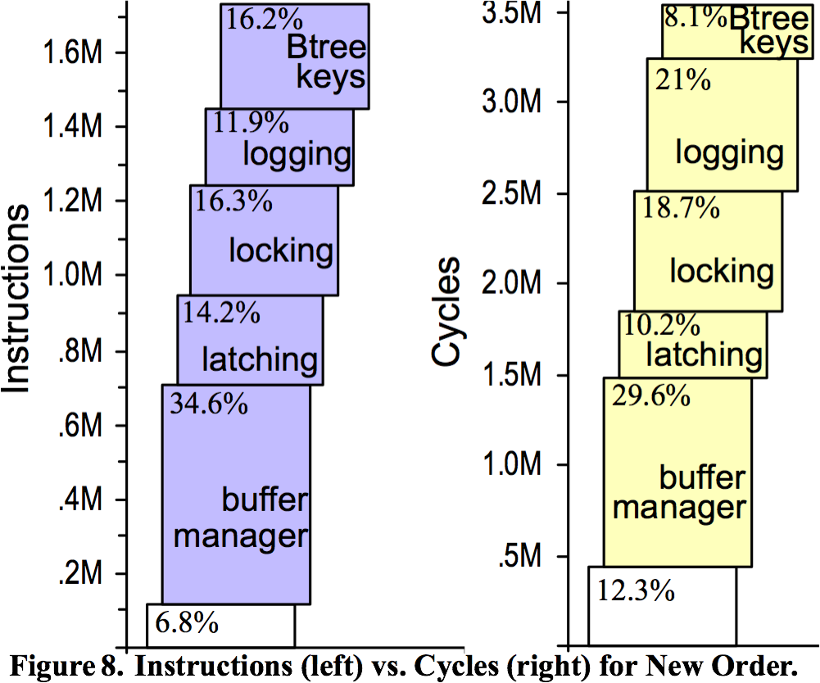
Time breakdown for Shore DBMS
Systematically removed code for locking, logging, and disk I/O
Remaining useful work
Source: “OLTP Under the Looking Glass”, SIGMOD 2008

Slide 3
TPC-C
Most queries go to one warehouse

Slide 4
PS2 Part II
// user u_uid with a name, gender, age, and race
CREATE TABLE users(u_uid int PRIMARY KEY,
u_name char(50),
u_gender char,
u_age int,
u_race int)
// relatives table records familial relationships between users
// relationships are not symmetric, so e.g., if A is B's child, then
// there will be two entries: (A,B,child) and (B,A,parent)
CREATE TABLE relatives(rl_uid1 int,
rl_uid2 int,
rel_type int,
PRIMARY KEY (rl_uid1, rl_uid2));
// data set collected about a specific user on a specific
// genome sequencing platform,
// with results stored in a specified file
CREATE TABLE datasets(d_did int PRIMARY KEY,
d_time timestamp,
d_platform char(20),
d_uid int REFERENCES users(u_uid),
d_file char(100));
// results produced by processing pipeline
// each disorder column represents a specific
// condition (e.g., disorder1 might be diabetes,
// disorder2 might be a type of cancer, etc.)
CREATE TABLE results(r_rid int PRIMARY KEY,
r_did int REFERENCES datasets(d_did),
r_uid int REFERENCES users(u_uid),
r_pipeline_version int,
r_timestamp int,
r_disorder1probability float,
...
r_disorder50probability float)

Slide 5
CREATE TABLE users(u_uid int PRIMARY KEY,
u_name char(50),
u_gender char,
u_age int,
u_race int)
CREATE TABLE relatives(rl_uid1 int,
rl_uid2 int,
rel_type int,
PRIMARY KEY (rl_uid1, rl_uid2));
SELECT d_file
FROM users as u, relatives as rl, datasets as d,
results as r
WHERE d_uid = rl_uid1
AND rl_uid2 = u_uid
AND r_uid = u_uid
AND u_gender = 'F'
AND r_disorder1probability > .85
AND r_timestamp = (
SELECT MAX(r_timestamp)
FROM results
WHERE r_uid = u_uid)
CREATE TABLE datasets(d_did int PRIMARY KEY,
d_time timestamp,
d_platform char(20),
d_uid int REFERENCES users(u_uid),
d_file char(100));
CREATE TABLE results(r_rid int PRIMARY KEY,
r_did int REFERENCES datasets(d_did),
r_uid int REFERENCES users(u_uid),
r_pipeline_version int,
r_timestamp int,
r_disorder1probability float,
...
r_disorder50probability float)

