Slide 1
Big Table
Lecture 21
Sam Madden
drop date today
Grade calculator: http://db.csail.mit.edu/6.830/grade.php

Slide 2
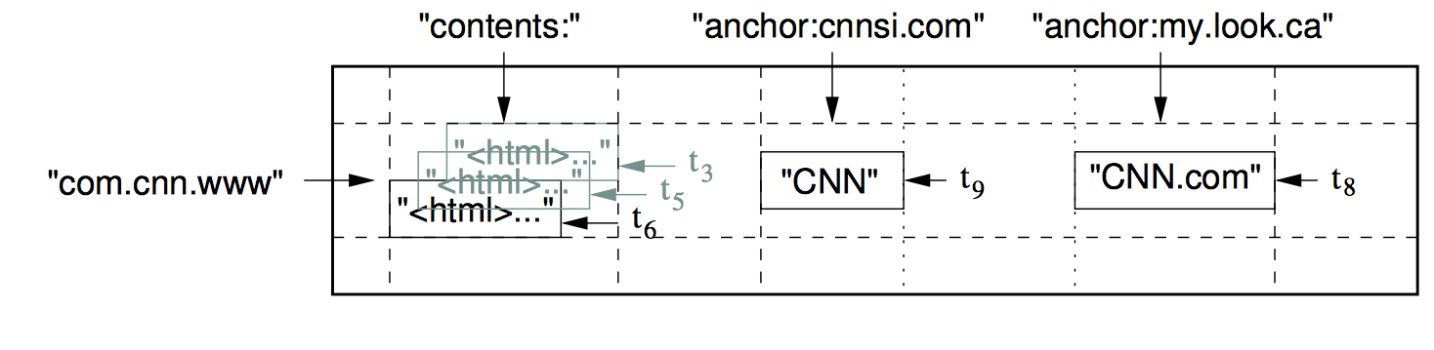
Example Big Table (Fig 1)

Slide 3
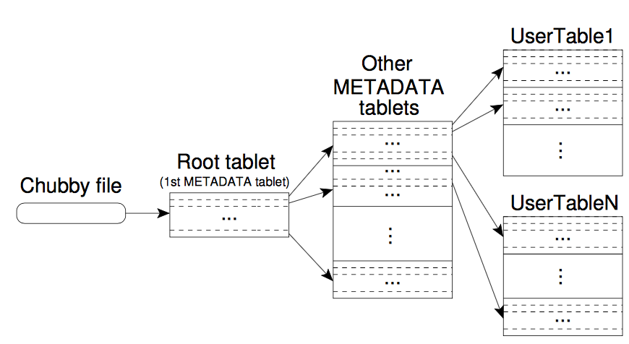
Tablet Servers (Fig 4)

Slide 4
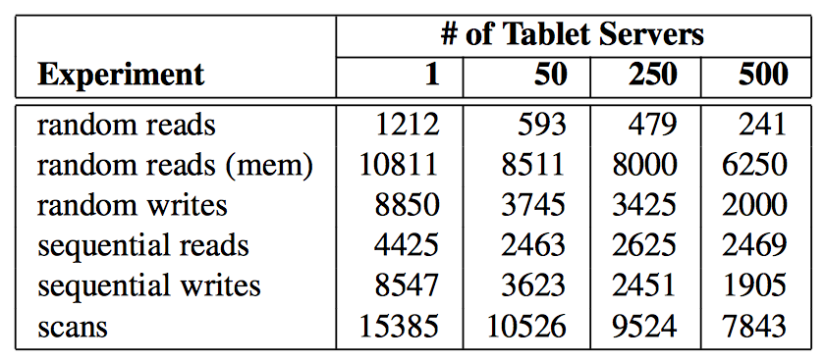
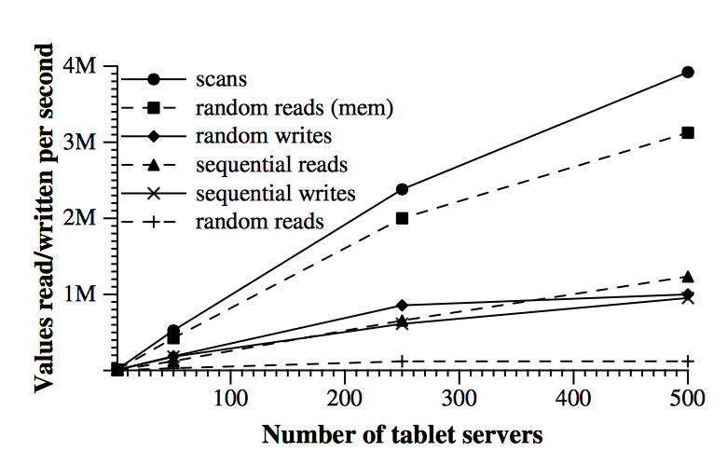
Evaluation: Number of 1000-byte values read/written per second (Fig 6)
rate per tablet server
aggregate rate across all tablet servers

