Slide 1
Hadoop & Spark
6.830 Lecture 21
11/24/2014

Slide 2
MapReduce Word Count Example
map(String key, String value):
// key: document name
// value: document contents
for each word w in value:
EmitIntermediate(w, "1");
reduce(String key, Iterator values):
// key: a word – called once per word in all docs
// values: a “1” for each occurrence of this work in all docs
int result = length(values)
Emit(AsString(result));

Slide 3
Spark Example
//Find error lines
lines = spark.textFile("hdfs://...")
errors = lines.filter(_.startsWith("ERROR"))
errors.persist()
//count all errors
errors.count()
// Count errors mentioning MySQL:
errors.filter(_.contains("MySQL")).count()
// Return the time fields of errors mentioning
// HDFS as an array (assuming time is field
// number 3 in a tab-separated format): errors.filter(_.contains("HDFS")) .map(_.split(’\t’)(3)) .collect()

Slide 4
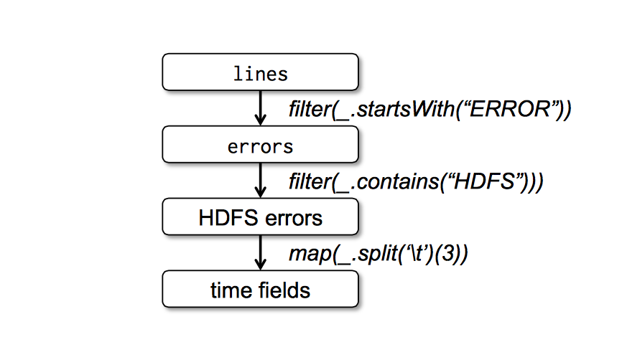
Lineage Graph

Slide 5
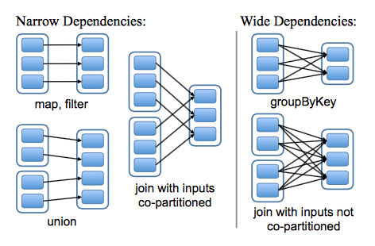
Types of Dependencies

Slide 6
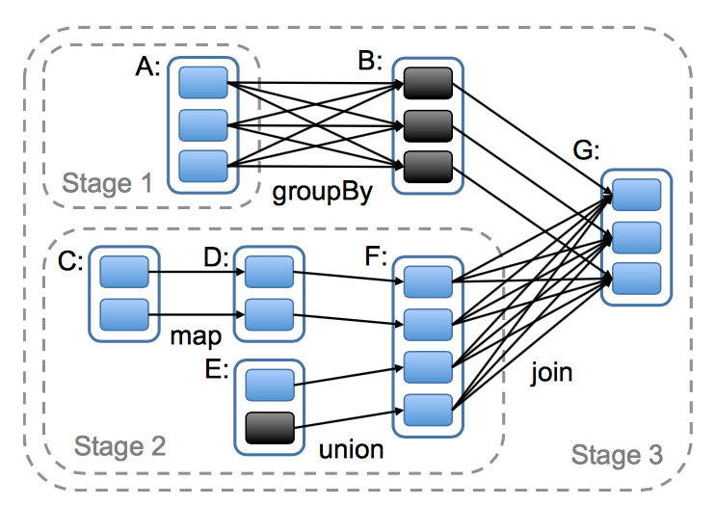
Scheduling Stages

Slide 7
Spark Performance

