Slide 1
6.830 Lecture 7
Column Stores
9/24/2014

Slide 2
Indexes Recap
 | Heap File | B+Tree | Hash File
Insert | O(1) | O( log_{B} n ) | O(1)
Delete | O(P) | O( log_{B} n ) | O(1)
Scan | O(P) | O( log_{B} n + R ) | -- / O(P)
Lookup | O(P) | O( log_{B} n ) | O(1)
n : number of tuples
P : number of pages in file
B : branching factor of B-Tree
R : number of pages in range

Slide 3
R-Trees / Spatial Indexes
y
x

Slide 4
R-Trees / Spatial Indexes
y
x

Slide 5
R-Trees / Spatial Indexes
y
x

Slide 7
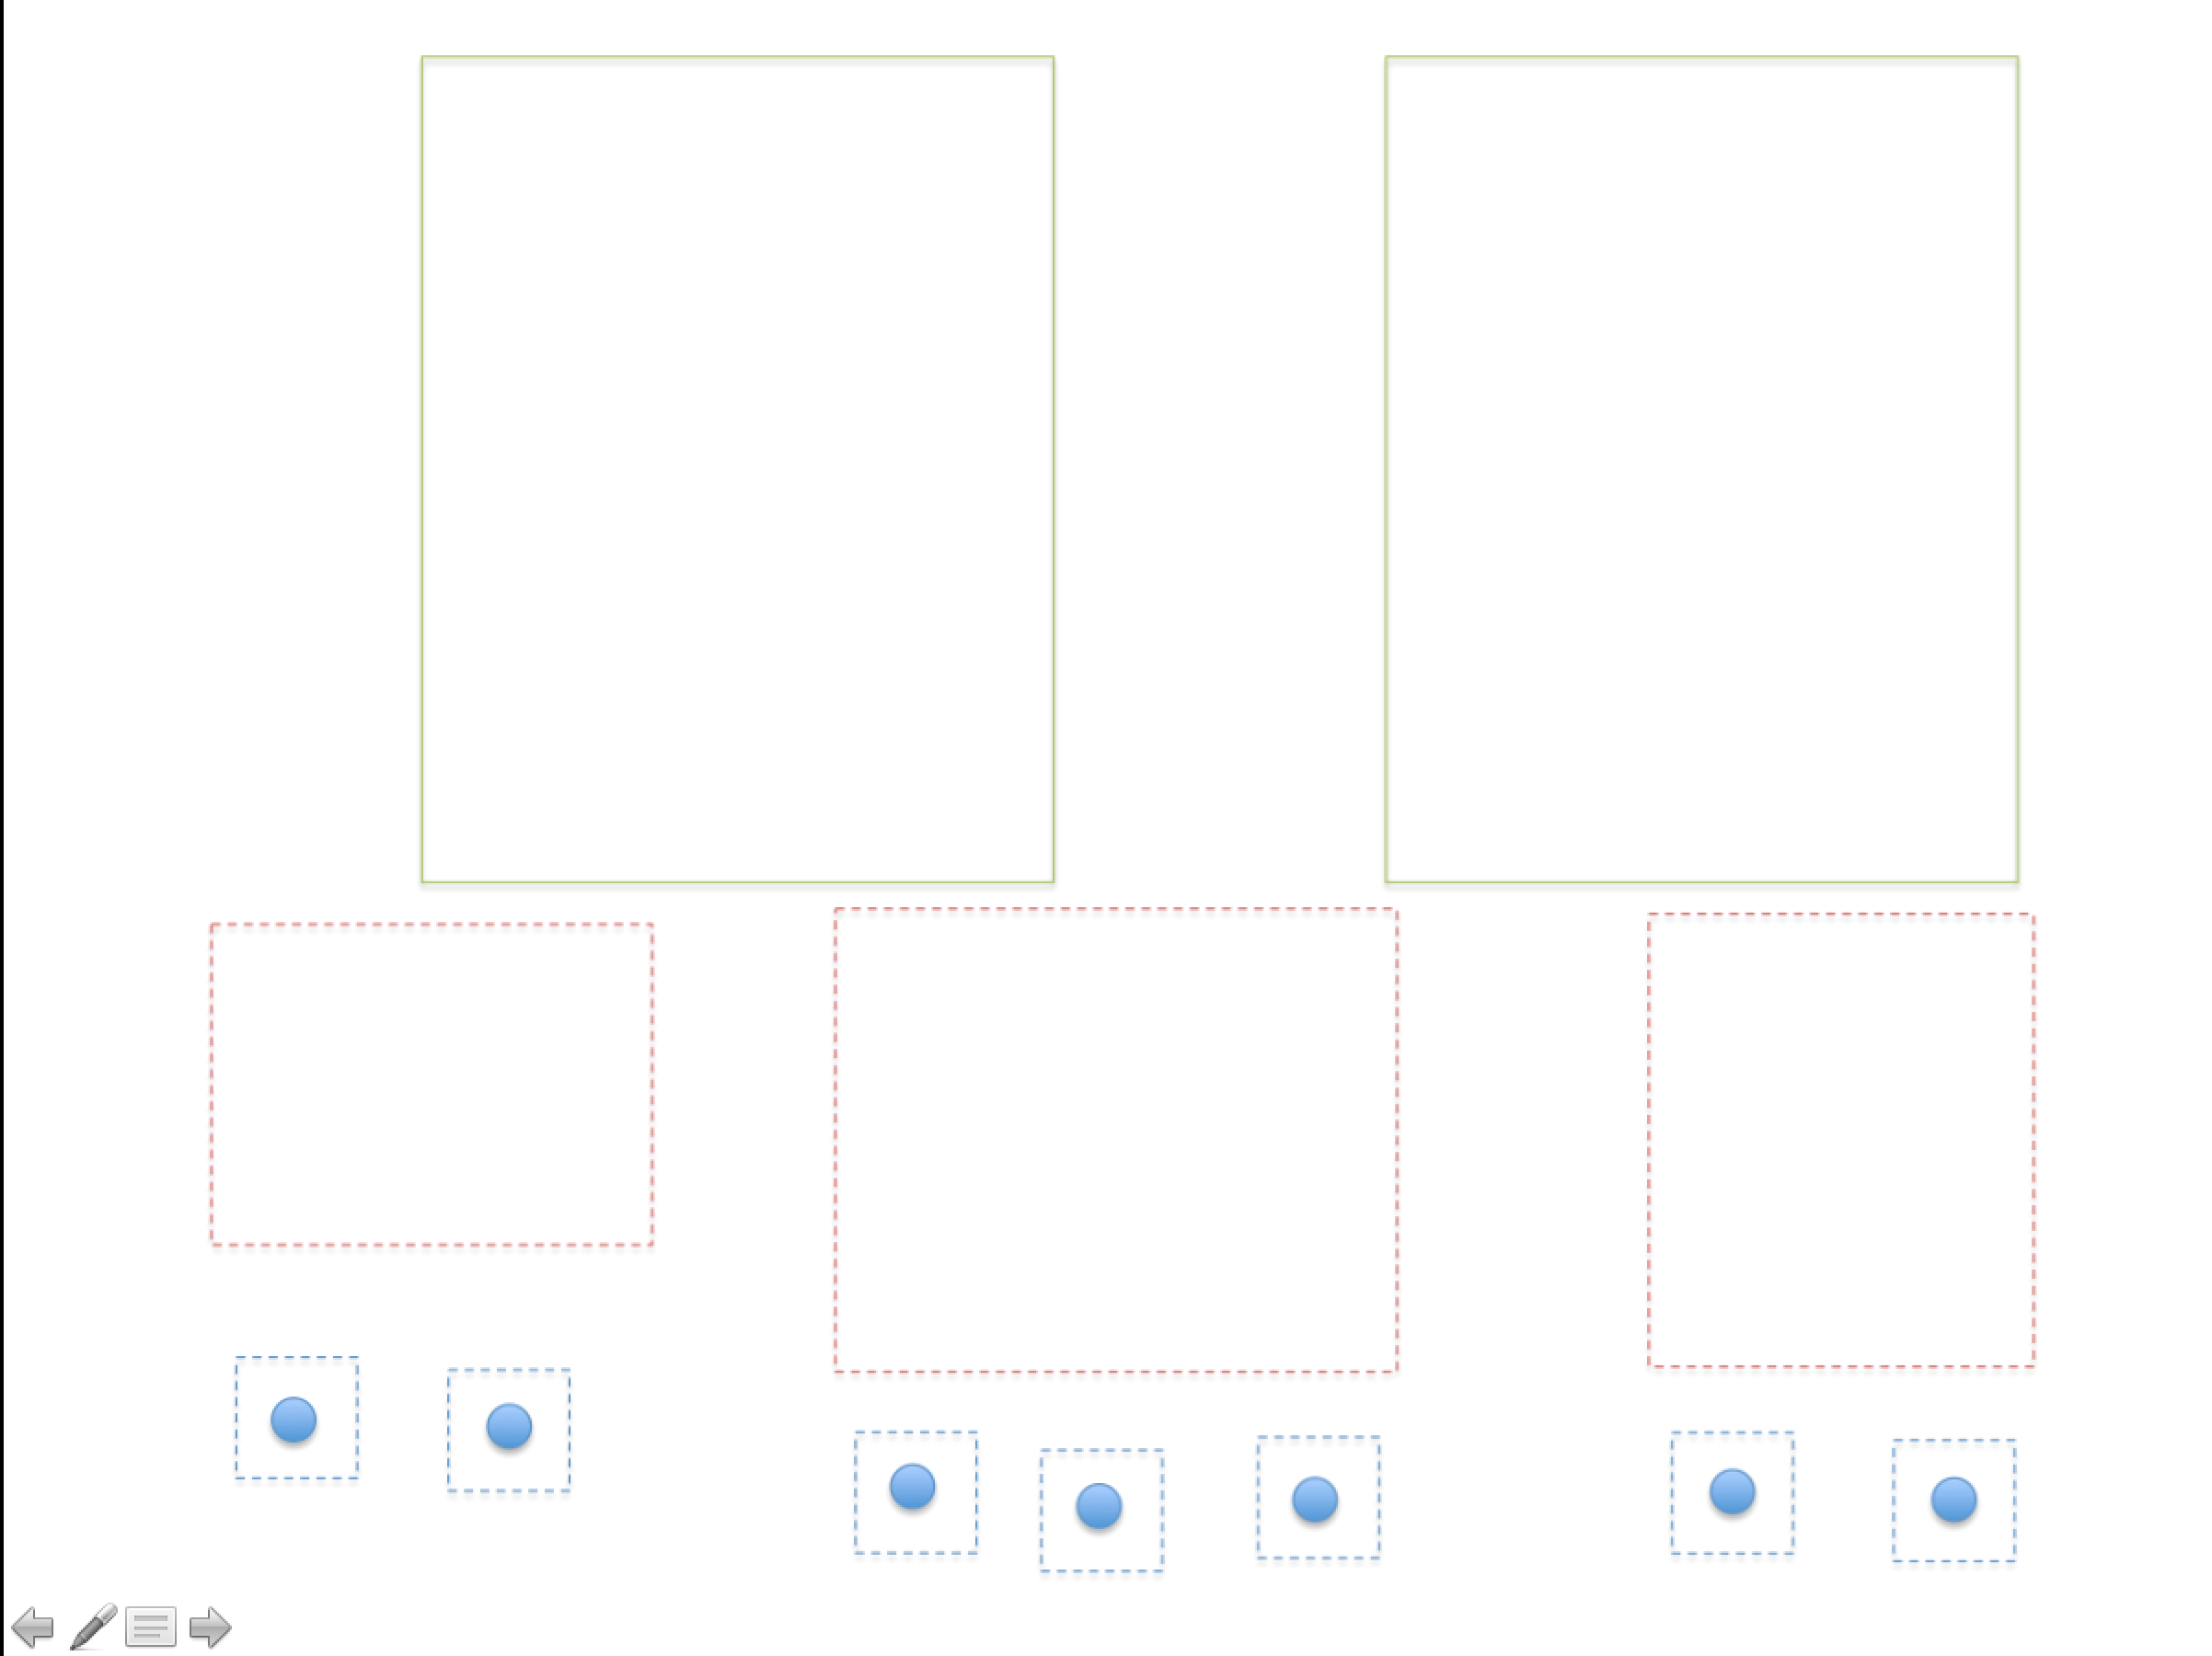
Q

Slide 8
Quad-Tree
y
x

Slide 9
Quad-Tree
y
x

Slide 10
Quad-Tree
y
x

Slide 11
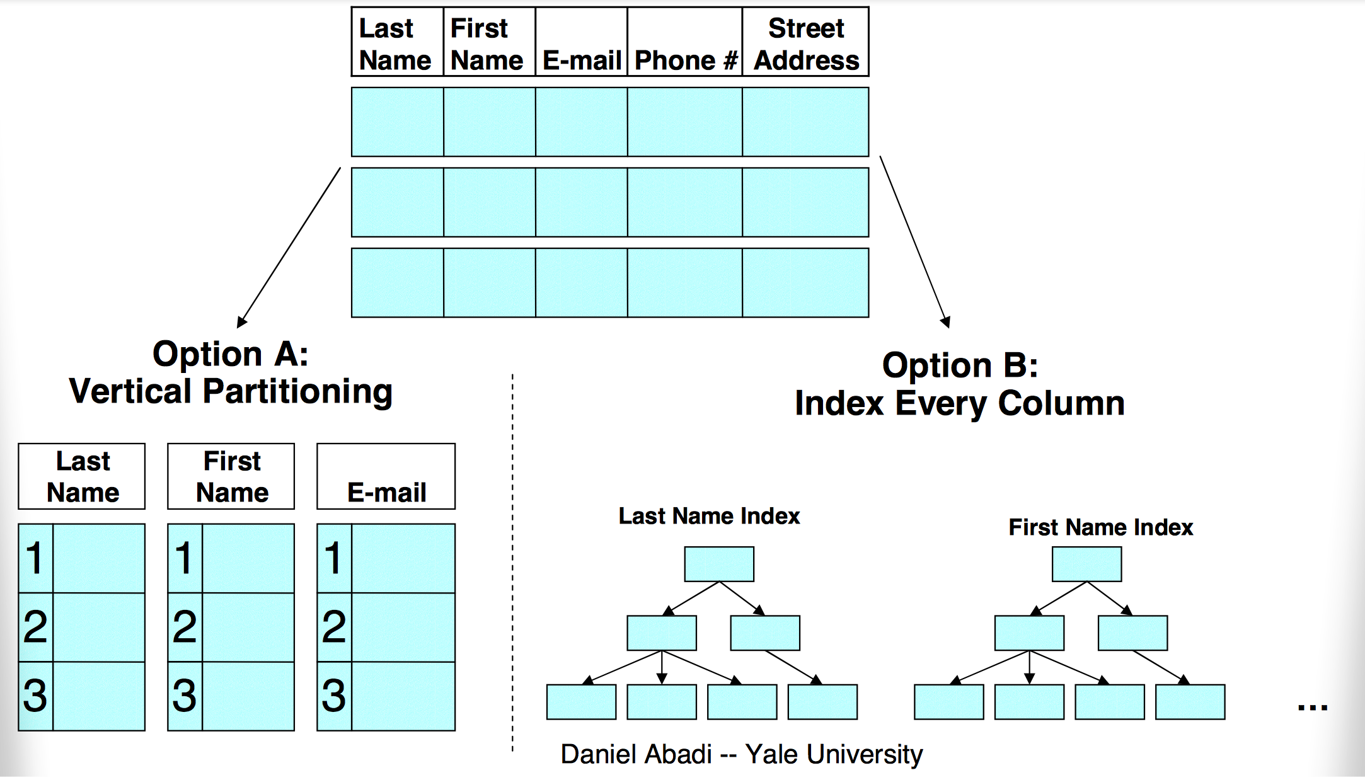
Two Emulation Approaches

Slide 12
C-Store Performance
How much do these optimizations matter?
Wanted to compare against best you could do with a commercial system

Slide 13
Emulating a Column Store
Two approaches:
Vertical partitioning: for n column table, store n two-column tables, with ith table containing a tuple-id, and attribute i
Sort on tuple-id
Merge joins for query results
Index-only plans
Create a secondary index on each column
Never follow pointers to base table

Slide 14
Bottom Line
SSBM (Star Schema Benchmark -- O’Neil et al ICDE 08)
Data warehousing benchmark based on TPC-H
Scale 100 (60 M row table), 17 columns
Average across 12 queries
Row store is a commercial DB, tuned by professional DBA vs C-Store
Commercial System Does Not Benefit From Vertical Partitioning
Time (s)
Notes:
Row store partitions on date

Slide 15
Problems with Vertical Partitioning
Tuple headers
Total table is 4GB
Each column table is ~1.0 GB
Factor of 4 overhead from tuple headers and tuple-ids
Merge joins
Answering queries requires joins
Row-store doesn’t know that column-tables are sorted
Sort hurts performance
Would need to fix these, plus add direct operation on compressed data, to approach C-Store performance

Slide 16
Problems with Index-Only Plans
Consider the query:
SELECT store_name, SUM(revenue) FROM Facts, Stores
WHERE fact.store_id = stores.store_id AND stores.country = “Canada”
GROUP BY store_name
Two WHERE clauses result in a list of tuple IDs that pass all predicates
Need to go pick up values from store_name and revenue columns
But indexes map from value→tuple ID!
Column stores can efficiently go from tuple ID→value in each column

Slide 17
Recommendations for Row-Store Designers
Might be possible to get C-Store like performance
Need to store tuple headers elsewhere (not require that they be read from disk w/ tuples)
Need to provide efficient merge join implementation that understands sorted columns
Need to support direct operation on compressed data
Requires “late materialization” design

