Slide 1
Quiz 2 Review
6.814 / 6.830 F2014

Slide 2
Key Concepts: Transactions
ACID
Serializability
Serial equivalence (testing via conflict graph)
Conflict vs view serializability
Two-phase locking (strict/rigorous)
Deadlocks & Deadlock detection (waits-for graph)
Optimistic concurrency control
Three conditions under which commits allowed
Serial vs Parallel Validation
Granularity of locking (intention locks)
Phantoms

Slide 3
Recovery
Goal: losers undone, winners redone
Write ahead logging
Log all writes, plus xaction start / end
STEAL/FORCE
ARIES:
3 passes
ANALYSIS: determine where to start replay from
REDO: “repeat history”
UNDO: remove effects of losers
“physiological logging”
dirty page table (DPT) / transaction table (XT)
cheap checkpoints: just flush DPT/XT
dirty pages flushed (not logged)
CLRs for recovering during crashes in recovery

Slide 4
Parallel / Distributed Databases
Shared memory vs shared nothing
Goal: linear speed up (not always possible)
Horizontal partitioning
Hash/range/round robin
Parallel query processing
Filter / projection applied locally
Joins
Proper partitioning: done locally
Improper partitioning: requires repartitioning, or replication of one table on all nodes
Group BYs
“Pre-aggregation” – compute partial aggregates locally (SUMs, COUNTs, etc), and then merge

Slide 5
Distributed Transactions
Goal: preserve atomicity across multiple machines
Two-phase commit protocol
Additional logging; some records forced, some not
Workers “PREPARE” xactions; once prepared a worker must wait for coordinator to determine outcome of a xaction
Coordinator commits transactions that it and all workers vote “YES” for
Commit point is when coordinator logs xaction outcome
Presumed abort / presumed commit variants

Slide 6
Replication
Key strategy for preserving high-availability
Keep multiple copies of each data item
Single master vs multi-master
Asynchronous vs synchronous

Slide 7
Readings: Dynamo
Dynamo & Eventual Consistency
CAP theorem & ACID vs BASE
Uses consistent hashing & replication
Multiple versions of each data item
Vector clocks to track changes
Configurable numbers of replicas/readers/writers (N/R/W) to tune consistency guarantees
Eventual consistency: all replicas eventually agree on state of an tiem

Slide 8
BigTable
Wide area distributed storage system
Single-record atomicity
3D table: keys, column groups, columns
Append-only storage
Writes buffered in memory, persistent via WAL
Minor compactions: periodically flush memory to tablets, stored on GFS
Major compactions: merge tablets
B+Tree like structure in metadata tablets
Chubby lock service to find root tablet; master
Master allocates key space to workers, updates metadata

Slide 9
Spark
A better MapReduce
“Data Flow” language allowing users to compose pipelines of filters, maps, joins, aggregates, etc
Resilient Distributed Datasets (RDDs)
Cached in memory for performance between iterations / operations
Made recoverably by persistent logging of lineage
Also periodic checkpoints

Slide 10
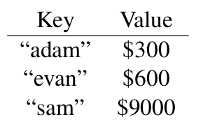
BigTable Sample Question
Consider an example table storing
bank accounts in Google’s BigTable system:
The bank programmer implements the deposit function as follows:
function deposit(account, amount):
currentBalance = bigtable.get(account)
currentBalance += amount
bigtable.put(account, currentBalance)
The user executes deposit(“sam”, $500).
The program crashes somewhere during execution. What are the possible states of the “sam” row in the table?

Slide 11
Answer
The row could either have “sam” = $9000 or “sam” = $9500, depending on if the program crashed before or after it wrote the result.

Slide 12
BigTable #2
The user executes deposit(“sam”, $500). The program completes. Immediately after the program completes, the power goes out in the BigTable data center, and all the machines reboot.
When BigTable recovers, what are the possible states of the “sam” row in the table?

Slide 13
Answer
The row can only have the value $9500, since BigTable does not inform a client that a write has been completed until it logs the update to disk on multiple physical machines. Thus, when BigTable recovers it will find the write in the log.

Slide 14
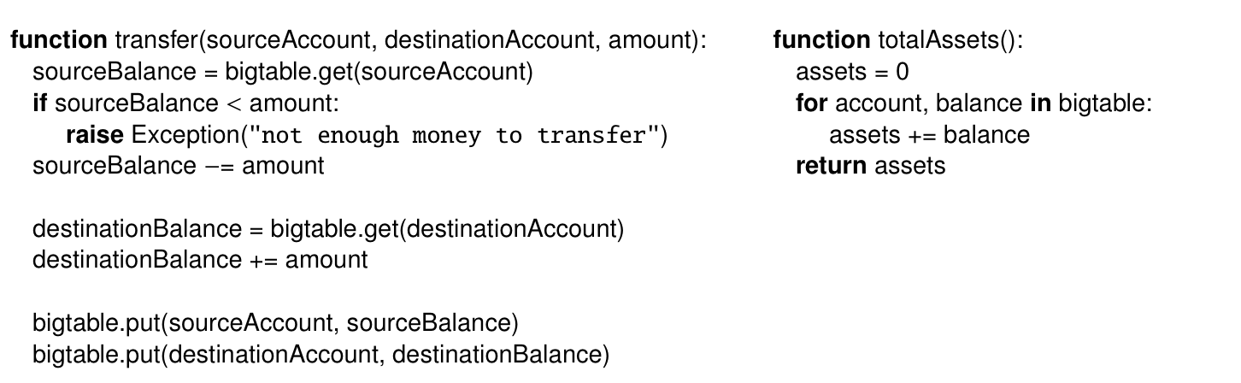
BigTable #3
Now consider the following pair of functions:

Slide 15
Big Table #3 (continued)
Given the table above, a program executes transfer(“evan”, “adam”, 200). While that function is executing, another program executes totalAssets(). What return values from totalAssets() are possible?
For the purposes of this question, assume there is only one version of each value, and that the values in BigTable are stored and processed in the order given above (i.e., “adam”, “evan”, “sam”). Provide a short explanation for your answer.

Slide 16
Answer
$9,900 is possible if totalAssets either reads all the balances before or after the transfer modifies any of them. $9,700 is possible if totalAssets reads “adam” before the $200 is added, but reads “evan” after $200 is deducted.
It might seem like $10,100 is possible, by reading “adam” after adding $200, and reading “evan” before the subtract. However, this is not possible. The transfer function performs the subtract, then the add. The scan in totalAssets reads the rows in order. Thus, if it sees the modified version of “adam” it will see the modified version of “evan.” However, it would not be a good idea to write an application that depends on this behavour, as it depends on the order of the keys and the operations in the code, which could easily change.

Slide 17
Logging
You have a database with logging and recovery as described in the ARIES paper. Your database uses strict two-phase locking. Your database has just two items in it, X with starting value 10, and Y with starting value 100.
You start three transactions at the same time, with transaction IDs (TIDs) TA, TB, and TC:
TA | TB | TC
BEGIN TRANSACTION X=X+1 Y=Y*3 END | BEGIN TRANSACTION Y=Y*2 X=X+5 END | BEGIN TRANSACTION X = X * 10 END

Slide 18
Logging (con’t)
These three transactions are the only activity in the system. The system crashes due to a power failure soon after you start the transactions. You are not sure whether or not any of them completed. You look at the disk while the system is down and see that, in the heap file, Y has the value 200. You restart the system and let the database recovery procedure complete. You query the database for the value of X, and it returns the value 110.

Slide 19
Logging (con’t)
Write down a log, as it would have appeared on the disk while the system was down, that is compatible with the above story. You need only include Update (U), Commit (C), and Abort (A) records.
Specify the TID (TA, TB, or TC) and record type for each record, and for Updates, the item being written (X or Y) and the new value being written.

Slide 20
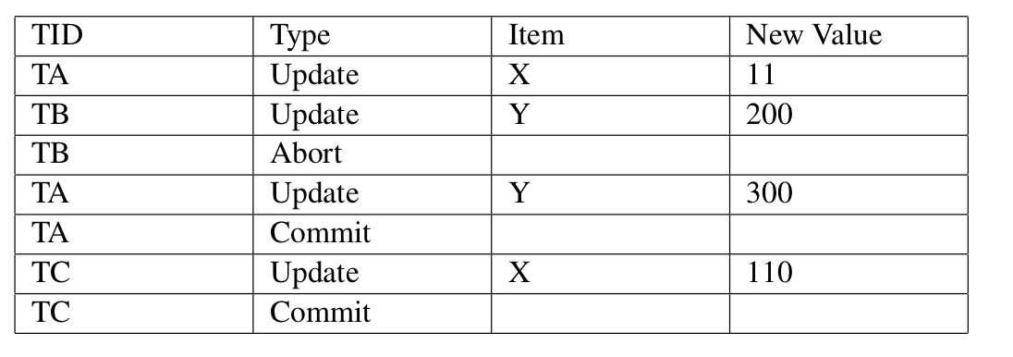
Solution
The buffer manager writes Y to disk after TB sets Y=200, and before TB aborts, which it is allowed to do under a STEAL policy. The buffer manager does not write Y to disk after TA commits, which it is allowed to do under a NO-FORCE policy. One reason TB might abort is that it deadlocks with TA.

Slide 21
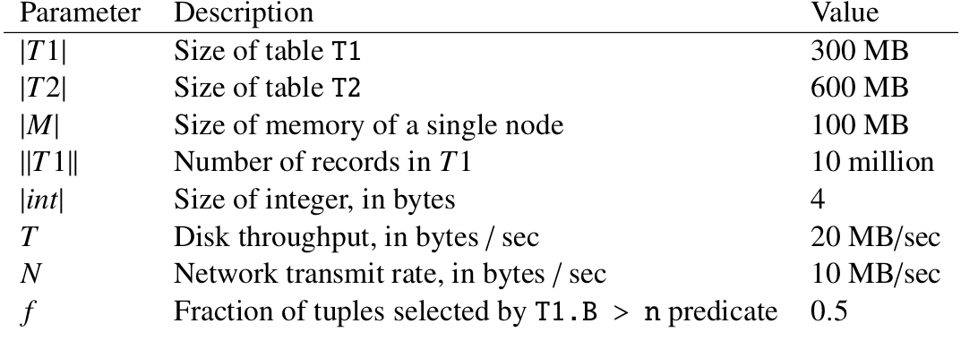
Distributed Query Planning Problem
You have a database with two tables with the following schema:
T1 : (A int PRIMARY KEY, B int, C varchar)
T2 : (D int REFERENCES T1.A, E varchar)
You are running the following query:
SELECT T1.A,COUNT(*) FROM T1,T2 AND T1.A = T2.D AND T1.B > n GROUP BY T1.A
The database has the
following configuration:

Slide 22
Question
Suppose you run the query on a single node. Assuming there are no indices, and the tables are not sorted, indicate what join algorithm (of the algorithms we have studied in class) would be most efficient, and estimate the time to process the query, ignoring disk seeks and CPU costs.

Slide 23
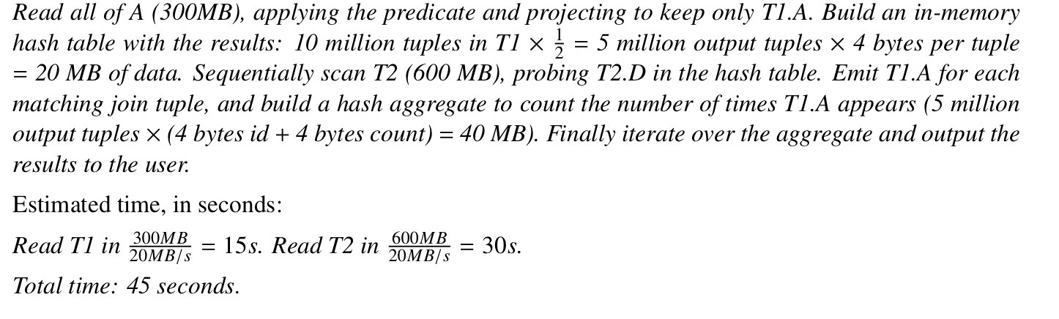
Answer

Slide 24
Question
Now suppose you switch to a cluster of 5 machines. If the above query is the only query running in the system, describe a partitioning for the tables and join algorithm that will provide the best performance, and estimate the total processing time (again, ignoring disk seeks and CPU cost).
You may assume about the same number of T2.D values join with each T1.A value.
You can assume the coordinator can receive an aggregate 50 MB/sec over the network from the five workers transmitting simultaneously at 10 MB/sec.

Slide 25
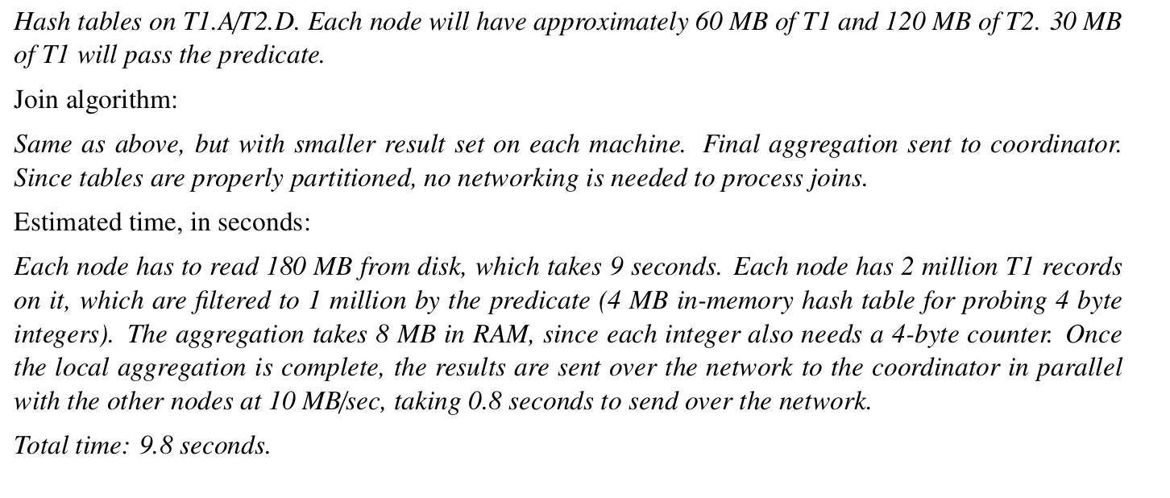
Answer

Slide 26
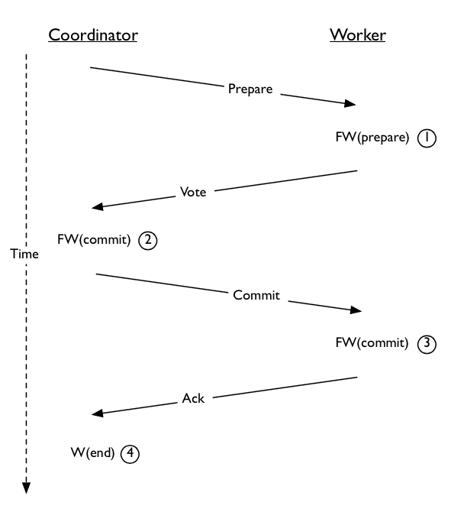
Two-phase Commit
Consider the following diagram of 2PC:

Slide 27
Questions
Suppose that the force-write at (1) were an unforced log write. Describe, in one or two sentences, what could go wrong.
Suppose that the force-write at (2) did not happen. Describe, in one or two sentences, what could go wrong.
Suppose that the force-write at (3) were an unforced log write. Describe, in one or two sentences, what could go wrong.
Suppose that the unforced write at (4) did not happen. Describe, in one or two sentences, what could go wrong.

Slide 28
Answers
If the worker crashes after sending its vote without writing the log record to disk (which contains the information that it is prepared and voted yes), it will abort the transaction on recovery (since it will assume it crashed before preparing.) This is a problem because the coordinator will assume that it can commit because the worker sent a yes vote.
The coordinator may send out a commit message to a subset of the workers and then crash. When it recovers, it will abort the transaction (because it has no commit record for it). When workers poll for the state of the transaction, the coordinator will reply ’abort’, which is inconsistent with the fact that the coordinator has already told some workers to commit.
The worker may send the acknowledgment and then crash; since the commit record is not forced, on recovery it will ask the coordinator for the status of the transaction. In the meantime, the coordinator may have heard an from all sites and written the end record and forgotten about the transaction; hence, the coordinator will tell the worker to ’abort’, which is incorrect because all other sites committed the transaction.
If the coordinator crashes and there is no end record in the log, the coordinator will resend commit messages to all of this workers. This is not a problem, as they will have already committed and will hence do nothing and simply send an ack; hence, this only leads to wasted communication when the coordinator crashes.

