Slide 1
A MapReduce Framework on Heterogeneous Systems

Slide 2
Contents
Architecture
Two-level scheduling
Multi grain input tasks
Task flow configuration
Communication

Slide 3
Difficulty of using Heterogeneous Systems
Performance
Speedup, Scalability
Resource Utilization
Programmability
Handle parallelism among nodes/processors/cores/accelerators
Handle data movement among more memory hierarchies

Slide 4
Typical Programming Models for GPUs
Input Array
Reduction on nodes
MPI
Process 0
…
Process N
Local Reduction
OpenMP/Pthread
CUDA/OpenCL
OpenMP
…
…
PThread
OpenMP
Local Reduction
CUDA/OpenCL/
OpenACC
GPU 0
CPU 1
…
…
GPU 0
CPU 1
Notes:
Does not provide the fault tolerance, users has to handle the parallelism details between CUDA OpenMP, and MPI.

Slide 5
Typical Programming Models for GPUs
Input Array
Global Reduction
MPI Process 0
…
MPI Process N
Local Reduction
CUDA,OpenCL, OpenMP,Pthread
OpenMP/Pthread
…
…
CUDA /OpenCL
OpenMP/Pthread
Hardware
GPU 0
CPU 1
…
…
GPU 0
CPU 1
Notes:
Does not provide the fault tolerance, users has to handle the parallelism details between CUDA OpenMP, and MPI.

Slide 6
Typical Programming Models for GPUs
Input Array
Computation
MPI Process 0
…
MPI Process N
Local Reduction
CUDA,OpenCL OpenMP,Pthread
CUDA,OpenCL OpenMP,Pthread
…
…
CUDA,OpenCL OpenMP,Pthread
CUDA,OpenCL OpenMP,Pthread
Global Reduction
MPI Process 0
…
MPI Process N
Notes:
Does not provide the fault tolerance, users has to handle the parallelism details between CUDA OpenMP, and MPI.

Slide 7
Typical Programming Models for GPUs
Input Split
Map Stage
Mapper
…
Mapper
Local Reduction
Local combiner
…
Local combiner
Global Reduction
Reducer
…
Reducer
Notes:
Does not provide the fault tolerance, users has to handle the parallelism details between CUDA OpenMP, and MPI.

Slide 8
Our solution for MapReduce framework on multiple GPUs and CPUs
Master Node
Job Tracker
task
task
task
Communication and Data Transfer
Task Scheduler
Worker Node
Worker Node
GPU worker
CPU worker
Task Tracker
GPU worker
CPU worker
Task Tracker

Slide 9
Scheduling
Scheduling MapReduce tasks to heterogeneous multiprocessors is a different, and algorithmically more challenging problem than homogeneous one
Homogeneous task grain is not suitable to be processed by inhomogeneous resources
Priority scheduling , highest density first, weighted shortest elapsed time first, and weighted late arrival processor sharing does not work in this scenario

Slide 10
Input Data Handling
Difficulty: Input Data need to be processed by heterogeneous resources
Multiple grain task for different devices
Two-level input tasks organization
Reuse C/C++ class, and define own DistributedParititonClass
Input Data Handling
Provider | Base class
<Type> | C/C++ basic data type, or user defined data structure
Vector<Type> | Vector<Type>
Vector<MapTask> | ParallelTasks<T>
DistributedPartitionClass <MapTask> | DistributedPartitions<T>
Notes:
Matrix Multiplication, sequential, threads, multinodes, OpenMPI, DryadLINQ provide unified data model based on LINQ and .NET language

Slide 11
Input Data Class
DistributedTaskInput
ParallelTaskInput
C/C++ basic type
User defined data type
Serialization
materialization

Slide 12
Scheduling
Two-level scheduling
First level scheduling partitions among nodes (happens on master node)
Second level scheduling tasks among devices on same node (happens on worker node)
Dynamic scheduling
Heterogeneous work stealing
Funnel the tasks

Slide 13
Scheduling on Master Node
task1
Task2
task5
task6
task7
task8
task9
task10
Task11
Task3
task4
Task12
Task13
Task14
Task15
Task16
Task17
Task18
Task19
Task20
Task21
Task22
Task23
Task24
Task25
Task26
Task27
Task28
Task29
Task30
Task31
Task32
task1
task2
tast4
task3
task1
task2
tast4
task3
task1
task2
tast4
task3
task1
task2
tast4
task3
task1
task2
tast4
task3
task1
task2
tast4
task3
task1
task2
tast4
task3
task1
task2
tast4
task3
Create a list of tasks
Split tasks into partitions
#partitions = 2*(#cpu_group + #gpus)
Sample: there are 2 cpu_groups and 2 gpu cards, split 32 tasks into 2*4 partitions, each contains 4 tasks.
Worker Node #0
Worker Node #1
Group 1
Group 2
Group 1
Group 2
CPU core#0
GPU #0
CPU core#0
GPU #0
CPU core#1
CPU core#1
CPU core#0
CPU core#0
CPU core#2
CPU core#3

Slide 14
Scheduling at Worker Node -- tasks funnel
Eliminate the cost of create/terminate thread for CPU and GPU workers.
Maintain the GPU context among different Stream or Kernel invocation.
Worker Node
Slot 1
Slot 2
task3
task2
Task1
task3
task2
Task1
Task Tracker
CPU
Slot1
Slot2
GPU
Slot1
Slot2
task1
task2
Task3
Task4
Task5
task6
CPU core#0
task1
Task2
task3
GPU #0
task1
Task2
task3

Slide 15
Task Scheduling on Worker Node
While true do
foreach worker i do
if worker_info[i].has_task = 0 then
/*assign a map task block to worker i*/
worker_info[i].task_index <- task_offset
worker_info[i].task_size <-TASK_BLOCK_SIZE;
worker_info[i].has_task <- 1;
task_offset += TASK_BLOCK_SIZE;
end
end
/*end the loop when all map tasks are scheduled*/
if task_offset >= total_tasks_size then
break;
end
End
Send end message to all the worker on this nodes

Slide 16
Scheduling at Worker Node -- heterogeneous work stealing
Worker Node
Partition List
task1
task2
tast4
task3
task1
task2
tast4
task3
task1
task2
tast4
task3
task1
task2
tast4
task3
GPU pick up partition at each time, and launch a stream for each task within partition to deliver the parallelism
CPU pick up one task at each time, and set up the related task information.
Slot 1
Slot 2
Slot 3
CPU #0
CPU #0
GPU #0
task1
2
3
4
task1
2
3
4
task1
task2
tast4
task3
task1
task2
tast4
task3

Slide 17
Basic Execution Plan
Local Combine
GPU Map
CPU Map
Combine
GPU Reduce
CPU Reduce
4
7
16
2
5
6
1
8
3
10
11
12
13
14
15
9
1
2
3
4
5
6
7
8
9
configure
map
shuffle
reduce

Slide 18
Execution Plan Configuration
HeterogeneousMapReduceJobExecutionPlan
CPUMap
GPUMap
CPULocalCombiner
GPULocalCombiner
Shuffle
CPUReduce
GPUReduce
Refinement passes
Task granularity optimization
Devices choose
Partial Aggregation,
Aggregation Tree, Fusion
Hierarchical Aggregation
Memory hierarchy
Data locality affinity
Avoid unnecessary data transformation

Slide 19
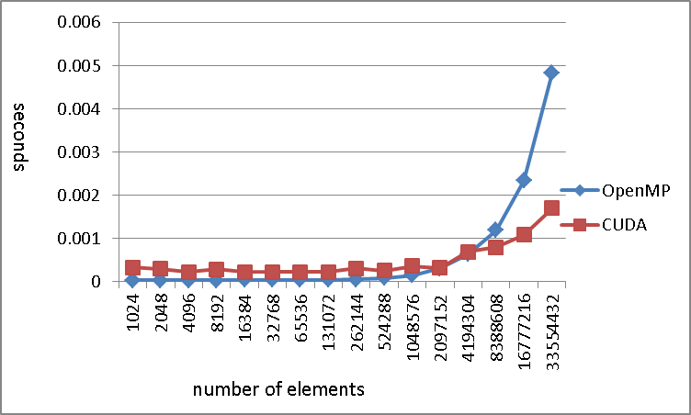
Execution Plan Refinement -- sample GlobalReductions
Inputs
Inputs
CPU Map
GPU Map
GPU Map
CPU Reduce
GPU Reduce
CPU Reduce
Refine the execution plan based on application profile, hardware capability, and size of input data
Sample, OpenMP version of Sum is faster than CUDA version when #elements larger than 4 million per node

Slide 20
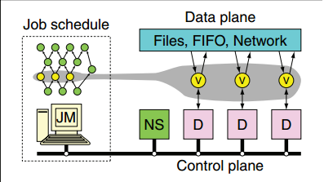
Communication
Files: data stored after task completes
Shared memory FIFO: worker on same node
Network: no disk access, but receiver and sender need happens in the same time
RDMA, and device memory transfer between GPUs directly.
The utilities:
ADIOS, MVAPICH

Slide 21
Backups

Slide 22
Execution workflow
Configure GPU and CPU MapReduce tasks
Iterations
Task Scheduler
GPU Host Map Task
Wrapper for CUDA code
GPU Kernel Map Task
CUDA code
CPU Map Task
C/C++ code
3
16
5
6
10
12
13
7
2
11
4
15
9
16
8
1
Local
Combiner
Shuffle Intermediate Key/Value Pairs in CPU Memory
1
2
3
4
5
6
7
8
9
Task Scheduler
GPU Host Reduce Task
Wrapper for CUDA code
GPU Reduce Task
CUDA code
CPU Reduce Task
C/C++ code
Merge Output

Slide 23
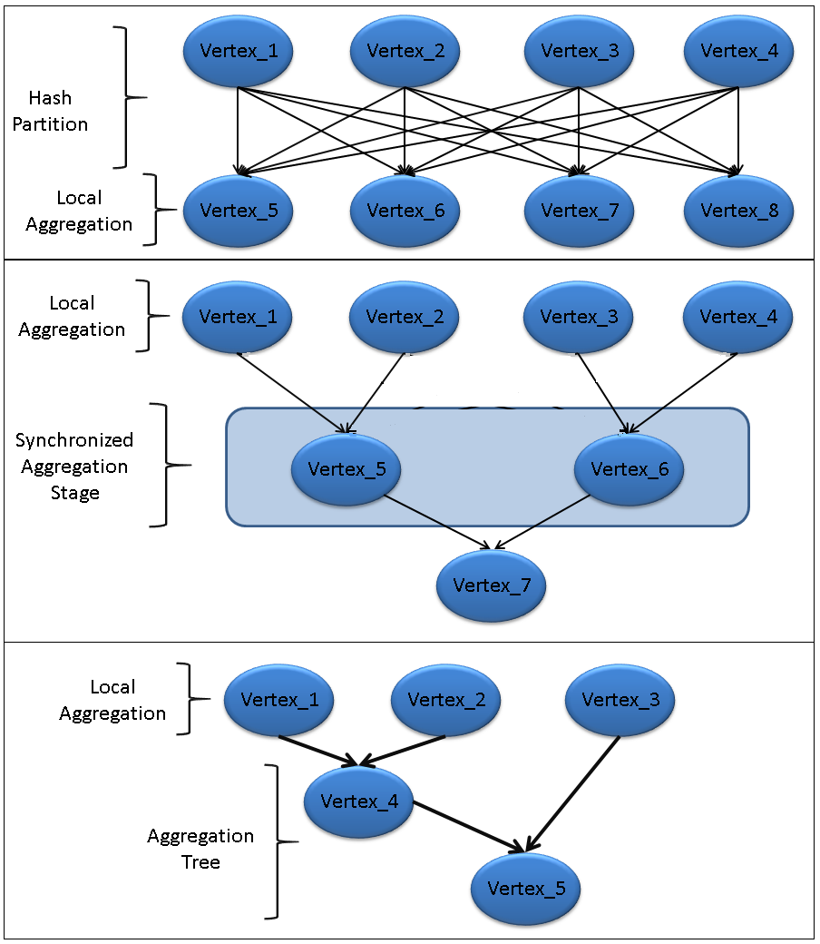
Distributed Grouped Aggregation Execution Scheme Refinement

Slide 24
References
Dryad: Distributed Data-Parallel Programs from Sequential Building Blocks
Multi-GPU MapReduce on GPU Clusters
Accelerating MapReduce on a Coupled CPU-GPU Architecture
Hybrid Map Task Scheduling for GPU-based Heterogeneous Clusters
Scalable Data Clustering using GPU Clusters
Parallel Processing in CPU and GPU Heterogeneous Environment
Multigrain Affinity for Heterogeneous Work Stealing

Slide 25
Typical Programming Models for GPUs
Input Array
Computation
MPI Process 0
…
MPI Process N
Local Reduction
CUDA,OpenCL OpenMP,Pthread
CUDA,OpenCL OpenMP,Pthread
…
…
CUDA,OpenCL OpenMP,Pthread
CUDA,OpenCL OpenMP,Pthread
Global Reduction
MPI Process 0
…
MPI Process N
Notes:
Does not provide the fault tolerance, users has to handle the parallelism details between CUDA OpenMP, and MPI.

Slide 26
Typical Programming Models for GPUs
Input Split
Map Stage
Mapper
…
Mapper
Local Reduction
Local combiner
…
Local combiner
Global Reduction
Reducer
…
Reducer
Notes:
Does not provide the fault tolerance, users has to handle the parallelism details between CUDA OpenMP, and MPI.

Slide 27
Execution workflow
Input Split
Iterations
Job Tracker (Master node)
Map
Map
Map
3
16
5
6
10
12
13
7
2
11
4
15
9
16
8
1
Local
Combiner
Shuffle Intermediate Key/Value Pairs in CPU Memory
1
2
3
4
5
6
7
8
9
Task Scheduler
Reduce
GPU Reduce Task
CUDA code
Map
Merge Output

Slide 28
MPI Process 0
Broadcast Data MPI_Broadcast
MPI Process 1
…
MPI Process N
Launch Kernel
OpenMP
OpenMP
…
…
OpenMP
OpenMP
Read from shared memory
Distance Kernel
Membership Kernel
Local reduce Kernel
GPU
GPU
…
…
GPU
GPU
cudaMemcopyH2D
cudaMemcopyD2H
OpenMP
OpenMP
…
…
OpenMP
OpenMP
Copy to shared memory
Local reduction
MPI Process 1
…
MPI Process N
Read from shared memory
Global reduction
Calculate new centroids
MPI Process 0
Write output to shared memory
Notes:
Does not provide the fault tolerance, users has to handle the parallelism details between CUDA OpenMP, and MPI.

Slide 29
Job Tracker
Task Tracker 0
…
Task Tracker N
Run Map task
Map Task
Map Task
…
…
Map Task
Map Task
Read data from disk to memory
Distance Function
Membership function
Local reduce function
GPU
GPU
…
…
GPU
GPU
Read data from pipe
cudaMemcopyH2D
cudaMemcopyD2H
write data to shared mem
Map Task
Map Task
…
…
Map Task
Map Task
Read data from pipe
Copy to shared memory
Write data to local disk
Local combiner
combiner
…
combiner
Read data from shared memory
Copy data to local disk
Global reduction
Calculate new centroids
Reduce task
Read data from http
Write results to disk
Notes:
Does not provide the fault tolerance, users has to handle the parallelism details between CUDA OpenMP, and MPI.

Slide 31
MPI Process 0
Broadcast Data MPI_Broadcast
MPI Process 1
…
MPI Process N
Launch Kernel
OpenMP
OpenMP
…
…
OpenMP
OpenMP
Read from shared memory
Distance Kernel
GPU
GPU
…
…
GPU
GPU
cudaMemcopyH2D
cudaMemcopyD2H
Membership Kernel
GPU
GPU
…
…
GPU
GPU
cudaMemcopyH2D
cudaMemcopyD2H
Local reduce Kernel
GPU
GPU
…
…
GPU
GPU
cudaMemcopyH2D
cudaMemcopyD2H
OpenMP
OpenMP
…
…
OpenMP
OpenMP
Copy to shared memory
Local reduction
MPI Process 1
…
MPI Process N
Read from shared memory
Global reduction
Calculate new centroids
MPI Process 0
Write output to shared memory
Notes:
Does not provide the fault tolerance, users has to handle the parallelism details between CUDA OpenMP, and MPI.

Slide 32
Job Tracker
Task Tracker 0
…
Task Tracker N
Run Map task
Map Task
Map Task
…
…
Map Task
Map Task
Read data from disk to memory
Distance Function
Membership function
Local reduce function
GPU
GPU
…
…
GPU
GPU
Read data from pipe
cudaMemcopyH2D
cudaMemcopyD2H
write data to shared mem
Map Task
Map Task
…
…
Map Task
Map Task
Read data from pipe
Copy to shared memory
Write data to local disk
Local combiner
combiner
…
combiner
Read data from shared memory
Copy data to local disk
Global reduction
Calculate new centroids
Reduce task
Read data from http
Write results to disk
Notes:
Does not provide the fault tolerance, users has to handle the parallelism details between CUDA OpenMP, and MPI.

