Slide 1
Introduction to Graph Databases
Chicago Graph Database Meet-Up Max De Marzi

Slide 2

About Me
Built the Neography Gem (Ruby Wrapper to the Neo4j REST API)
Playing with Neo4j since 10/2009
My Blog: http://maxdemarzi.com
Find me on Twitter: @maxdemarzi
Email me: maxdemarzi@gmail.com
GitHub: http://github.com/maxdemarzi

Slide 3
Agenda
Trends in Data
NOSQL
What is a Graph?
What is a Graph Database?
What is Neo4j?

Slide 4
Trends in Data

Slide 5
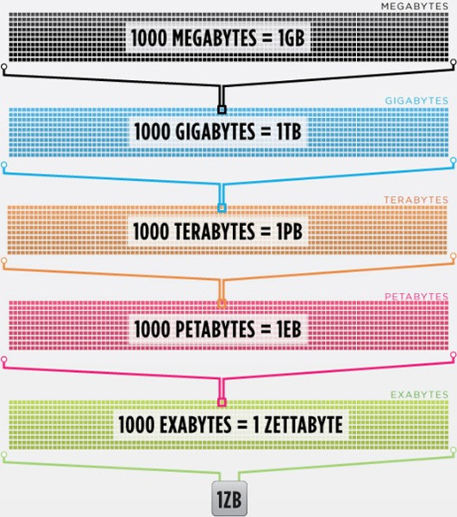
Data is getting bigger:
“Every 2 days we create as much information as we did up to 2003”
– Eric Schmidt, Google

Slide 6
Data is more connected:
Text (content)
HyperText (added pointers)
RSS (joined those pointers)
Blogs (added pingbacks)
Tagging (grouped related data)
RDF (described connected data)
GGG (content + pointers + relationships + descriptions)

Slide 7

Data is more Semi-Structured:
If you tried to collect all the data of every movie ever made, how would you model it?
Actors, Characters, Locations, Dates, Costs, Ratings, Showings, Ticket Sales, etc.

Slide 8
NOSQL
Not Only SQL

Slide 9
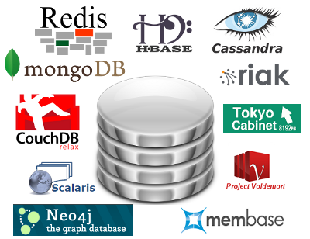
Less than 10% of the NOSQL Vendors

Slide 10
Key Value Stores
Most Based on Dynamo: Amazon Highly Available Key-Value Store
Data Model:
Global key-value mapping
Big scalable HashMap
Highly fault tolerant (typically)
Examples:
Redis, Riak, Voldemort

Slide 11
Key Value Stores: Pros and Cons
Pros:
Simple data model
Scalable
Cons
Create your own “foreign keys”
Poor for complex data

Slide 12
Column Family
Most Based on BigTable: Google’s Distributed Storage System for Structured Data
Data Model:
A big table, with column families
Map Reduce for querying/processing
Examples:
HBase, HyperTable, Cassandra

Slide 13
Column Family: Pros and Cons
Pros:
Supports Simi-Structured Data
Naturally Indexed (columns)
Scalable
Cons
Poor for interconnected data

Slide 14
Document Databases
Data Model:
A collection of documents
A document is a key value collection
Index-centric, lots of map-reduce
Examples:
CouchDB, MongoDB

Slide 15
Document Databases: Pros and Cons
Pros:
Simple, powerful data model
Scalable
Cons
Poor for interconnected data
Query model limited to keys and indexes
Map reduce for larger queries

Slide 16
Graph Databases
Data Model:
Nodes and Relationships
Examples:
Neo4j, OrientDB, InfiniteGraph, AllegroGraph

Slide 17
Graph Databases: Pros and Cons
Pros:
Powerful data model, as general as RDBMS
Connected data locally indexed
Easy to query
Cons
Sharding ( lots of people working on this)
Scales UP reasonably well
Requires rewiring your brain

Slide 18
Living in a NOSQL World
RDBMS
Graph
Databases
Complexity
Document
Databases
BigTable
Clones
Key-Value
Store
Relational
Databases
90% of
Use Cases
Size

Slide 19
What is a Graph?

Slide 20

What is a Graph?
An abstract representation of a set of objects where some pairs are connected by links.
Object (Vertex, Node)
Link (Edge, Arc, Relationship)

Slide 21




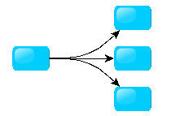
Different Kinds of Graphs
Undirected Graph
Directed Graph
Pseudo Graph
Multi Graph
Hyper Graph
Notes:
An undirected graph is one in which edges have no orientation. The edge (a, b) is identical to the edge (b, a).
A directed graph or digraph is an ordered pair D = (V, A)
A pseudo graph is a graph with loops
A multi graph allows for multiple edges between nodes
A hyper graph allows an edge to join more than two nodes

Slide 22



More Kinds of Graphs
Weighted Graph
Labeled Graph
Property Graph
Notes:
A weighted graph has a number assigned to each edge
A labeled graph has a label assigned to each node or edge
A property graph has keys and values for each node or edge

Slide 23
What is a Graph Database?
A database with an explicit graph structure
Each node knows its adjacent nodes
As the number of nodes increases, the cost of a local step (or hop) remains the same
Plus an Index for lookups

Slide 24
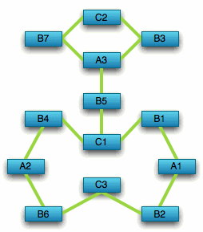
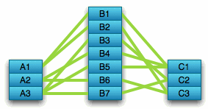
Compared to Relational Databases
Optimized for aggregation
Optimized for connections

Slide 25
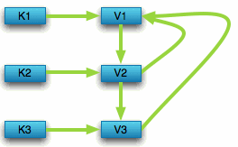

Compared to Key Value Stores
Optimized for simple look-ups
Optimized for traversing connected data

Slide 26
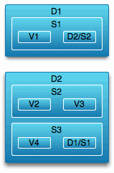
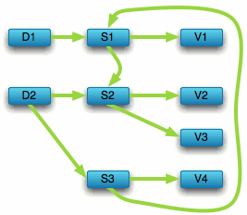
Compared to Key Value Stores
Optimized for “trees” of data
Optimized for seeing the forest and the trees, and the branches, and the trunks

Slide 27
What is Neo4j?

Slide 28
What is Neo4j?
A Graph Database + Lucene Index
Property Graph
Full ACID (atomicity, consistency, isolation, durability)
High Availability (with Enterprise Edition)
32 Billion Nodes, 32 Billion Relationships, 64 Billion Properties
Embedded Server
REST API
Notes:
Atomic = all or nothing, consistent = stay consistent from one tx to another, isolation = no tx will mess with another tx, durability = once tx committed, it stays

Slide 29
Good For
Highly connected data (social networks)
Recommendations (e-commerce)
Path Finding (how do I know you?)
A* (Least Cost path)
Data First Schema (bottom-up, but you still need to design)

Slide 30
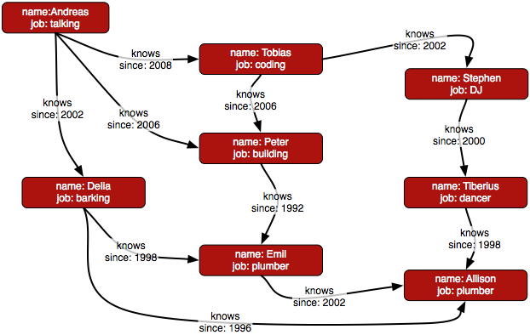
Property Graph

Slide 31


// then traverse to find results
start n=(people-index, name, “Andreas”)
match (n)--()--(foaf) return foaf
n

Slide 32

Cypher
Pattern Matching Query Language (like SQL for graphs)
// get node 0
start a=(0) return a
// traverse from node 1
start a=(1) match (a)-->(b) return b
// return friends of friends
start a=(1) match (a)--()--(c) return c

Slide 33
Gremlin
A Graph Scripting DSL (groovy-based)
// get node 0
g.v(0)
// nodes with incoming relationship
g.v(0).in
// outgoing “KNOWS” relationship
g.v(0).out(“KNOWS”)

Slide 34
If you’ve ever
Joined more than 7 tables together
Modeled a graph in a table
Written a recursive CTE
Tried to write some crazy stored procedure with multiple recursive self and inner joins
You should use Neo4j

Slide 35
Language
LanguageCountry
Country
language_code
language_name
word_count
language_code
country_code
primary
country_code
country_name
flag_uri
Language
Country
name
code
word_count
IS_SPOKEN_IN
name
code
flag_uri
as_primary
35

Slide 36
name: “Canada”
languages_spoken: “[ ‘English’, ‘French’ ]”
language:“English”
spoken_in
name: “USA”
spoken_in
name: “Canada”
spoken_in
language:“French”
spoken_in
name: “France”

Slide 37
Country
name
flag_uri
language_name
number_of_words
yes_in_langauge
no_in_language
currency_code
currency_name
Country
Language
name
flag_uri
name
number_of_words
yes
no
SPEAKS
Currency
USES_CURRENCY
code
name

Slide 38
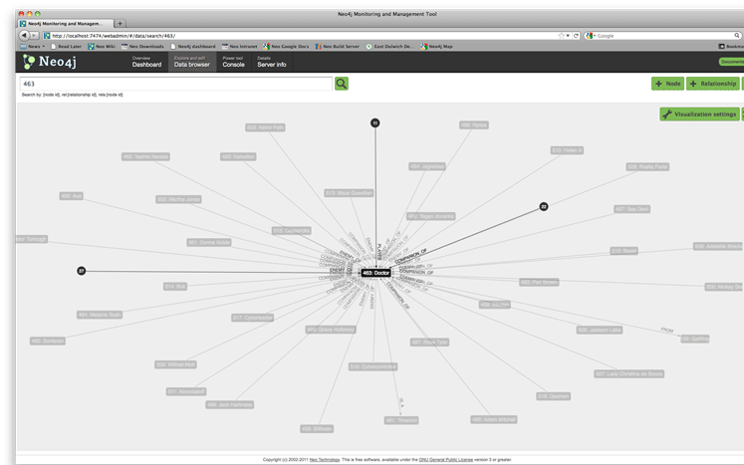
Neo4j Data Browser

Slide 39
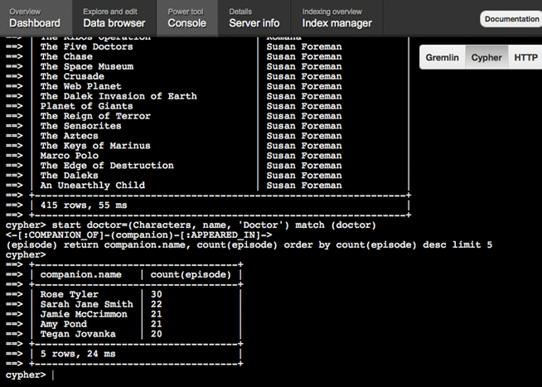
Neo4j Console

Slide 40
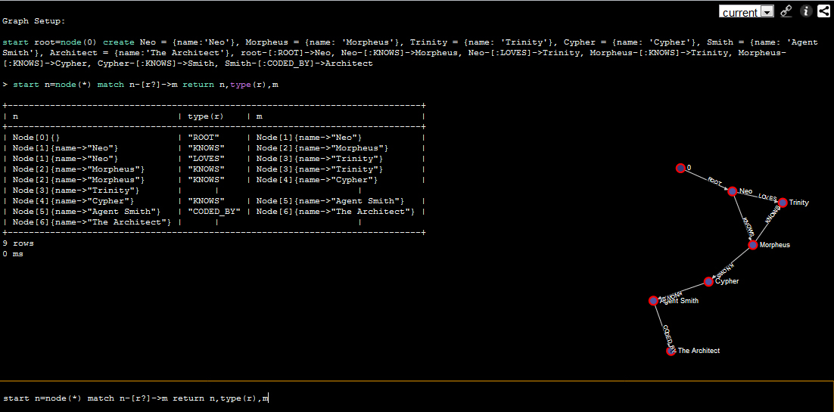
console.neo4j.org
Try it right now:
start n=node(*) match n-[r:LOVES]->m return n, type(r), m
Notice the two nodes in red, they are your result set.

Slide 41
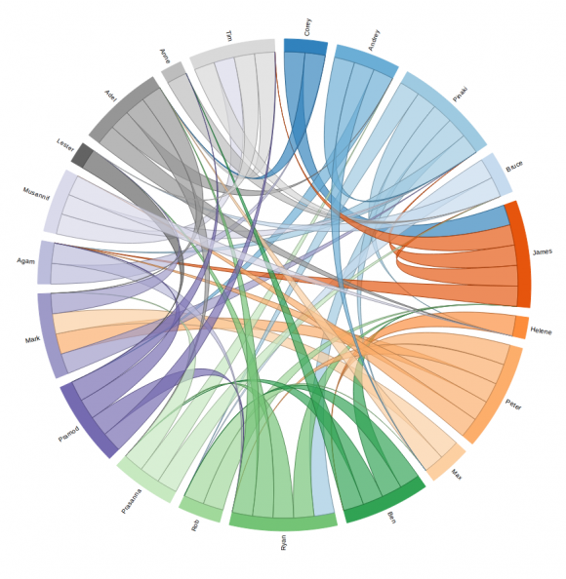
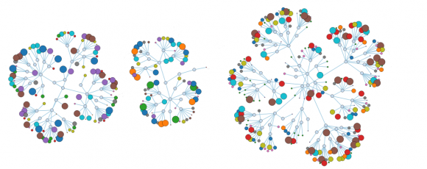
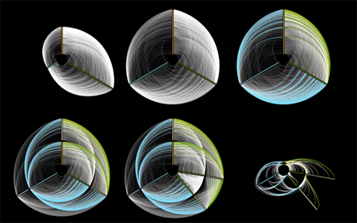
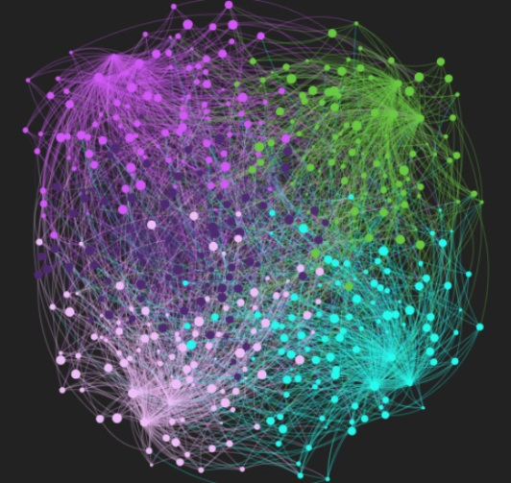
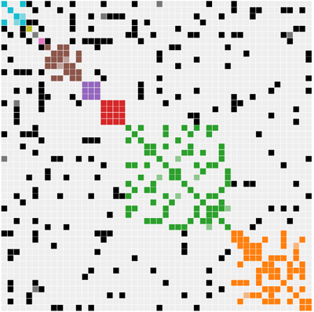
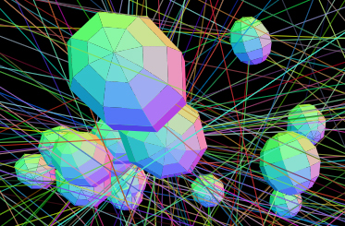
What does a Graph look like?

Slide 42
Questions?
?

Slide 43
Thank you!
http://maxdemarzi.com

