Slide 1

Big Data Research in the AMPLab: BDAS and Beyond
Michael Franklin
UC Berkeley
1st Spark Summit
December 2, 2013
UC BERKELEY

Slide 2



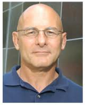

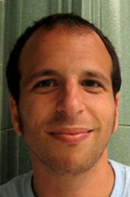


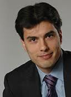










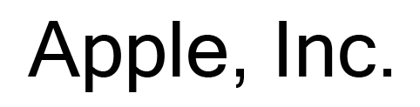








AMPLab: Collaborative Big Data Research
Launched: January 2011, 6 year planned duration
Personnel: ~60 Students, Postdocs, Faculty and Staff
Expertise: Systems, Networking, Databases and Machine Learning
In-House Apps: Crowdsourcing, Mobile Sensing, Cancer Genomics
UC BERKELEY

Slide 3
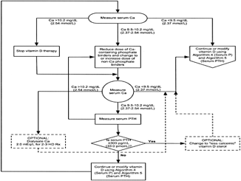
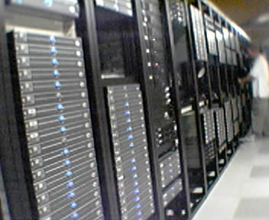

AMPLab: Integrating Diverse Resources
Algorithms
Machine Learning, Statistical Methods
Prediction, Business Intelligence
Machines
Clusters and Clouds
Warehouse Scale Computing
People
Crowdsourcing, Human Computation
Data Scientists, Analysts

Slide 4
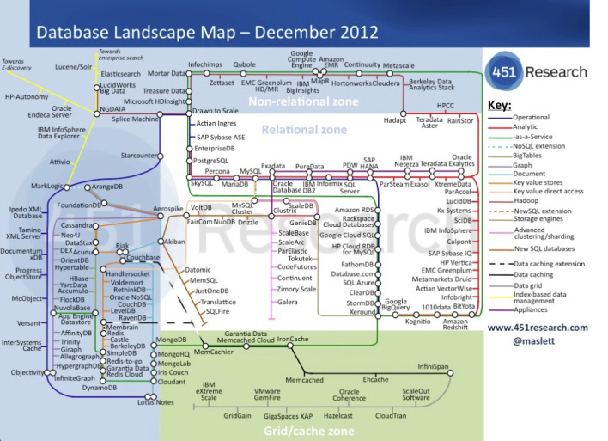
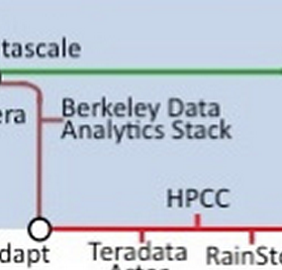
Big Data Landscape – Our Corner

Slide 5
Berkeley Data Analytics Stack
Shark (SQL)
BlinkDB
GraphX
MLBase
AMP
Alpha or Soon
Spark Streaming
ML-lib
Apache Spark
AMP
Released
BSD/Apache
3rd Party Open Source
Tachyon
HDFS / Hadoop Storage
Apache Mesos
YARN Resource Manager

Slide 6

Our View of the Big Data Challenge
Something’s
gotta give…
Time
Answer
Quality
Money
Massive
Diverse
and
Growing
Data
Massive Diverse and Growing
Data

Slide 7
Speed/Accuracy Trade-off
Interactive
Queries
Error
Time to Execute on
Entire Dataset
5 sec
30 mins
Execution Time

Slide 8
Speed/Accuracy Trade-off
Interactive
Queries
Error
Time to Execute on
Entire Dataset
Pre-Existing
Noise
5 sec
30 mins
Execution Time

Slide 9

A data analysis (warehouse) system that …
builds on Shark and Spark
returns fast, approximate answers with error bars by executing queries on small samples of data
is compatible with Apache Hive (storage, serdes, UDFs, types, metadata) and supports Hive’s SQL-like query structure with minor modifications
Agarwal et al., BlinkDB: Queries with Bounded Errors and Bounded Response Times on Very Large Data. ACM EuroSys 2013, Best Paper Award

Slide 10
Sampling Vs. No Sampling
1020
10x as response time
is dominated by I/O
Query Response Time (Seconds)
103
18
13
10
8
1
10⁻¹
10⁻²
10⁻³
10⁻⁴
10⁻⁵
Fraction of full data

Slide 11
Sampling Vs. No Sampling
1020
Error Bars
Query Response Time (Seconds)
(0.02%)
103
(0.07%)
(1.1%)
(3.4%)
(11%)
18
13
10
8
1
10⁻¹
10⁻²
10⁻³
10⁻⁴
10⁻⁵
Fraction of full data

Slide 12
People Resources
Hybrid Human-Machine Computation
Data Cleaning
Active Learning
Handling the last 5%
Supporting Data Scientists
Interactive Analytics
Visual Analytics
Collaboration
Franklin et al., CrowdDB: Answering Queries with Crowdsourcing, SIGMOD 2011
Wang et al., CrowdER: Crowdsourcing Entity Resolution, VLDB 2012
Trushkowsky et al., Crowdsourcing Enumeration Queries, ICDE 2013 Best Paper Award

Slide 13
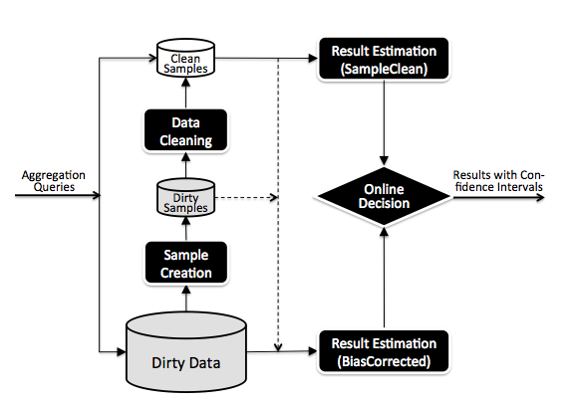
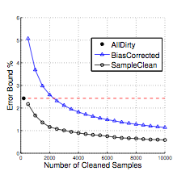
Less is More? Data Cleaning + Sampling
J. Wang et al., Work in Progress

Slide 14

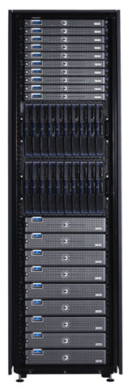
Working with the Crowd
Incentives
Fatigue, Fraud, & other Failure Modes
Latency & Prediction
Work Conditions
Interface Impacts Answer Quality
Task Structuring
Task Routing

Slide 15
The 3E’s of Big Data: Extreme Elasticity Everywhere
Algorithms
Approximate Answers
Machines
Cloud Computing – esp. Spot Instances
Multi-tenancy
People
Dynamic Task and Microtask Marketplaces
Visual analytics
ML Libraries and Ensemble Methods
Relaxed (eventual) consistency/ Multi-version methods
Active Learning
Manipulative interfaces and mixed mode operation

Slide 16
The Research Challenge
AMP Integration +
Extreme Elasticity +
Tradeoffs +
More Sophisticated Analytics
= Extreme Complexity

Slide 17

Can we Take a Declarative Approach?
Can reduce complexity through automation
End Users tell the system what they want, not how to get it
SQL
Result
MQL
Model

Slide 18
Goals of MLbase
ML Insights
MLbase
Systems Insights
Easy scalable ML development (ML Developers)
Easy/user-friendly ML at scale (End Users)
Along the way, we gain insight into data intensive computing
Notes:
Turn ML into an engineering discipline
Mlbase is a system which consists of a library of distributed machine learning algorithms, programming abstractions to support the development of these, and a suite of tools to make building and deploying models in a distributed setting easy for end users.

Slide 19
A Declarative Approach
End Users tell the system what they want, not how to get it
Example: Supervised Classification
var X = load(”als_clinical”, 2 to 10)
var y = load(”als_clinical”, 1)
var (fn-model, summary) = doClassify(X, y)
Algorithm Independent

Slide 20
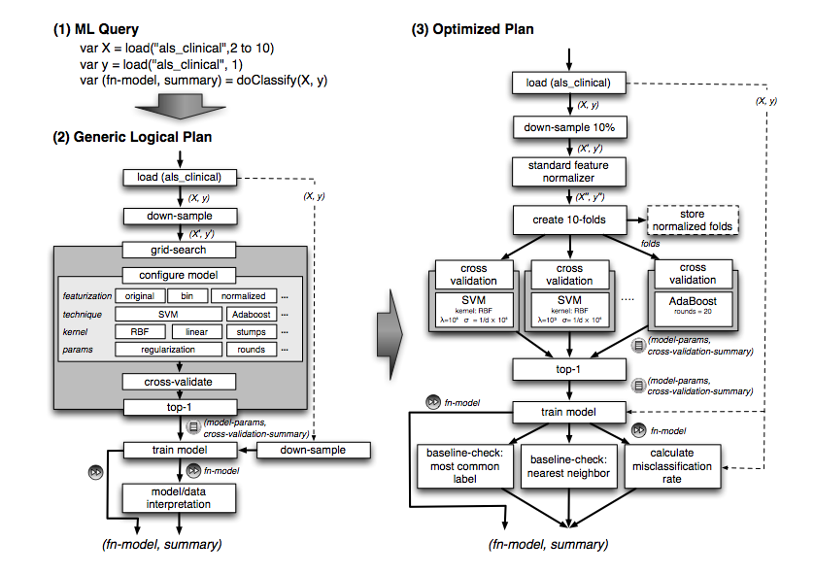
MLBase – Query Compilation

Slide 21
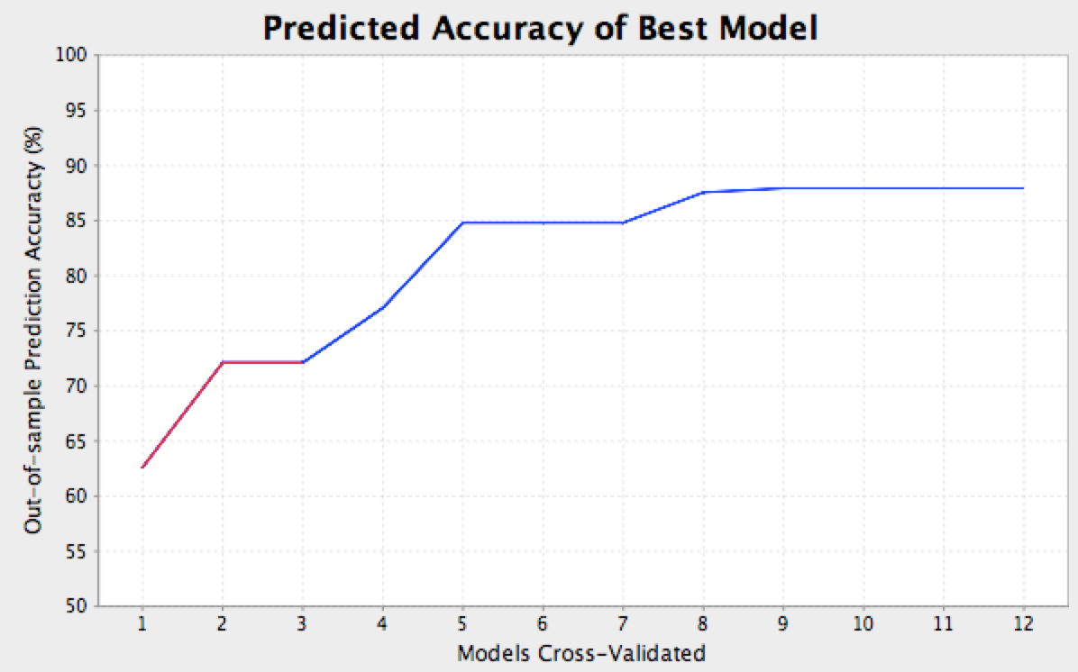
Query Optimizer: A Search Problem
System is responsible for searching through model space
Opportunities for physical optimization
5min
SVM
Boosting

Slide 22



MLbase: Progress
initial
release:
Spring
2014
MQL Parser
Query Planner / Optimizer
ML Library
(Contracts)
ML Developer API
Runtime
Released
July 2013

Slide 23
Other Things We’re Working On
GraphX: Unifying Graph Parallel & Data Parallel Analytics
OLTP and Serving Workloads
MDCC: Mutli Data Center Consistency
HAT: Highly-Available Transactions
PBS: Probabilistically Bounded Staleness
PLANET: Predictive Latency-Aware Networked Transactions
Fast Matrix Manipulation Libraries
Cold Storage, Partitioning, Distributed Caching
Machine Learning Pipelines, GPUs,
…

Slide 24






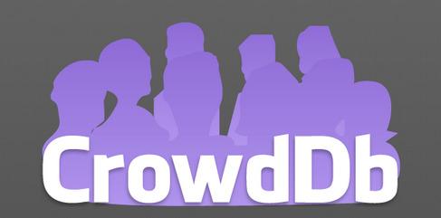
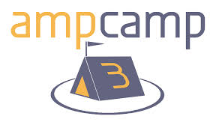
It’s Been a Busy 3 Years

Slide 25
Be Sure to Join us for the Next 3
UC BERKELEY
amplab.cs.berkeley.edu
@amplab

