Slide 1
DISTRIBUTED QUERY PROCESSING
MYTHILI.K

Slide 2
Topics Covered
Distributed database
Query processing
Distributed query processing methodology
Query decomposition
Data localization
Global query optimization
Join ordering
Semi join
Local query optimization

Slide 3
Distributed Database
Multiple, Logically interrelated Databases distributed over a complete network.

Slide 4
Query Processing
Translating a high level query (relational calculus) in a sequence of database operators (relational algebra + communication operators)
One high level query can have many equivalent transformations, the main difficulty is to select the most efficient one

Slide 5
Contd..
Example – Input
All players called “Muller", who are playing for a team
QUERY: SELECT p.Name
FROM Players p, Teams t
WHERE p.TID = t.TID
AND p.Name LIKE " Muller"

Slide 6
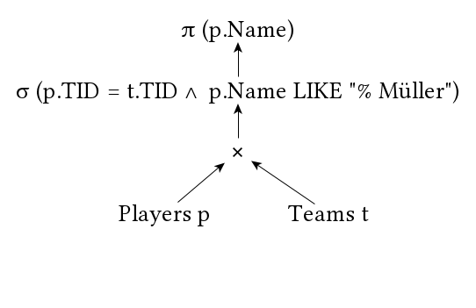
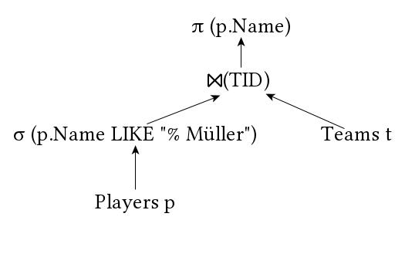
QUERY: SELECT p.Name FROM Players p, Teams t WHERE p.TID = t.TID AND p.Name LIKE " Muller"
Solution 1
Solution 2

Slide 7
DISTRIBUTED QUERY PROCESSING
The retrieval of data from different sites in a network.

Slide 8
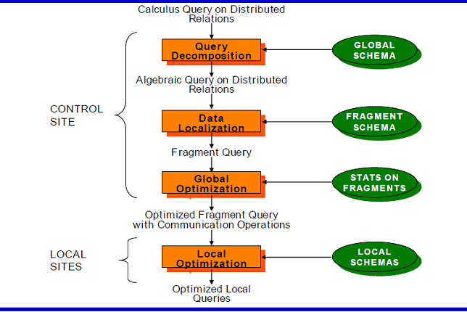
Methodology

Slide 9
1. Query Decomposition
Decomposing a high level query (relational calculus) into an algebraic query (relational algebra) on global relations

Slide 10
Steps of query decomposition
1) Normalization: Rewriting the query in a normalized form,
that is useful for further manipulations
2) Analysis: Query is analysed semantically so that incorrect
queries are detected and rejected
3) Elimination of redundancy: Simplifying query to
eliminate redundant predicates
4) Rewriting: The relational calculus query is translated in a
equivalent algebraic query

Slide 11
Normalization
Conjunctive normal form
(p11∨p12∨…∨p1n) ∧…∧ (pm1∨pm2∨…∨pmn)
Disjunctive normal form
(p11∧p12 ∧…∧p1n) ∨…∨ (pm1 ∧pm2∧…∧ pmn)
OR's mapped into union
AND's mapped into join or selection

Slide 12
SELECT p.Name FROM Players p, Teams t WHERE p.TID = t.TID AND (p.Name LIKE " Muller“ OR p.Name LIKE “Kim”)
Conjunctive Normal Form
(p.TID = t.TID) ∧ (p.Name =“Muller” ∨ p.Name =“Kim”)
Disjunctive Normal Form
((p.TID = t.TID) ∧ (p.Name =“Muller”)) ∨ ((p.TID = t.TID) ∧ (p.Name =“Kim”))

Slide 13
Analysis
Rejecting normalized queries for which further processing is impossible or unnecessary
Two main reasons for rejection:
1)Type incorrectness: Using a relation or an attribute which is unknown in the global schema or using wrong datatype for an operation
2)Semantical incorrectness: If the components of a query do not contribute in any way to generate a valid result

Slide 14
Simplification (removing redundancy)
SELECT DISTINCT f.Position
FROM Players p, Formation f
WHERE (NOT(f.Position = striker")
AND (f.Position = "striker" OR f.Position="keeper")
AND NOT(f.Position = "keeper"))
OR (f.PID = p.PID
AND p.Name = "Thomas Muller")
SELECT DISTINCT f.Position
FROM Players p, Formation f
WHERE f.PID = p.PID
AND p.Name = "Thomas Muller"

Slide 15
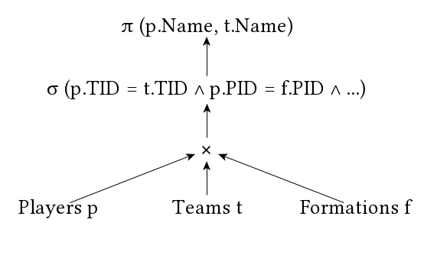
SELECT p.Name, t.Name FROM Players p, Team t, Formation f WHERE p.TID = t.TID AND p.PID = f.PID AND p.Active = 1 AND (t.Name = "FC Bayern Munchen“ OR t.Name = "Borussia Dortmund") AND f.Position = "striker"
Rewriting
Two Steps:
1. Transforming the query into an algebraic relational query tree.
2. Restructuring the algebraic tree to improve performance
Ex:All active strikers of "FC Bayern Munchen" and "Borussia Dortmund"

Slide 16
How to improve a "bad-algebraic-tree"?
Separating of unary operators (selection, projection)
Grouping unary operators on the same relation
Commuting unary operators with binary operators
Changing order of binary operators

Slide 17
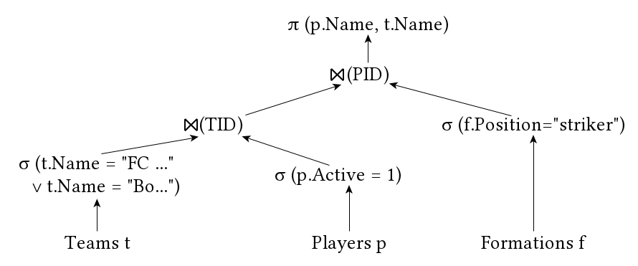
Algebraic Tree

Slide 18
2. Data Localization
Input: Algebraic query on distributed relations
Purpose:
∗ Apply data distribution information to the algebra operations and determine which fragments are involved
∗ Substitute global query with queries on fragments
∗ Optimize the global query

Slide 19
Horizontal Fragmentation
Query:
SELECT * FROM EMP, ASG WHERE EMP.ENO=ASG.ENO
Horizontal fragmentation:
∗ EMP1 = σ(ENO ≤ ” E3”(EMP))
∗ EMP2 = σ (” E3” ≤ENO>” E6”(EMP))
∗ EMP3 = σENO> ” E6”(EMP)
∗ ASG1 = σENO ≤ ” E3”(ASG)
∗ ASG2 = σENO> ” E3”(ASG)

Slide 20
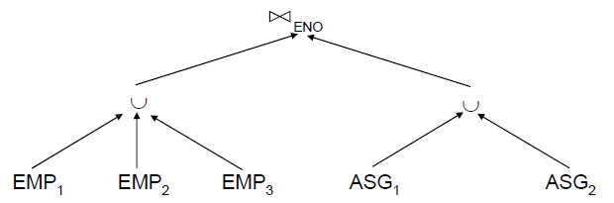
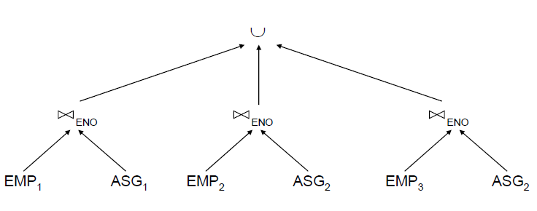
Contd..
Generic Query
Reduced Query

Slide 21
Vertical Fragmentation
Query:
SELECT ENAME FROM EMP
Fragmentation:
∗ EMP1 = ΠENO,ENAME (EMP )
∗ EMP2 = ΠENO,TITLE (EMP )

Slide 22
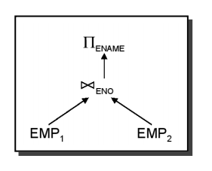
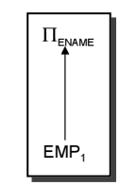
SELECT ENAME FROM EMP
Generic Query
Reduced Query

Slide 23
3. Global Query Optimization
Input: Fragment query
Find the best (not necessarily optimal) global schedule
➠ Minimize a cost function
➠ Distributed join processing
Which relation to ship where?
Ship-whole vs. ship-as-needed
➠ Decide on the use of semi joins

Slide 24
Join Ordering
Example relations: Employee at site 1 and Department at Site 2
Employee at site 1. 10,000 rows. Row size = 100 bytes. Table size = 10⁶ bytes.
Department at Site 2. 100 rows. Row size = 35 bytes. Table size = 3,500 bytes.
Q: For each employee, retrieve employee name and department name Where the employee works.
Q: Π_{Fname,Lname,Dname} (Employee _{Dno = Dnumber} Department)

Slide 25
Contd..
Strategies:
Transfer Employee and Department to site 3.
Total transfer bytes = 1,000,000 + 3500 = 1,003,500 bytes.
Transfer Employee to site 2, execute join at site 2 and send the result to site 3.
Query result size = 40 * 10,000 = 400,000 bytes. Total transfer size = 400,000 + 1,000,000 = 1,400,000 bytes.
Transfer Department relation to site 1, execute the join at site 1, and send the result to site 3.
Total bytes transferred = 400,000 + 3500 = 403,500 bytes.

Slide 26
Semijoin R_{j}⋉ R_{i}
It is used to reduce the data transmission cost.
Computing steps:
Project R_{i} on attribute A (R_{i}[A] ) and ship this projection ( a semijoin projection) from the site of R_{i} to the site of R_{j} ;
Reduce R_{j} to R_{j}’ by eliminating tuples where attribute A are not matching any value in R_{i}[A] .

Slide 27
Contd..
R₁[A]
Site 2
Site 1
1
R₁
2
R₂
3
Ship(3)
A
B
projection
A
C
1
4
3
7
2
5
4
8
3
6
5
9
reduce
Ship(6)
3
7
R₂’
Ship(2)
qs

Slide 28
Contd..
Project the join attributes of Department at site 2, and transfer them to site 1. For Q, 4 * 100 = 400 bytes are transferred
Join the transferred file with the Employee relation at site 1, and transfer the required attributes from the resulting file to site 2. For Q, 34 * 10,000 = 340,000 bytes are transferred.
Execute the query by joining the transferred file with Department and present the result to the user at site 2.
Using this strategy, we transfer 340,400 bytes for Q.

Slide 29
4. Local Optimization
Input: Best global execution schedule
Use the centralized optimization techniques

Slide 30
References
R. Elmasri, S.B. Navathe, “Fundamentals of Database Systems”, Fifth Edition,Pearson Education/Addison Wesley, 2007.
Henry F Korth, Abraham Silberschatz, S. Sudharshan, “Database System Concepts”, Fifth Edition, McGraw Hill, 2006.

Slide 31
THANK YOU
.

