Slide 1
Approximate Continuous Query Answering Over Streams and Dynamic Linked Data Sets
Soheila Dehghanzadeh, Daniele Dell’Aglio, Shen Gao,
Emanuele Della Valle, Alessandra Mileo, Abraham Bernstein

Slide 2
Outline
Introduction
Motivating example
Problem definition
Proposed solution
Experimental results
Conclusion

Slide 3
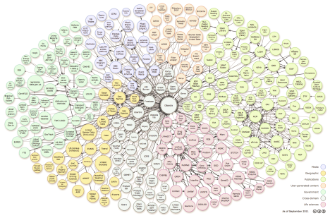
Introduction: Query Processing On Linked Data?
Off-line materialization
Replication (database) or Caching (web)
Local Store
UPDATES
Query Processor
Query
Response
NEW sources
Report changes to the local store (maintenance)
sources pro-actively report changes or their existence (pushing).
query processor discover new sources and changes by frequent crawling (pulling).
Fast maintenance leads high quality but slow response and vice versa.
Varying maintenance frequency can adjust the quality and time of provided response.
Current literature are minimizing the maintenance as much as they can
Minimize materialized data by analysing the query workload. (view selection).
On-demand maintenance of materialized data.
Optimize the maintenance code (DBToaster).
A few have touched the Quality-Time trade-off to minimize the maintenance.
Web
Notes:
The estimation will create a lot of problem:
Each maintenance requires a summarization of a different world with different freshness.
how to summarize the data? Which snapshot of data to summarize? (fully fresh or partially fresh)
If qp frequently maintain their local strore, less resources will be available for the qp and the reponse time becomes longer.
On the other hand if qp dedicate more resources for qp then the maintenance procedure will be less frequent and data becomes stale.
We determine the best maintenance plan and execute “only” that maintenance “lively”.
If I want to estimate the quality of a specific maintenance strategy, I should have the summarization which have that particular maintenance.
Estimating the quality of each maintenance strategy requires summarizing the data that was in a similar situation or trying to design a dynamic summarization. For example if I want to estimate the quality of response of a query with live executing sub-query1 and sub-query2 I should have a summarization of a situation that those 2 have been fresh and
These summarization becomes out-of-date according to the real situation. For example, if I summarize a situation where 2 views are fresh would that be always valid for evaluating scenarios where these 2 are fresh? And does that make sense to have a summary for each combination of fresh views? 2^number of fresh views.
What would happen if I update
Even if I have the summarization of that situation, it stil
The main problem in query processing is to
------------
To process queries over web one naïve approach is to process queries over individual data sources which is not realistic because it takes an infinite amount of time.
The solution to this problem was to replicate or cache data in a local store and process queries over it. however, this solution arises another problem which is changes to original data is not reflected on local store. The maintenance procedure is responsible to keep the local copy up-to-date. Depending on the change reporting mechanism, maintenance should be done with different strategies.
In the second maintenance type I should mention that “here maintenance translates to live execution”.
We get the query, we estimate the quality of each underlying view (this view has been update 10 mins ago and it decreases freshness 10% a minutes. The only problem is the actual updates are happening in burst) , we choose the corresponding summarization for each maintenance and use that to estimate the quality of join.

Slide 4
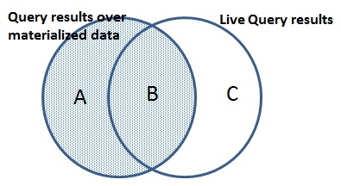
My suggestion to minimize the maintenance
Maintain a view only if its “quality” is below a “threshold”.
Quality?
Freshness of a view B/(B+A) (A=0 fully fresh).
Completeness of a view B/(B+C) (C=0 fully complete).
Threshold?
Response quality requirements should be translated to view quality requirements.
Estimate the quality of response based on the quality of views without actually computing the response.
80% freshness
V1
V2
V3
V4
20%
100%
10%
80%
Notes:
For that I need to define the quality and a way to specify threshold.
We discovered that quality requirements of a user response can be summarized based on 2 factors freshness and completeness and we define them as follows: imagine user could run the query on the real data and get the transparent circle and I provide him with the response on my materialized data the shaded circle. If A turns out empty, you will say, see my responses are fresh even though they are not complete. If C turns out empty then you will say my responses are complete even though some of them are out of data. We didn’t include C in detention of freshness because in our intuition changing C doesn’t affect freshness and changing A doesn’t affect completeness either.
Now a way to specify threshold.
And having the user specified quality dimensions for their response, we should translate it to quality dimensions for underlying views.
Problem: We want on-demand maintenance according to required quality to prevent unnecessary maintenance.
This approach will work very well on the query workloads that hugely share views and the views become out-of-date very soon.(frequently used and updated)
This require estimating the quality of response that each maintenance strategy will provide without actually executing maintenance.
Why it is important? It eliminates unnecessary maintenance (live executions/update processing) and leads to faster response and better scalability.

Slide 5
My Experiment
Alice | Lives | Dublin | True
Bob | Lives | Berlin | False
Alice | Job | Teacher | True
Bob | Job | Developer | False
I simplified the problem.
I assumed that I have a cache in which all triples have been assigned with a label specifying their freshness status.
I want to estimate the quality of a query response over this cache using a synopsis that I built without actually executing the query.
I decided to extend the synopsis of cardinality estimation for my freshness estimation. How?
Notes:
This is for one snapshot but since quality is changing rapidly we have to design several synopsis for various snapshots or design a dynamic histogram.

Slide 6
Cardinality Estimation
Freshness
Summarize the data distribution into buckets and keep the bucket cardinality. Trade space and time with accuracy.
Alice | Job | Teacher
Alice | Lives | Dublin
Alice | Job | PhD student
Alice | Lives | Athlon
Bob | Job | Manager
Bob | Lives | Berlin
Bob | Lives | Chicago
Bob | Lives | Munich
Bob | Lives | Belfast
Bob | Lives | Limerick
Bob | Job | CEO
Bob | Job | Consultant
True
True
False
False
True
True
True
False
False
False
False
False
* Job * 5
* Lives * 7
2
3
Estimated | Actual
2/5 | 2/5
6/35 | 3/19
Alice Job * 2
Bob Job * 3 Alice Lives * 2 Bob Lives * 5
1
1
1
2
Estimated | Actual
5 | 5
35 | 19
Estimated | Actual
5 | 5
19 | 19
Estimated | Actual
2/5 | 2/5
3/19 | 3/19
Q1: ?a Job ?b
Q2: (?a Job ?b)^(?a Lives ?c)
Notes:
Less accurate but save required space and response time.
More granularity in bucket ➔ more space, longer response time but higher accuracy.

Slide 7
Cardinality Estimation Approaches
Summaries should capture the distribution of attributes and the dependencies among join predicates.
Indexing approaches relax both assumptions.
Histogram captures the distribution of attributes for more accurate estimation.
Probabilistic Graphical Models captures dependencies among attributes by learning Bayesian network of the underlying data and estimate the cardinality of a query.

Slide 8
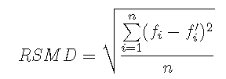
Measure Performance of The Estimation Approach
Measure the difference between the actual and estimated freshness of queries in a query set.
n is the number of queries

Slide 9
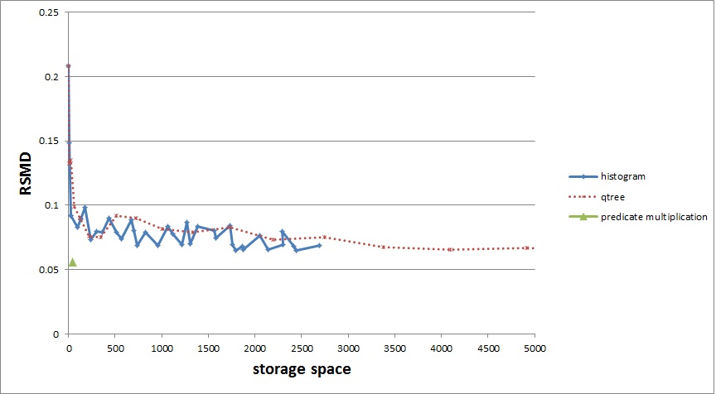
Preliminary results
Notes:
(Do you have any preliminary results that demonstrate that your approach is promising)
It is obvious that to capture freshness distribution per entry using histogram, our summary requires more space.

Slide 10
Conclusion
We proposed a new approach for on-demand view maintenance based on the response quality requirements.
We defined quality requirements based freshness and completeness.
We summarized a synthetic dataset to estimate the freshness of various queries using indexing and histogram.
Combining the idea of probabilistic graphical model with histogram to capture both the distribution and dependencies among various join predicates is the next promising step.

Slide 11
Thanks a lot for your attention !
Any comment is welcomed!

Slide 12
Problem: We want on-demand maintenance according to required quality to prevent unnecessary maintenance.
This approach will work very well on the query workloads that hugely share views and the views become out-of-date very soon.(frequently used and updated)
This require estimating the quality of response that each maintenance strategy will provide without actually executing maintenance.
Why it is important? It eliminates unnecessary maintenance (live executions/update processing) and leads to faster response and better scalability.

Slide 13
Estimating the quality of response for different maintenance strategies
Each maintenance requires a summarization of a different world with different freshness.
how to summarize the data?
Which snapshot of data to summarize? (fully fresh or partially fresh)

Slide 14
Freshness of Q=(?x Job ?y) Join (?x livesin ?z)
Bob | Teacher | Limerick | True
Bob | Teacher | Galway | True
Bob | PhD | Limerick | True
Bob | PhD | Galway | True
Alice | Professor | Dublin | True
Alice | Professor | Cork | True
Bob | Job | Teacher | True
Bob | Job | PhD | True
Alice | Job | Professor | True
Bob | Lives in | Limerick | True
Bob | Lives in | Galway | True
Alice | Lives in | Dublin | True
Alice | Lives in | Cork | True
100%
100%
100%
Bob | Teacher | Limerick | True
Bob | Teacher | Galway | True
Bob | PhD | Limerick | False
Bob | PhD | Galway | False
Alice | Professor | Dublin | True
Alice | Professor | Cork | False
Bob | Job | Teacher | True
Bob | Job | PhD | False
Alice | Job | Professor | True
Bob | Lives in | Limerick | True
Bob | Lives in | Galway | True
Alice | Lives in | Dublin | True
Alice | Lives in | Cork | False
True
True
False
True
66%
66%
75%
50%
False
Bob | Job | Teacher | True
Bob | Job | PhD | False
Alice | Job | Professor | False
Bob | Teacher | Limerick | True
Bob | Teacher | Galway | False
Bob | PhD | Limerick | False
Bob | PhD | Galway | False
Alice | Professor | Dublin | False
Alice | Professor | Cork | False
Bob | Lives in | Limerick | True
Bob | Lives in | Galway | False
Alice | Lives in | Dublin | True
Alice | Lives in | Cork | False
33%
50%
16%
Bob | Job | Teacher | False
Bob | Job | PhD | False
Alice | Job | Professor | False
Bob | Lives in | Limerick | False
Bob | Lives in | Galway | False
Alice | Lives in | Dublin | True
Alice | Lives in | Cork | False
Bob | Teacher | Limerick | False
Bob | Teacher | Galway | False
Bob | PhD | Limerick | False
Bob | PhD | Galway | False
Alice | Professor | Dublin | False
Alice | Professor | Cork | False
0%
25%
0%

Slide 15
Joint distribution of deletion rate for
Select ?x,?y,?a4
WHERE
?x income ?a1
?x position ?a2
?x teacherof ?y
?x education ?a3
?y location ?a4
?y difficulty ?a5
?y name ?a6
P1 | PhD | lecturer | <70 | prc1 | true
p2 | M.S. | lecturer | <70 | prc1 | true
p3 | B.S. | prof | <70 | adc1 | true
prc1 | GB | <10 | math | true
adc1 | EB | <10 | DOS | true
lab1 | LB | >10 | OSLAB | true
prc1 | P1 | GB | true
prc1 | P2 | GB | true
adc1 | P3 | EB | true
100%
100%
100%
education
person
position
income
P1 | PhD | lecturer | <70 | prc1 | true
p2 | PhD | lecturer | <70 | prc1 | true
p3 | PhD | prof | <70 | adc1 | true
prc1 | GB | <10 | math | true
adc1 | EB | <10 | DOS | false
lab1 | LB | >10 | OSLAB | true
prc1 | P1 | GB | true
prc1 | P2 | GB | true
adc1 | P3 | EB | false
100%
66%
66%
Teacher of
P1 | PhD | lecturer | <70 | prc1 | true
p2 | PhD | lecturer | <70 | prc1 | true
p3 | PhD | prof | <70 | adc1 | false
prc1 | GB | <10 | math | true
adc1 | EB | <10 | DOS | true
lab1 | LB | >10 | OSLAB | false
prc1 | P1 | GB | true
prc1 | P2 | GB | true
adc1 | P3 | EB | true
100%
66%
100%
location
course
difficulty
P1 | PhD | lecturer | <70 | prc1 | true
p2 | PhD | lecturer | <70 | prc1 | true
p3 | PhD | prof | <70 | adc1 | true
prc1 | GB | <10 | math | true
adc1 | EB | <10 | DOS | false
lab1 | LB | >10 | OSLAB | false
prc1 | P1 | GB | true
prc1 | P2 | GB | true
adc1 | P3 | EB | flase
100%
33%
66%
name

Slide 16
Research questions and hypothesis
How to adjust the maintenance according to response quality requirements.
What is the quality of response provided without maintenance (current materialized data)?
Which maintenance strategy can boost the response quality up-to the required level with lowest maintenance cost ( live execution/update processing).
Hypothesis:
Having quality of join counterparts, we “CAN” estimate the quality of (maintained) join results and choose the best maintenance which can fulfil the required quality in shortest time.
Notes:
(What is the object of your study? What is the hypothesis that you will test? )
We want to minimize maintenance
Maintained join is a join with updated join counterparts

Slide 17
My approach
There are two quality metrics: freshness(B/(A+B)), completeness(B/(B+C)).
First research question: What is the freshness of the response provided with cache (without maintenance)?
We summarize cache snapshot with fresh/stale labeled triples to estimate the freshness of queries.
Summarization
Capture dependencies between join counterparts.
Capture the distribution of freshness for each summarization dimension.
Our first summarization approach assumes total independence and uniform distribution.
In the histogram approach we try to address uniform distribution assumption. This requires more space to achieve better estimations.
Notes:
(What is the main idea behind your approach? The key innovation?)
We use summarization to estimate join freshness based on freshness of join counterparts.
Can we expect the summary (build from one snapshot) to respond properly for other snapshots? If it captures the joint distribution properly then we can…
We just want to summarize cache

Slide 18
State of the art
Difficulty? Capturing all the dependencies among various sub-queries and learn distribution of fresh entries in a summary to estimate the freshness of join results is a very complicated task. Most summarizations assumes independence and uniform distribution.
In RDBMS
Join has been modelled as a selection over the Cartesian product. (selection condition over the Cartesian product is the join condition)
Estimation of query response quality boils down to quality estimation of selection conditions.
Heavily influenced by the role of identity key per tuple which doesn’t exist in RDF data model.
Goal is to estimate the quality of different selection conditions using different formula and probabilities based on if the selection condition (partially) contains the identity key.
Notes:
(Why is the problem difficult? What have others tried to do? )
Estimating the freshness of selection condition still requires join distribution. Thus we need to capture join distribution anyways.

Slide 19
Evaluation plan
I’ll test the hypothesis by measuring the difference between actual freshness and estimated freshness.
Baseline is freshness estimation with independent assumption and uniform freshness distribution between join counterparts.
Capturing more dependencies and accurate distribution of freshness leads to more accurate freshness estimation.
Probabilistic graphical models can capture more dependencies which leads to more accurate freshness estimation and response quality and optimization in maintenance.
Notes:
How do you plan to test your hypothesis? What will you measure? What will you compare to?

Slide 20
Reflections
The ideal case is to run query on the actual cache without summarization which leads to 100% accuracy in freshness estimation which is not feasible due to huge space requirements and long response time.
Summarization will provide faster but approximate results with lower space requirements.
Summarization techniques require capturing the distribution and the dependencies. The more accurate distribution and capturing more dependency leads to more accurate estimations.
Notes:
Provide an argument, based either on common knowledge or on evidence that you have accumulated, the your approach is likely to succeed.

