Slide 1

Query Optimization &
How to interpret query
execution plan
Amol Barewar
Email:barewaramol@gmail.com

Slide 2
Contents
Query Optimization
Types of Optimization
Optimization
Problem and Solutions with practical examples
Understanding The Execution Plan
References

Slide 3
Types Of Optimizations
Rule Based
Cost Based

Slide 4
Rule Based Optimization
RBO uses predefined set of precedence rules(golden rules) to figure out the optimal path
These rules used to choose one index over another index and when full table scan
Oracle 9i has 20 “golden rules” for optimal execution path
ALTER SESSION SET OPTIMIZER_MODE = RULE/CHOOSE;

Slide 5
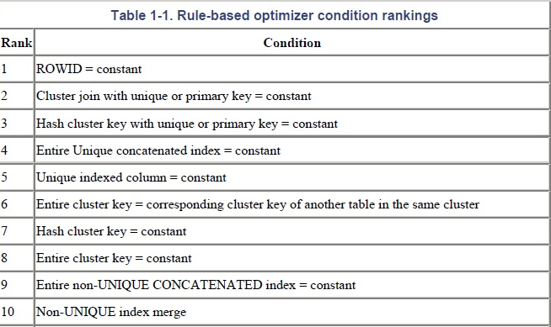
Rule Based Optimization

Slide 6
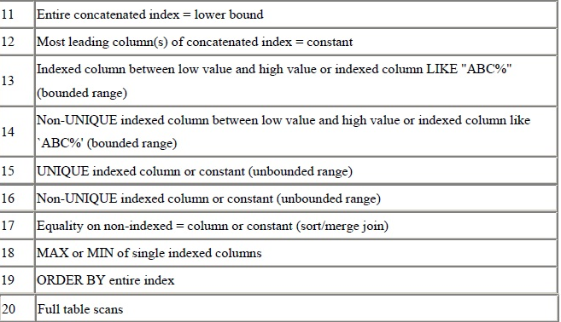
Rule Based Optimization

Slide 7
Join in SQL
Emp_Id | Ename | EAddr
Emp_Id | Emp_dept | Emp_sal
Employee
Department
Driving Table…..?
Notes:
The driving table is read once and for each row in the driving table, the inner table is processed once.

Slide 8
Solutions
Unique or primary key index
No of =‘s in index
Higher % of columns
One 2-col index vs. two 1-col
Same no of col in index?
Index1(A1,B,C); Table 1
Index2(A2,F,G); Table 2
Select *
From Table1,Table2
Where A1=1 and B=2 and
G=2 and F like ’%something’ and A1=A2
Two 1-Col Index: Table 1
Index1(A)
Index2(B);
One 2-Col Index: Table 2
Index3(E,F);
Notes:
When index on same no of columns and not all columns are match then rightmost table index is used

Slide 9
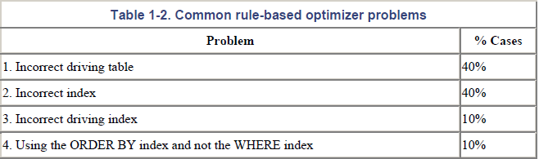
Rule Based Optimization
Rule-Based Optimizer Problems and Solutions

Slide 10
Rule Based Optimization
Problem 1: Incorrect Driving Table
SELECT COUNT(*) FROM acct a, trans b
WHERE b.cost_center = 'MASS'
AND a.acct_name = 'MGA'
AND a.acct_name = b.acct_name;
Response = 19.722 seconds
SELECT COUNT(*) FROM trans b, acct a
WHERE b.cost_center= 'MASS'
AND a.acct_name = 'MGA'
AND a.acct_name = b.acct_name;
Response = 1.904 seconds

Slide 11
Rule Based Optimization
Problem 2: Incorrect Driving Index
SELECT COUNT(*)
FROM trans
WHERE cost_center = 'MASS'
AND bmark_id = 9;
Response Time = 4.255 seconds
SELECT COUNT(*)
FROM trans
WHERE bmark_id = 9
AND cost_center = 'MASS';
Response Time = 1.044 seconds

Slide 12
Rule Based Optimization
Problem 3: Using the ORDER BY Index and not the WHERE Index
SELECT fod_flag, account_no
FROM account_master
WHERE (account_code like 'I%')
ORDER BY account_no;
Index_1 UNIQUE (ACCOUNT_NO)
Index_2 (ACCOUNT_CODE)
Index (ACCOUNT_CODE, ACCOUNT_NO)

Slide 13
Cost Based Optimization
ANALYZE
DBMS_STATS
RULE BASED
ANALYZE & DBMS_STATS
Collect statistics about tables, clusters and indexes, and store those statistics in the data dictionary
RULE BASED
If table not analyzed CBO apply Rule Based Logic to select best path
Notes:
ANALYZE & DBMS_STATS functions collect statistics about tables, clusters, and indexes, and store those statistics in the data dictionary.

Slide 14

ANALYZE
ANALYZE COMPUTE & ANALYZE ESTIMATE
Table and it’s index
Index dropped..?
DBMS_STATS.GATHER_SCHEMA_STATS & GATHER_TABLE_STATS : CASCADE=>TRUE
Notes:
COMPUTE: ALL ROWS(Small table), ESTIMATE: SAMPLE ROWS(Large)
DBMS_STATS.GATHER_SCHEMA_STATS and GATHER_TABLE_STATS analyze only tables by default, not their indexes

Slide 15
ANALYZE Examples
1. ANALYZE TABLE EMP ESTIMATE STATISTICS SAMPLE 5 PERCENT FOR ALL INDEXED COLUMNS;
2. ANALYZE INDEX EMP_NDX1 ESTIMATE STATISTICS SAMPLE 5 PERCENT FOR ALL INDEXED COLUMNS;
3. ANALYZE TABLE EMP COMPUTE STATISTICS FOR ALL INDEXED COLUMNS;
4. ANALYZE TABLE EMP DELETE STATISTICS;

Slide 16
Cost Based Optimization Steps
Parse
Check Syntax
Object Privilege
Plans
All possible execution plans listed
Cost
Calculate cost of each execution plans

Slide 17
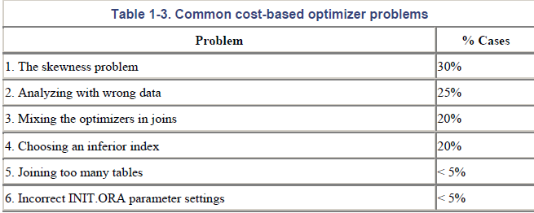
Cost Based Optimization Steps
Cost-Based Optimizer Problems and Solutions

Slide 18
Cost Based Optimization
Problem 1: The Skewness Problem
SELECT acct_no, customer, product, trans_date, amt
FROM trans
WHERE status='O';
Response time = 16.308 seconds
> ANALYZE TABLE TRANS COMPUTE STATISTICS FOR ALL INDEXED COLUMNS
Response time reduces to 0.259 seconds

Slide 19
Cost Based Optimization
Problem 2: Analyzing with Wrong Data
The cost-based optimizer requires accurate information, including accurate data volumes, to have any chance of creating efficient execution plans otherwise performance will degrade a large scale
Example:
Before analyze the cardinality is 1000(10000/10) on 10000 rows
And now we insert the 10000 new rows with distinct values so what will be the new cardinality?

Slide 20
Cost Based Optimization
Problem 4: Choosing an Inferior Index
where business_unit = :5
and ledger = :6
and fiscal_year = :7
and accounting_period = :8
and affiliate = :9
and statistics_code = :10
and project_id = :11
and account = :12
and currency_cd = :13
and deptid = :14
and product = :15

Slide 21
Cost Based Optimization
Problem 4: Choosing an Inferior Index
where business_unit = :5
and ledger = :6
and fiscal_year = :7
and accounting_period between 1 and 12
and affiliate = :9
and statistics_code = :10
and project_id = :11
and account = :12
and currency_cd = :13
and deptid = :14
and product = :15

Slide 22
Cost Based Optimization
Problem 4: Choosing an Inferior Index
business_unit
ledger
fiscal_year
affiliate
statistics_code
project_id
account
currency_cd
deptid
Product
accounting_period

Slide 23
Understanding Execution Plan

Slide 24
How data fetched for query…?
SELECT prod_category, AVG(amount_sold)
FROM o_sales s, o_products p
WHERE p.prod_id = s.prod_id
GROUP BY prod_category;
GET SALES
GET PRODUCTS
Apply Join
Apply Group BY(Sort)
Return Result

Slide 25
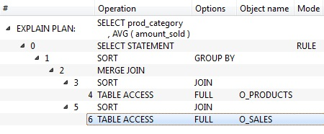
Interpreting Execution plan
GROUP BY
JOIN
O_SALES
Level 3
Level 2
Level 1
O_PRODUCT

Slide 26
Understanding the Execution Plans
Cardinality
Join Type
Join Order
Join Method
Access Method
Partition Pruning
Parallel Execution
Notes:
Parameters should be considered for differentiating the good and bad execution plan

Slide 27
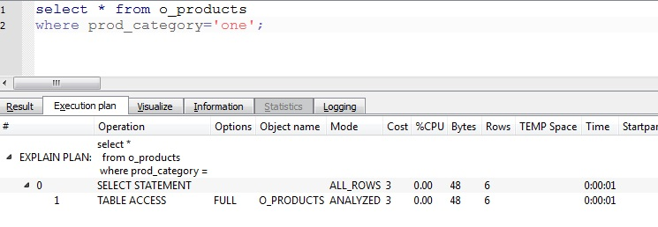
Cardinality
Estimate no of rows coming out of the operation
Complex formula used for this calculations
Incorrect Cardinality
Total Rows: 18
Different val: 3
Notes:
Oracle uses histograms for the good cardinality prediction

Slide 28
Access Method
Table
Full Table Scan
Index
Index Unique Scan
Index Range Scan
Row ID
Full Index Scan
Join
Hash Joins
Nested Loops joins
Sort Merge Joins
Index Skip Scan
Fast Full Index Scan
Bitmap Index
Notes:
Index Unique Scan : Only one row will be returned by unique index
Index Range Scan : =,<,>,LIKE (NON UNIQUE INDEX)
Order BY clause has all the columns present in the index and order same as index

Slide 29
SQL Hints
Hints can be placed in SQL to force optimizer to follow our desired retrieval path rather then calculated by the optimizer
Select /* +RULE */
From emp , dept
Where…..
Select statement instructs the optimizer to use the rule based optimizer rather than the cost based optimizer.
Delete /*+RULE*/ . . . . . . . .
Update /*+RULE*/ . . . . . . . .

Slide 30
References
1. Data Warehousing using Oracle
Dr. P.S.Deshpande
2. The oracle optimizer explain the explain plan
Oracle.com
3. Oracle SQL Tuning Pocket Reference
Mark Gurry

Slide 31
Thank You…….

