Slide 1
Communication Cost in Parallel Query Processing
Dan Suciu
University of Washington
Joint work with Paul Beame, Paris Koutris and the Myria Team

Slide 2
This Talk
How much communication is needed to compute a query Q on p servers?

Slide 3
Massively Parallel Communication Model (MPC)
Extends BSP [Valiant]
Input (size=m)
Input data = size m
O(m/p)
O(m/p)
Server 1
. . . .
Server p
Number of servers = p
Notes:
Say: in algorithms, L = maximum load. In lower bounds, L = average load

Slide 4
Massively Parallel Communication Model (MPC)
Extends BSP [Valiant]
Input (size=m)
Input data = size m
O(m/p)
O(m/p)
Server 1
. . . .
Server p
Number of servers = p
≤L
≤L
Round 1
One round = Compute & communicate
Server 1
. . . .
Server p
Notes:
Say: in algorithms, L = maximum load. In lower bounds, L = average load

Slide 5
Massively Parallel Communication Model (MPC)
Extends BSP [Valiant]
Input (size=m)
Input data = size m
O(m/p)
O(m/p)
Server 1
. . . .
Server p
Number of servers = p
≤L
≤L
Round 1
One round = Compute & communicate
Server 1
. . . .
Server p
≤L
≤L
Round 2
Algorithm = Several rounds
Server 1
. . . .
Server p
≤L
≤L
Round 3
. . . .
. . . .
Notes:
Say: in algorithms, L = maximum load. In lower bounds, L = average load

Slide 6
Massively Parallel Communication Model (MPC)
Extends BSP [Valiant]
Input (size=m)
Input data = size m
O(m/p)
O(m/p)
Server 1
. . . .
Server p
Number of servers = p
≤L
≤L
Round 1
One round = Compute & communicate
Server 1
. . . .
Server p
≤L
≤L
Round 2
Algorithm = Several rounds
Server 1
. . . .
Server p
Max communication load / round / server = L
≤L
≤L
Round 3
. . . .
. . . .
Notes:
Say: in algorithms, L = maximum load. In lower bounds, L = average load

Slide 7
Massively Parallel Communication Model (MPC)
Extends BSP [Valiant]
Input (size=m)
Input data = size m
O(m/p)
O(m/p)
Server 1
. . . .
Server p
Number of servers = p
≤L
≤L
Round 1
One round = Compute & communicate
Server 1
. . . .
Server p
≤L
≤L
Round 2
Algorithm = Several rounds
Server 1
. . . .
Server p
Max communication load / round / server = L
≤L
≤L
Round 3
. . . .
. . . .
Cost: | Ideal | Practical ε∈(0,1) | Naïve 1 | Naïve 2
Load L | L = m/p | L = m/p^{1-ε} | L = m | L = m/p
Rounds r | 1 | O(1) | 1 | p
Notes:
Say: in algorithms, L = maximum load. In lower bounds, L = average load

Slide 8
Massively Parallel Communication Model (MPC)
Extends BSP [Valiant]
Input (size=m)
Input data = size m
O(m/p)
O(m/p)
Server 1
. . . .
Server p
Number of servers = p
≤L
≤L
Round 1
One round = Compute & communicate
Server 1
. . . .
Server p
≤L
≤L
Round 2
Algorithm = Several rounds
Server 1
. . . .
Server p
Max communication load / round / server = L
≤L
≤L
Round 3
. . . .
. . . .
Cost: | Ideal | Practical ε∈(0,1) | Naïve 1 | Naïve 2
Load L | L = m/p | L = m/p^{1-ε} | L = m | L = m/p
Rounds r | 1 | O(1) | 1 | p
Notes:
Say: in algorithms, L = maximum load. In lower bounds, L = average load

Slide 9
Massively Parallel Communication Model (MPC)
Extends BSP [Valiant]
Input (size=m)
Input data = size m
O(m/p)
O(m/p)
Server 1
. . . .
Server p
Number of servers = p
≤L
≤L
Round 1
One round = Compute & communicate
Server 1
. . . .
Server p
≤L
≤L
Round 2
Algorithm = Several rounds
Server 1
. . . .
Server p
Max communication load / round / server = L
≤L
≤L
Round 3
. . . .
. . . .
Cost: | Ideal | Practical ε∈(0,1) | Naïve 1 | Naïve 2
Load L | L = m/p | L = m/p^{1-ε} | L = m | L = m/p
Rounds r | 1 | O(1) | 1 | p
Notes:
Say: in algorithms, L = maximum load. In lower bounds, L = average load

Slide 10
Massively Parallel Communication Model (MPC)
Extends BSP [Valiant]
Input (size=m)
Input data = size m
O(m/p)
O(m/p)
Server 1
. . . .
Server p
Number of servers = p
≤L
≤L
Round 1
One round = Compute & communicate
Server 1
. . . .
Server p
≤L
≤L
Round 2
Algorithm = Several rounds
Server 1
. . . .
Server p
Max communication load / round / server = L
≤L
≤L
Round 3
. . . .
. . . .
Cost: | Ideal | Practical ε∈(0,1) | Naïve 1 | Naïve 2
Load L | L = m/p | L = m/p^{1-ε} | L = m | L = m/p
Rounds r | 1 | O(1) | 1 | p
Notes:
Say: in algorithms, L = maximum load. In lower bounds, L = average load

Slide 11
Massively Parallel Communication Model (MPC)
Extends BSP [Valiant]
Input (size=m)
Input data = size m
O(m/p)
O(m/p)
Server 1
. . . .
Server p
Number of servers = p
≤L
≤L
Round 1
One round = Compute & communicate
Server 1
. . . .
Server p
≤L
≤L
Round 2
Algorithm = Several rounds
Server 1
. . . .
Server p
Max communication load / round / server = L
≤L
≤L
Round 3
. . . .
. . . .
Cost: | Ideal | Practical ε∈(0,1) | Naïve 1 | Naïve 2
Load L | L = m/p | L = m/p^{1-ε} | L = m | L = m/p
Rounds r | 1 | O(1) | 1 | p
Notes:
Say: in algorithms, L = maximum load. In lower bounds, L = average load

Slide 12
Example: Join(x,y,z) = R(x,y), S(y,z)
R
x | y
a | b
a | c
b | c
S
y | z
b | d
b | e
c | e
|R|=|S|=m
⋈
O(m/p)
O(m/p)
Input: R, S
Uniformly partitioned on p servers
Server 1
. . . .
Server p
Round 1
Server 1
. . . .
Server p
R(x,y) ⋈ S(y,z)
R(x,y) ⋈ S(y,z)
Round 1: each server
Sends record R(x,y) to server h(y) mod p
Sends record S(y,z) to server h(y) mod p
Assuming no skew
Output:
Each server computes the local join R(x,y) ⋈ S(y,z)
Load L = O(m/p) w.h.p.
Rounds r = 1

Slide 13
Speedup
Speed
A load of L = m/p corresponds to linear speedup
A load of L = m/p^{1-ε} corresponds to sub-linear speedup
# processors (=p)

Slide 14
Outline
The MPC Model
The Algorithm
Skew matters
Statistics matter
Extensions and Open Problems

Slide 15
Overview
Computes a full conjunctive query in one round of communication, by partial replication.
The tradeoff was discussed [Ganguli’92]
Shares Algorithm: [Afrati&Ullman’10]
For MapReduce
HyperCube Algorithm [Beame’13,’14]
Same as in Shares
But different optimization/analysis

Slide 16
The Triangle Query
T
Z | X
Fred | Alice
Jack | Jim
Fred | Jim
Carol | Alice
…
Input: three tables R(X, Y), S(Y, Z), T(Z, X) |R| = |S| = |T| = m tuples
Output: compute all triangles Trianges(x,y,z) = R(x,y), S(y,z), T(z,x)
S
Y | Z
Fred | Alice
Jack | Jim
Fred | Jim
Carol | Alice
…
R
X | Y
Fred | Alice
Jack | Jim
Fred | Jim
Carol | Alice
…
Notes:
Number of edges = 4532185
Followee = 152556
Follower = 154310
Avg(outdegree) = 29, max(outdegree) = 21510, 15006, 14853, …
Avg(indegree) = 29, max(indegree) = 20383, 13961, 9609, …
Number of pairs (x,z) connected by a path of length 2 =

Slide 17
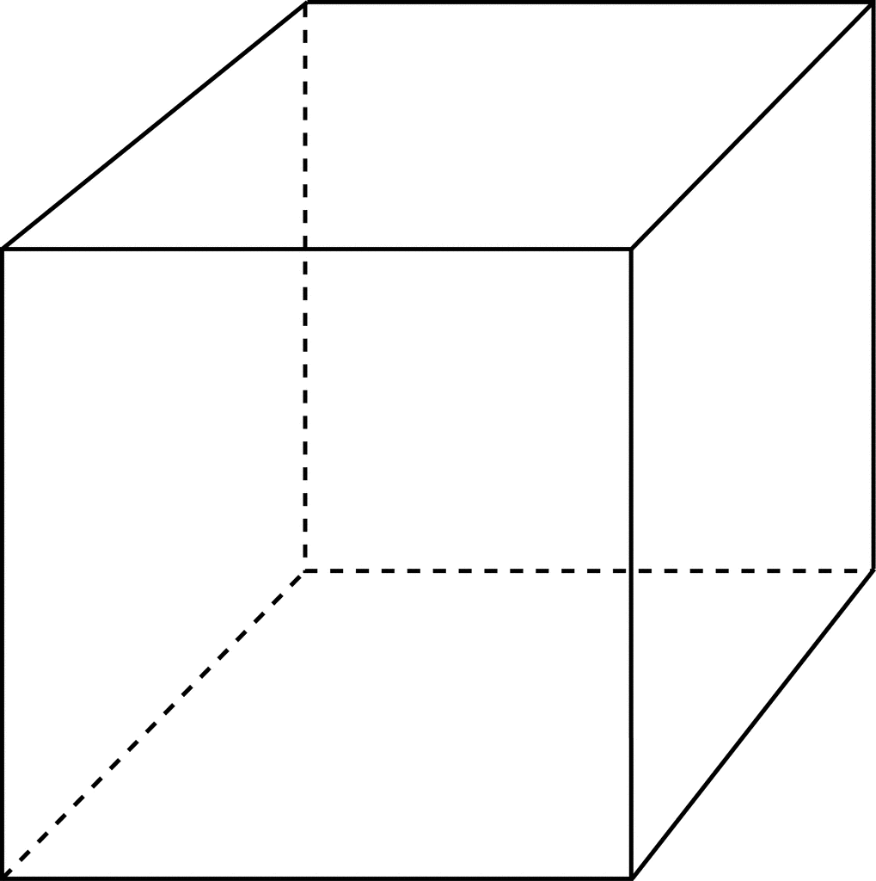
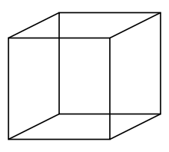
Triangles in One Round
Trianges(x,y,z) = R(x,y), S(y,z), T(z,x)
|R| = |S| = |T| = m tuples
Place servers in a cube p = p^{1/3} × p^{1/3} × p^{1/3}
Each server identified by (i,j,k)
Server (i,j,k)
(i,j,k)
k
j
i
p^{1/3}

Slide 18
Triangles in One Round
Trianges(x,y,z) = R(x,y), S(y,z), T(z,x)
|R| = |S| = |T| = m tuples
T
Z | X
Fred | Alice
Jack | Jim
Fred | Jim
Carol | Alice
…
Round 1:
Send R(x,y) to all servers (h₁(x),h₂(y),*)
Send S(y,z) to all servers (*, h₂(y), h₃(z))
Send T(z,x) to all servers (h₁(x), *, h₃(z))
Output:
compute locally R(x,y) ⋈ S(y,z) ⋈ T(z,x)
S
Y | Z
Fred | Alice
Jack | Jim
Fred | Jim
Carol | Alice
Jim | Jack
Jack | Jim
R
X | Y
Fred | Alice
Jack | Jim
Fred | Jim
Carol | Alice
…
Fred | Jim
Jim | Jack
Jim | Jack
Fred | Jim
(i,j,k)
Fred | Jim
Jim | Jack
Fred | Jim
Fred | Jim
Jim | Jack
Fred | Jim
Jack | Jim
Fred | Jim
k
Jack | Jim
j = h₁(Jim)
Jim | Jack
p^{1/3}
i = h₂(Fred)

Slide 19
Communication load per server
Trianges(x,y,z) = R(x,y), S(y,z), T(z,x)
|R| = |S| = |T| = m tuples
Theorem If the data has “no skew”, then the HyperCube computes Triangles in one round
with communication load/server O(m/p^{2/3}) w.h.p.
Sub-linear speedup
Can we compute Triangles with L = m/p?
No!
Theorem Any 1-round algo. has L = Ω(m/p^{2/3} )

Slide 20
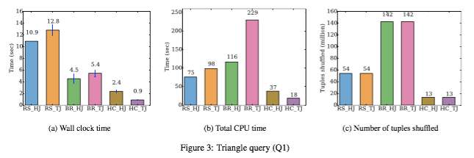
1.1M triples of Twitter data → 220k triangles; p=64
Trianges(x,y,z) = R(x,y), S(y,z), T(z,x)
|R| = |S| = |T| = 1.1M
local 1 or 2-step hash-join; local 1-step Leapfrog Trie-join (a.k.a. Generic-Join)
2 rounds hash-join
1 round broadcast
1 round hypercube

Slide 21
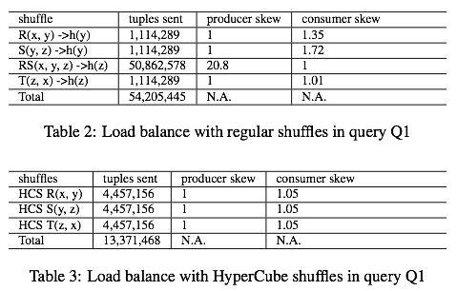
1.1M triples of Twitter data → 220k triangles; p=64
Trianges(x,y,z) = R(x,y), S(y,z), T(z,x)
|R| = |S| = |T| = 1.1M

Slide 22
HperCube Algorithm for Full CQ
p_{i} = the “share” of the variable x_{i}
Write: p = p₁ * p₂ * … * p_{k}
Round 1: send S_{j}(x_{j1}, x_{j2}, …) to all servers whose coordinates agree with h_{j1}(x_{j1}), h_{j2}(x_{j2}), …
Output: compute Q locally
h₁, …, h_{k} = independent random functions
Notes:
Latexit:
{\color[rgb]{0.000000,0.000000,1.000000}\mathbf{Q(x_1, \ldots, x_k) = S_1(\bar x_1), S_2(\bar x_2), \ldots, S_\ell(\bar x_\ell)}}

Slide 23
Computing Shares p₁, p₂, …, p_{k}
Suppose all relations have the same size m
Load/server from S_{j} :
L_{j} = m / (p_{j1} * p_{j2} * … )
Optimization problem: find p₁ * p₂ * … * p_{k} = p
[Afrati’10] nonlinear opt:
Minimize Σ_{j} L_{j}
[Beame’13] linear opt:
Minimize max_{j} L_{j}
Notes:
Latexit:
\mathbf{|{\color[rgb]{0.000000,0.000000,1.000000}S_1}| = {\color[rgb]{1.000000,0.000000,0.000000}m_1}, |{\color[rgb]{0.000000,0.000000,1.000000}S_2}| = {\color[rgb]{1.000000,0.000000,0.000000}m_2}, \ldots, |{\color[rgb]{0.000000,0.000000,1.000000}S_\ell}| = {\color[rgb]{1.000000,0.000000,0.000000}m_\ell}}

Slide 24
Fractional Vertex Cover
Hyper-graph: nodes x₁, x₂ …, hyper-edges S₁, S₂, …
Vertex cover: a set of nodes that includes at least one node from each hyper-edge S_{j}
Fractional vertex cover: v₁, v₂, … v_{k} ≥ 0 s.t.:
Fractional vertex cover value τ* = min_{v1,… vk} Σ_{i} v_{i}
Notes:
Latexit:
\forall \mathbf{j: } \sum_{\mathbf{i: {\color[rgb]{0.000000,0.000000,1.000000}x_i} \in {\color[rgb]{0.000000,0.000000,1.000000}S_j}}} {\color[rgb]{0.000000,0.000000,0.000000}{\color[rgb]{0.000000,0.000000,1.000000}\mathbf{v_i}}}
\geq
\mathbf{{\color[rgb]{0.000000,0.000000,0.000000}1}}

Slide 25
Computing Shares p₁, p₂, …, p_{k}
Suppose all relations have the same size m
v₁*, v₂*, …, v_{k}* = optimal fractional vertex cover
Theorem. Optimal shares are: p_{i} = p ^{vi* / τ*}
Optimal load per server is: L = m / p^{1/τ*}
Can we do better? No:
1/p^{1/τ*} = speedup
Theorem L = m / p^{1/τ*} is also a lower bound.
Notes:
Latexit:
\text{minimize } {\color[rgb]{1.000000,0.000000,0.000000}\lambda} \\
\sum_{\mathbf{i}} \mathbf{{\color[rgb]{1.000000,0.000000,0.000000}e_i}} \leq 1 \\
\forall \mathbf{j: } {\color[rgb]{1.000000,0.000000,0.000000}\lambda} + \sum_{\mathbf{i: {\color[rgb]{0.000000,0.000000,1.000000}x_i} \in {\color[rgb]{0.000000,0.000000,1.000000}S_j}}} {\color[rgb]{1.000000,0.000000,0.000000}\mathbf{e_i}}
\geq
\mathbf{{\color[rgb]{1.000000,0.000000,0.000000}\mu}}
------------------------------------------
\text{minimize } {\color[rgb]{1.000000,0.000000,0.000000}\lambda} \\
\sum_{\mathbf{i}} \mathbf{\frac{e_i}{{\color[rgb]{1.000000,0.000000,0.000000}\mu}-{\color[rgb]{1.000000,0.000000,0.000000}\lambda}}} \leq \frac{1}{{\color[rgb]{1.000000,0.000000,0.000000}\mu}-{\color[rgb]{1.000000,0.000000,0.000000}\lambda}} \\
\forall \mathbf{j: } \sum_{\mathbf{i: {\color[rgb]{0.000000,0.000000,1.000000}x_i} \in {\color[rgb]{0.000000,0.000000,1.000000}S_j}}} \mathbf{\frac{e_i}{{\color[rgb]{1.000000,0.000000,0.000000}\mu}-{\color[rgb]{1.000000,0.000000,0.000000}\lambda}}}
\geq
1

Slide 26
Examples
L = m / p^{1/τ*}
Integral vertex cover
t* = 2
Triangles(x,y,z) = R(x,y), S(y,z), T(z,x)
½
Fractional vertex cover
τ* = 3/2
½
½
½
½
5-cycle: R(x,y), S(y,z), T(z,u), K(u,v), L(v,x)
½
τ* = 5/2
½

Slide 27
Lessons So Far
MPC model: cost = communication load + rounds
HyperCube: rounds=1, L = m/p^{1/τ*} Sub-linear speedup Note: it only shuffles data! Still need to compute Q locally.
Strong optimality guarantee: any algorithm with better load m/p^{s} reports only 1/p^{s×τ*-1} fraction of answers. Parallelism gets harder as p increases!
Total communication = p×L = m × p^{1-1/τ*} MapReduce model is wrong! It encourages many reducers p

Slide 28
Outline
The MPC Model
The Algorithm
Skew matters
Statistics matter
Extensions and Open Problems

Slide 29
Skew Matters
If the database is skewed, the query becomes provably harder. We want to optimize for the common case (skew-free) and treat skew separately
This is different from sequential query processing, were worst-case optimal algorithms (LFTJ, generic-join) are for arbitrary instances, skewed or not.

Slide 30
Skew Matters
0
1
0
Join(x,y,z) = R(x,y),S(y,z) L = m/p
Suppose R, S are skewed, e.g. single value y
The query becomes a cartesian product! Product(x,z) = R(x),S(z) L = m/p^{1/2}
τ* = 1
1
1
τ* = 2
Lets examine skew…

Slide 31
All You Need to Know About Skew
Hash-partition a bag of m data values to p bins
Fact 1 Expected size of any one fixed bin is m/p
Fact 2 Say that database is skewed if some value has degree > m/p. Then some bin has load > m/p
Fact 3 Conversely, if the database is skew-free then max size of all bins = O(m/p) w.h.p.
Join: if ∀degree < m/p then L = O(m/p) w.h.p Triangles: if ∀degree < m/p^{1/3} then L = O(m/p^{2/3} ) w.h.p
Hiding log p factors

Slide 32
The AGM Inequality
Atserias, Grohe, Marx’13
Suppose all relations have the same size m
Theorem. [AGM] Let u₁, u₂, …, u_{l} be an optimal fractional edge cover, and ρ* = u₁+u₂+ … +u_{l}
Then: |Q| ≤ m^{ρ*}

Slide 33
The AGM Inequality
Suppose all relations have the same size m
Fact. Any MPC algorithm using r rounds and load/server L satisfies r×L ≥ m / p^{1/ρ*}
Proof.
Tightness of AGM: there exists db s.t. |Q| = m^{ρ*}
AGM: one server reports only (r×L)^{ρ*} answers
All p servers report only p×(r×L)^{ρ*} answers
WAIT: we computed Join with L = m / p now we say L ≥ m / p^{1/2} ?

Slide 34
Lessons so Far
Skew affects communication dramatically
w/o skew: L = m / p^{1/τ*} fractional vertex cover
w/ skew: L ≥ m / p^{1/ρ*} fractional edge cover
E.g. Join from linear m/p to m/p^{1/2}
Focus on skew-free databases. Handle skewed values as a residual query.

Slide 35
Outline
The MPC Model
The Algorithm
Skew matters
Statistics matter
Extensions and Open Problems

Slide 36
Statistics
So far: all relations have same size m
In reality, we know their sizes = m₁, m₂, …
Q1: What is the optimal choice of shares?
Q2: What is the optimal load L?
Will answer Q2, giving closed formula for L. Will answer Q1 indirectly, by showing that HyperCube takes advantage of statistics.

Slide 37
Statistics for Cartesian Product
2-way product Q(x,y) = S₁(x) × S₂(y)
|S₁|=m₁, |S₂| = m₂
Shares p = p₁ × p₂
L = max(m₁ / p₁ , m₂ / p₂) Minimized when m₁ / p₁ = m₂ / p₂
S₁(x) →
S₂(y) →
t-way product: Q(x₁,…,x_{u}) = S₁(x₁)× …×S_{t}(x_{t}):
Notes:
Latexit:
\left(
\frac
{\prod_{\mathbf{j}} \mathbf{{\color[rgb]{1.000000,0.000000,0.000000}M_j}}^{\mathbf{{\color[rgb]{0.000000,0.000000,1.000000}u_j}}}}
{\mathbf{{\color[rgb]{1.000000,0.000000,0.000000}p}}}
\right)
^{\frac{1}{\sum_{\mathbf{j}} \mathbf{{\color[rgb]{0.000000,0.000000,1.000000}u_j}}}}
{\color[rgb]{1.000000,0.000000,0.000000}\mathbf{L_{\text{algo}}}} =
\left(\frac{
\mathbf{{\color[rgb]{1.000000,0.000000,0.000000}m_1} \cdot {\color[rgb]{1.000000,0.000000,0.000000}m_2}}}
{{\color[rgb]{1.000000,0.000000,0.000000}\mathbf{p}}}
\right)^{{\color[rgb]{0.000000,0.000000,1.000000}\frac{1}{2}}}
Latexit:
{\color[rgb]{1.000000,0.000000,0.000000}\mathbf{L}} =
\left(\frac{
\mathbf{{\color[rgb]{1.000000,0.000000,0.000000}m_1} \cdot {\color[rgb]{1.000000,0.000000,0.000000}m_2}}}
{{\color[rgb]{1.000000,0.000000,0.000000}\mathbf{p}}}
\right)^{{\color[rgb]{0.000000,0.000000,1.000000}\frac{1}{2}}}

Slide 38
Fractional Edge Packing
Hyper-graph: nodes x₁, x₂ …, hyper-edges S₁, S₂, …
Edge packing: a set of hyperedges S_{j1}, S_{j2}, …, S_{jt} that are pairwise disjoint (no common nodes)
Fractional edge packing: u₁, u₂, … u_{l} ≥ 0 s.t.:
This is the dual of a fractional vertex cover v₁, v₂, …, v_{k}
By duality: max_{u1,… ul} Σ_{j} u_{j} = min_{v1,, …, vk} Σ_{i} v_{i} = τ*
Notes:
Latexit:
\forall \mathbf{j: } \sum_{\mathbf{i: {\color[rgb]{0.000000,0.000000,1.000000}x_i} \in {\color[rgb]{0.000000,0.000000,1.000000}S_j}}} {\color[rgb]{0.000000,0.000000,0.000000}{\color[rgb]{0.000000,0.000000,1.000000}\mathbf{v_i}}}
\geq
\mathbf{{\color[rgb]{0.000000,0.000000,0.000000}1}}

Slide 39
Statistics for a Query Q
Relations sizes= m₁, m₂, … Then, for any 1-round algorithm
Fact (simple) For any packing S_{j1}, S_{j2}, …, S_{jt} of size t, the load is:
L ≥
Theorem: [Beame’14] (1) For any fractional packing u₁, …, u_{l} the load is
L ≥
(2) The optimal load of the HyperCube algorithm is max_{u} L(u)
Notes:
Preamble:
\usepackage{helvet} \renewcommand{\familydefault}{\sfdefault}
----------------------------------
\left(
\frac
{\prod_{\mathbf{j}} \mathbf{{\color[rgb]{1.000000,0.000000,0.000000}m_j}}^{\mathbf{{\color[rgb]{0.000000,0.000000,1.000000}u_j}}}}
{\mathbf{{\color[rgb]{1.000000,0.000000,0.000000}p}}}
\right)
^{\frac{1}{\sum_{\mathbf{j}} \mathbf{{\color[rgb]{0.000000,0.000000,1.000000}u_j}}}}
----------------------------------
{\color[rgb]{1.000000,0.000000,0.000000}\mathbf{L} }= &
\left(
\frac{\mathbf{{\color[rgb]{1.000000,0.000000,0.000000}m_1 \cdot m_2 \cdots m_t}}}
{\mathbf{{\color[rgb]{1.000000,0.000000,0.000000}p}}}
\right)^
{\color[rgb]{0.000000,0.000000,1.000000}\frac{1}{\mathbf{t}}}
----------------------------------
\left(
\frac{\mathbf{{\color[rgb]{1.000000,0.000000,0.000000}m_{j_1} \cdot m_{j_2} \cdots m_{j_t}}}}
{\mathbf{{\color[rgb]{1.000000,0.000000,0.000000}p}}}
\right)^
\frac{1}{{\color[rgb]{0.000000,0.000000,1.000000}t}}
----------------------------------
{\color[rgb]{1.000000,0.000000,0.000000}\mathbf{L}(\mathbf{{\color[rgb]{0.000000,0.000000,1.000000}u}})} = &
\left(
\frac
{
\mathbf{{\color[rgb]{1.000000,0.000000,0.000000}m_1}}^{{\color[rgb]{0.000000,0.000000,1.000000}u_1}}
\cdot
\mathbf{{\color[rgb]{1.000000,0.000000,0.000000}m_2}}^{{\color[rgb]{0.000000,0.000000,1.000000}u_2}}
\cdots
\mathbf{{\color[rgb]{1.000000,0.000000,0.000000}m_\ell}}^{{\color[rgb]{0.000000,0.000000,1.000000}u_\ell}}
}
{\mathbf{{\color[rgb]{1.000000,0.000000,0.000000}p}}}
\right)
^{\frac{1}{\mathbf{{\color[rgb]{0.000000,0.000000,1.000000}u_1}}+\mathbf{{\color[rgb]{0.000000,0.000000,1.000000}u_2+\cdots+\mathbf{{\color[rgb]{0.000000,0.000000,1.000000}u_\ell}}}}}}

Slide 40
Example
½
½
1
0
Trianges(x,y,z) = R(x,y), S(y,z), T(z,x)
½
0
Edge packing u₁, u₂, u₃
1/2, 1/2, 1/2 | (m₁ m₂ m₃)^{1/3} / p^{2/3}
1, 0, 0 | m₁ / p
0, 1, 0 | m₂ / p
0, 0, 1 | m₃ / p
Notes:
Latexit
\left(
\frac
{
\mathbf{{\color[rgb]{1.000000,0.000000,0.000000}m_1}}^{\mathbf{{\color[rgb]{0.000000,0.000000,1.000000}u_1}}}
\cdot
\mathbf{{\color[rgb]{1.000000,0.000000,0.000000}m_2}}^{\mathbf{{\color[rgb]{0.000000,0.000000,1.000000}u_2}}}
\cdot
\mathbf{{\color[rgb]{1.000000,0.000000,0.000000}m_3}}^{\mathbf{{\color[rgb]{0.000000,0.000000,1.000000}u_3}}}
}
{\mathbf{{\color[rgb]{1.000000,0.000000,0.000000}p}}}
\right)
^{\frac{1}{\mathbf{{\color[rgb]{0.000000,0.000000,1.000000}u_1}}+\mathbf{{\color[rgb]{0.000000,0.000000,1.000000}u_2}}+\mathbf{{\color[rgb]{0.000000,0.000000,1.000000}u_3}}}}

Slide 41
Example
½
½
1
0
Trianges(x,y,z) = R(x,y), S(y,z), T(z,x)
½
0
Edge packing u₁, u₂, u₃
1/2, 1/2, 1/2 | (m₁ m₂ m₃)^{1/3} / p^{2/3}
1, 0, 0 | m₁ / p
0, 1, 0 | m₂ / p
0, 0, 1 | m₃ / p
Notes:
Latexit
\left(
\frac
{
\mathbf{{\color[rgb]{1.000000,0.000000,0.000000}m_1}}^{\mathbf{{\color[rgb]{0.000000,0.000000,1.000000}u_1}}}
\cdot
\mathbf{{\color[rgb]{1.000000,0.000000,0.000000}m_2}}^{\mathbf{{\color[rgb]{0.000000,0.000000,1.000000}u_2}}}
\cdot
\mathbf{{\color[rgb]{1.000000,0.000000,0.000000}m_3}}^{\mathbf{{\color[rgb]{0.000000,0.000000,1.000000}u_3}}}
}
{\mathbf{{\color[rgb]{1.000000,0.000000,0.000000}p}}}
\right)
^{\frac{1}{\mathbf{{\color[rgb]{0.000000,0.000000,1.000000}u_1}}+\mathbf{{\color[rgb]{0.000000,0.000000,1.000000}u_2}}+\mathbf{{\color[rgb]{0.000000,0.000000,1.000000}u_3}}}}

Slide 42
Example
½
½
1
0
Trianges(x,y,z) = R(x,y), S(y,z), T(z,x)
½
0
Edge packing u₁, u₂, u₃
1/2, 1/2, 1/2 | (m₁ m₂ m₃)^{1/3} / p^{2/3}
1, 0, 0 | m₁ / p
0, 1, 0 | m₂ / p
0, 0, 1 | m₃ / p
Notes:
Latexit
\left(
\frac
{
\mathbf{{\color[rgb]{1.000000,0.000000,0.000000}m_1}}^{\mathbf{{\color[rgb]{0.000000,0.000000,1.000000}u_1}}}
\cdot
\mathbf{{\color[rgb]{1.000000,0.000000,0.000000}m_2}}^{\mathbf{{\color[rgb]{0.000000,0.000000,1.000000}u_2}}}
\cdot
\mathbf{{\color[rgb]{1.000000,0.000000,0.000000}m_3}}^{\mathbf{{\color[rgb]{0.000000,0.000000,1.000000}u_3}}}
}
{\mathbf{{\color[rgb]{1.000000,0.000000,0.000000}p}}}
\right)
^{\frac{1}{\mathbf{{\color[rgb]{0.000000,0.000000,1.000000}u_1}}+\mathbf{{\color[rgb]{0.000000,0.000000,1.000000}u_2}}+\mathbf{{\color[rgb]{0.000000,0.000000,1.000000}u_3}}}}

Slide 43
Example
½
½
1
0
Trianges(x,y,z) = R(x,y), S(y,z), T(z,x)
½
0
Edge packing u₁, u₂, u₃
1/2, 1/2, 1/2 | (m₁ m₂ m₃)^{1/3} / p^{2/3}
1, 0, 0 | m₁ / p
0, 1, 0 | m₂ / p
0, 0, 1 | m₃ / p
L = the largest of these four values.
Notes:
Latexit
\left(
\frac
{
\mathbf{{\color[rgb]{1.000000,0.000000,0.000000}m_1}}^{\mathbf{{\color[rgb]{0.000000,0.000000,1.000000}u_1}}}
\cdot
\mathbf{{\color[rgb]{1.000000,0.000000,0.000000}m_2}}^{\mathbf{{\color[rgb]{0.000000,0.000000,1.000000}u_2}}}
\cdot
\mathbf{{\color[rgb]{1.000000,0.000000,0.000000}m_3}}^{\mathbf{{\color[rgb]{0.000000,0.000000,1.000000}u_3}}}
}
{\mathbf{{\color[rgb]{1.000000,0.000000,0.000000}p}}}
\right)
^{\frac{1}{\mathbf{{\color[rgb]{0.000000,0.000000,1.000000}u_1}}+\mathbf{{\color[rgb]{0.000000,0.000000,1.000000}u_2}}+\mathbf{{\color[rgb]{0.000000,0.000000,1.000000}u_3}}}}

Slide 44
Example
½
½
1
0
Trianges(x,y,z) = R(x,y), S(y,z), T(z,x)
½
0
Edge packing u₁, u₂, u₃
1/2, 1/2, 1/2 | (m₁ m₂ m₃)^{1/3} / p^{2/3}
1, 0, 0 | m₁ / p
0, 1, 0 | m₂ / p
0, 0, 1 | m₃ / p
L = the largest of these four values.
Assuming m₁ > m₂ , m₃
When p is small, then L = m₁ / p.
When p is large, then L = (m₁ m₂ m₃)^{1/3} / p^{2/3}
Notes:
Latexit
\left(
\frac
{
\mathbf{{\color[rgb]{1.000000,0.000000,0.000000}m_1}}^{\mathbf{{\color[rgb]{0.000000,0.000000,1.000000}u_1}}}
\cdot
\mathbf{{\color[rgb]{1.000000,0.000000,0.000000}m_2}}^{\mathbf{{\color[rgb]{0.000000,0.000000,1.000000}u_2}}}
\cdot
\mathbf{{\color[rgb]{1.000000,0.000000,0.000000}m_3}}^{\mathbf{{\color[rgb]{0.000000,0.000000,1.000000}u_3}}}
}
{\mathbf{{\color[rgb]{1.000000,0.000000,0.000000}p}}}
\right)
^{\frac{1}{\mathbf{{\color[rgb]{0.000000,0.000000,1.000000}u_1}}+\mathbf{{\color[rgb]{0.000000,0.000000,1.000000}u_2}}+\mathbf{{\color[rgb]{0.000000,0.000000,1.000000}u_3}}}}

Slide 45
Discussion
Speedup
Fact 1 L = [geometric-mean of m₁,m₂,..] / p^{1/Σuj}
Fact 2 As p increases, speedup degrades. 1/p^{1/Σuj} → 1/p^{1/τ*}
Fact 3 . If m_{j} < m_{k}/p , then u_{j} = 0. Intuitively: broadcast the small relations S_{j}
Notes:
{\color[rgb]{1.000000,0.000000,0.000000}\mathbf{L}} = &
\max_{\mathbf{\color[rgb]{0.000000,0.000000,1.000000}u}}
\left(
\frac
{
\mathbf{{\color[rgb]{1.000000,0.000000,0.000000}m_1}}^{{\color[rgb]{0.000000,0.000000,1.000000}u_1}}
\cdot
\mathbf{{\color[rgb]{1.000000,0.000000,0.000000}m_2}}^{{\color[rgb]{0.000000,0.000000,1.000000}u_2}}
\cdots
\mathbf{{\color[rgb]{1.000000,0.000000,0.000000}m_\ell}}^{{\color[rgb]{0.000000,0.000000,1.000000}u_\ell}}
}
{\mathbf{{\color[rgb]{1.000000,0.000000,0.000000}p}}}
\right)
^{\frac{1}{\mathbf{{\color[rgb]{0.000000,0.000000,1.000000}u_1}}+\mathbf{{\color[rgb]{0.000000,0.000000,1.000000}u_2+\cdots+\mathbf{{\color[rgb]{0.000000,0.000000,1.000000}u_\ell}}}}}}

Slide 46
Outline
The MPC Model
The Algorithm
Skew matters
Statistics matter
Extensions and Open Problems

Slide 47
Coping with Skew
Definition A value c is a “heavy hitter” for x_{i} in S_{j} if degree_{Sj}(x_{i}=c) > m_{j} / p_{i}, where p_{i} = share of x_{i}
There are at most O(p) heavy hitters: known by all servers.
HypeSkew algorithm:
Run HyperCube on the skew-free part of the database
In parallel, for each heavy hitter value c, run HyperSkew on the residual query Q[c/x_{i}] (Open problem: how many servers to allocate to c)

Slide 48
Coping with Skew
What we know today:
Join(x,y,z) = R(x,y), S(y,z) Optimal load L: between m/p and m/p^{1/2}
Triangles(X,Y,Z) = R(X,Y), S(Y,Z), T(Z,X) Optimal load L: between m/p^{1/3} and m/p^{1/2}
General query Q: still ill understood
Open problem: upper/lower bounds for skewed values

Slide 49
Multiple Rounds
What we would like:
Reduce load below m/p^{1/τ*}
ACQ no-skew: load m/p, rounds O(1) [Afrati’14]
Challenge: large intermediate results
Reduce the penalty of heavy hitters;
Triangles from m/p^{1/2} to m/p^{1/3} in 2 rounds
Challenge: the m/p^{1/ρ*} barrier for skewed data
What else we know today:
Algorithms: [Beame’13,Afrati’14]. Limited.
Upper bound: [Beame’13]. Limited.
Open problem: solve multi-rounds

Slide 50
More Resources
Extended slides, exercises, open problems:
PhD Open Warsaw, March 2015 phdopen.mimuw.edu.pl/index.php?page=l15w1 or search for ‘phd open dan suciu’
Papers:
Beame, Koutris, S, [PODS’13, 14] Chu, Balazinska, S. [SIGMOD’15]
Myria website: myria.cs.washington.edu/
Thank you!

