Slide 1
Patterns of Parallel Programming
Ade Miller (adem@microsoft.com)
Senior Development Manager
Microsoft patterns & practices

Slide 2

Introduction
Why you should care
Where to start
Pattern walkthrough
Conclusions (and a quiz)

Slide 3
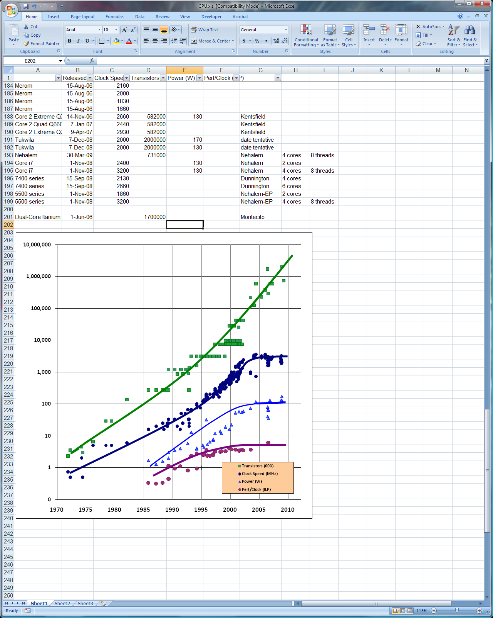
Why Should You Care?
Then: Faster clocks
Now:
More cores
End of the
Free Lunch
Intel CPU Trends (sources: Intel, Wikipedia, K. Olukotun)
Dual-Core Itanium 2
Pentium 4
Pentium
386

Slide 4
The End of The Free Lunch
Although driven by hardware changes, the parallel revolution is primarily a software revolution.
Parallel hardware is not “more of the same.”
Software is the gating factor.
Software requires the most changes to regain the “free lunch.”
Hardware parallelism is coming, more and sooner than most people yet believe.

Slide 5
Where Should I Start?
“Avoid multithreaded code”
“Parallel programming is hard”
“It’s for the experts”
How do we succeed in this new parallel world?
Let’s look at an application and see…

Slide 6
An Example: Adatum-Dash
A Financial application for portfolio risk analysis
Look at large chunks of recent and historical data
Compare models with market conditions
Source code (beta) available: http://parallelpatterns.codeplex.com/

Slide 7
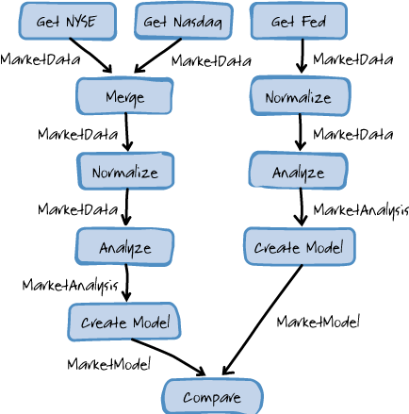
The Adatum Dash Scenario

Slide 8
Adatum Dash

Slide 9
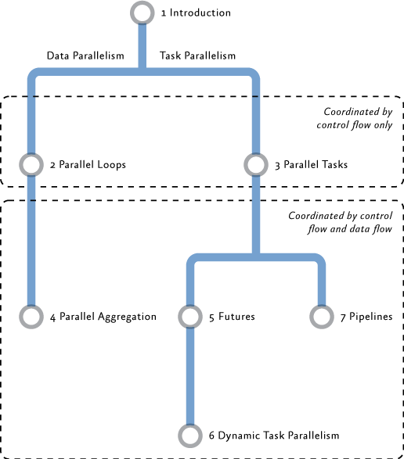
Finding Potential Parallelism
Tasks vs. Data
Control Flow
Control and Data Flow

Slide 10
Data Parallelism
Data “chunk” size?
Too big – under utilization
Too small – thrashing
Chunk layout?
Cache and cache line size
False cache sharing
Data dependencies?

Slide 11
Task Parallelism
Enough tasks?
Too many – thrashing
Too few – under utilization
Work per task?
Small workloads
Variable workloads
Dependencies between tasks?
Removable
Separable
Read only or read/write

Slide 12
Control and Data Flow
Task constraints
Temporal: A → B
Simultaneous: A ↔ B
None: A B
External constraints
I/O read or write order
Message or list output order
Linear and irregular orderings
Pipeline
Futures
Dynamic Tasks

Slide 13
Solution Forces
Flexibility:
Easy to modify for different scenarios
Runs on different types of hardware
Efficiency:
Time spent managing the parallelism vs. time gained from utilizing more processors or cores
Performance improves as more cores or processors are added – Scaling
Simplicity:
The code can be easily debugged and maintained

Slide 14
The Adatum Dash Scenario

Slide 15
The Futures Pattern

Slide 16
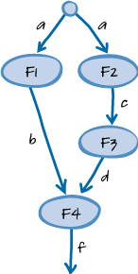
The Futures Pattern
“Does the ordering of steps in your algorithm depend on data flow constraints?”
Directed Acyclic Graph
Dependencies between tasks
F4 depends on the result of F1 & F3 etc
Also called “Task Graph”

Slide 17
Task Size and Granularity
Variable size tasks – harder to balance
Small tasks – more overhead; management and communication
Large tasks – less potential for utilization
Hardware specific – more tasks than cores

Slide 18
Course Grained Partition

Slide 19
Fine Grained Partition

Slide 20
Futures

Slide 21
Finer Grained Partition

Slide 22
Data Parallelism Patterns

Slide 23
The Parallel Loop Pattern
“Do you have sequential loops where there's no communication among the steps of each iteration?”
A very common problem!

Slide 24
The Parallel Aggregation Pattern
“Do you need to summarize data by applying some kind of combination operator? Do you have loops with steps that are not fully independent?”
Calculate sub-problem result per task
Merge results later
Reduces need for locking
“Reduction” or “map/reduce”

Slide 25
Parallel Loops and Aggregation

Slide 26
The Parallel Tasks Pattern

Slide 27
The Parallel Tasks Pattern
“Do you have specific units of works with
well-defined control dependencies?”

Slide 28
Partitioning
How do we divide up the workload?
Fixed workloads
Variable workloads
Workload size
Too large – hard to balance
Too small – communication may dominate

Slide 29
Workload Balancing
Static allocation:
By blocks
By index (interleaved)
Guided
Dynamic work allocation
known and unknown task sizes
Task queues
Work stealing
The TPL does a lot of this work for you

Slide 30
Sharing State and Synchronization
Don’t share!
Read only data
Data isolation
Synchronization

Slide 31
Parallel Tasks

Slide 32
The Pipeline Pattern

Slide 33
The Pipeline Pattern
“Does your application perform a sequence of operations repetitively? Does the input data have streaming characteristics?”
1
1
1
1
2
2
2
3
3

Slide 34
The Producer/Consumer Pattern
Organize by Ordering
Producers… produce!
Block when buffer full
Consumers… consume!
Block when buffer empty

Slide 35
Workload Balancing
Pipeline length
Long – High throughput
Short – Low latency
Stage workloads
Equal – linear pipeline
Unequal – nonlinear pipeline

Slide 36
Passing Data Down the Pipe
Shared queue(s)
Large queue items – under utilization
Small queue items – locking overhead

Slide 37
Pipeline

Slide 38
Opportunities for Parallelism
Pipeline
Futures
Parallel Loop
Parallel Aggregation
Parallel Tasks

Slide 39
But Wait… There’s More!

Slide 40
What About Recursive Problems?
Many problems can be tackled using recursion:
Task based: Divide and Conquer
Data based: Recursive Data

Slide 41
The Dynamic Task Parallelism Pattern

Slide 42
The Dynamic Task Parallelism Pattern
“Does your algorithm divide the problem domain dynamically during the run? Do you operate on recursive data structures such as graphs?”

Slide 43
Workload Balancing
Deep trees – thrashing
Limit the tree depth
Shallow trees – under utilization
Unbalanced Trees – under utilization

Slide 44
Dynamic Task Parallelism Example
static void Walk<T>(Tree<T> root, Action<T> action)
{
if (root == null) return;
var t1 = Task.Factory.StartNew(() => action(root.Data));
var t2 = Task.Factory.StartNew(() => Walk(root.Left, action));
var t3 = Task.Factory.StartNew(() => Walk(root.Right, action));
Task.WaitAll(t1, t2, t3);
}

Slide 45
Conclusions
Success =
Frameworks and runtimes
Task Parallel Library for .NET
Parallel Patterns Library for C++
Tools
Visual Studio 2010
Guidance!

Slide 46

Conclusions
QUIZ…

Slide 47
Our Book
A Guide to Parallel Programming: Design Patterns for Decomposition, Coordination and Scalable Sharing
Goal: Help developers make the most of the new parallel features in Visual Studio 2010:
Due for release late summer 2010.
http://parallelpatterns.codeplex.com/

Slide 48
Your Help
Take the book sample and read it!
Come and give me feedback…
Architecture Area of the TLC (next to the Dev Info desk) - 10:30 to 12:30 on Wednesday
The p&p Booth
You don’t need to be a “parallel expert” to provide feedback!
The first 40 people to read it and give me feedback @ TechEd will get a free copy!

Slide 49
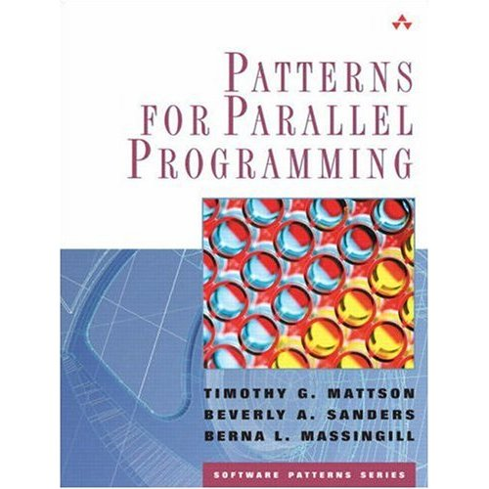



Other Resources
Books
Patterns for Parallel Programming – Mattson, Sanders & Massingill
Design Patterns – Gamma, Helm, Johnson & Vlissides
Head First Design Patterns – Freeman & Freeman
Patterns of Enterprise Application Architecture – Fowler
Research
A Pattern Language for Parallel Programming ver2.0
ParaPLOP - Workshop on Parallel Programming Patterns
My Blog: http://ademiller.com/tech/ (Decks etc.)

Slide 50




Resources
Required Slide
Learning
Sessions On-Demand & Community
Microsoft Certification & Training Resources
www.microsoft.com/teched
www.microsoft.com/learning
Resources for IT Professionals
Resources for Developers
http://microsoft.com/technet
http://microsoft.com/msdn

Slide 51



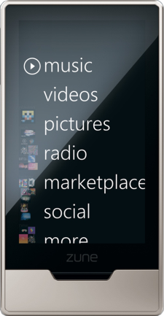
Required Slide
Complete an evaluation on CommNet and enter to win!

Slide 52

Sign up for Tech·Ed 2011 and save $500 starting June 8 – June 31st
http://northamerica.msteched.com/registration
You can also register at the North America 2011 kiosk located at registration Join us in Atlanta next year

Slide 53

© 2010 Microsoft Corporation. All rights reserved. Microsoft, Windows, Windows Vista and other product names are or may be registered trademarks and/or trademarks in the U.S. and/or other countries.
The information herein is for informational purposes only and represents the current view of Microsoft Corporation as of the date of this presentation. Because Microsoft must respond to changing market conditions, it should not be interpreted to be a commitment on the part of Microsoft, and Microsoft cannot guarantee the accuracy of any information provided after the date of this presentation. MICROSOFT MAKES NO WARRANTIES, EXPRESS, IMPLIED OR STATUTORY, AS TO THE INFORMATION IN THIS PRESENTATION.

Slide 54
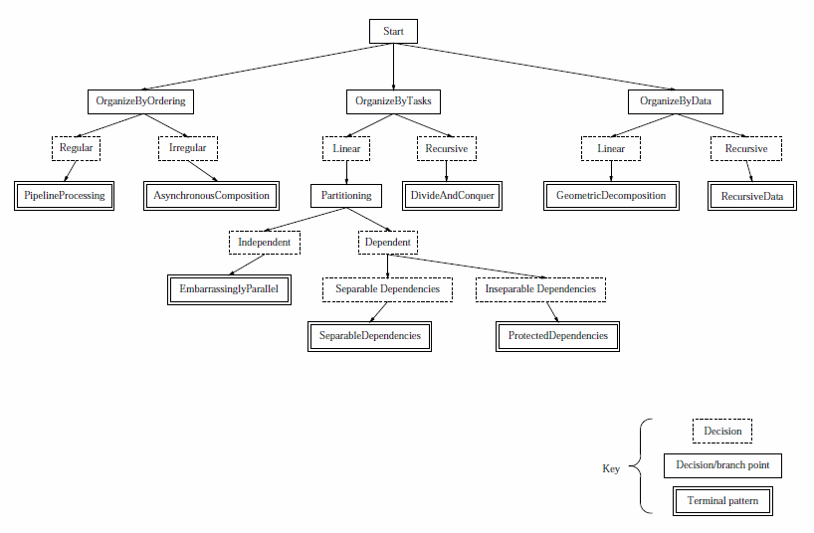
Pipeline
Actors
Divide & Conquer
Distributed
Array
MPMD
Map
Reduce
Producer/ Consumer
SPMD
Parallel Loops
Master/Worker
Shared Queue
Repository
Fork/
Join
Task Graph
SOA Facade
Source: More Patterns for Parallel Application Programs, Berna L. Massingill, Timothy G. Mattson and Beverly A. Sanders

Slide 55
Supporting Patterns
“Gang of Four” Patterns
Façade
Decorator
Repository
Shared Data Patterns
Shared Queue

Slide 56
The Façade Pattern
Hide parallelism
Optimize call granularity
Source: Design Patterns – Gamma, Helm, Johnson & Vlissides
Patterns of Enterprise Application Architecture - Fowler

Slide 57
The Decorator Pattern
Encapsulate parallelism
Calling code is parallel agnostic
Add parallelism to an existing (base) class
IFoo
ConcurrentFoo
IFoo
Foo
Source: Design Patterns – Gamma, Helm, Johnson & Vlissides

Slide 58
The Repository Pattern
Shared hash or queue
Database
Distributed cache
Source: Patterns of Enterprise Application Architecture - Fowler

Slide 59
The Shared Queue Pattern
Task Queue
A decorator to Queue
Hides the locking which protects the underlying queue
Facilitates Producer/Consumer pattern
Producers call: theQueue.Enqueue()
Consumers call: theQueue.Dequeue()
Source: Patterns for Parallel Programming – Mattson, Sanders & Massingill

Slide 60
Shared Queue Example
var results = new ConcurrentQueue<Result>();
Parallel.For(0, 1000, (i) =>
{
Result result = ComputeResult(i);
results.Enqueue(result);
});

Slide 61
Parallel With PLINQ
var accountRatings = accounts.AsParallel() .Select(item => CreditRating(item))
.ToList();

Slide 62
Loop Parallel Examples
Parallel.For (0, acc.Length, i =>
{
acc[i].UpdateCreditRating();
});
#pragma omp parallel for
for (int i = 0; i < len; i++)
{
acc[i].UpdateCreditRating(); }

Slide 63
Parallel Tasks Example
Parallel.Invoke(
() => ComputeMean(),
() => ComputeMedian()
);
parallel_invoke(
[&] { ComputeMean(); },
[&] { ComputeMedian(); },
);

Slide 64
Pipeline Examples
var input = new BlockingCollection<string>();
var readLines = Task.Factory.StartNew(() =>
{
try {
foreach(var line in File.ReadAllLines(@"input.txt")) input.Add(line);
}
finally { input.CompleteAdding(); }
});
var writeLines = Task.Factory.StartNew(() =>
{
File.WriteAllLines(@”output.txt", input.GetConsumingEnumerator());
});
Task.WaitAll(readLines, writeLines);

Slide 65
Pipeline Examples
Get-ChildItem C:\ | Where-Object {$_.Length -gt 2KB} | Sort-Object Length

