Slide 1

PRESTO
Kiran Palaka

Slide 2
Problem to solve
Huge production of data.
As data is growing enormously to the point of peta bytes , querying the database has become a big issue.
So we should be able to run more interactive queries and get results faster .

Slide 3
Introduction
Presto is a open source distributed sql query engine.
For running queries against of all sizes ranging from gigabytes to petabytes .
It supports ANSI SQL ,including complex queries,aggresgations,joins and window functions .
It is implemented in java.

Slide 4
Presto: I can query
Presto
HIVE
HBASE
Relational databases
Proprietary data stores

Slide 5
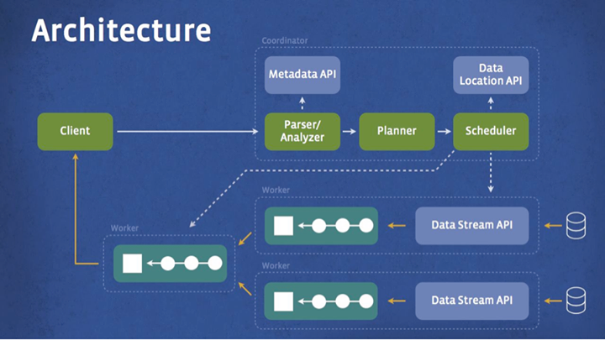
Architecture

Slide 6
Architecture Explanation
Client sends sql to presto coordinator.
Coordinator parses ,analyzes and plans the query execution.
The scheduler wires together the execution pipeline ,assigns work to nodes closest to data and monitors the progress.
The client pulls the data from output stage which in turn pulls data from underlying stages.

Slide 7
Hive/Mapreduce Execution model
Hive translates queries into multiple stage of mapreduce tasks and execute them one after the other.
Each task reads input from disk and writes intermediate output back to disk.

Slide 8
Presto Execution
Presto engine does not use Mapreduce.
It employs a custom query and execution engine with operators designed to support sql semantics.
Processing is in memory and pipelined across the network between stages which avoids unnecessary I/O and associated latency overhead.
Pipelined execution model runs multiple stages at once and streams data from one stage to next as it becomes available which reduces end-to-end latency

Slide 9
Note
Presto dynamically compiles certain portions of query plan to byte code which lets JVM optimize and generate native machine code.

Slide 10
Extensibility
Presto was designed with a simple storage abstraction that makes its easy to provide sql query capability against disparate data sources.
Connectors only need to provide interfaces for fetching meta data, getting data locations and accessing data itself.

Slide 11
Limitations
Size limitation on the join tables and cardinality of unique groups.
Lacks the ability to write output back to tables. Currently query results are streamed to client.

Slide 12
Presto developers claim:
Presto is 10x better than hive/Mapreduce in terms of cpu efficiency and latency for most queries.
Supports ANSI sql, including joins, left/right outer joins,subqueries,most of the common aggregate and scalar functions, including approximate distinct counts, approximate percentiles

