Slide 1
Clinical Data Repository Versus a Data Warehouse — Which Do You Need? By Tim Campbell

Slide 2

Unlocking the Value of Data
Even though a clinical data repository is good at gathering data, it can’t provide the depth of information necessary for cost and quality improvements because it wasn’t designed for this type of use. Instead, what health systems need is a flexible, late-binding enterprise data warehouse (EDW).

Slide 3

Clinical Data Repository
A clinical data repository consolidates data from various clinical sources, such as an EMR or a lab system, to provide a full picture of the care a patient has received.
Some examples of the types of data found in a clinical data repository include demo-graphics, lab results, radiology images, admissions, transfers, and diagnoses.

Slide 4

Clinical Data Repository
While the data contained in a clinical repository is valuable because it shows a patient’s clinical data, the design is not an adequate solution for health systems for numerous reasons. Mainly because it doesn’t offer flexible analytics for analysts to use as they work to improve patient care.
Unfortunately, there are other limitations as well.

Slide 5

Clinical Data Repository
Clinical data repositories are inefficient – When clinicians request many reports all at once the IT team usually into a report factory rather than functioning as an experienced analytics team.
These highly skilled, highly paid IT employees end up spending their time tracking down the data, pulling it into the repository, and spitting out reports.

Slide 6
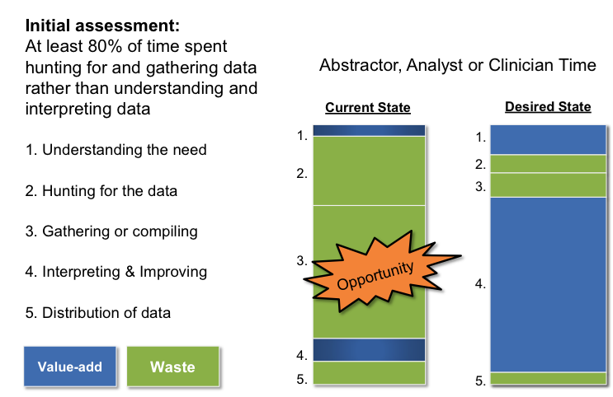
Clinical Data Repository
Reduce Wasted Time

Slide 7

Clinical Data Repository
There’s a large margin for costly errors – Clinical data repositories often use complex data models and their structure is normalized.
Because of this complexity, the report writer will join many different tables in one report, increasing the margin for error during coding and the time it takes to build these reports.

Slide 8

Clinical Data Repository
Reports aren’t standardized – When data is being pulled from clinical data repositories and then different visualization tools are used to build those reports, each report will look and function differently.
Without a centralized tool for reporting across the organization, reporting will continue to have a different look and feel by department or functional area, making report reading less efficient.

Slide 9

Clinical Data Repository
Tools aren’t standardized – When tools aren’t standardized, users of the tools, such as clinicians or analysts, need to learn how to use each tool to generate their reports.
This lack of standardization is frustrating. Plus learning how to use each tool adds to the time and cost of reporting.

Slide 10

Clinical Data Repository
Data isn’t always secure – With data spread across many clinical data repositories, there is no way to audit who is looking at the data. Even built-in safeguards within those systems are limited.
Despite the best intentions and safeguards the data becomes extremely vulnerable, exposing the hospital or health system to needless risk.

Slide 11

Late-Binding™ Enterprise Data Warehouse
While the patient level care information the clinical data repository provides is important, there’s a better solution that will provide a single source of truth across the entire health system: a Late-Binding™ Data Warehouse
There are 7 major benefits:

Slide 12

Late-Binding™ Enterprise Data Warehouse
1. Faster time to value – With a Late-Binding™ Data Warehouse, you don’t need to wait months or years to map all of your data. Instead, you can start small, pulling in and binding only the data you need for specific initiatives. This allows a much faster time to value and quickly demonstrates the benefits.

Slide 13

Late-Binding™ Enterprise Data Warehouse
2. Flexible architecture means easy adjustments – The flexibility of a Late-Binding™ Data Warehouse is critical because healthcare definitions change rapidly — and frequently. The architecture makes it much easier to adjust to changes in protocols or regulations, new technologies, and dozens of other operational and clinical factors.

Slide 14

Late-Binding™ Enterprise Data Warehouse
3. Reduction in waste and inefficiencies – Instead of analysts using their precious time to hunt down data, they are significantly adding value to the organization. With a one-stop shop for data and a place that requires only one login to get any data in the system, analysts now have a place to analyze data so they no longer need to cobble data together for their reports.

Slide 15

Late-Binding™ Enterprise Data Warehouse
4. Reduced errors means reduced costs – A Late-Binding™ architecture decreases the possibility of expensive errors. When analysts need to perform data validation to ensure the data in the reports matches the source data, they can easily return to the source system to see what source field and table that column came from.

Slide 16

Late-Binding™ Enterprise Data Warehouse
5. Reports are standardized – Late-Binding™ Data Warehouse look the same across the entire organization. Once there’s an EDW team in place, their goal is to treat every service as a customer and provide standardized reports with the same look and feel. This approach contributes to a more systematized, unified organization.

Slide 17

Late-Binding™ Enterprise Data Warehouse
6. No more long wait times – IT departments are usually overwhelmed with requests. By the time they’re able to work on a report, the requirements may have already changed. With a Late-Binding™ Data Warehouse, a dedicated, enterprise team, service lines will have their own resource who’s role is to work with them to produce meaningful reports and make alterations as needs and wants change.

Slide 18

Late-Binding™ Enterprise Data Warehouse
7. Data is secure – With a Late-Binding™ Data Warehouse, the organization has a central, secure repository for all data. Individual departments can still maintain their own repositories — although they may want to re-think that strategy after experiencing a full EDW — but their data is now visible to all authorized users and the organization gains far tighter control over its data.

Slide 19

Return on Investment
Heathcare providers employ hundreds of different technology solutions they’ve purchased from multiple vendors, with no way to extract the various data points into one single source of truth.
A Late-Binding™ Data Warehouse is able to incorporate all the disparate data from across the organization leading to greater insights and a better return on investment in the short, mid- and long-term.

Slide 20
More on this topic:
Early vs. Late-Binding Approaches to Data Warehousing. Which Is Better for Healthcare? Mike Doyle, Vice President
What Is the Best Healthcare Data Warehouse Model? Comparing Enterprise Data Models, Independent Data Marts, and Late-Binding Solutions Steve Barlow, Senior Vice President and Co-Founder
Late-Binding vs. EMR-Based Models: Comparing Data Warehouse Methodologies Eric Just, Vice President, Technology
The Late-Binding™ Data Warehouse White Paper Dale Sanders, Vice President, Strategy

Slide 21

Other Clinical Quality Improvement Resources
Click to read additional information at www.healthcatalyst.com
Tim Campbell joined Health Catalyst as a data architect in February of 2011. Previously, he worked for a year-and-a-half as a project manager for a company that provided point-of-sale software for the fast-food industry. He has a Bachelor of Arts degree from Saint John’s University in Collegeville, Minnesota where he majored in business management and Spanish.

