Slide 1
DSP
3D scene rendering
Client input processing
DRS
Multi-view rendering
Game execution
H.264 encoding
DRS / EQS management
EQS
Game node monitoring
QoS / Streaming
Notes:
Figure : System Architecture

Slide 2




Audio data
3D scene data
Rendering images
Client
DSP
DRS
EQS
Scene update information

Slide 3
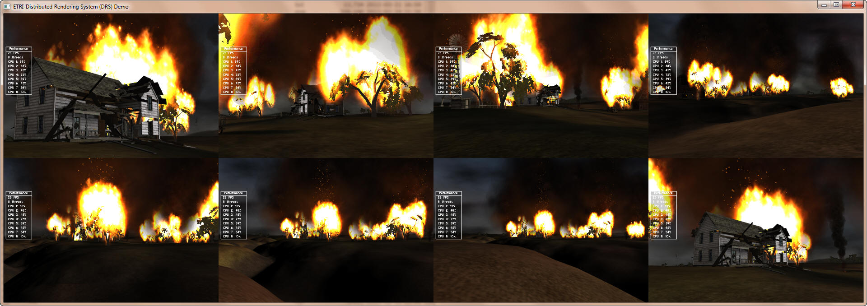

Slide 4

FPS (frames per second)
Frame time (sec)

Slide 5
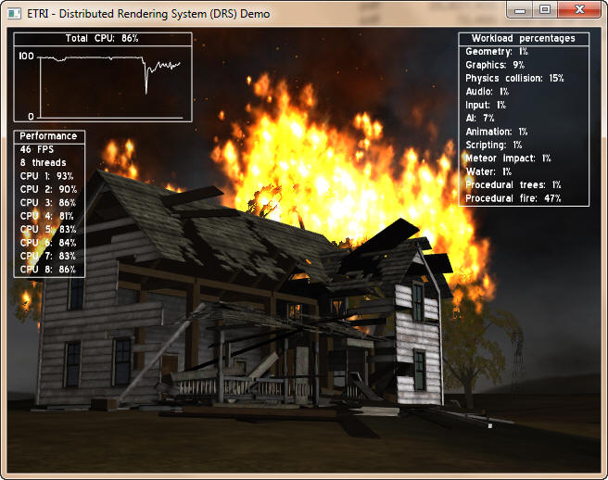
FPS (frames per second)
Frame time (sec)

Slide 6




DSP Manager
Game Node
100 base T switch
Game Node
DRS/EQS
Clients

Slide 7

FPS (frames per second)
Frame time (sec)

Slide 9
DRS Block Architecture
Distributed Rendering System (DRS) Block
Rendering Scheduler
Multi-view
Manager
Rendering Task Manager
(Decomposition/Parallelization)
3D Renderer Library (OGRE)
System Interfaces
Distributed Service Platform (DSP)
Encoding/QoS/Streaming System (EQS)

