Slide 1
Dryad
Distributed Data-Parallel Programs from Sequential Building Blocks

Slide 2
Contents
Introduction
System Overview
Describing graph & Writing a vertex program
Job execution
Experimental evaluation
Building on dryad
Discussion / critics
Q & A

Slide 3
Introduction
Dryad

Slide 4
The Dryad Project
Motivation
Easier development for parallel & distributed applications
Aims from single machine system to large cluster systems
Problems
High latency & Unreliable network
Control of resources
Authentication & Access control
…
Primary focuses on
Reliability
Efficiency
Scalability

Slide 5
vs Earlier Works
‘Require’ developers to make parallel application
MapReduce, GPU Shader Language, parallel database
Earlier works restrict application’s communication flow
MapReduce does for Simplicity
Dryad allows ‘fine control’ on data flow
Allows arbitrary communication graph
Control over subroutines in vertices
Many kind of channel interfaces (TCP, Shared memory, file)
Unrestricted number of input / output

Slide 6
Dryad contributions
Handles difficult problems
Scheduling
Optimizing within a computer
Fault-tolerance
Deliver data to needed location
Scalability
Programmability
Simple graph description language
Simpler, higher-level programming abstraction

Slide 7
System Overview
Dryad

Slide 8
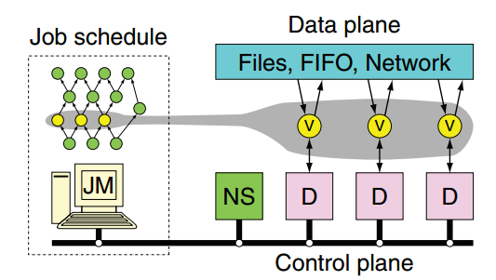
Overview
Channel
Files, FIFO (Shared Memory), Network
Job Manager (JM)
Scheduling
Only responsible for control decision
SPOF (Single Point Of Failure)
Name Server (NS)
Enumerate all the available computers
Position of computers (for data locality)
Daemon (D)
Actually runs the vertices (gets from Job Manager)
Proxy for communicating with job manager
Simple task scheduler & distributed storage system

Slide 9
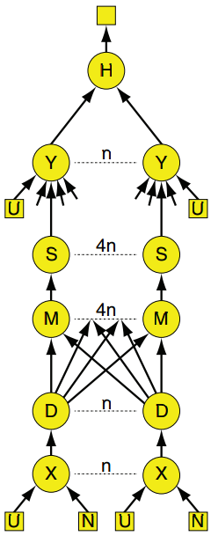
SQL Query Example
select distinct p.objID
from photoObjAll p
join neighbors n — call this join “X”
on p.objID = n.objID
and n.objID < n.neighborObjID
and p.mode = 1
join photoObjAll l — call this join “Y”
on l.objid = n.neighborObjID
and l.mode = 1
and abs((p.u-p.g)-(l.u-l.g))<0.05
and abs((p.g-p.r)-(l.g-l.r))<0.05
and abs((p.r-p.i)-(l.r-l.i))<0.05
and abs((p.i-p.z)-(l.i-l.z))<0.05

Slide 10
SQL Query Example
Control Flow
Join (X) -> Distribute(D) -> Merge & Sort(M, S) -> Join (Y)
4n M & S vertices
To maximize use of quad core
Merge operation
Non-deterministic (orders items according to arriving time)
Generates different results
It’ll be okay?
What channel to use between vertices?

Slide 11
Describing a Graph & Writing a program
Dryad

Slide 12
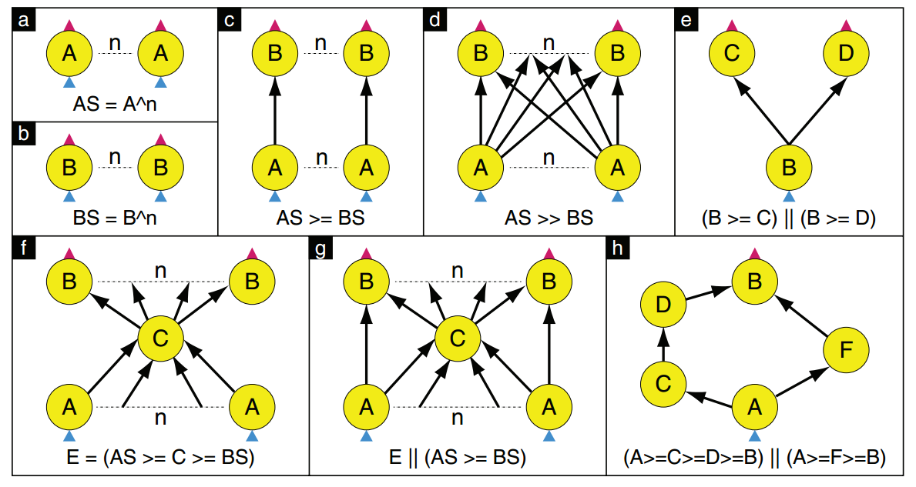
Graph description operators
A >= B: Point-wise composition
A >> B: Complete bipartite graph
A || B: Merging two graphs

Slide 13
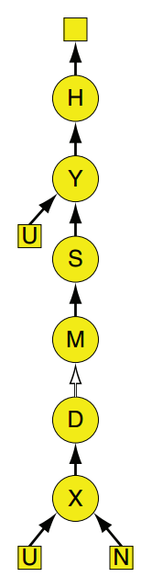
Graph Skeleton

Slide 14
Channel Types
Temporary file (Default)
Writing/Reading to/from disk
Slow, but data is preserved
No concern for deadlock
TCP pipe
No disk access
End-point vertices must run at same time (Data not preserved after completion)
Shared-Memory FIFO
Lowest Communication cost
End-point vertices must run within the same process
Shortcut: Programmer need to fully understand about physical structures of the system!

Slide 15
Writing a program
Implemented mostly by C++
Daemon executes vertices sent from Job Manager
No type-checking
Should determine the type of items to read/write in vertices
Some pre-defined vertex classes
map, reduce, distribute, joins, …
Can run legacy binaries using “process wrapper”
Wrapper vertex should support arbitrary data types
Support pipelined execution
Support Event-based programming style using a shared thread pool
Channel handling

Slide 16
Job Execution
Dryad

Slide 17
Job Execution
Execution Record
When a vertex’s all input channels are ready
Added to scheduling queue
‘Constraint’, ‘Preference’ – for locality
Temporary channel files
Managed and automatically cleaned up by daemon
Web-based interface

Slide 18
Vertex Fault Tolerance
If JM fails, the job is terminated
Vertex scheduler could employ check pointing or replication
Vertex execution failed, JM informed
Directly from process via daemon
Heartbeat timeout
Mark execution record as fail
Vertex re-executed, channel re-created
Errors need not be propagated forward!
Deterministic operation – always same result with same input
Can re-run vertex at any time

Slide 19
Stage callback
Every vertex belongs to a single ‘stage'
Stage callback is managed by each ‘stage’ manager
Called on
Stage transition
Regular timer interrupt
Can implement sophisticated behaviors
Detecting / Dealing with stragglers
Run-time graph refinement

Slide 20
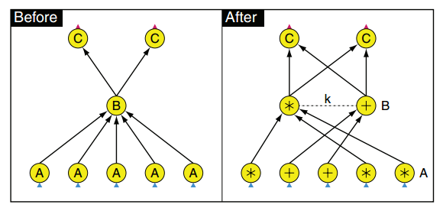
Two-level hierarchy refinement
Many clusters have two-level network structure
Switch in rack (lower level)
Per-rack switch (higher level)
Single large core switch (root)
Between-rack communication cost < internal-rack communication cost
Reduces within rack -> lower communication cost
Redraw graph after input vertices have completed
By stage manager

Slide 21
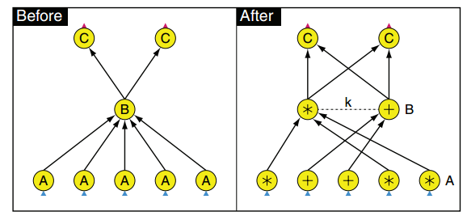
Partial aggregation refinement
Automatically parallelize internal vertices
Operates by
Setting max. number of input channels
Setting max. number of volume of input data
Dynamically increases number of vertices
Can be more efficient than static method
Can not know the intermediate data size before the computation begin
Graph’s skeleton unchanged

Slide 22
Experimental Evaluation
Dryad

Slide 23
Evaluation overview
Hardware
2GHz, 4Core
8Gbytes DRAM
…
SQL Query experiment
Small number of computers
Comparison with SQL Server
“in-memory” vs “two-pass”
Data mining experiment
MapReduce style job

Slide 24
SQL Query Experiments
Same as queries in the previous example
M -> S -> Y: Shared memory
In-memory vs Two-pass
In-memory: D -> M uses shared memory (corresponding M) and TCP/IP (others)
Two-pass: Uses disk I/O for other communications

Slide 25
Non-Deterministic Operation
M (Merge) is non-deterministic
When failed, it can’t fully recovered by just re-executing
Items orders can be changed when re-executing
But, it’s okay because S and M are connected with shared FIFO
S (Sort) reorders items regardless of arrival time
S-M is deterministic
S-M is in one process and stops together when failure occurred

Slide 26
Channel types and deadlock
In-memory variant requires at least n computers
If not, M will wait forever
Example: n=3 with 2 computers
S
S
S
M
M
M
D
D
D
Live
Live
Dead

Slide 27
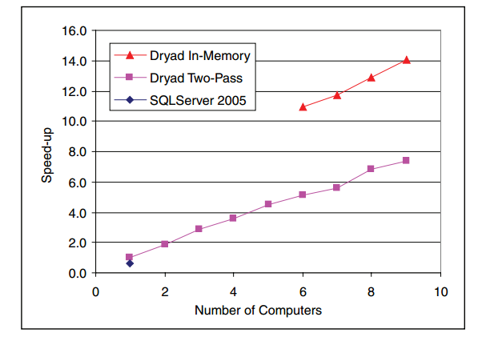
Result

Slide 28
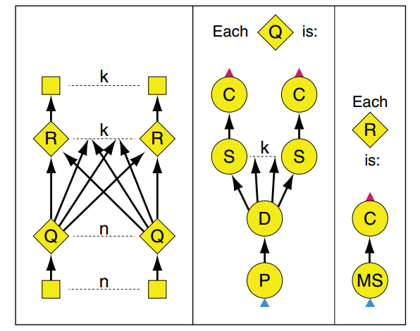
Data Mining Experiment
Get queries’ frequency
Not scalable -> Too many Q’s

Slide 29
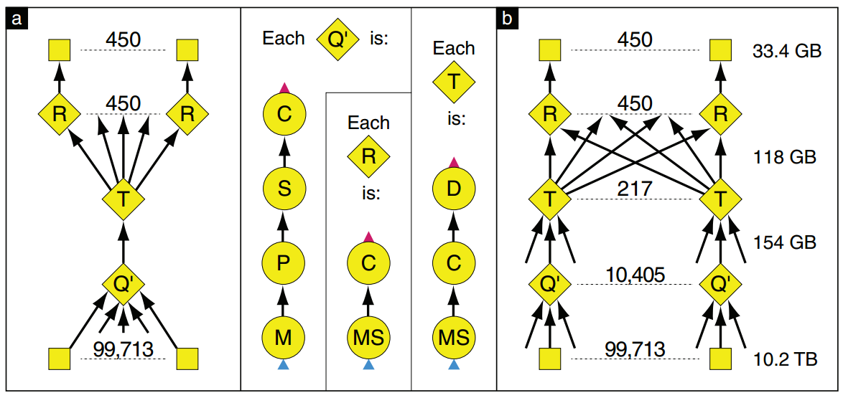
Data Mining Experiment
Scale using partial aggregation refinement

Slide 30
Data Mining Experiment
Do not have to modify vertices
Not trivial

Slide 31
Building on dryad
Nebula
Hides most of the details of the Dryad program
Implicitly determine the number of vertices
SSIS
Distributed SQL Queries (Future)

Slide 32
Discussion / Critics
Trade-off between flexibility and simplicity
vs MapReduce
TCP/IP, Shared memory channel
Can avoid writing to slow disk
Can’t persist data (vs Spark)
Basic run-time optimization
Further improved in SCOPE
Fault-tolerance
Simplifies problem by restricting to use deterministic operators
Recovering is not parallel
Using deterministic operators is not obligated in compiler
Programmer can decides communication graph
Storm
DAG – hard to process iterations

Slide 33
Q & A
Dryad

