Slide 1
Bigtable: A Distributed Storage System for Structured Data Fay Chang, Jeffrey Dean, Sanjay Ghemawat, Wilson C. Hsieh, Deborah A. Wallach Mike Burrows, Tushar Chandra, Andrew Fikes, Robert E. Gruber
Geore Han

Slide 2
Table of Contents
Introduction
Building Block
Data Model
Implementation
Refinements
Performance Evaluation
Conclusion
Comparison with HBase

Slide 3
Why not a DBMS?
Scale is too large for most commercial Databases
Cost would be very high
Low-level storage optimizations help performance significantly
Hard to map semi-structured data to relational database
Non-uniform fields makes it difficult to insert/query data

Slide 4
What is Bigtable?
Bigtable is a distributed storage system for managing structured data
Bigtable does not support a full relational data model
Scalable
Self managing
Used by more than 60 Google products
Used for variety of demanding workloads
Notes:
구글 analytics, 구글 finance, google documents, google earth, google fusion tables, …
Throughput oriented batch processing / Latency sensitive data serving

Slide 5
Bigtable
Goal
Wide applicability
Scalability
High performance
High availability
Simple data model that supports dynamic control over data layout and format

Slide 6
APIs
The Bigtable API provides functions:
Creating and deleting tables and column families
Changing cluster, table and column family metadata
Support for single row transactions
Allows cells to be used as integer counters
Client supplied scripts can be executed in the address space of servers

Slide 7
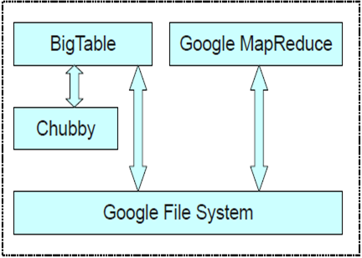
Architecture
Bigtable
Google MapReduce
Chubby
CMS server
Google File System

Slide 8
Building Blocks
Bigtable is built on several other pieces of Google infrastructure
Google File system (GFS)
SSTable: Data structure for storage
Chubby: Distributed lock service
Index (block range)
64K block
64K block
64K block
……
Notes:
Index는 메모리에 로드. 이에, 필요한 부분을 찾을 때 메모리 scan을 통해 찾고, 한 번의 disk seek만으로 필요한 데이터를 볼 수 있도록.
Chubby가 굉장히 중요한 역할을 한다고 강조함. → chubby 없으면 bigtable도 없다! 라는 식
To ensure that there is at most one active master at any time
Store the bootstrap location of Bigdable data
To discover tablet servers and finalize tablet information
To store bigdatble shcema information
To store access control lists

Slide 9
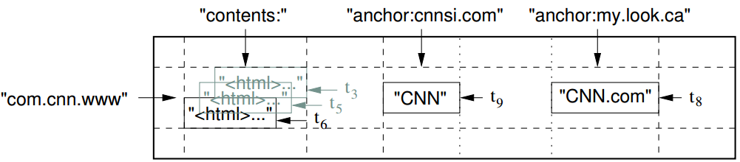
Data Model; Row
The row key in a table are arbitrary strings
Data is maintained in lexicographic order by row key
Each row range is called a tablet, which is the unit of distribution and load balancing

Slide 10
Data Model; Column
Column keys are grouped into sets called column families
Data stored in a column family is usually of the same type
A column key is named using the syntax: family:qualifier
Column family names must be printable, but qualifiers may be arbitrary strings

Slide 11
Data Model; Timestamp
Each cell in a Bigtable can contain multiple version of the same data
Versions are indexed by 64-bit integer timestamps
Timestamps can be assigned:
Automatically by Bigtable, or
Explicitly by client applications
Timestamps consolidation
Keep last n versions of a cell, or values that were written in the last n days

Slide 12
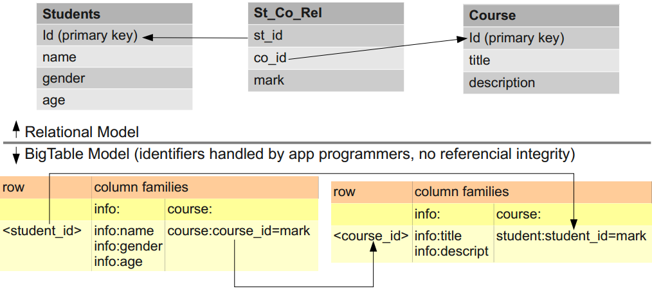
Data Model; vs relational model

Slide 13
Implementation
Three major components
Library linked into every client
Single master server
Assigning tablets to tablet servers
Detecting addition and expiration of tablet servers
Balancing tablet-server load
Garbage collection files in GFS
Many tablet servers
Manages a set of tablets
Tablet servers handle read and write requests to its table
Split tablets that have grown too large

Slide 14
Implementation
Each table consists of a set of tablets
Initially, each table has just one tablet
Tablets are automatically split as the table grows
(each approximately 100-200 MB in size be default)
Row size can be arbitrary (hundreds of GB)

Slide 15
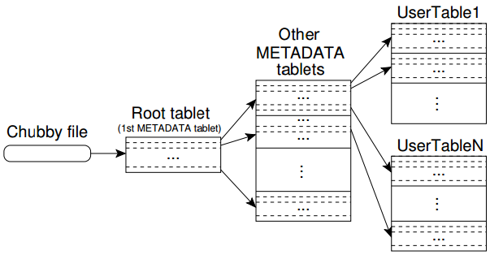
Locating Tablets
Three level hierarchy
Level 1: Chubby file containing location of the root tablet
Level 2: Root tablet contains the location of METADATA tablets
Level 3: Each METADATA tablet contains the location of user tablets
Location of tablet is stored under a row key that encodes table identifier and its end row
Notes:
각 METADATA row 는 보통 1KB의 데이터를 메모리에 저장, 128 MB의 메타데이타 tablets은 이 스킴에 따르면 2^34 tablets을 관리할 수 있음
Client library 가 table location을 caching하고 있음. 만약 이를 모르거나, 잘못된 위치를 가지고 있을 경우 이 하이어라키 트리를 거꾸로 올라가며 받아냄. 만약 캐시가 비어있으면 그냥 chubby read 한번을 포함해서 쭉 읽으면 해결
오래되어 있는 경우엔 일반적으로 여섯번 왕복해야함. (왜지?)
METADATA table는 tablet과 관계된 log 같은 2차 정보도 들고있음. (디버깅과 perf. 분석에 사용)

Slide 16
Tablet Assignment
Master server startup
Grabs unique master lock in Chubby
Scans the tablet server directory in Chubby
Communicates with every live tablet server
Scans METADATA table to learn set of tablets
Master is responsible for finding when tablet server is no longer serving its tablets and reassigning those tablets as soon as possible
Periodically asks each tablet server for the status of its lock
If no reply, master tries to acquire the lock itself
If successful to acquire lock, then tablet server is either dead or having network trouble

Slide 17
Tablet Assignment
Tablet server start up
It creates and acquires an exclusive lock on, a uniquely named file on Chubby
Master monitors this directory to discover tablet servers
Tablet server stops serving tablets
If it loses its exclusive lock
Tries to reacquire the lock on its file as long as the file still exists
If file no longer exists, the tablet server will never be able to serve again → Kills itself → system remove tablet server’s machine from the cluster → release its lock so that master will reassign its tablets more quickly

Slide 18
Tablet Assignment
Tablet servers
Cluster manager
1. Start a server
Chubby
7. Acquire and Delete the lock
8. Reassign unassigned tablets
2. Create a lock
3. Acquire a lock
4. Monitor
Region Server
5. Assign tablets
Master Server
6. Check lock status

Slide 19
Tablet Serving
Updates committed to a commit log
Recently committed updates are stored in memory – memtable
Older updates are stored in a sequence of SSTables

Slide 20
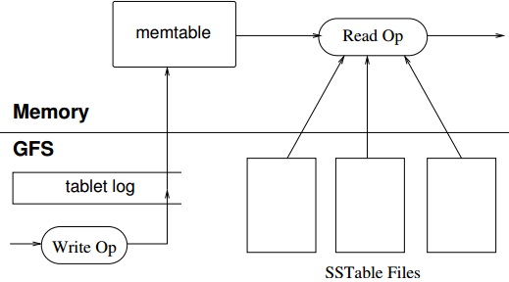
Tablet Serving
Write operation
Server checks if it is well-formed
Checks if the sender is authorized
Write to commit log
After commit, contents are into Memtable
Read operation
Check well-formedness of request
Check authorization in Chubby file
Merge memtable and SSTables to find data
Return data

Slide 21
Compaction
Control “size”
Minor Compaction
Move data from memtable to SSTable
Merging Compaction
Merge multiple SSTables and memtable to a single SSTable
Major Compation
Re-writes all SSTables into exactly one SSTable
Notes:
Minor compaction: 멤테이블 용량 threshold 이상으로 차면 SSTable로 바꾸고 새로운 멤테이블 만듬 → 1) momory 사용량 줄이고 2) recovery time 줄임
Merging Compaction: Minor compaction 반복될 경우 SSTable 너무 많아져서 read 오래 걸림 → merge
Major compaction: 일반적으로 deleted record를 SSTable이 들고 있을 수 있는데 이러한 record가 많아지면 안됨. 이를 위해 모든 SSTable을 하나의 SSTable로 merging compaction 하는 것을 major compaction이라 함

Slide 22
Refinements
Locality groups
Clients can group multiple column families together into a locality group
Compression
Compression applied to each SSTable block seperately
Uses Bentley and Mcllroy’s scheme and fast compresion algorithm
E.g. 2,4,6,9,7 → 2, 2, 3, -2
Bloom filters
Notes:
Delta encoding 2,4,6,9,7

Slide 23
Refinements
Caching
Scan Cache: a high-level cache that caches key-value pairs returned by the SSTable interface
Block Cache: a lower-level cache that caches SSTable blocks read from file system
Commit-log implementation
Suppose on log per tablet rather have one log per tablet server
Notes:
Scan cache → 같은 data 반복적으로 읽을 때
Block cache → 같은 locality에 있는(같은 row에 있는?) 서로 다른 column에 대한 반복적인 read

Slide 24
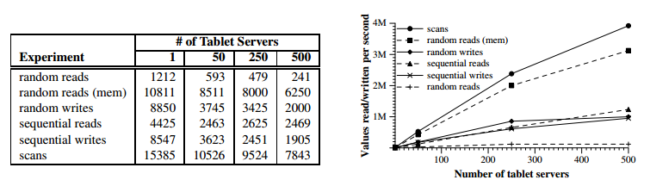
Performance Evaluation

Slide 25
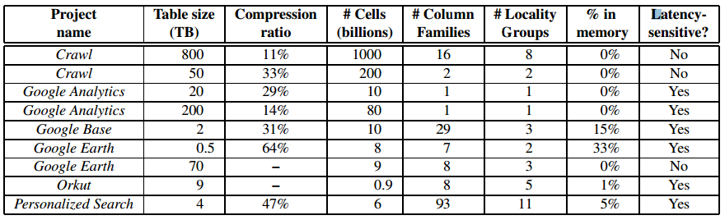
Applications at Google

Slide 26
Conclusions by Authors
Satisfies goals of high-availability, high-performance, massively scalable data storage
Successfully used by various Google products
A distributed systems
Designed to store enormous volumes of data
Can be easily scaled to accommodate peta-bytes of data across thousands of nodes

Slide 27
Compare with HBase

Slide 28
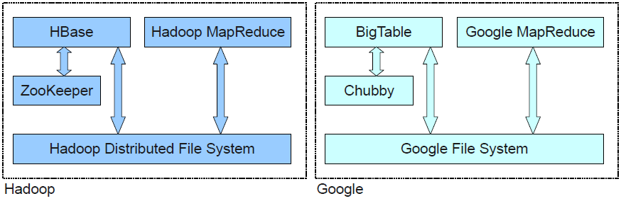
Hadoop’s and Google’s stacks

Slide 29
Key difference
Memory Mapping
Single Master
MVCC
Locality Groups
KeyValue (Cell) Cache
Client Isolation

Slide 30
Opinion

Slide 31
Thank you!

Slide 32
References
http://static.googleusercontent.com/media/research.google.com/en//archive/bigtable-osdi06.pdf
http://www.slideshare.net/tomcythankachan1/google-bigtable-15370454
http://www.slideshare.net/udanax/bigtable-and-hbase
http://lsd.ls.fi.upm.es/lsd/nuevas-tendencias-en-sistemas-distribuidos/HBase_2.pdf

