Slide 1

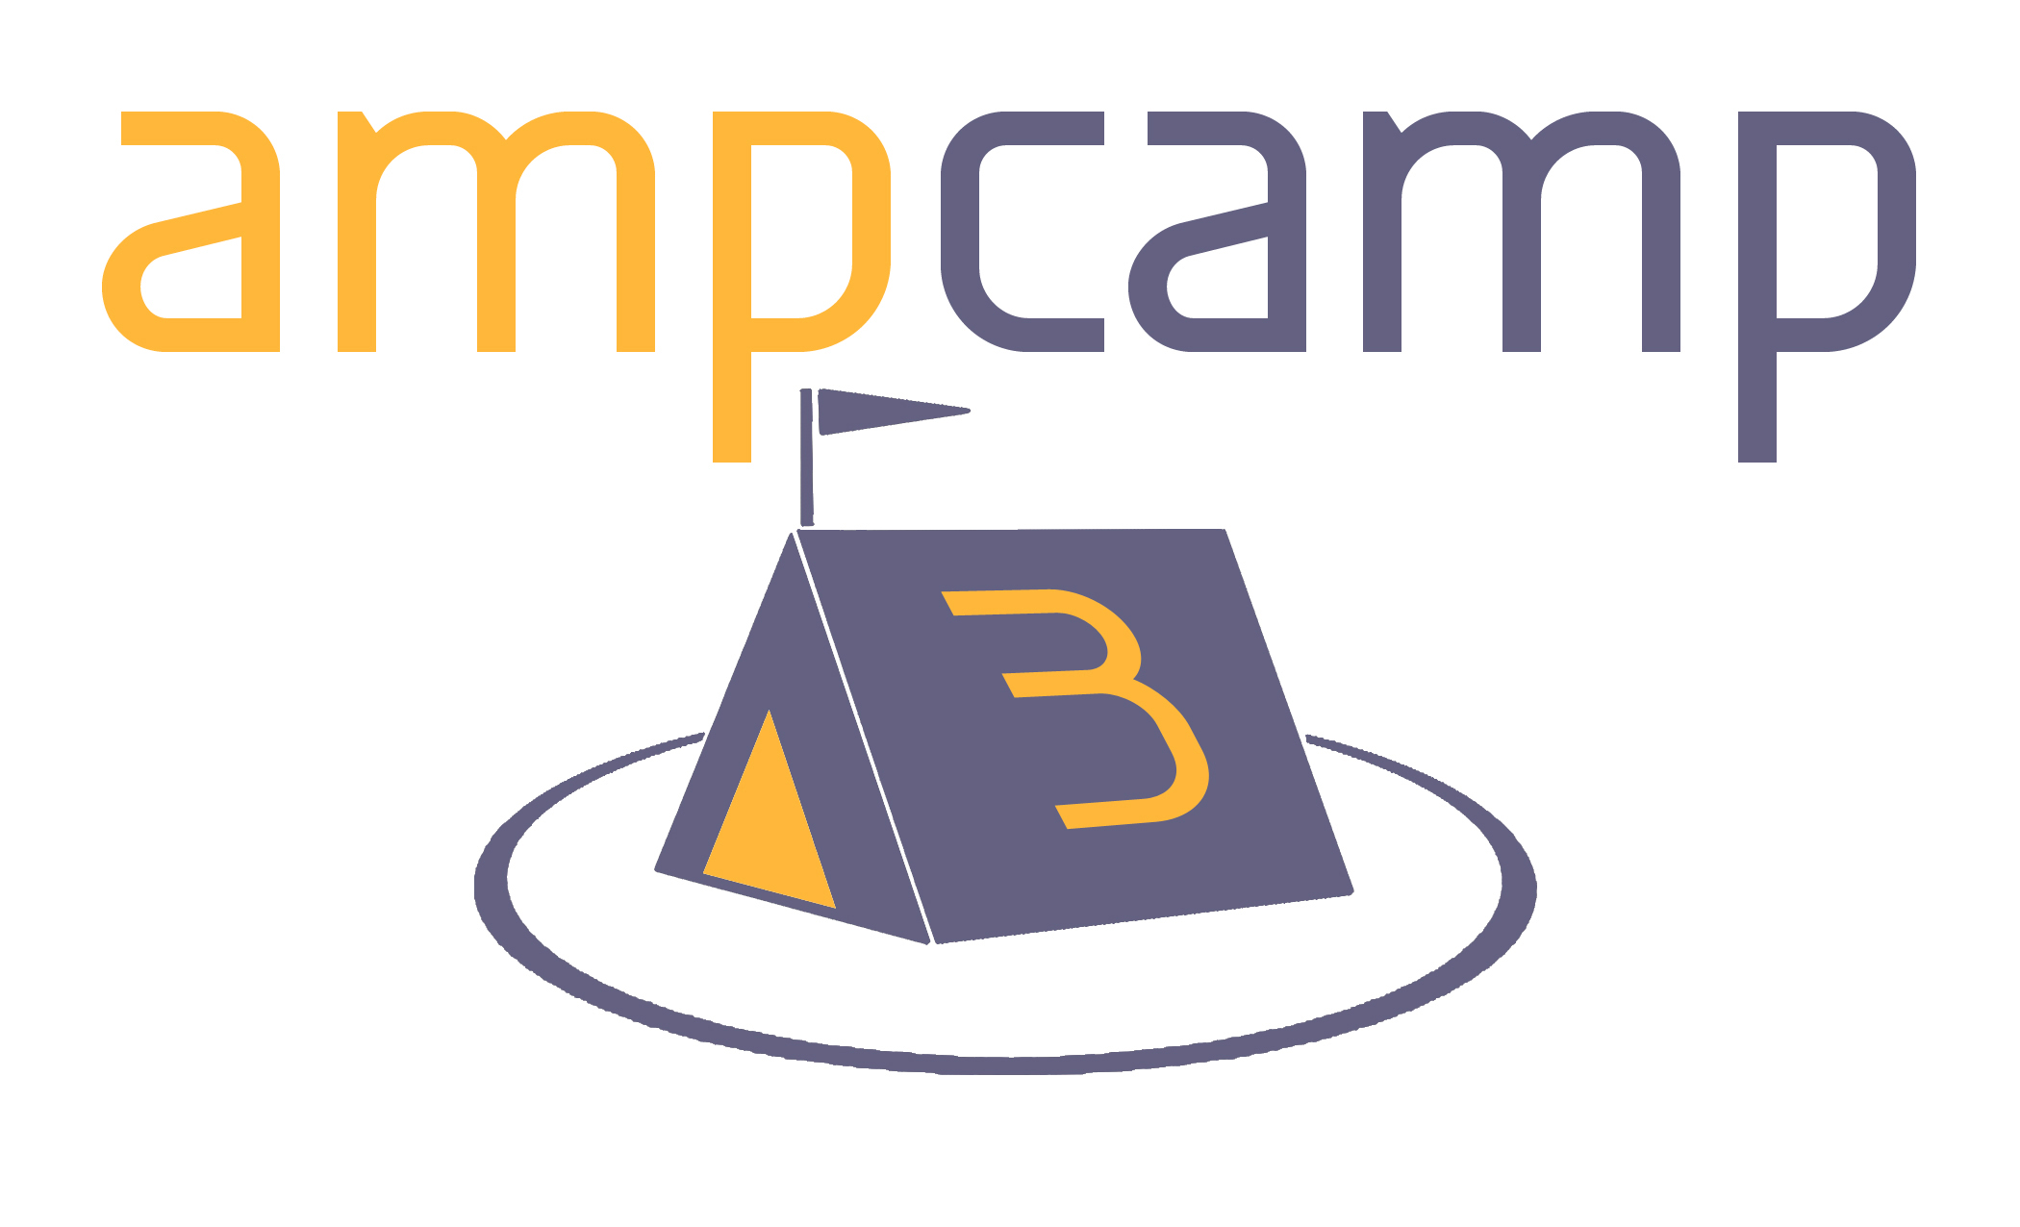





















Intro to AMPLab and Berkeley Data Analytics Stack
UC BERKELEY
Ion Stoica
UC Berkeley

Slide 2
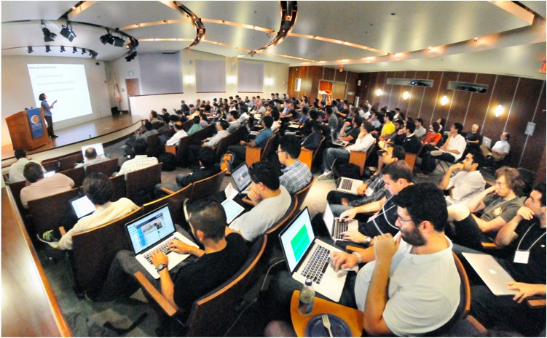

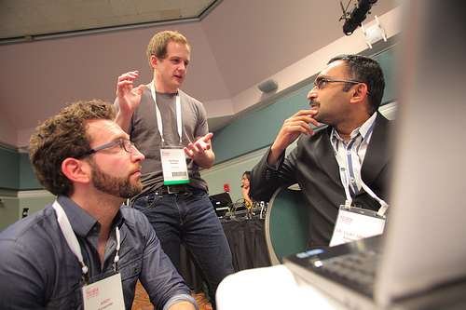
A Brief History…
AMPCamp 1 (August, 2012)
150 campers (3,000+ online)
AMPCamp 2 (February, 2013)
Full-Day Strata Tutorial
Sold-out hands-on tutorial
AMPCamp 3 (Today and Tomorrow)
250 capers (sold-out)

Slide 3
What is Big Data used For?
Reports, e.g.,
Track business processes, transactions
Diagnosis, e.g.,
Why is user engagement dropping?
Why is the system slow?
Detect spam, worms, viruses, DDoS attacks
Decisions, e.g.,
Personalized medical treatment
Decide what feature to add to a product
Decide what ads to show
Data is only as useful as the decisions it enables
Notes:
What do people use big data for?
First, they use it to generate reports to track and better understand business processes, ransactions
Second, they use it to diagnose and answer questions such as Why the user engagement dropping?, why is the system slow? Or to detect spam, worms, or DDoS attacks
But most importantly they use it to make decisions, such us improving the business process, deciding what features to add to the product, deciding what ad to show, or, once it identifies a spam, to block it.
Thus, the development of the BDAS stack is driven by the believe that “data is as useful as the decisions you can take based on that data”

Slide 4



Data Processing Goals
Low latency (interactive) queries on historical data: enable faster decisions
E.g., identify why a site is slow and fix it
Low latency queries on live data (streaming): enable decisions on real-time data
E.g., detect & block worms in real-time (a worm may infect 1mil hosts in 1.3sec)
Sophisticated data processing: enable “better” decisions
E.g., anomaly detection, trend analysis
Notes:
So what does this mean?
Well, this means that we want low response-time on historical data since the faster we can make a decision the better.
We want the ability to perform queries on live data since decisions on real-time data are better than on stale data.
Finally, we want to perform sophisticated processing on massive data as, in principle, processing more data will lead to better decisions.

Slide 5

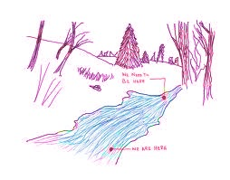
Our Goal
Batch
Single
Stack!
Interactive
Streaming
Support batch, streaming, and interactive computations…
… and make it easy to compose them
Easy to develop sophisticated algorithms (e.g., graph, ML algos)

Slide 6
The Need for Unification (1/2)
Today’s state-of-art analytics stack
Streaming stack
(e.g., Storm)
Real-Time
Analytics
Logs
Demux
Batch stack
(e.g., Hadoop)
Ad-Hoc queries
on historical data
Interactive queries (e.g., HBase, Impala, SQL)
Interactive queries
on historical data
Challenges:
Need to maintain three separate stacks
Expensive and complex
Hard to compute consistent metrics across stacks
Hard and slow to share data across stacks

Slide 7
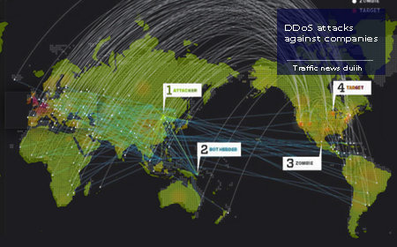
The Need for Unification (2/2)
Make real-time decisions
Detect DDoS, fraud, etc
E.g.,: what’s needed to detect a DDoS attack?
Detect attack pattern in real time → streaming
Is traffic surge expected? → interactive queries
Making queries fast → pre-computation (batch)
And need to implement complex algos (e.g., ML)!

Slide 8

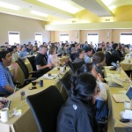
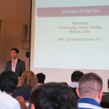
The Berkeley AMPLab
Algorithms
January 2011 – 2017
8 faculty
> 40 students
3 software engineer team
Organized for collaboration
AMP
Machines
People
AMPCamp 1
(August, 2012)
3 day retreats
(twice a year)
150 campers
(3000 on-line)

Slide 9
The Berkeley AMPLab
Governmental and industrial funding:
Goal: Next generation of open source data analytics stack for industry & academia:
Berkeley Data Analytics Stack (BDAS)

Slide 10
Data Processing Stack
Data Processing Layer
Resource Management Layer
Storage Layer

Slide 11
Hadoop Stack
Hive
Pig
HBase
Storm
Data Processing Layer
…
Hadoop MR
Resource Management Layer
Hadoop Yarn
Storage Layer
HDFS, S3, …

Slide 12
BDAS Stack
Spark
Streaming
BlinkDB
GraphX
MLBase
Data Processing Layer
Shark SQL
MLlib
Spark
Resource Management Layer
Mesos
Storage Layer
HDFS, S3, …
Tachyon

Slide 13
How do BDAS & Hadoop fit together?
Spark Straming
MLBase
Spark
Streaming
BlinkDB
BlinkDB
Graph
X
MLbase
GraphX
Hive
Pig
HBase
Storm
Shark
SQL
ML
library
Shark SQL
MLlib
Spark
Spark
Hadoop MR
Mesos Mesos
Hadoop Yarn
HDFS, S3, …
Tachyon

Slide 14
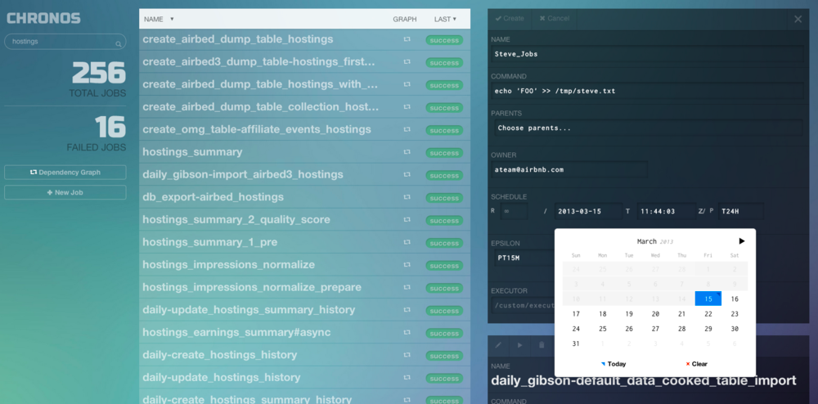
Apache Mesos
Spark
Stream.
BlinkDB
GraphX
MLBase
Shark
MLlib
Spark
Mesos
HDFS, S3, …
Tachyon
Enable multiple frameworks to share same cluster resources (e.g., Hadoop, Storm, Spark)
Twitter’s large scale deployment
6,000+ servers,
500+ engineers running jobs on Mesos
Third party Mesos schedulers
AirBnB’s Chronos
Twitter’s Aurora
Mesospehere: startup to commercialize Mesos

Slide 15
Apache Spark
Spark
Stream.
BlinkDB
GraphX
MLBase
Shark
MLlib
Spark
Mesos
HDFS, S3, …
Tachyon
Distributed Execution Engine
Fault-tolerant, efficient in-memory storage (RDDs)
Powerful programming model and APIs (Scala, Python, Java)
Fast: up to 100x faster than Hadoop
Easy to use: 5-10x less code than Hadoop
General: support interactive & iterative apps
Two major releases since last AMPCamp

Slide 16
Spark Streaming
Spark
Stream.
BlinkDB
GraphX
MLBase
Shark
MLlib
Spark
Mesos
HDFS, S3, …
Tachyon
Large scale streaming computation
Implement streaming as a sequence of <1s jobs
Fault tolerant
Handle stragglers
Ensure exactly one semantics
Integrated with Spark: unifies batch, interactive, and batch computations
Alpha release (Spring, 2013)

Slide 17
Shark
Spark
Stream.
BlinkDB
GraphX
MLBase
Shark
MLlib
Spark
Mesos
HDFS, S3, …
Tachyon
Hive over Spark: full support for HQL and UDFs
Up to 100x when input is in memory
Up to 5-10x when input is on disk
Running on hundreds of nodes at Yahoo!
Two major releases along Spark

Slide 18
Performance and Generality (Unified Computation Models)
Interactive
(SQL, Shark)
Batch
(ML, Spark)
Streaming
(SparkStreaming)

Slide 19
Unified Programming Models
Unified system for SQL, graph processing, machine learning
All share the same set of workers and caches

Slide 20












Gaining Rapid Traction
Spark
Stream.
BlinkDB
GraphX
MLBase
Shark
MLlib
Spark
Mesos
HDFS, S3, …
Tachyon
Sold out AMPCamp and Strata tutorials
1,000+ Spark meetup users
20+ companies contributing code
Notes:
Alibab, tenzent
At Berkeley, we have been working on a solution since 2009. This solution consists of a software stack for data analytics, called the Berkeley Data Analytics Stack. The centerpiece of this stack is Spark.
Spark has seen significant adoption with hundreds of companies using it, out of which around sixteen companies have contributed back the code. In addition, Spark has been deployed on clusters that exceed 1,000 nodes.

Slide 21
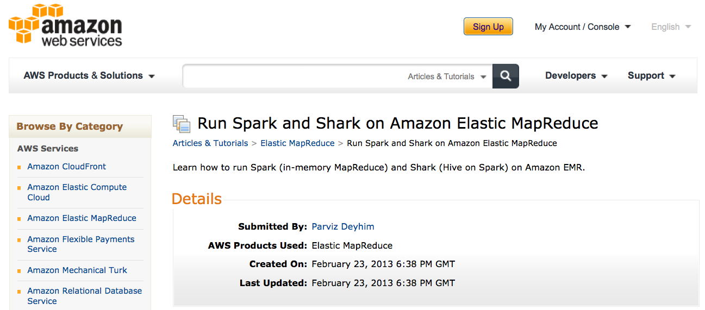
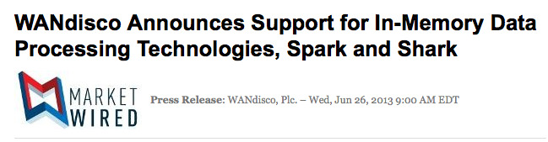
Gaining Rapid Traction

Slide 22
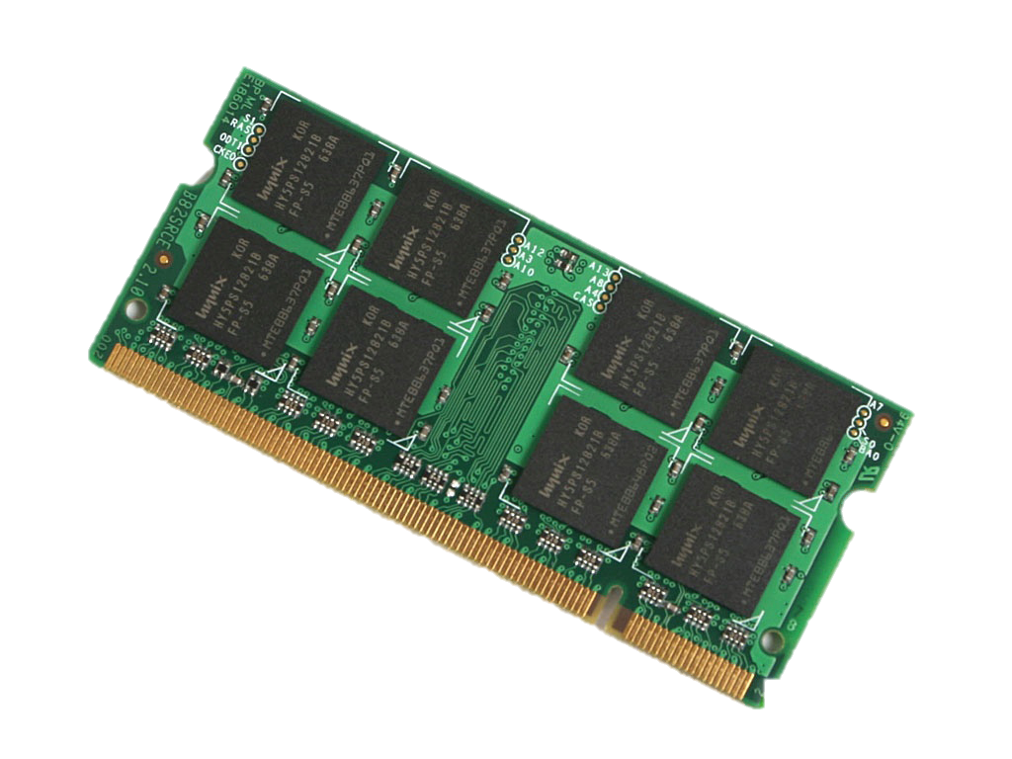
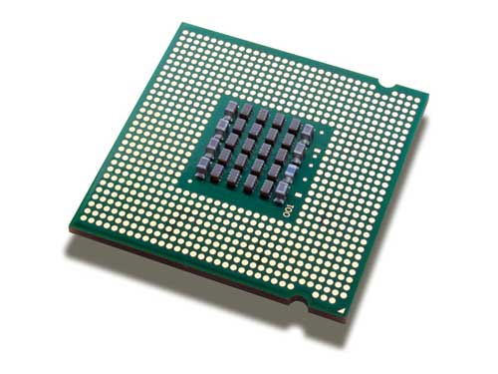
BlinkDB
Spark
Stream.
BlinkDB
GraphX
MLBase
Shark
MLlib
Spark
Mesos
HDFS, S3, …
Tachyon
Trade between query performance and accuracy using sampling
Why?
In-memory processing doesn’t guarantee interactive processing
E.g., ~10’s sec just to scan 512 GB RAM!
Gap between memory capacity and transfer rate increasing
512GB
doubles every 18 months
doubles every 36 months
40-60GB/s
16 cores

Slide 23
Key Insights
Spark
Stream.
BlinkDB
GraphX
MLBase
Shark
MLlib
Spark
Mesos
HDFS, S3, …
Tachyon
Input often noisy: exact computations do not guarantee exact answers
Error often acceptable if small and bounded
Main challenge: estimate errors for arbitrary computations
Alpha release (August, 2013)
Allow users to build uniform and stratified samples
Provide error bounds for simple aggregate queries

Slide 24
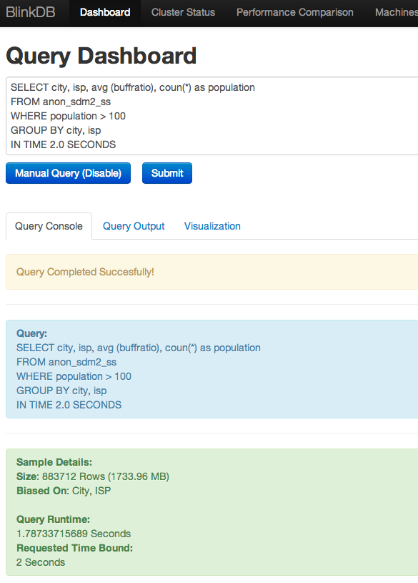
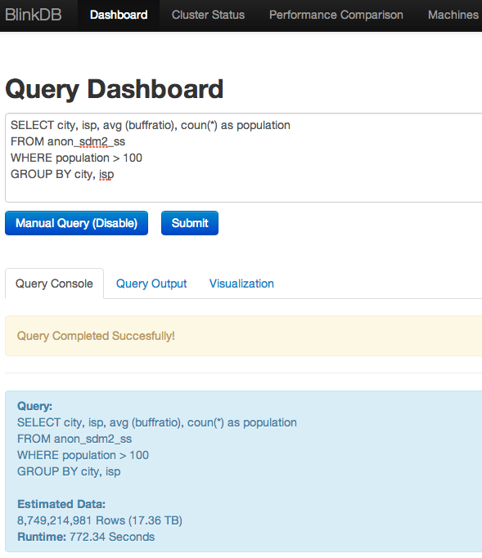
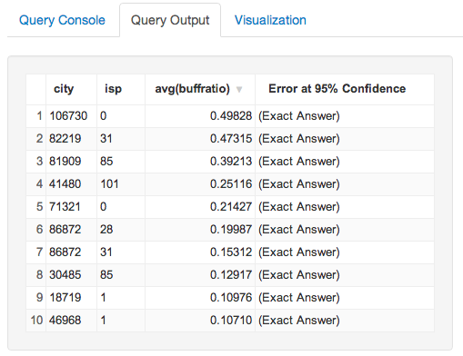
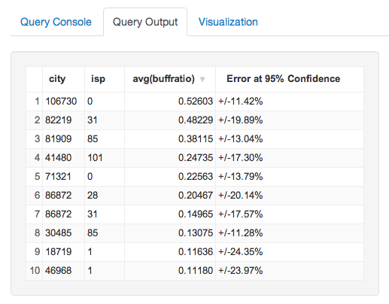
Example: Video Quality Diagnosis
Top 10 worse performers identical!
440x faster!
Latency: 772.34 sec
(17TB input)
Latency: 1.78 sec
(1.7GB input)
Notes:
Here are the results of the query we execute on real anonymized data that show the top ten combination of ISP and city that perform the worse. This query provides exact results, runs over an input of 17TB, and takes 772 seconds.
Now, on the right hand side we run the same query on a sample of 1.7GB that fits in the memory. This query takes only 2 sec, and provides approximate results; the errors for 95% confidence intervals are shown, the top ten worse ISP city combinations and their rankings are the same!
So in this case we basically provide the same result, but 400x faster!

Slide 25
GraphX
Spark
Stream.
BlinkDB
GraphX
MLBase
Shark
MLlib
Spark
Mesos
HDFS, S3, …
Tachyon
Combine data-parallel and graph-parallel computations
Provide powerful abstractions:
PowerGraph, Pregel implemented in less than 20 LOC!
Leverage Spark’s fault tolerance
Alpha release: expected this fall

Slide 26
MLlib and MLbase
Spark
Stream.
BlinkDB
GraphX
MLBase
Shark
MLlib
Spark
Mesos
HDFS, S3, …
Tachyon
MLlib: high quality library for ML algorithms
Will be released with Spark 0.8 (September, 2013)
MLbase: make ML accessible to non-experts
Declarative interface: allow users to say what they want
E.g., classify(data)
Automatically pick best algorithm for given data, time
Allow developers to easily add and test new algorithms
Alpha release of MLI, first component of MLbase, in September, 2013

Slide 27
Tachyon
Spark
Stream.
BlinkDB
GraphX
MLBase
Shark
MLlib
Spark
Mesos
HDFS, S3, …
Tachyon
In-memory, fault-tolerant storage system
Flexible API, including HDFS API
Allow multiple frameworks (including Hadoop) to share in-memory data
Alpha release (June, 2013)

Slide 28
Compatibility to Existing Ecosystem
Accept inputs from Kafka, Flume, Twitter,
TCP Sockets, …
GraphLab API
Spark
Streaming
BlinkDB
GraphX
MLBase
Shark SQL
MLlib
Hive API
Spark
Resource Management Layer
Mesos
Support Hadoop, Storm, MPI
Storage Layer
HDFS, S3, …
Tachyon
HDFS API

Slide 29
Summary
BDAS: address next Big Data challenges
Unify batch, interactive, and streaming computations
Easy to develop sophisticate applications
Support graph & ML algorithms, approximate queries
Witnessed significant adoption
20+ companies, 70+ individuals contributing code
Exciting ongoing work
MLbase, GraphX, BlinkDB, …
Batch
Spark
Interactive
Streaming

Slide 30
AMPCamp Schedule (Today)
Rest of this session: AMPCamp Curriculum, Mesos
10:45-12:45pm: Spark, Shark, and Spark Streaming
12:45-2pm: Lunch
2-4:30pm: Hand-on exercises (Spark, Shark, Spark Streaming)
5-6:30pm: User presentations (Conviva, Ooyala, Yahoo!)
6:30-8:30pm: Reception

Slide 31
AMPCamp Schedule (Tomorrow)
9-10:15pm: BlinkDB, MLbase
10:45-12:45pm: Hand-on exercises (BlinkDB, MLbase, Mesos)
12:45-2:15pm: Lunch
2:15-3:15pm: Introduction to Tachyon and GarphX
3:15-3:30pm: Wrap Up and Concluding Remarks

