Slide 1
Hive for Analytic Workloads
Alan Gates (@alanfgates)

Slide 2
Batch AND Interactive SQL-IN-Hadoop
Stinger Initiative A broad, community-based effort to drive the next generation of HIVE
Stinger Project
(announced February 2013)
Hive 0.11, May 2013:
Base Optimizations
SQL Analytic Functions
ORCFile, Modern File Format
Goals:
Speed Improve Hive query performance by 100X to allow for interactive query times (seconds)
Hive 0.12, October 2013:
VARCHAR, DATE Types
ORCFile predicate pushdown
Advanced Optimizations
Performance Boosts via YARN
Scale
The only SQL interface to Hadoop designed for queries that scale from TB to PB
Hive 0.13, April 2014:
Hive on Apache Tez
SQL standard authorization
Permanent UDFs
Vectorized Processing
SQL
Support broadest range of SQL semantics for analytic applications running against Hadoop
…all IN Hadoop

Slide 3
Stinger Highlights
13 months
145 separate contributors
from 44 separate entities
3 Hive releases, 0.11, 0.12, and 0.13
392,000 lines of new Java code

Slide 4
Now this is not the end. It is not even the beginning of the end. But it is, perhaps, the end of the beginning.
-Winston Churchill

Slide 5
Hive 0.13 Performance
The TPC Benchmark™DS is a decision support benchmark that models queries and data maintenance. It evaluates decision support systems that examine large volumes of data to answer real-world business questions.
Test: 50 SQL queries on Hive 0.13
Test Environment
Driven by the Hive Testbench: https://github.com/cartershanklin/hive-testbench
Nodes: 20 nodes, 256 GB per node – only 48G per node used for Hive
Drives: 6x 4TB WDC WD4000FYYZ-0 drives per node
Interconnect: 10GB
Processors: 2x Intel(R) Xeon(R) CPU E5-2640 v2 @ 2.00GHz for total of 16 CPU cores per machine
Scale: 30K (30T total data)

Slide 6
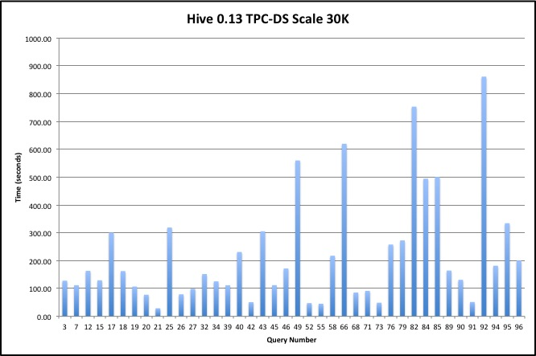
Benchmark Results
Queries modified to have partition key that duplicates join key, making it easier for the optimizer to choose which partitions to scan.
Notes:
21 – 29 sec, scan one day of items table

Slide 7
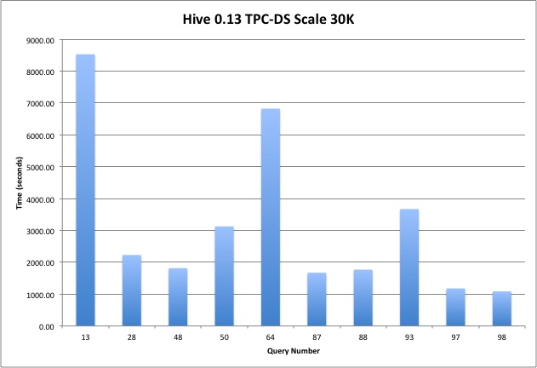
Benchmark Results
Queries modified to have partition key that duplicates join key, making it easier for the optimizer to choose which partitions to scan.
Notes:
93 – fact to fact left outer join over a years data, finished in around an hour
13 – full year 6 way star join

Slide 8
SQL Semantics
Release | SQL Semantics
Hive 0.10 & before | SELECT, JOIN, WHERE, GROUP BY, HAVING, ORDER BY, UNION, ROLLUP/CUBE, subqueries in FROM
Hive 0.11 | Windowing functions (RANK, ROW_NUMBER) and OVER clause
Hive 0.13 | Subqueries with IN, EXISTS in WHERE and HAVING Common table expressions (WITH clause) Join condition in WHERE CREATE FUNCTION (stored on cluster)
Next Steps | Temporary tables Subqueries with equality and inequality operators Full UNION support Set operators, EXCEPT and INTERSECT

Slide 9
Security
Release | Security
Hive 0.12 & before | StorageBasedAuthorizationProvider, maps file level security secure, based on HDFS security coarse grained, no column or row level security default, all advisory everyone has grant permissions
Hive 0.13 | SQL standard security for tables, views, and databases GRANT/REVOKE ROLEs Column and row level permissions via views
Next Steps | Integration with XA Secure Extend to cover execution of functions

Slide 10
Data Type Conformance
Release | Available Data Types
Hive 0.10 & before | Integer types, floating types, string, array, map, struct, timestamp, binary
Hive 0.11 | decimal (default precision and scale only)
Hive 0.12 | date, varchar
Hive 0.13 | char, user defined precision and scale for decimal

Slide 11
Read and Write, ACID
Release | Write Capabilities, ACID Compliance
Hive 0.12 & before | INSERT and INSERT OVERWRITE available Locking available, requires ZooKeeper for durability No ACID
Hive 0.13 | ACID compliant ingestion of data from streaming sources such as Flume and Storm Snapshot isolation for readers
Next Steps | Addition of INSERT … VALUES, UPDATE, DELETE Multi-statement transactions: BEGIN, COMMIT, ROLLBACK Integration with HCatalog
Owen and I have a talk on this at 5:30 today.

Slide 12
Optimizer
Release | Optimizer
Hive 0.11 & before | Rules based optimizer Mostly simple rules such as push filter below join
Hive 0.12 | Correlation optimizer Where possible combine related execution into single job
Next Steps | Use Optiq for cost based optimization Join ordering and operator selection using statistics and cost estimates Expand statistics calculated and used in planning
Julian has a talk on this at 4:35 today.

Slide 13
MapReduce is dead, Long live Hadoop

Slide 14
MapReduce is dead, Long live Hadoop
Tez Talks:
A New Chapter in Hadoop Data Processing, today 12:05
Hive on Apache Tez: Benchmarked at Yahoo! Scale, today 12:05
Hive + Tez: A Performance Deep Dive, today 2:35

Slide 15
ORC File Format
Columnar format for complex data types
Built into Hive from 0.11
Support for Pig via OrcLoader/OrcStorer
Support for MapReduce via HCat
Two levels of compression
Lightweight type-specific and generic
Built in indexes
Every 10,000 rows with position information
Min, Max, Sum, Count of each column
Supports seek to row number

Slide 16
ORC File Format
Hive 0.12
Predicate Push Down
Improved run length encoding
Adaptive string dictionaries
Padding stripes to HDFS block boundaries
Hive 0.13
Stripe-based Input Splits
Input Split elimination
Vectorized Reader
Customized Pig Load and Store functions
ACID support
Next Steps
Faster writes
Integer dictionaries
Better block buffering

Slide 17
Vectorized Query Execution
Designed for Modern Processor Architectures
Avoid branching in the inner loop.
Make the most use of L1 and L2 cache.
How It Works
Process records in batches of 1,000 rows
Generate code from templates to minimize branching.
What It Gives
30x improvement in rows processed per second.
Initial prototype: 100M rows/sec on laptop
In Hive 0.13, initial (map) tasks vectorized
Current work: vectorize shuffle and reduce tasks

Slide 18
Try it Yourself
Apache Hive 0.13
http://hive.apache.org/downloads.html
Download and play with HDP-2.1
http://hortonworks.com/products/hortonworks-sandbox/ for use on your laptop
http://hortonworks.com/hdp/ for use on your cluster

Slide 19
Thank You!
@alanfgates
@hortonworks

