Slide 1
Hive+Tez: A Performance deep dive
Jitendra Pandey
Gopal Vijayaraghavan

Slide 2
Batch AND Interactive SQL-IN-Hadoop
Stinger Initiative A broad, community-based effort to drive the next generation of HIVE
Stinger Project
(announced February 2013)
Hive 0.11, May 2013:
Base Optimizations
SQL Analytic Functions
ORCFile, Modern File Format
Goals:
Speed Improve Hive query performance by 100X to allow for interactive query times (seconds)
Hive 0.12, October 2013:
VARCHAR, DATE Types
ORCFile predicate pushdown
Advanced Optimizations
Performance Boosts via YARN
Scale
The only SQL interface to Hadoop designed for queries that scale from TB to PB
Hive 0.13, April, 2013
Hive on Apache Tez
Cost Based Optimizer (Optiq)
Vectorized Processing
SQL
Support broadest range of SQL semantics for analytic applications running against Hadoop
…all IN Hadoop
Notes:
base optimizations:
Star join, MMR->MR, Multiple map joins grouped to single mapper.
Which analytic functions?
Windowing functions, over clause
Advanced optimizations
Predicate push down only eliminates the orc stripes?
Performance boosts via YARN
Improvements in shuffle

Slide 3
SPEED: Increasing Hive Performance
Interactive Query Times across ALL use cases
Simple and advanced queries in seconds
Integrates seamlessly with existing tools
Currently a >100x improvement in just nine months
Key Highlights
Tez: New execution engine
Vectorized Query Processing
Startup time improvement
Statistics to accelerate query execution
Cost Based Optimizer: Optiq
Elements of Fast SQL Execution
Query Planner/Cost Based Optimizer w/ Statistics
Query Startup
Query Execution
I/O Path
Notes:
Tools? BI tools, Tableu, Microstrategy
Hive-0.13 is 100x faster.
Startup time improvements:
- Pre-launch the App master, keep containers around, what are the elements of query startup.
- Faster metastore lookup.
Using statistics other than Optiq:
- Metadata queries
- Estimating number of reducers
- Map join coversion
Optique: Join reordering

Slide 4
Statistics and Cost-based optimization
HIVE-5775
Statistics:
Hive has table and column level statistics
Used to determine parallelism, join selection
Optiq: Open source, Apache licensed query execution framework in Java
Used by Apache Drill, Apache Cascading, Lucene DB
Based on Volcano paper
20 man years dev, more than 50 optimization rules
Goals for hive
Ease of Use – no manual tuning for queries, make choices automatically based on cost
View Chaining/Ad hoc queries involving multiple views
Help enable BI Tools front-ending Hive
Emphasis on latency reduction
Cost computation will be used for
Join ordering
Join algorithm selection
Tez vertex boundary selection
Notes:
What is Optiq
50 optimization rules, examples
- Join reordering rules, filter push down, column pruning.
Should we mention we generate AST?
Ad hoc queries involving multiple views:
Currently supported to create views, the query on a view is executed by replacing the view with the subquery.
What is tez vertex boundary?

Slide 5
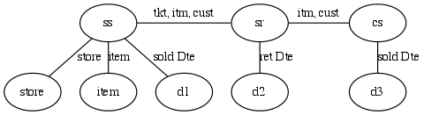
TPC-DS Query 17
select i_item_id
,i_item_desc
,s_state
,count(ss_quantity) as store_sales_quantitycount
,….
from store_sales ss ,store_returns sr, catalog_sales cs, date_dim d1, date_dim d2, date_dim d3, store s, item i
where d1.d_quarter_name = '2000Q1’ and d1.d_date_sk = ss.ss_sold_date_sk and i.i_item_sk = ss.ss_item_sk
and s.s_store_sk = ss.ss_store_sk and ss.ss_customer_sk = sr.sr_customer_sk and ss.ss_item_sk = sr.sr_item_sk
…
group by i_item_id ,i_item_desc, ,s_state
order by i_item_id ,i_item_desc, s_state
limit 100;
Joins Store Sales, Store Returns and Catalog Sales fact tables.
Each of the fact tables are independently restricted by time.
Analysis at Item and Store grain, so these dimensions are also joined in.
As specified Query starts by joining the 3 Fact tables.

Slide 6
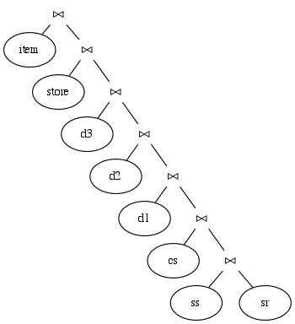
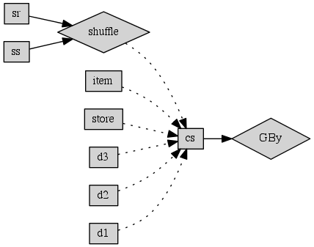
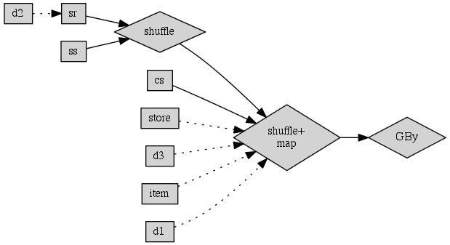
TPC-DS Query 17
Specified
Join Tree
Non CBO Plan
CBO Plan
Notes:
What is shuffle+map?
Why is d1 not joined with ss before first shuffle?

Slide 7
TPC-DS Query 17
Facts restricted to 3 months
Fact tables
partitioned by Day,
bucketed by Item
Bucketing off
Bucketing should help CBO plan.
SR table much smaller. Better chance of Bucket Join in place of Shuffle Join.
 | Run 1 | Run 2
Non CBO | 127.53 | 100.71
CBO | 50.9 | 44.52
Orderings considered by Planner
Join Ordering | Cost Estimate
['item', [[[[[['d2', 'store_returns'], 'store_sales'], 'catalog_sales'], 'd1'], 'd3'], 'store']] | 3547898.061
…
['store_returns', 'd2’] | 19224.71
['store_sales', 'store_returns’] | 23057497.991
['d1', 'store_sales'] | 26142.943
Notes:
Why is Run2 slower for Non-CBO ?
What is bucketing off?

Slide 8
Apache Tez (“Speed”)
Replaces MapReduce as primitive for Pig, Hive, Cascading etc.
Smaller latency for interactive queries
Higher throughput for batch queries
22 contributors: Hortonworks (13), Facebook, Twitter, Yahoo, Microsoft
Task with pluggable Input, Processor and Output
Task
Input
Processor
Output
Tez Task - <Input, Processor, Output>
YARN ApplicationMaster to run DAG of Tez Tasks
Notes:
Why higher throughput?
How many contributors now?

Slide 9
Hive-on-MR vs. Hive-on-Tez
HIVE-4660
SELECT g1.x, g1.avg, g2.cnt
FROM (SELECT a.x, AVERAGE(a.y) AS avg FROM a GROUP BY a.x) g1
JOIN (SELECT b.x, COUNT(b.y) AS avg FROM b GROUP BY b.x) g2
ON (g1.x = g2.x)
ORDER BY avg;
Tez avoids unnecessary writes to HDFS
Hive – MR | Hive – Tez
GROUP b BY b.x
M
M
M
GROUP BY x
GROUP a BY a.x
M
M
R
R
R
M
M
M
M
M
R
HDFS
HDFS
GROUP BY a.x
JOIN (a,b)
JOIN (a,b)
M
M
R
R
R
ORDER BY
R
HDFS
ORDER BY
M
R
Notes:
No unncessary writes to HDFS.
Number of processes reduced.
The edges between M and R can be generalized.

Slide 10
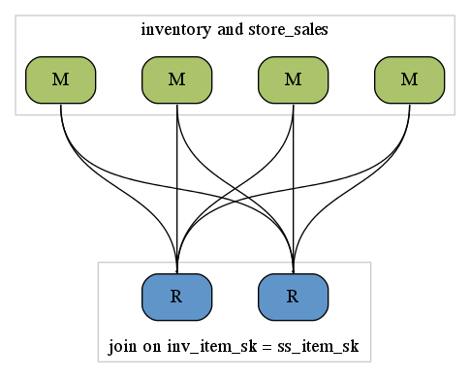
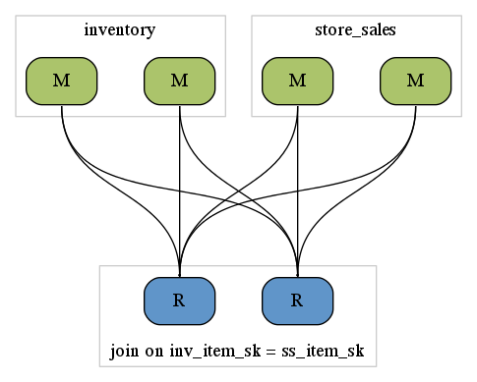
Shuffle Join
SELECT ss.ss_item_sk, ss.ss_quantity, inv.inv_quantity_on_hand
FROM inventory inv
JOIN store_sales ss
ON (inv.inv_item_sk = ss.ss_item_sk);
Hive – MR | Hive – Tez
Notes:
On MR:
each mapper sorts partitions of both tables
In Tez
a mapper sorts only one table, the operators don’t have to switch between data sources.

Slide 11
Broadcast Join
SELECT ss.ss_item_sk, ss.ss_quantity, avg_price, inv.inv_quantity_on_hand
FROM (select avg(ss_sold_price) as avg_price, ss_item_sk, ss_quantity_sk from store_sales
group by ss_item_sk) ss
JOIN inventory inv
ON (inv.inv_item_sk = ss.ss_item_sk);
Hive – MR | Hive – Tez
Store Sales scan. Group by and aggregation reduce size of this input.
Store Sales scan. Group by and aggregation.
M
M
M
M
M
M
R
R
R
R
Broadcast edge
HDFS
Inventory and Store Sales (aggr.) output scan and shuffle join.
Inventory scan and Join
M
M
M
M
M
M
HDFS
R
R
HDFS
Notes:
Inventory is the bigger table in this case.
Similar to map-join w/o the need to build a hash table on the client
Will work with any level of sub-query nesting
Uses stats to determine if applicable
How it works:
Broadcast result set is computed in parallel on the cluster
Join processor are spun up in parallel
Broadcast set is streamed to join processor
Join processors build hash table
Other relation is joined with hashtable
Tez handles:
Best parallelism
Best data transfer of the hashed relation
Best scheduling to avoid latencies
Why broadcast join is better than the map join?
-- Multiple hashes can be generated in parallel
-- hashtable in memory can be more compact than the serialized one in local task
-- subqueries were always on streaming side and were joined with shuffle join
Parallelism:
Splits of a dimension table processed in parallel across mappers
Data transfer
- No hdfs write in between
Schedule
- read from rack local replica of the dimensional table

Slide 12
1-1 Edge
Typical star schema join involve join between large number of tables
Dimension aren’t always tiny (Customer dimension)
Might not be able to handle all dimensions in single vertex as broadcast joins
Tez allows streaming records from one processor to the next via a 1-1 Edge
Transfer details (streaming, files, etc) are handled transparently
Scheduling/cluster capacity is worked out by Tez
Allows hive to build a pipeline of in memory joins which we can stream records through

Slide 13
Dynamically Partitioned Hash Join
SELECT ss.ss_item_sk, ss.ss_quantity, inv.inv_quantity_on_hand
FROM store_sales ss
JOIN inventory inv
ON (inv.inv_item_sk = ss.ss_item_sk);
Hive – MR | Hive – Tez
Inventory scan (Runs as single local map task)
M
Inventory scan (Runs on cluster potentially more than 1 mapper)
M
M
HDFS
Custom edge (routes outputs of previous stage to the correct Mappers of the next stage)
Store Sales scan and Join (Inventory hash table read as side file)
Store Sales scan and Join (Custom vertex reads both inputs – no side file reads)
M
M
M
M
M
M
HDFS
HDFS
Notes:
Comparing the bucketed map join in MR vs Tez
Inventory table is already bucketed.
In MR,
The hash map for each bucket is built in a single mapper in sequence, loaded in hdfs, then joined with store sales where the hash table is read as a side file.
In Tez,
The inventory scan is run in parallel in multiple mappers that process buckets.
------
Kicks in when large table is bucketed
Bucketed table
Dynamic as part of query processing
Uses custom edge to match the partitioning on the smaller table
Allows hash-join in cases where broadcast would be too large
Tez gives us the option of building custom edges and vertex managers
Fine grained control over how the data is replicated and partitioned
Scheduling and actual data transfer is handled by Tez

Slide 14
Dynamically Partitioned Hash Join
Plans look very similar to map join but the way things work change between MR and Tez.
Hive – MR (Bucket map-join) | Hive – Tez
Not dynamically partitioned. Both tables need to be bucketed by the join key. Local task that generates the hash table writes n files corresponding to n buckets. Number of mappers for the join must be same as the number of buckets. Each of these mappers reads the corresponding bucket file of the local task to perform the join. | Only one of the sides needs to be bucketed and the other side is dynamically bucketed. Also works if neither side is explicitly bucketed, but another operation forced bucketing in the pipeline (traits) No writing to HDFS. There can be more mappers than number of buckets, and a bucket can be processed in parallel on multiple mappers.

Slide 15
Union all
SELECT count(*) FROM (
SELECT distinct ss_customer_sk from store_sales where ss_store_sk = 1
UNION ALL
SELECT distinct ss_customer_sk from store_sales where ss_store_sk = 2) as customers
Hive – MR | Hive – Tez
M
M
M
M
M
M
M
M
M
M
M
M
Two MR jobs to do the distinct
R
R
R
R
In Tez the sub-query output is pre-aggregated and send directly to a common final node
Both sub-queries are materialized onto HDFS
HDFS
R
M
HDFS
Single map reads both sides and aggregates
R
HDFS
Notes:
Common operation in decision support queries
Caused additional no-op stages in MR plans
Last stage spins up multi-input mapper to write result
Intermediate unions have to be materialized before additional processing
Tez has union that handles these cases transparently w/o any intermediate steps

Slide 16
Multi-insert queries
FROM (SELECT * FROM store_sales, date_dim WHERE ss_sold_date_sk = d_date_sk and d_year = 2000)
INSERT INTO TABLE t1 SELECT distinct ss_item_sk
INSERT INTO TABLE t2 SELECT distinct ss_customer_sk;
Hive – MR | Hive – Tez
M
Map join date_dim/store sales
Broadcast Join (scan date_dim, join store sales)
M
M
HDFS
Materialize join on HDFS
M
M
M
M
M
M
HDFS
Distinct for customer + items
R
R
Two MR jobs to do the distinct
M
M
M
M
M
M
HDFS
R
R
HDFS
Notes:
Allows the same input to be split and written to different tables or partitions
Avoids duplicate scans/processing
Useful for ETL
Similar to “Splits” in PIG
In MR a “split” in the operator pipeline has to be written to HDFS and processed by multiple additional MR jobs
Tez allows to send the mulitple outputs directly to downstream processors

Slide 17
Execution
“A good plan violently executed now is better than a perfect plan executed next week.
George S. Patton

Slide 18
Faster Query Setup
AM per-session instead of per-query
Reused across JDBC connections
No more local tasks
Except fetch aggregation
Metastore fetches are much faster
Metastore direct sql fast-path
Partition filters pushed to metastore
Use distributed cache efficiently for hive-exec.jar
/home/$user/.hiveJars
UDF Jars as well
.jar.<sha1> identifier to avoid conflicts
Multiple version compatibility easily
YARN localizes the jars once per node (not per query)
Kryo instead of XML to serialize operators
Works better on jdk7

Slide 19
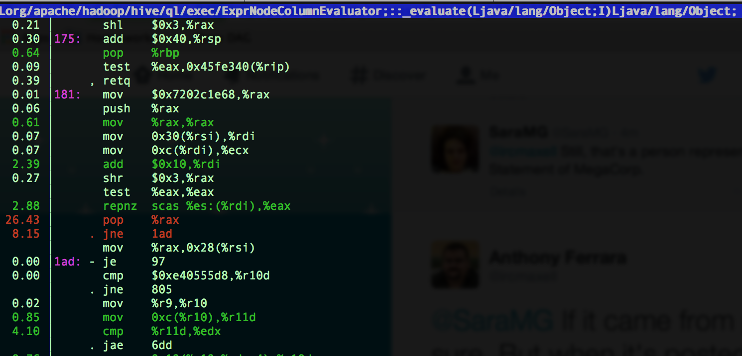
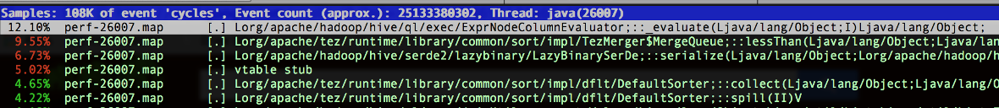
Faster Operator Pipeline
Previously on hive
Notes:
checkcast

Slide 20
Operator Vectorization
Avoid Writable objects & use primitive int/long
Allows efficient JIT code for primitive types
Generate per-type loops & avoid runtime type-checks
The classes generated look like
LongColEqualDoubleColumn
LongColEqualLongColumn
LongColEqualLongScalar
Avoid duplicate operations on repeated values
isRepeating & hasNulls
Notes:
Tpch query 1 and query 6.
Before:

Slide 21
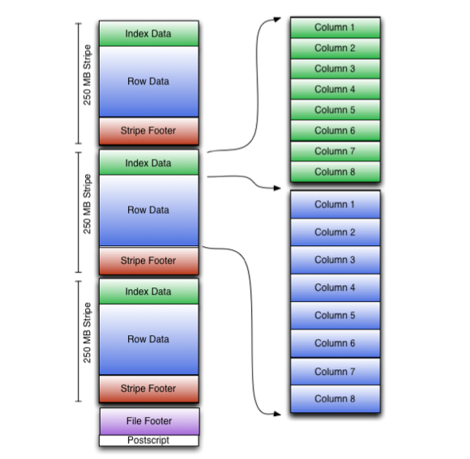
Optimized Row Columnar File
ORC Vectorized Reader
Logical Compression helps reader
isRepeating
Split per-stripe
Row-group level indexes
Stripe level indexes
PPD avoids a lot of IO
Column conditions are ANDed
Notes:
1Tb of tpc-hdata compreses to 200Gb of ORC data.
30Tb of tpc-ds data compresses to approx ~6Tb of ORC data.

Slide 22
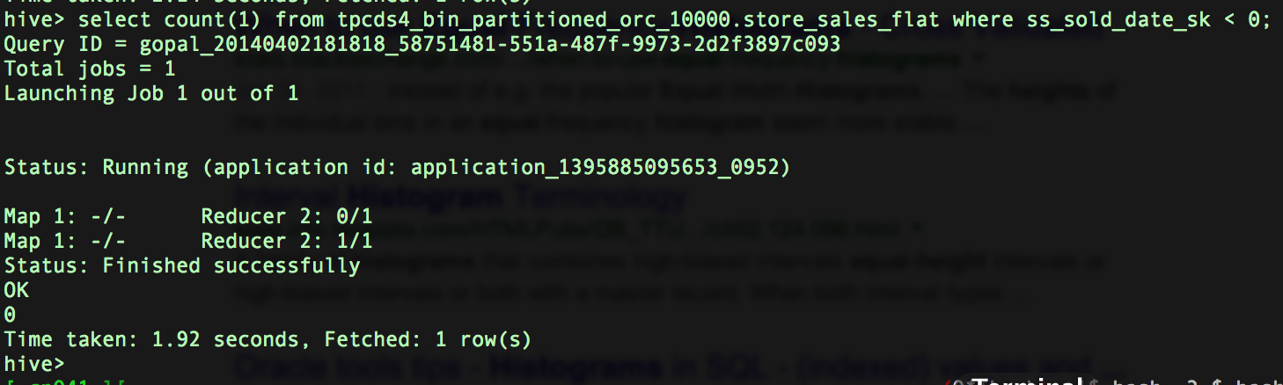
Faster Statistics
ORC stripe footers aggregate stats per-column
Min/Max/Sum/Count
set hive.stats.autogather=true;
ANALYZE TABLE <table> compute statistics partialscan;
Reads only ORC footers
Predicate computation without Tez/MR tasks

Slide 23
Faster Execution: Tez
Multiple edge types
Broadcast
Shuffle
One-to-One
Multiple output types
Sorted
Unsorted
Unsorted Partitioned
Per-vertex configurations
Instead of one configuration between M&R tasks

Slide 24
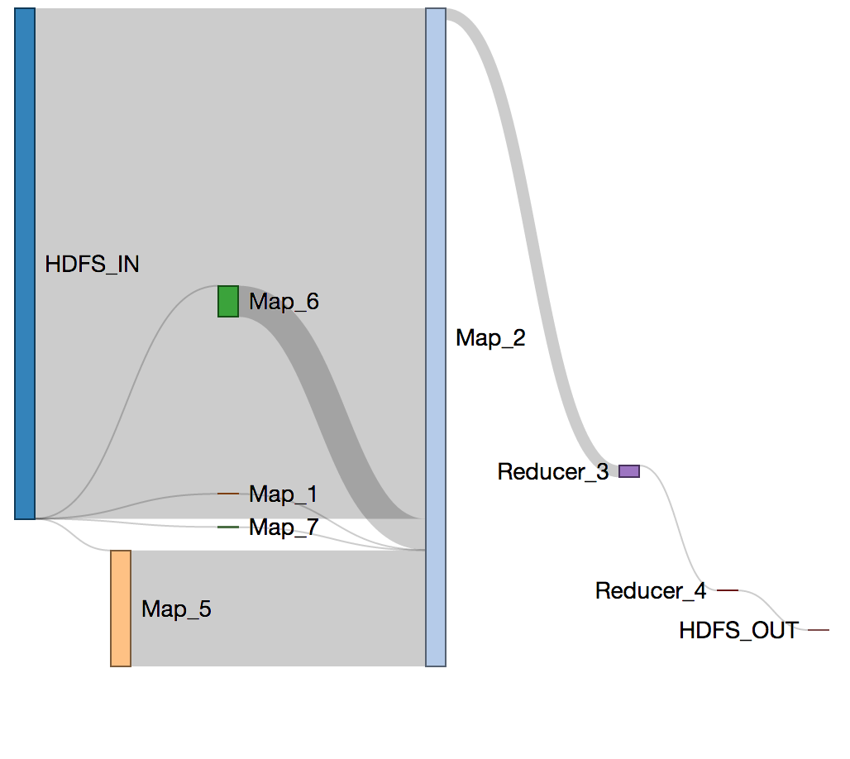
Tez I/O speed-ups
Tez shuffle can use keep-alive over HTTP
Shuffle scheduler can optimize connection count
Can fetch all map outputs from one node via 1 connection
Can skip fetching 0 sized partitions from a mapper
Speeds up group-by queries with high locality
Reducers finish shuffle faster
Shuffle threads are re-used in container re-use
Secure shuffle has crypto thread-local inits

Slide 25
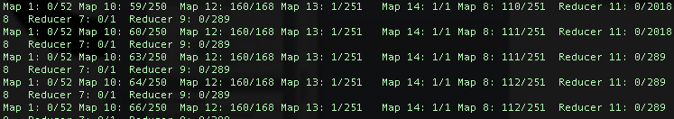
Skewed Reducers: auto-parallelism
Often queries are slow because of one slow reducer
Skewed data is too common in real life queries
This avoids running too many reducers with with very little data
Future
This can be extended to group by input size
This mechanism can actually speculate on stalling reducers better (split into 3)

Slide 26
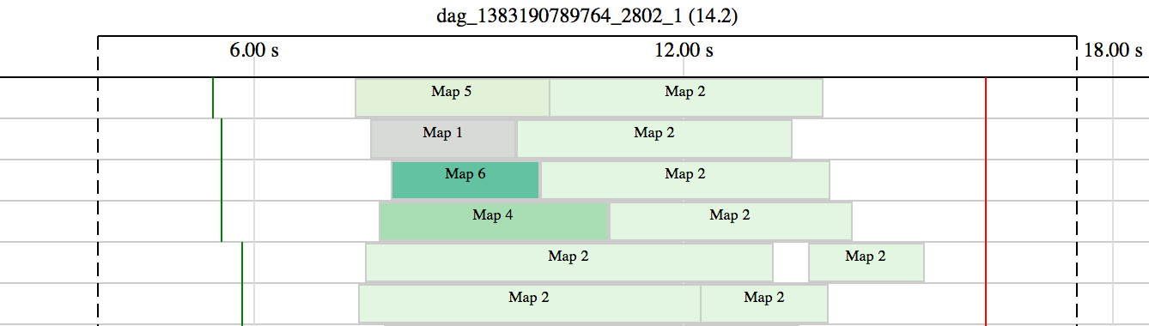
A Query in motion
4-way Map join + map reduce reduce query
Timeline in left to right, each lane represents one container

Slide 27
Defer/Skip tasks
No more uploading hive-exec.jar/UDFs for every query
No more spinning up an AM for each stage
No more computation on hive client (local task)

Slide 28
Concurrency of small tasks
Hive used to run several lightweight tasks in a local VM
LocalTask was a bottleneck
No locality
No parallelism
Small VM
Tez Broadcast edges solve that problem

Slide 29
Concurrent Split Generation
Tez input intializers are run parallel
No more spinning up an AM for each stage
No more computation on hive client (local task)

Slide 30
Split Elimination
ORC comes with Predicate Push Down in the reader
Queries with SARGable where clauses
http://en.wikipedia.org/wiki/Sargable
Run the SARGs in the AM, using ORC footer data
Eliminate splits before task spinups, avoid container costs
Offers a soft cache for the ORC footers
Zero splits offers an early exit for data validity checks (i.e price < 0)

Slide 31
Pipelining Split->Task
The task only depends on its own input
It starts talking to YARN immediately once its inputs are ready
Faster generation of dimension tables
Fact tables can optimize on this further
Will break existing FileSplit mechanism

Slide 32
Filling up the pipeline
Tez allows grouping splits dynamically
Obsoletes CombineFileInputFormat
Grouped according to locality
1.7 x available containers (or any factor actually)
Allow query to use up 100% of queue capacity
Without tuning mapred split size for each data-set

Slide 33
ORC Split extras
RCFile had horrible split performance
rcfile::sync() was slow to find a sync point
ORC Reader allows exact splits for stripes
ORC Writer can pad a stripe to an HDFS block
5%-7% overhead measured on table
100% locality of a stripe in a block

Slide 34
Container reuse
Tez specific feature
Run an entire DAG using the same containers
Different vertices use same container
Saves time talking to YARN for new containers

Slide 35
Container reuse (II)
Tez provides an object registry within a vertex
This can be used to cache map-join hash-tables
JVM JIT kicks in and optimizes better on re-use

Slide 36
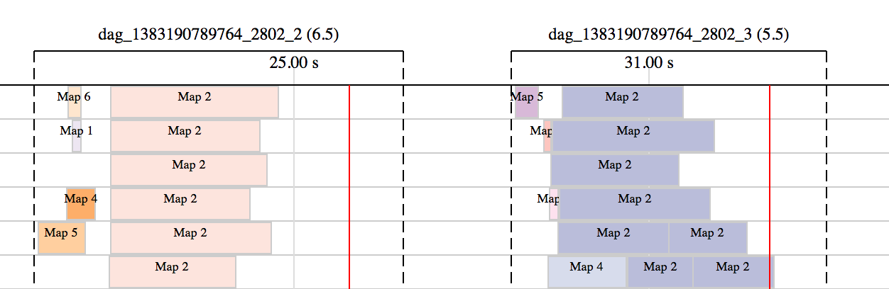
Container re-use (Session)
Keep a container group alive between queries
Fast query spin-up and skip YARN queue
Even better JIT performance on >1 queries

Slide 37
HiveServer2 and Sessions
HiveServer2 can keep sessions alive
Between different JDBC queries
New security model helps
All secure queries run as “hive” user
Ideal for short exploratory queries
Uses same JARs (no download for task)
Even better JIT performance on >1 queries

Slide 38
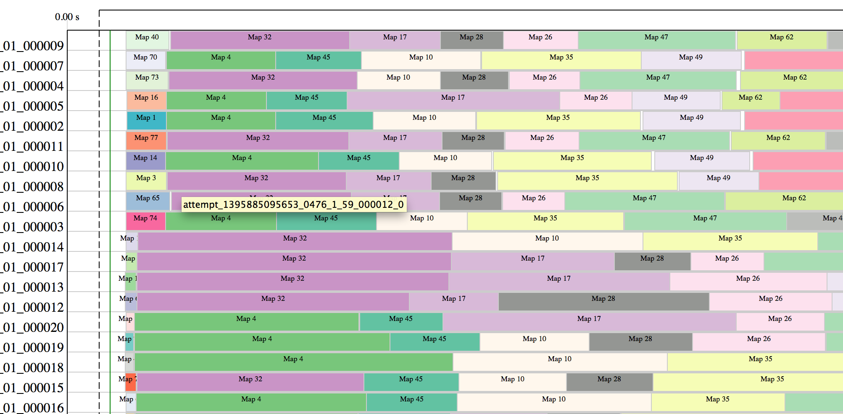
Supersize it!
78 vertex + 8374 tasks on 50 containers

Slide 39
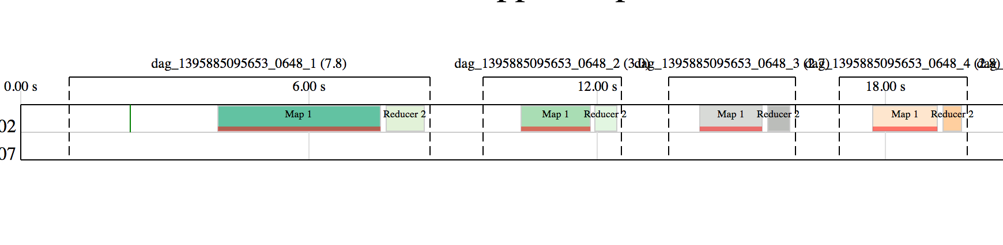
Query overload #2
5000 hive query test-set
Only 3.9k triggered compute tasks
Rest was optimized away into fetch tasks or metadata tasks
Gets progressively faster as the JVM JIT improves the native code

Slide 40
Big picture

Slide 41
Roadmap
Expand uses for CBO
Join Algorithm selection
Tez checkpoint selection (recovery)
Temp Tables
Session life-time
Sharing of intermediate results
Materialized views
Pre-compute common results/aggregations
Transparently route via CBO
Join/Grouping w/o sort
Tez decouples algorithm from data transfer
Sort-merge bucket in Tez
Leverage vertex manager
Co-locate partitions on HDFS
Inline sampling/range partitioning with Tez
Sample/create histogram dynamically for skew joins and total order sort

