Slide 1
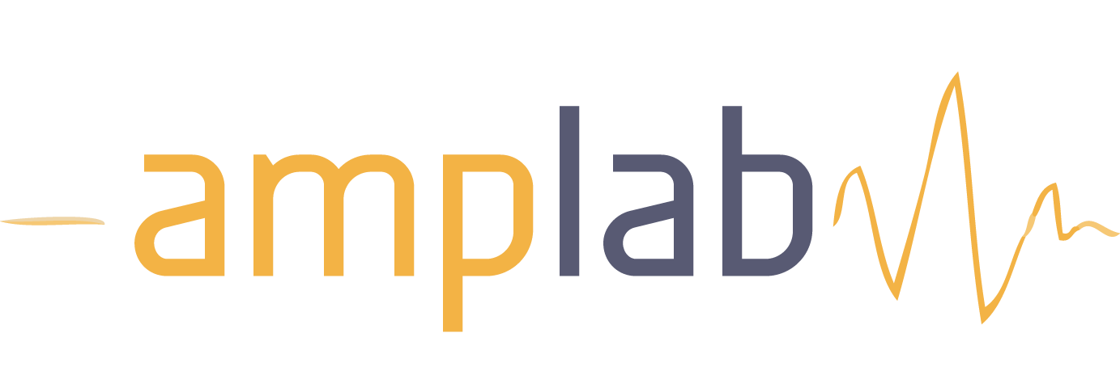




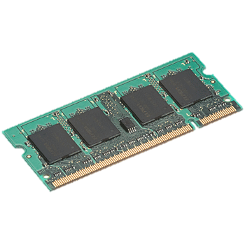
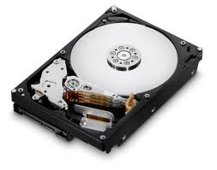
Blink and It’s Done: Interactive Queries on Very Large Data
Sameer Agarwal, Aurojit Panda, Barzan Mozafari, Anand Iyer, Samuel Madden, Ion Stoica
http://blinkdb.cs.berkeley.edu
How long does it take to process
System Design
In This Demo
1 PB on 5000 Machines?
SELECT
foo (*)
FROM TABLE
IN 2 SECONDS;
Query Plan
Error Bars & Confidence Intervals
Determine the cause for anomalous buffer ratios for online video customers
Based on 17 TB of anonymized data from Conviva, Inc.
Queries run on 100 EC2 nodes
Sample Selection
Hadoop/Spark
2-3 Hours
25-30 Minutes
HiveQL/SQL
Query
…
…
Too slow for
interactivity!
Result
…
…
182.23 ± 5.56
(95% confidence)
TABLE
Sampling Module
…
…
System Information
Hard Disks
Memory
Original
Data
Applications Require Interactivity
On-Disk
Samples
In-Memory
Samples
Built on Hadoop and Spark.
Supports Aggregation queries.
Analyzing big-data is increasingly important
Ad-hoc analysis is valuable
Can often trade off accuracy for interactivity
Runtime Sample Selection
BlinkDB vs. No Sampling
BlinkDB enables trade-off between query runtime and accuracy
200-300x Faster!
Sample Queries
SELECT avg(sessionTime)
FROM Table
WHERE city=‘Berkeley’
GROUP BY dt, os, isp
WITHIN 2 SECONDS
SELECT avg(sessionTime)
FROM Table
WHERE city=‘Berkeley’
GROUP BY dt, os, isp
ERROR 0.1 CONFIDENCE 95.0%
Response Time Guarantees
Based on a query’s error and latency profile
BlinkDB augments queries with
Response Time or Error Constraints
Offline Sample Selection
Columns picked using a MILP optimization
BlinkDB Features
ID | City | Ad Clicks
1 | NYC | 5
2 | NYC | 6
3 | NYC | 7
4 | Berkeley | 12
5 | NYC | 9
6 | Berkeley | 7
ID | City | Ad Clicks
1 | NYC | 5
3 | NYC | 7
5 | NYC | 9
Maximum Error Guarantees
Error bars on sampled results
Multi-dimensional (stratified) samples: allow queries over rare values
Multi-granular samples: fine control over runtime and accuracy
Uniform
ID | City | Ad Clicks
1 | NYC | 5
3 | NYC | 7
6 | Berkeley | 7
Biased/
Stratified

