Slide 1
CPS 516: Data-intensive Computing Systems
Instructor: Shivnath Babu
TA: Jie Li

Slide 2
A Brief History
Relational database management systems
Time
1975-
1985
Let us first see what a relational database system is
1985-
1995
1995-
2005
2005-
2010
2020

Slide 3
Data Management
Query
Query
Query
User/Application
Data
DataBase Management System (DBMS)

Slide 4
Example: At a Company
Query 1: Is there an employee named “Nemo”?
Query 2: What is “Nemo’s” salary?
Query 3: How many departments are there in the company?
Query 4: What is the name of “Nemo’s” department?
Query 5: How many employees are there in the
“Accounts” department?
Employee
Department
ID | Name | DeptID | Salary | …
10 | Nemo | 12 | 120K | …
20 | Dory | 156 | 79K | …
40 | Gill | 89 | 76K | …
52 | Ray | 34 | 85K | …
… | … | … | … | …
ID | Name | …
12 | IT | …
34 | Accounts | …
89 | HR | …
156 | Marketing | …
… | … | …

Slide 5
DataBase Management System (DBMS)
High-level
Query Q
Answer
Translates Q into
best execution plan
for current conditions,
runs plan
DBMS
Data

Slide 6
Example: Store that Sells Cars
Owners of
Honda Accords
who are <=
23 years old
Make | Model | OwnerID | ID | Name | Age
Honda | Accord | 12 | 12 | Nemo | 22
Honda | Accord | 156 | 156 | Dory | 21
Join (Cars.OwnerID = Owners.ID)
Filter (Make = Honda and
Model = Accord)
Filter (Age <= 23)
Cars
Owners
Make | Model | OwnerID
Honda | Accord | 12
Toyota | Camry | 34
Mini | Cooper | 89
Honda | Accord | 156
… | … | …
ID | Name | Age
12 | Nemo | 22
34 | Ray | 42
89 | Gill | 36
156 | Dory | 21
… | … | …

Slide 7
DataBase Management System (DBMS)
High-level
Query Q
Answer
Translates Q into
best execution plan
for current conditions,
runs plan
DBMS
Keeps data safe and correct despite failures,
concurrent updates, online processing, etc.
Data

Slide 8
A Brief History
Relational database management systems
Time
Assumptions and requirements changed over time
1975-
1985
1985-
1995
Semi-structured and
unstructured data (Web)
Hardware developments
1995-
2005
Developments in
system software
2005-
2010
Changes in
data sizes
2020

Slide 9
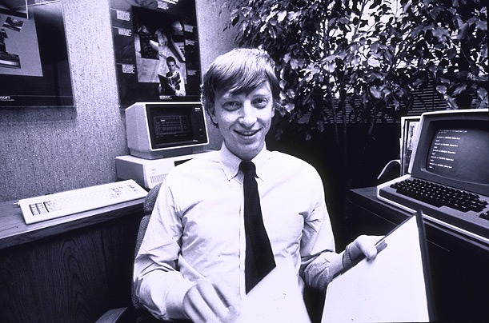
Big Data: How much data?
Google processes 20 PB a day (2008)
Wayback Machine has 3 PB + 100 TB/month (3/2009)
eBay has 6.5 PB of user data + 50 TB/day (5/2009)
Facebook has 36 PB of user data + 80-90 TB/day (6/2010)
CERN’s LHC: 15 PB a year (any day now)
LSST: 6-10 PB a year (~2015)
640K ought to be enough for anybody.
From http://www.umiacs.umd.edu/~jimmylin/

Slide 10
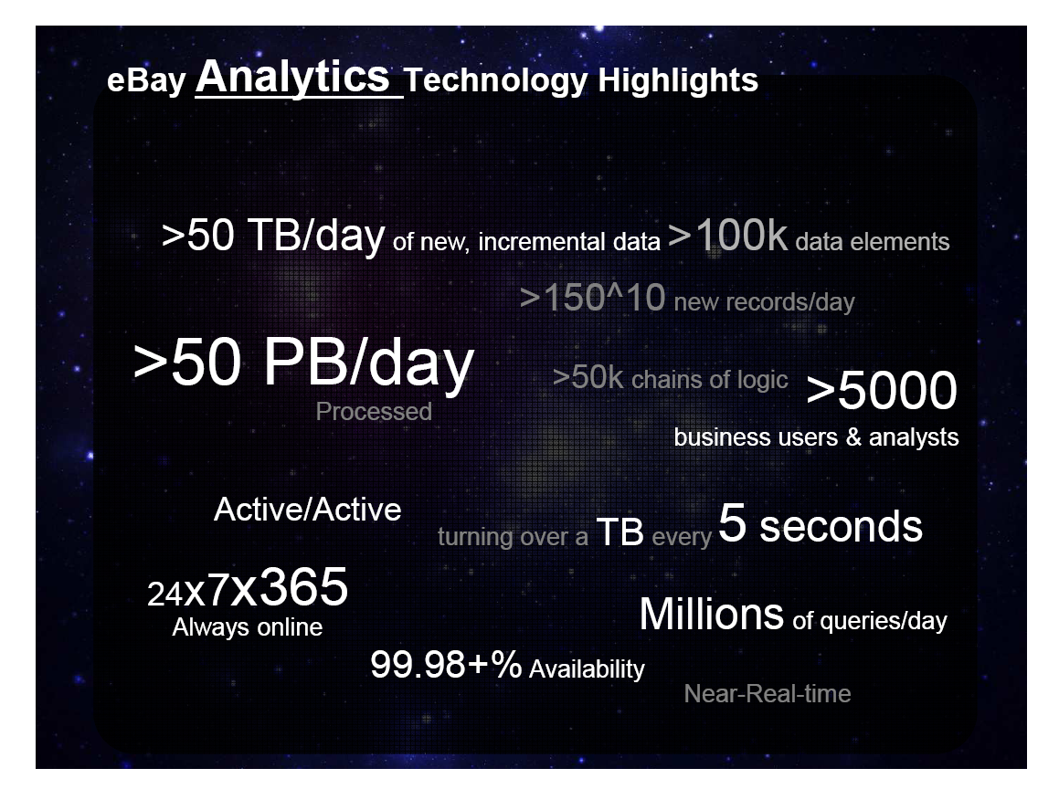
From: http://www.cs.duke.edu/smdb10/

Slide 11

New Realities
The quest for knowledge used to begin with grand theories.
Now it begins with massive amounts of data.
Welcome to the Petabyte Age.
TB disks < $100
Everything is data
Rise of data-driven culture
Very publicly espoused by Google, Wired, etc.
Sloan Digital Sky Survey, Terraserver, etc.
From: http://db.cs.berkeley.edu/jmh/

Slide 12

Fox Audience Network
Greenplum parallel DB
42 Sun X4500s (“Thumper”) each with:
48 500GB drives
16GB RAM
2 dual-core Opterons
Big and growing
200 TB data (mirrored)
Fact table of 1.5 trillion rows
Growing 5TB per day
4-7 Billion rows per day
Also extensive use of R and Hadoop
Yahoo! runs a 4000 node Hadoop cluster (probably the largest). Overall, there are 38,000 nodes running Hadoop at Yahoo!
From: http://db.cs.berkeley.edu/jmh/
As reported by FAN, Feb, 2009

Slide 13
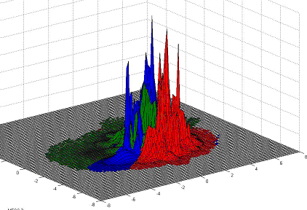
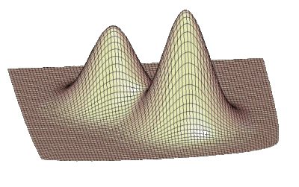
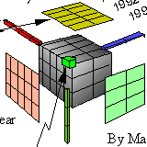


A Scenario from FAN
How many female WWF fans under the age of 30 visited the Toyota community over the last 4 days and saw a Class A ad?
How are these people similar to those that visited Nissan?
Open-ended question about statistical densities (distributions)
From: http://db.cs.berkeley.edu/jmh/

Slide 14


Multilingual development
SQL or MapReduce
Sequential code in a variety of languages
Perl
Python
Java
R
Mix and Match!
SE HABLA MAPREDUCE SQL SPOKEN HERE QUI SI PARLA PYTHON HIER JAVA GESPROCKEN R PARLÉ ICI
From: http://db.cs.berkeley.edu/jmh/

Slide 15
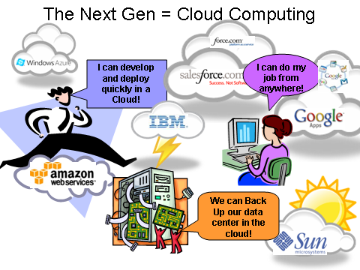
From: http://outsideinnovation.blogs.com/pseybold/2009/03/-sun-will-shine-in-blue-cloud.html

Slide 16
What we will cover
Scalable data processing (40%)
Parallel query plans and operators
Systems based on MapReduce
Scalable key-value stores
Processing rapid, high-speed data streams
Principles of query processing (35%)
Indexes
Query execution plans and operators
Query optimization
Data storage (15%)
Databases Vs. Filesystems (Google/Hadoop Distributed FileSystem)
Data layouts (row-stores, column-stores, partitioning, compression)
Concurrency control and recovery (10%)
Consistency models for data (ACID, BASE, Serializability)
Write-ahead logging

Slide 17
Course Logistics
Web: www.cs.duke.edu/courses/fall12/compsci516/
Books:
(Recommended) Hadoop: The Definitive Guide, by Tom White
Database Systems: The Complete Book, by H. Garcia-Molina, J. D. Ullman, and J. Widom
Grading:
Project 25% (Hopefully, on Amazon Cloud!)
Homeworks 25%
Midterm 25%
Final 25%

Slide 18
See Course Web Page For
Course outline
Homeworks
Projects
Tentative date for midterm

