Slide 1
An Introduction to Data Warehousing

Slide 2
Data, Data everywhere yet ...
I can’t find the data I need
data is scattered over the network
many versions, subtle differences
I can’t get the data I need
need an expert to get the data
I can’t understand the data I found
available data poorly documented
I can’t use the data I found
results are unexpected
data needs to be transformed from one form to other

Slide 3
So What Is a Data Warehouse?
Definition: A single, complete and consistent store of data obtained from a variety of different sources made available to end users in a what they can understand and use in a business context. [Barry Devlin]
By comparison: an OLTP (on-line transaction processor) or operational system is used to deal with the everyday running of one aspect of an enterprise.
OLTP systems are usually designed independently of each other and it is difficult for them to share information.

Slide 4
Why Do We Need Data Warehouses?
Consolidation of information resources
Improved query performance
Separate research and decision support functions from the operational systems
Foundation for data mining, data visualization, advanced reporting and OLAP tools

Slide 5
Why Data Warehousing?
Which are our lowest/highest margin customers ?
Who are my customers and what products are they buying?
What is the most effective distribution channel?
What product prom- -otions have the biggest impact on revenue?
Which customers are most likely to go to the competition ?
What impact will new products/services
have on revenue and margins?

Slide 6
What Is a Data Warehouse Used for?
Knowledge discovery
Making consolidated reports
Finding relationships and correlations
Data mining
Examples
Banks identifying credit risks
Insurance companies searching for fraud
Medical research

Slide 7
How Do Data Warehouses Differ From Operational Systems?
Goals
Structure
Size
Performance optimization
Technologies used

Slide 8
Comparison Chart of Database Types
Data warehouse | Operational system
Subject oriented | Transaction oriented
Large (hundreds of GB up to several TB) | Small (MB up to several GB)
Historic data | Current data
De-normalized table structure (few tables, many columns per table) | Normalized table structure (many tables, few columns per table)
Batch updates | Continuous updates
Usually very complex queries | Simple to complex queries

Slide 9
Design Differences
Operational System
Data Warehouse
ER Diagram
Star Schema

Slide 10
Supporting a Complete Solution
Operational System-
Data Entry
Data Warehouse-
Data Retrieval

Slide 11
Data Warehouses, Data Marts, and Operational Data Stores
Data Warehouse – The queryable source of data in the enterprise. It is comprised of the union of all of its constituent data marts.
Data Mart – A logical subset of the complete data warehouse. Often viewed as a restriction of the data warehouse to a single business process or to a group of related business processes targeted toward a particular business group.
Operational Data Store (ODS) – A point of integration for operational systems that developed independent of each other. Since an ODS supports day to day operations, it needs to be continually updated.

Slide 12
Decision Support
Used to manage and control business
Data is historical or point-in-time
Optimized for inquiry rather than update
Use of the system is loosely defined and can be ad-hoc
Used by managers and end-users to understand the business and make judgements

Slide 13
What are the users saying...
Data should be integrated across the enterprise
Summary data had a real value to the organization
Historical data held the key to understanding data over time
What-if capabilities are required

Slide 14

Data Warehousing -- It is a process
Technique for assembling and managing data from various sources for the purpose of answering business questions. Thus making decisions that were not previous possible
A decision support database maintained separately from the organization’s operational database

Slide 15
Data Warehouse Architecture
Relational Databases
Extraction Cleansing
Optimized Loader
Data Warehouse Engine
Analyze Query
Legacy Data
Purchased Data
Metadata Repository

Slide 16
From the Data Warehouse to Data Marts
Information
Individually Structured
Less
History
Normalized
Detailed
Departmentally Structured
Data Warehouse
Organizationally Structured
More
Data

Slide 17
Users have different views of Data
Tourists: Browse information harvested by farmers
OLAP
Farmers: Harvest information
from known access paths
Organizationally
structured
Explorers: Seek out the unknown and previously unsuspected rewards hiding in the detailed data

Slide 18
Wal*Mart Case Study
Founded by Sam Walton
One the largest Super Market Chains in the US
Wal*Mart: 2000+ Retail Stores
SAM's Clubs 100+Wholesalers Stores
This case study is from Felipe Carino’s (NCR Teradata) presentation made at Stanford Database Seminar

Slide 19
Old Retail Paradigm
Suppliers
Accept Orders
Promote Products
Provide special Incentives
Monitor and Track The Incentives
Bill and Collect Receivables
Estimate Retailer Demands
Wal*Mart
Inventory Management
Merchandise Accounts Payable
Purchasing
Supplier Promotions: National, Region, Store Level

Slide 20
New (Just-In-Time) Retail Paradigm
No more deals
Shelf-Pass Through (POS Application)
One Unit Price
Suppliers paid once a week on ACTUAL items sold
Wal*Mart Manager
Daily Inventory Restock
Suppliers (sometimes SameDay) ship to Wal*Mart
Warehouse-Pass Through
Stock some Large Items
Delivery may come from supplier
Distribution Center
Supplier’s merchandise unloaded directly onto Wal*Mart Trucks

Slide 21
Information as a Strategic Weapon
Daily Summary of all Sales Information
Regional Analysis of all Stores in a logical area
Specific Product Sales
Specific Supplies Sales
Trend Analysis, etc.
Wal*Mart uses information when negotiating with
Suppliers
Advertisers etc.

Slide 22
Schema Design
Database organization
must look like business
must be recognizable by business user
approachable by business user
Must be simple
Schema Types
Star Schema
Fact Constellation Schema
Snowflake schema

Slide 23
Star Schema
A single fact table and for each dimension one dimension table
Does not capture hierarchies directly
T
i
m
e
date, custno, prodno, cityname, sales
p
r
o
d
f
a
c
t
c
u
s
t
c
i
t
y

Slide 24
Dimension Tables
Dimension tables
Define business in terms already familiar to users
Wide rows with lots of descriptive text
Small tables (about a million rows)
Joined to fact table by a foreign key
heavily indexed
typical dimensions
time periods, geographic region (markets, cities), products, customers, salesperson, etc.

Slide 25
Fact Table
Central table
Typical example: individual sales records
mostly raw numeric items
narrow rows, a few columns at most
large number of rows (millions to a billion)
Access via dimensions

Slide 26
Snowflake schema
Represent dimensional hierarchy directly by normalizing tables.
Easy to maintain and saves storage
T
i
m
e
p
r
o
d
date, custno, prodno, cityname, ...
f
a
c
t
c
u
s
t
c
i
t
y
r
e
g
i
o
n

Slide 27
Fact Constellation
Fact Constellation
Multiple fact tables that share many dimension tables
Booking and Checkout may share many dimension tables in the hotel industry
Promotion
Hotels
Booking
Checkout
Travel Agents
Room Type
Customer

Slide 28
Data Granularity in Warehouse
Summarized data stored
reduce storage costs
reduce cpu usage
increases performance since smaller number of records to be processed
design around traditional high level reporting needs
tradeoff with volume of data to be stored and detailed usage of data

Slide 29
Granularity in Warehouse
Solution is to have dual level of granularity
Store summary data on disks
95% of DSS processing done against this data
Store detail on tapes
5% of DSS processing against this data

Slide 30
Levels of Granularity
Banking Example
account
month
# trans
withdrawals
deposits
average bal
Operational
account
activity date
amount
teller
location
account bal
monthly account
register -- up to
10 years
60 days of
activity
amount
activity date
amount
account bal
Not all fields
need be archived

Slide 31
Data Integration Across Sources
Savings
Loans
Trust
Credit card
Same data
different name
Different data
Same name
Data found here
nowhere else
Different keys
same data

Slide 32
Data Transformation
Operational/
Source Data
Sequential
Legacy
Relational
External
Data
Transformation
Accessing Capturing Extracting Householding Filtering
Reconciling Conditioning Loading Validating Scoring
Data transformation is the foundation for achieving single version of the truth
Major concern for IT
Data warehouse can fail if appropriate data transformation strategy is not developed

Slide 33
Data Transformation Example
Data Warehouse
appl A - m,f
appl B - 1,0
appl C - x,y
appl D - male, female
encoding
appl A - pipeline - cm
appl B - pipeline - in
appl C - pipeline - feet
appl D - pipeline - yds
unit
appl A - balance
appl B - bal
appl C - currbal
appl D - balcurr
field

Slide 34
Data Integrity Problems
Same person, different spellings
Agarwal, Agrawal, Aggarwal etc...
Multiple ways to denote company name
Persistent Systems, PSPL, Persistent Pvt. LTD.
Use of different names
mumbai, bombay
Different account numbers generated by different applications for the same customer
Required fields left blank
Invalid product codes collected at point of sale
manual entry leads to mistakes
“in case of a problem use 9999999”

Slide 35
Data Transformation Terms
Extracting
Conditioning
Scrubbing
Merging
Householding
Enrichment
Scoring
Loading
Validating
Delta Updating

Slide 36
Data Transformation Terms
Householding
Identifying all members of a household (living at the same address)
Ensures only one mail is sent to a household
Can result in substantial savings: 1 million catalogues at Rs. 50 each costs Rs. 50 million . A 2% savings would save Rs. 1 million

Slide 37
Refresh
Propagate updates on source data to the warehouse
Issues:
when to refresh
how to refresh -- incremental refresh techniques

Slide 38
When to Refresh?
periodically (e.g., every night, every week) or after significant events
on every update: not warranted unless warehouse data require current data (up to the minute stock quotes)
refresh policy set by administrator based on user needs and traffic
possibly different policies for different sources

Slide 39
Refresh techniques
Incremental techniques
detect changes on base tables: replication servers (e.g., Sybase, Oracle, IBM Data Propagator)
snapshots (Oracle)
transaction shipping (Sybase)
compute changes to derived and summary tables
maintain transactional correctness for incremental load

Slide 40
How To Detect Changes
Create a snapshot log table to record ids of updated rows of source data and timestamp
Detect changes by:
Defining after row triggers to update snapshot log when source table changes
Using regular transaction log to detect changes to source data

Slide 41
Querying Data Warehouses
SQL Extensions
Multidimensional modeling of data
OLAP
More on OLAP later …

Slide 42
SQL Extensions
Extended family of aggregate functions
rank (top 10 customers)
percentile (top 30% of customers)
median, mode
Object Relational Systems allow addition of new aggregate functions
Reporting features
running total, cumulative totals

Slide 43
Reporting Tools
Andyne Computing -- GQL
Brio -- BrioQuery
Business Objects -- Business Objects
Cognos -- Impromptu
Information Builders Inc. -- Focus for Windows
Oracle -- Discoverer2000
Platinum Technology -- SQL*Assist, ProReports
PowerSoft -- InfoMaker
SAS Institute -- SAS/Assist
Software AG -- Esperant
Sterling Software -- VISION:Data

Slide 44
Decision support tools
Mining
tools
Direct
Query
Reporting
tools
OLAP
Essbase
Intelligent Miner
Crystal reports
Merge
Clean
Summarize
Relational
DBMS+
e.g. Redbrick
Data warehouse
Detailed
transactional
data
GIS
data
Operational data
Census
data
Bombay branch
Delhi branch
Calcutta branch
Oracle
IMS
SAS

Slide 45
Deploying Data Warehouses
What business information keeps you in business today? What business information can put you out of business tomorrow?
What business information should be a mouse click away?
What business conditions are the driving the need for business information?

Slide 46
Cultural Considerations
Not just a technology project
New way of using information to support daily activities and decision making
Care must be taken to prepare organization for change
Must have organizational backing and support

Slide 47
User Training
Users must have a higher level of IT proficiency than for operational systems
Training to help users analyze data in the warehouse effectively

Slide 48
Summary: Building a Data Warehouse
Data Warehouse Lifecycle
Analysis
Design
Import data
Install front-end tools
Test and deploy

Slide 49
A case -- the STORET Central Warehouse
Improved performance and faster data retrieval
Ability to produce larger reports
Ability to provide more data query options
Streamlined application navigation

Slide 50
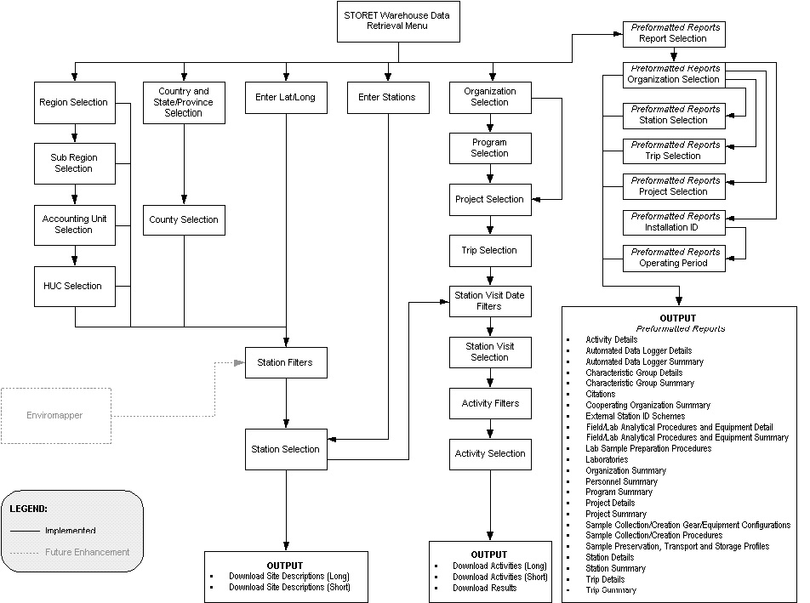
Old Web Application Flow

Slide 51
Central Warehouse Application Flow
Search Criteria Selection
Report Size Feedback/
Report Customization
Report Generation

Slide 52
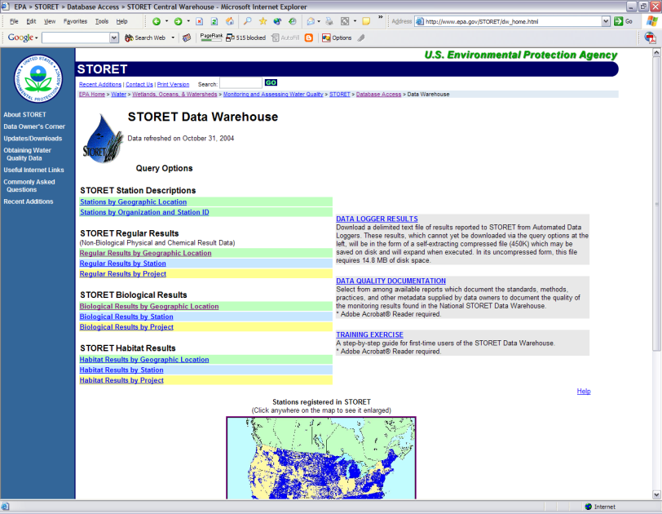
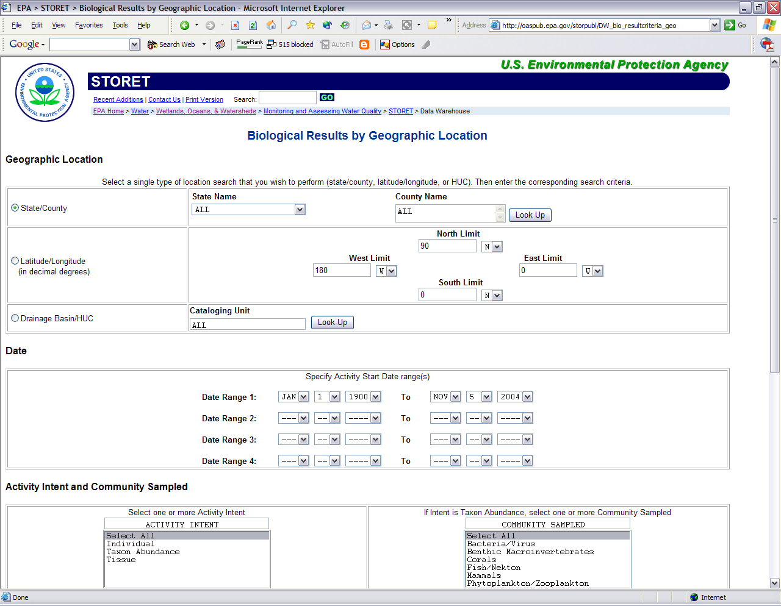
Web Application Demo
STORET Central Warehouse:
http://epa.gov/storet/dw_home.html

Slide 53
STORET Central Warehouse – Potential Future Enhancements
More query functionality
Additional report types
Web Services
Additional source systems?

Slide 54
Data Warehouse Components
SOURCE: Ralph Kimball

Slide 55
Data Warehouse Components – Detailed
SOURCE: Ralph Kimball

Slide 56
Online analytical processing (OLAP)

Slide 57
Nature of OLAP Analysis
Aggregation -- (total sales, percent-to-total)
Comparison -- Budget vs. Expenses
Ranking -- Top 10, quartile analysis
Access to detailed and aggregate data
Complex criteria specification
Visualization
Need interactive response to aggregate queries

Slide 58
Multi-dimensional Data
Measure - sales (actual, plan, variance)
Dimensions: Product, Region, Time
Hierarchical summarization paths
Product Region Time
Industry Country Year
Category Region Quarter
Product City Month week
Office Day
Region
W
S
N
Juice
Product
Cola
Milk
Cream
Toothpaste
Soap
1
2
3
4
5
6
7
Month

Slide 59
Conceptual Model for OLAP
Numeric measures to be analyzed
e.g. Sales (Rs), sales (volume), budget, revenue, inventory
Dimensions
other attributes of data, define the space
e.g., store, product, date-of-sale
hierarchies on dimensions
e.g. branch -> city -> state

Slide 60
Operations
Rollup: summarize data
e.g., given sales data, summarize sales for last year by product category and region
Drill down: get more details
e.g., given summarized sales as above, find breakup of sales by city within each region, or within the Andhra region

Slide 61
More OLAP Operations
Hypothesis driven search: E.g. factors affecting defaulters
view defaulting rate on age aggregated over other dimensions
for particular age segment detail along profession
Need interactive response to aggregate queries
=> precompute various aggregates

Slide 62
MOLAP vs ROLAP
MOLAP: Multidimensional array OLAP
ROLAP: Relational OLAP

Slide 63
SQL Extensions
Cube operator
group by on all subsets of a set of attributes (month,city)
redundant scan and sorting of data can be avoided
Various other non-standard SQL extensions by vendors

Slide 64
OLAP: 3 Tier DSS
Data Warehouse
OLAP Engine
Decision Support Client
Database Layer
Application Logic Layer
Presentation Layer
Store atomic data in industry standard Data Warehouse.
Generate SQL execution plans in the OLAP engine to obtain OLAP functionality.
Obtain multi-dimensional reports from the DSS Client.

Slide 65
Strengths of OLAP
It is a powerful visualization tool
It provides fast, interactive response times
It is good for analyzing time series
It can be useful to find some clusters and outliners
Many vendors offer OLAP tools

Slide 66
Brief History
Express and System W DSS
Online Analytical Processing - coined by EF Codd in 1994 - white paper by Arbor Software
Generally synonymous with earlier terms such as Decisions Support, Business Intelligence, Executive Information System
MOLAP: Multidimensional OLAP (Hyperion (Arbor Essbase), Oracle Express)
ROLAP: Relational OLAP (Informix MetaCube, Microstrategy DSS Agent)

Slide 67
OLAP and Executive Information Systems
Oracle -- Express
Pilot -- LightShip
Planning Sciences -- Gentium
Platinum Technology -- ProdeaBeacon, Forest & Trees
SAS Institute -- SAS/EIS, OLAP++
Speedware -- Media
Andyne Computing -- Pablo
Arbor Software -- Essbase
Cognos -- PowerPlay
Comshare -- Commander OLAP
Holistic Systems -- Holos
Information Advantage -- AXSYS, WebOLAP
Informix -- Metacube
Microstrategies --DSS/Agent

Slide 68
Microsoft OLAP strategy
Plato: OLAP server: powerful, integrating various operational sources
OLE-DB for OLAP: emerging industry standard based on MDX --> extension of SQL for OLAP
Pivot-table services: integrate with Office 2000
Every desktop will have OLAP capability.
Client side caching and calculations
Partitioned and virtual cube
Hybrid relational and multidimensional storage

