Slide 1

DATA WAREHOUSING
Presentation Prepared by:
Ankur Chandel

Slide 2
CONTENTS
Database and Data Warehousing
History of data warehousing
Evolution in organization use of data warehouses
Data Warehouse Architecture
Benefits of data warehousing
Strategic uses of data warehousing
Disadvantages of data warehouses
Data mart
Data mining
Data mining for decision support
Text mining
OLAP
Data warehousing integration
Business intelligence

Slide 3
Database and Data Ware Housing….
The Difference…
DWH Constitute Entire Information Base For All Time..
Database Constitute Real Time Information…
DWH Supports DM And Business Intelligence.
Database Is Used To Running The Business
DWH Is How To Run The Business

Slide 4
A producer wants to know….
Which are our lowest/highest margin customers ?
Who are my customers and what products are they buying?
What is the most effective distribution channel?
What product prom- -otions have the biggest impact on revenue?
Which customers are most likely to go to the competition ?
What impact will new products/services
have on revenue and margins?

Slide 5
Data, Data everywhere yet ...
I can’t find the data I need
data is scattered over the network
many versions, subtle differences
I can’t get the data I need
need an expert to get the data
I can’t understand the data I found
available data poorly documented
I can’t use the data I found
results are unexpected
data needs to be transformed from one form to other

Slide 6
What is a Data Warehouse?
A single, complete and consistent store of data obtained from a variety of different sources made available to end users in a what they can understand and use in a business context.

Slide 7
What is Data Warehousing?
Information
A process of transforming data into information and making it available to users in a timely enough manner to make a difference
Data

Slide 8
Data Warehousing -- a process
It is a relational or multidimensional database management system designed to support management decision making.
A data warehousing is a copy of transaction data specifically structured for querying and reporting.
Technique for assembling and managing data from various sources for the purpose of answering business questions. Thus making decisions that were not previous possible

Slide 9
Data warehousing is …
Subject Oriented: Data that gives information about a particular subject instead of about a company's ongoing operations.
Integrated: Data that is gathered into the data warehouse from a variety of sources and merged into a coherent whole.
Time-variant: All data in the data warehouse is identified with a particular time period.
Non-volatile: Data is stable in a data warehouse. More data is added but data is never removed. This enables management to gain a consistent picture of the business.
Data warehousing is combining data from multiple and usually varied sources into one comprehensive and easily manipulated database.
Common accessing systems of data warehousing include queries, analysis and reporting.
Because data warehousing creates one database in the end, the number of sources can be anything you want it to be, provided that the system can handle the volume, of course.
The final result, however, is homogeneous data, which can be more easily manipulated.

Slide 10
History of data warehousing
The concept of data warehousing dates back to the late 1980s when IBM researchers Barry Devlin and Paul Murphy developed the "business data warehouse".
1960s - General Mills and Dartmouth College, in a joint research project, develop the terms dimensions and facts.
1970s - ACNielsen and IRI provide dimensional data marts for retail sales.
1983 – Tera data introduces a database management system specifically designed for decision support.
1988 - Barry Devlin and Paul Murphy publish the article An architecture for a business and information systems in IBM Systems Journal where they introduce the term "business data warehouse".

Slide 11
OLTP
OLTP- ONLINE TRANSACTION PROCESSING
Special data organization, access methods and implementation methods are needed to support data warehouse queries (typically multidimensional queries)
OLTP systems are tuned for known transactions and workloads while workload is not known a priori in a data warehouse
e.g., average amount spent on phone calls between 9AM-5PM in Pune during the month of December

Slide 12
OLTP vs Data Warehouse
OLTP
Application Oriented
Used to run business
Detailed data
Current up to date
Isolated Data
Clerical User
Few Records accessed at a time (tens)
Read/Update Access
No data redundancy
Database Size 100MB -100 GB
Transaction throughput is the performance metric
Thousands of users
Managed in entirety
Warehouse (DSS)
Subject Oriented
Used to analyze business
Summarized and refined
Snapshot data
Integrated Data
Knowledge User (Manager)
Large volumes accessed at a time (millions)
Mostly Read (Batch Update)
Redundancy present
Database Size 100 GB - few terabytes
Query throughput is the performance metric
Hundreds of users
Managed by subsets

Slide 13
To summarize ...
OLTP Systems are used to “run” a business
The Data Warehouse helps to “optimize” the business

Slide 14
Evolution in organizational use of data warehouses
Organizations generally start off with relatively simple use of data warehousing. Over time, more sophisticated use of data warehousing evolves. The following general stages of use of the data warehouse can be distinguished:
Off line Operational Database
Data warehouses in this initial stage are developed by simply copying the data off an operational system to another server where the processing load of reporting against the copied data does not impact the operational system's performance.
Off line Data Warehouse
Data warehouses at this stage are updated from data in the operational systems on a regular basis and the data warehouse data is stored in a data structure designed to facilitate reporting.
Real Time Data Warehouse
Data warehouses at this stage are updated every time an operational system performs a transaction (e.g. an order or a delivery or a booking.)
Integrated Data Warehouse
Data warehouses at this stage are updated every time an operational system performs a transaction. The data warehouses then generate transactions that are passed back into the operational systems.

Slide 15
Data Warehouse Architecture
Client
Client
Query & Analysis
Metadata
Warehouse
Integration
Source
Source
Source

Slide 16
The data has been selected from various sources and then integrate and store the data in a single and particular format.
Data warehouses contain current detailed data, historical detailed data, lightly and highly summarized data, and metadata.
Current and historical data are voluminous because they are stored at the highest level of detail.
Lightly and highly summarized data are necessary to save processing time when users request them and are readily accessible.
Metadata are “data about data”. It is important for designing, constructing, retrieving, and controlling the warehouse data.
Technical metadata include where the data come from, how the data were changed, how the data are organized, how the data are stored, who owns the data, who is responsible for the data and how to contact them, who can access the data , and the date of last update.
Business metadata include what data are available, where the data are, what the data mean, how to access the data, predefined reports and queries, and how current the data are.

Slide 17
Business advantages
It provides business users with a “customer-centric” view of the company’s heterogeneous data by helping to integrate data from sales, service, manufacturing and distribution, and other customer-related business systems.
It provides added value to the company’s customers by allowing them to access better information when data warehousing is coupled with internet technology.
It consolidates data about individual customers and provides a repository of all customer contacts for segmentation modeling, customer retention planning, and cross sales analysis.
It removes barriers among functional areas by offering a way to reconcile views from multiple areas, thus providing a look at activities that cross functional lines.
It reports on trends across multidivisional, multinational operating units, including trends or relationships in areas such as merchandising, production planning etc.

Slide 18
Strategic uses of data warehousing
Industry | Functional areas of use | Strategic use
Airline | Operations; marketing | Crew assignment, aircraft development, mix of fares, analysis of route profitability, frequent flyer program promotions
Banking | Product development; Operations; marketing | Customer service, trend analysis, product and service promotions, reduction of IS expenses
Credit card | Product development; marketing | Customer service, new information service, fraud detection
Health care | Operations | Reduction of operational expenses
Investment and Insurance | Product development; Operations; marketing | Risk management, market movements analysis, customer tendencies analysis, portfolio management
Retail chain | Distribution; marketing | Trend analysis, buying pattern analysis, pricing policy, inventory control, sales promotions, optimal distribution channel
Telecommunications | Product development; Operations; marketing | New product and service promotions, reduction of IS budget, profitability analysis
Personal care | Distribution; marketing | Distribution decisions, product promotions, sales decisions, pricing policy
Public sector | Operations | Intelligence gathering

Slide 19
Disadvantages of data warehouses
Data warehouses are not the optimal environment for unstructured data.
Because data must be extracted, transformed and loaded into the warehouse, there is an element of latency in data warehouse data.
Over their life, data warehouses can have high costs. Maintenance costs are high.
Data warehouses can get outdated relatively quickly. There is a cost of delivering suboptimal information to the organization.
There is often a fine line between data warehouses and operational systems. Duplicate, expensive functionality may be developed. Or, functionality may be developed in the data warehouse that, in retrospect, should have been developed in the operational systems and vice versa.

Slide 20
Data Marts
A data mart is a scaled down version of a data warehouse that focuses on a particular subject area.
A data mart is a subset of an organizational data store, usually oriented to a specific purpose or major data subject, that may be distributed to support business needs.
Data marts are analytical data stores designed to focus on specific business functions for a specific community within an organization.
Usually designed to support the unique business requirements of a specified department or business process
Implemented as the first step in proving the usefulness of the technologies to solve business problems
Reasons for creating a data mart
Easy access to frequently needed data
Creates collective view by a group of users
Improves end-user response time
Ease of creation in less time
Lower cost than implementing a full Data warehouse
Potential users are more clearly defined than in a full Data warehouse

Slide 21
From the Data Warehouse to Data Marts
Information
Individually Structured
Less
History
Normalized
Detailed
Departmentally Structured
Data Warehouse
Organizationally Structured
More
Data

Slide 22

Characteristics of the Departmental Data Mart
Small
Flexible
Customized by Department
OLAP
Source is departmentally structured data warehouse
Data mart
Data warehouse

Slide 23

Data Mining
Data Mining is the process of extracting information from the company's various databases and re-organizing it for purposes other than what the databases were originally intended for.
It provides a means of extracting previously unknown, predictive information from the base of accessible data in data warehouses.
Data mining process is different for different organizations depending upon the nature of the data and organization.
Data mining tools use sophisticated, automated algorithms to discover hidden patterns, correlations, and relationships among organizational data.
Data mining tools are used to predict future trends and behaviors, allowing businesses to make proactive, knowledge driven decisions.
For ex: for targeted marketing, data mining can use data on past promotional mailings to identify the targets most likely to maximize the return on the company’s investment in future mailings.

Slide 24

Functions
Classification: It infers the defining characteristics of a certain group
Clustering: identifies group of items that share a particular characteristic
Association: identifies relationships between events that occur at one time
Sequencing: similar to association, except that the relationship exists over a period of time
Forecasting: estimates future values based on patterns within large sets of data

Slide 25
Characteristics
Data mining tools are needed to extract the buried information “ore”.
The “miner” is often an end user, empowered by “data drills” and other power query tools to ask ad hoc questions and get answers quickly, with little or no programming skill.
The data mining environment usually has a client/server architecture.
Because of the large amounts of data, it is sometimes necessary to use parallel processing for data mining.
Data mining tools are easily combined with spreadsheets and other end user software development tools, enabling the mined data to be analyzed and processed quickly and easily.
Data mining yields five types of information: associations, sequences, classifications, clusters and forecasting.
“Striking it rich” often involves finding unexpected, valuable results.

Slide 26
Common data mining applications
APPLICATION | DESCRIPTION
Market segmentation | Identifies the common characteristics of customers who buys the same products from the company
Customer churn | Predicts which customers are likely to leave your company and go to a competitor
Fraud detection | Identifies which transactions are most likely to be fraudulent
Direct marketing | Identifies which prospects should be included in a mailing list to obtain the highest response rate
Market based analysis | Understands what products or services are commonly purchased together
Trend analysis | Reveals the difference between a typical customer this month versus last month
Science | Simulates nuclear explosions; visualizes quantum physics

Slide 27
Entertainment | Models customer flows in theme parks; analyzes safety of amusement parks rides
Insurance and health care | Predicts which customers will buy new policies; identifies behavior patterns that increase insurance risk; spots fraudulent claims
Manufacturing | Optimizes product design, balancing manufacturability and safety; improves shop-floor scheduling and machine utilization
Medicine | Ranks successful therapies for different illnesses; predicts drug efficacy; discovers new drugs and treatments
Oil and gas | Analyzes seismic data for signs of underground deposits ; prioritizes drilling locations; simulates underground flows to improve recovery
Retailing | Discerns buying-behavior patterns; predicts how customers will respond to marketing campaigns

Slide 28
Data Mining works with Data Warehouse
Data Warehousing provides the Enterprise with a memory
Data Mining provides the Enterprise with intelligence

Slide 29
Data mining for decision support
Two capabilities are provided new business opportunities
Automated prediction of trends and behavior: for ex, targeted marketing.
Automated discovery of previously unknown patterns: for ex, detecting fraudulent credit card transactions and identifying anomalous data representing data entry-keying errors.

Slide 30
Data mining tools
IT tools and techniques are used by data miners
Neural computing: It is a machine learning approach by which historical data can be examined for patterns.
Intelligent agents: It is the promising approach to retrieve information from the internet or from intranet-based databases.
Association analysis: An approach that uses a specialized set of algorithms that sort through large data sets and expresses statistical rules among items.

Slide 31

Text mining
Text mining is the application of data mining to non structured or less structured text files.
Operates with less structured information
Frequently focused on document format rather than document content

Slide 32
Text mining helps in….
Find the “hidden” content of documents, including additional useful relationships
Relate documents across previously unnoticed divisions (e.g.: discover that customers in two different product divisions have the same characteristics)
Group documents by common themes (e.g.: identify all the customers of an insurance firms who have similar complaints and cancel their policies)

Slide 33
To summarize ...
OLTP Systems are used to “run” a business
The Data Warehouse helps to “optimize” the business

Slide 34
OLAP
Online Analytical Processing - coined by EF Codd in 1994 paper contracted by Arbor Software
Generally synonymous with earlier terms such as Decisions Support, Business Intelligence, Executive Information System
OLAP = Multidimensional Database

Slide 35
OLAP
Online analytical processing refers to such end user activities as DSS modelling using spreadsheets and graphics that are done online.
OLAP involves many different data items in complex relationships.
Objective of OLAP is to analyze complex relationships and look for patterns, trends and exceptions.

Slide 36
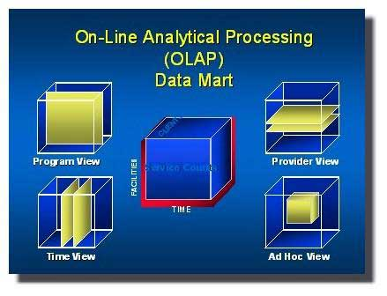

Slide 37
OLAP Is FASMI
Fast
Analysis
Shared
Multidimensional
Information

Slide 38
Strengths of OLAP
It is a powerful visualization paradigm
It provides fast, interactive response times
It is good for analyzing time series
It can be useful to find some clusters and outliers
Many vendors offer OLAP tools such as brio.com, cognus.com, microstrategy.com etc and it is possible to access an OLAP database from web.

Slide 39
Data warehousing integration
End Users:
Decision making and other tasks:
CRM, DSS, EIS
DATA SOURCES
(databases)
Direct use
Data organization ; storage
Information Data Warehouse (storage)
Use
Direct use
Data visualization
Use of
knowledge
Use
Analytical processing,
Data mining
Generate knowledge
use
storage
Purchased knowledge
Organizational
Knowledge base
STORAGE

Slide 40
Businesses run on information and the knowledge of how to put that information to use.
Knowledge is not readily available, it is continuously constructed from data and/or information, in a process that may not be simple or easy.
The transformation of data into knowledge may be accomplished in several ways
Data collection from various sources stored in simple databases

Slide 41
Data can be processed, organized, and stored in a data warehouse and then analyzed (e.g.) by using analytical processing) by end users for decision support.
Some of the data are converted to information prior to storage in the data warehouse, and some of the data and/or information can be analyzed to generate knowledge. For example, by using data mining, a process that looks for unknown relationships and patterns in the data, knowledge regarding the impact of advertising on a specific group of customers can be generated.
This generated knowledge is stored in an organizational knowledge base, a repository of accumulated corporate knowledge and of purchased knowledge.
The knowledge in the knowledge base can be used to support less experienced and users, or to support complex decision making.
Both the data and the information, at various times during the process, and the knowledge derived at the end of the process, may need to be presented to users.

Slide 42
Data Warehouse for Decision Support
Putting Information technology to help the knowledge worker make faster and better decisions
Used to manage and control business
Data is historical or point-in-time
Optimized for inquiry rather than update
Use of the system is loosely defined and can be ad-hoc
Used by managers and end-users to understand the business and make judgments

Slide 43
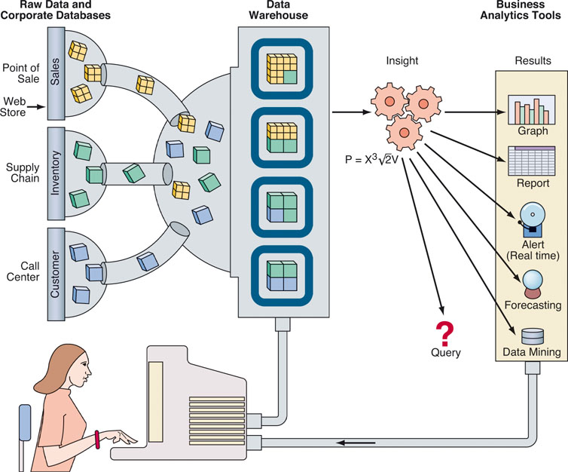
Business intelligence and data warehousing

Slide 44
Business Intelligence
One ultimate use of the data gathered and processed in the data life cycle is for business intelligence.
Business intelligence generally involves the creation or use of a data warehouse and/or data mart for storage of data, and the use of front-end analytical tools such as Oracle’s Sales Analyzer and Financial Analyzer or Micro Strategy’s Web.
Such tools can be employed by end users to access data, ask queries, request ad hoc (special) reports, examine scenarios, create CRM activities, devise pricing strategies, and much more.

Slide 45
How business intelligence works?
The process starts with raw data which are usually kept in corporate data bases. For example, a national retail chain that sells everything from grills and patio furniture to plastic utensils had data about inventory, customer information, data about past promotions, and sales numbers in various databases.
Though all this information may be scattered across multiple systems-and may seem unrelated-business intelligence software can being it together. This is done by using a data warehouse.
In the data warehouse (or mart) tables can be linked, and data cubes are formed. For instance, inventory information is linked to sales numbers and customer databases, allowing for deep analysis of information.

Slide 46
Using the business intelligence software the user can ask queries, request ad-hoc reports, or conduct any other analysis.
For example, deep analysis can be carried out by performing multilayer queries. Because all the databases are linked, one can search for what products a store has too much of, determine which of these products commonly sell with popular items, bases on previous sales. After planning a promotion to move the excess stock along with the popular products (by bundling them together, for example), one can dig deeper to see where this promotion would be most popular (and most profitable). The results of the request can be reports, predictions, alerts, and/or graphical presentations. These can be disseminated to decision makers to help them in their decision-making tasks.

Slide 47
More advanced applications of business intelligence include outputs such as
financial modeling
budgeting
resource allocation
and competitive intelligence.

Slide 48


