Slide 1
DataScience with Spark & Zeppelin
Ofer Mendelevitch
Vinay Shukla
Moon Soo Lee

Slide 2
Data Science with iPython Ofer Mendelevitch

Slide 3
The Data Science Workflow…

Slide 4

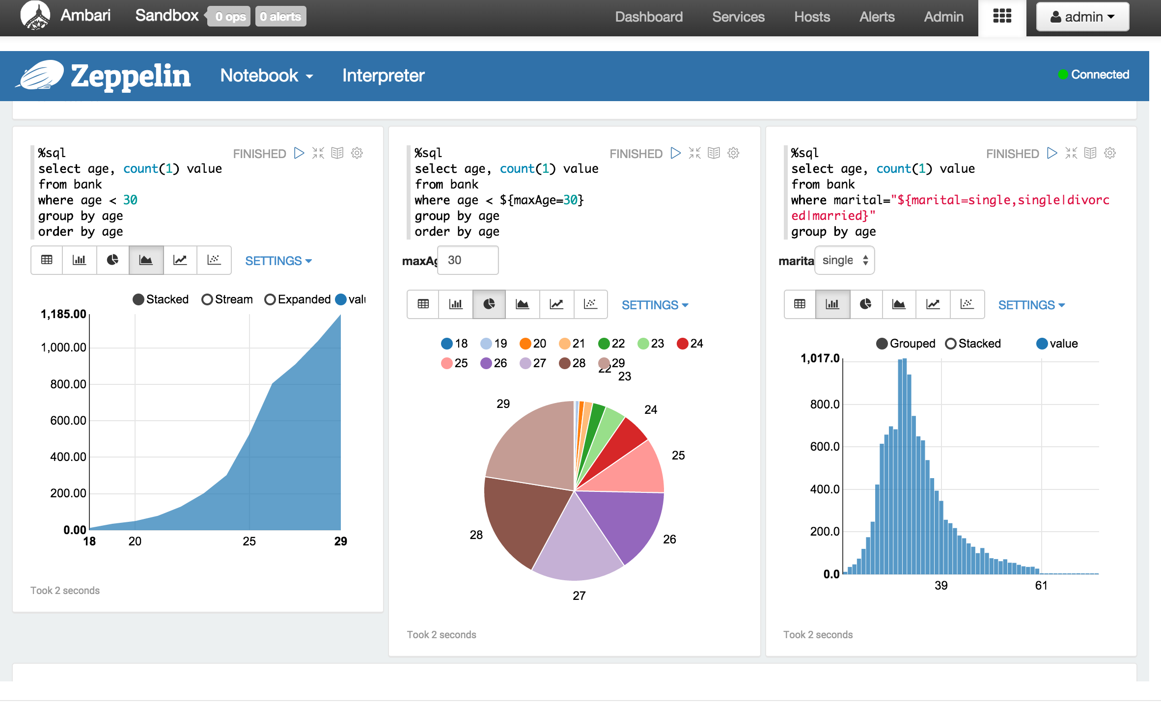
Introducing Apache Zeppelin
Lee Moon Soo, Vinay Shukla

Slide 5
Apache Zeppelin
A web-based notebook for interactive analytics
Deeply integrated with Spark and Hadoop
Supports multiple language backends
Incubating

Slide 6
Use cases for Zeppelin
Data exploration & discovery
Visualization - tables, graphs, charts
Interactive snippet-at-a-time experience
Collaboration and publishing
“Modern Data Science Studio”

Slide 7
DEMO I
A day in the life of a data scientist with Zeppelin

Slide 8
Apache Spark Integration
Supports scala, pyspark and spark sql
SparkContext injected automatically
Supports 3rd party dependencies
Spark-on-YARN and Spark standalone modes
Full Spark interpreter configuration
Multiple Spark interpreter profiles

Slide 9
DEMO I I
Apache Spark using Zeppelin

Slide 10
Support for multiple back-ends
Scala, Python, spark sql
Hive, Tajo, Ignite, Mysql, ….
Apache Flink
Markdown, shell
Driven by the community - thank you!
How is this so easy to do?

Slide 11


Zeppelin Interpreter Architecture
Interpreter is connector between Zeppelin and Backend data processing system.
ZeppelinServer
Thrift
InterpreterGroup
Spark
Interpreter
Interpreter
Interpreter
Spark
PySpark
SparkSQL
Dep
Separate JVM process
Load libraries
Share single SparkDriver
Spark cluster
Maven repository

Slide 12

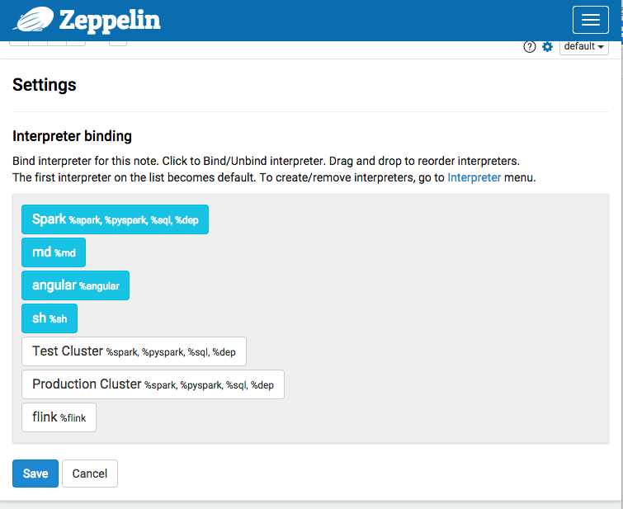
Notebook - Interpreter Selection
Spark
spark
pyspark
sql
dep
Load libraries
Share single SparkDriver
Spark cluster
Maven repository

Slide 13
DEMO III
Interpreter Deep Dive

Slide 14
Join the community
Try out Apache Zeppelin today
https://zeppelin.incubator.apache.org/
Join us on the community discussions
Help define how we shape the roadmap and features
Lets get this party started!

Slide 15



Questions?
Thank you
Resource Management
Governance
Security
YARN: Data Operating System
Operations
Storage
Cloud of your choice
Notes:
Apache Spark + Zeppelin for Data Workers

