Slide 1
Predicting System Performance for Multi-tenant Database Workloads
Mumtaz Ahmad¹, Ivan Bowman²
¹University of Waterloo, ²Sybase, an SAP company

Slide 2
Multi-tenant Databases
1
Multi-tenancy: single instance of application software, serving multiple clients.
Multi-tenant databases
Security: data isolation
Performance
Flexibility: customization for customers
# of tenants, size

Slide 3
Multi-tenant Databases
2
Multiple database servers per machine
Simplest approach
High isolation, restricted sharing of resources
Single database server, Shared schema
Security: permission mechanism needed to control data access for each tenant,
Flexibility: overhead for adding new column, adding new table, encrypting the data for a client, migration, customization for individual clients

Slide 4
Multi-tenant Databases
3
Single database server, Multiple databases
Middle of the road approach for security, flexibility and resource sharing
Well suited when packing databases with low demand
Order of magnitude better than Multiple database servers per machine.

Slide 5
Performance of multi-tenant Databases
4
Workloads coming from different tenants. Workloads interfering with each other
How is the performance impacted ?
Move workload W4 to a different host?
Given : W1, W2, W3 and W4
( W1, W2, W3) ?
(W4) ?
(W2, W3, w4) ?
(W1, W2, W4) ?

Slide 6
Performance Prediction Approaches
5
Traditional Approaches:
Staging, individual workload profiles, Analytical models ?
Challenge:
Interactions are hard to understand based on individual profiles
A read workload may end up causing many writes
Self managing optimizers, query plans change
Analyze workload mixes !

Slide 7
Empirical Study
6
Resource metrics:
CPU utilization: % processor time
Disk transfer speed: Avg. Disk sec/transfer
Single database server, Multiple databases
TPC-H, TPC-C workloads
TPC-H: size, CPU usage profile,
TPC-C : # of transactions, think time
SQL Anywhere 12

Slide 8
Multi-tenant Workloads
 | W1 | W2 | W3 | W4 | W5 | W6 | W7 | W8 | W9 | W10 | W11 | W12
CPU (%) | 28.2 | 25.38 | 25.28 | 25.20 | 26.10 | 25.31 | 50.07 | 75.08 | 62.19 | 58.57 | 57.86 | 63.12
Disk (ms/tr.) | 16.2 | 6.18 | 5.92 | 6.74 | 14.95 | 6.37 | 5.33 | 6.06 | 5.93 | 6.31 | 6.59 | 6.86
workloads | CPU (utilization%) | Disk ms/transfer
(w2,w3,w4) | 26.70 | 7.80
(w10,w11,w12) | 95.76 | 6.44
(w1,w2,… w12) | 35.30 | 53.27
(w1, …w9,w11) | 45.85 | 74.63
(w1,… w6, w9, w10, w11) | 44.43 | 63.96
7

Slide 9
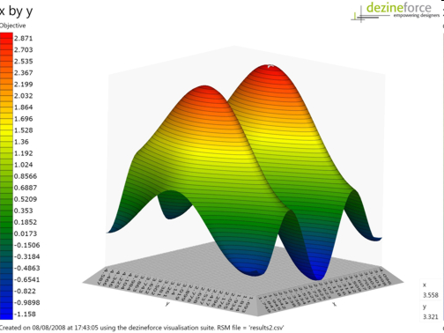
Workload Mixes
Workloads |  |  | Metric
_{W1} | _{W2} | _{W3} | _{mi}
0 | 0 | 1 | 23.42
1 | 0 | 1 | 55.12
1 | 1 | 1 | 67.62
1 | 1 | 0 | 20.45
Linear regression
Regression trees
Gaussian process models
8
Modeling workload mixes
Ideal: If we can observe every workload combination.

Slide 10
Predicting Resource Metrics
metric | LR | GP
CPU utilization (% processor time) | 12.83 | 15.44
Disk ms/transfer | 17.41 | 48.03
9
Random sampling for training data collection
Modeling approaches: linear regression, Gaussian processes,
MRE error for test mixes.

Slide 11
Predicting Resource Metrics
metric | LR | GP
CPU utilization (% processor time) | 12.83 | 15.44
 | 11.10 | 14.10
Disk ms/transfer | 17.41 | 48.03
 | 8.42 | 11.42
10
Heuristics: Ignore errors when both actual and predicted are in desirable range

Slide 12
Discussion
11
Workload features
y = f ( 1,0,0,1, ….)
Location independent: database file size, # of clients
Location dependent: query plan features
Workload definition
Collecting training data
Exhaustive training
Passive sampling: Monitor execution of production workloads
Active Sampling: Schedule “experiments”, maximize space coverage for a budget.

Slide 13
Summary
Presented a case for studying workload mixes in multi-tenant database systems
Modeling & reasoning about workload interactions:
Staging and simple additive approaches aren’t sufficient
Statistical modeling seems promising
Simple heuristics can lead to better results
12

