Slide 1
Lambda Architecture

Slide 2
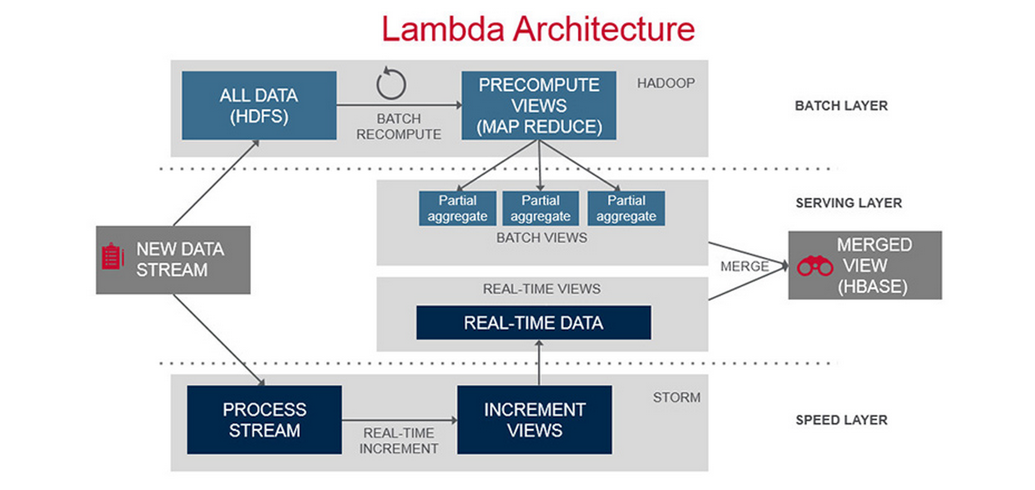
Lambda Architecture

Slide 3
Lambda Architecture
Unified Framework
Spark Core
Spark SQL
Spark Streaming

