Slide 1
Data Engineering
Introduction to Parallel Execution
Shivnath Babu

Slide 2
Introduction to Parallel Execution
Query or
Spark Program Q
Answers
Translates Q into
an execution plan
and runs the plan
Spark
Driver
Data resides
on one or
more
machines
Data Partition
Data Partition
Data Partition
Data Partition

Slide 3
Example: At a Company
Query 1: Is there an employee named “Nemo”?
Query 2: What is “Nemo’s” salary?
Query 3: How many departments are there in the company?
Query 4: What is the name of “Nemo’s” department?
Query 5: How many employees are there in the
“Accounts” department?
Employee
Department
ID | Name | DeptID | Salary | …
10 | Nemo | 12 | 120K | …
20 | Dory | 156 | 79K | …
40 | Gill | 89 | 76K | …
52 | Ray | 34 | 85K | …
… | … | … | … | …
ID | Name | …
12 | IT | …
34 | Accounts | …
89 | HR | …
156 | Marketing | …
… | … | …

Slide 4
Counting the number of records that will be read or transferred over the network in a parallel execution
We have a dataset R with two attributes A and B
There are 10000 records in R, with 2500 unique values of A and 5000 unique values of B
See Figure 1 on next slide

Slide 5
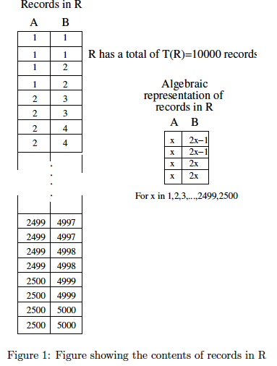

Slide 6

Counting exercise (contd.)
Dataset R has 10 partitions
R is stored on 10 machines, with one partition per machine
We want to find the result of:
See Figure on next slide

Slide 7
Data Partition
Data Partition
Data Partition
Data Partition
Data Partition
M1:
1 <= A
<= 250
M2:
251 <= A
<= 500
M5:
1001 <= A
<= 1250
Send records with
1 <= A <= 1250
Send records with
1251 <= A <= 2500
R1
R2
M6:
1251 <= A
<= 1500
M7:
1501 <= A
<= 1750
M10:
2251 <= A
<= 2500
Data Partition
Data Partition
Data Partition
Data Partition
Data Partition

Slide 8
Partitioning and Load Balancing
Looking at data as Key-Value pairs
The Map Vs. Reduce model of parallel execution
Partitioning:
Range Partitioning
Hash partitioning
List partitioning
The Shuffle step in parallel execution
Load balancing and skew problems

Slide 9
Same example (contd.)
Suppose records in R are partitioned randomly across M1-M10. What, if anything, changes?

Slide 10
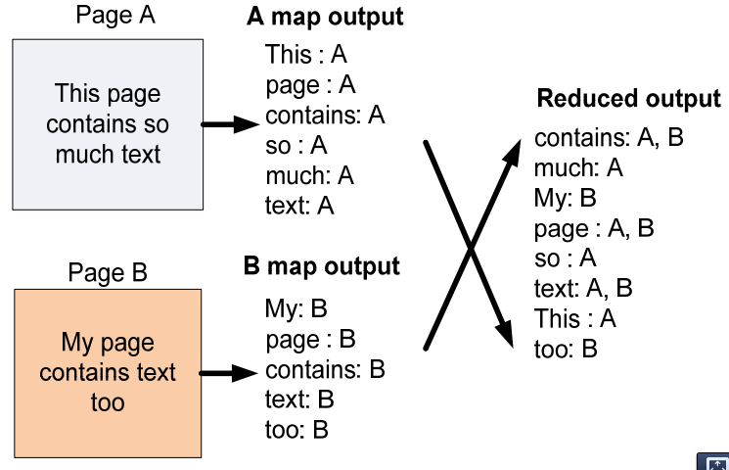
Other Common Tasks that Need Parallel Execution
Word counting
Inverted indexes

Slide 11
Other Common Tasks that Need Parallel Execution
TF-IDF
http://blog.cloudera.com/wp-content/uploads/2010/01/5-MapReduceAlgorithms.pdf

Slide 12
Other Common Tasks that Need Parallel Execution
Sorting
PageRank (will consider this when we study Graph Processing)
…

Slide 13
Join Example: Store that Sells Cars
Owners of
Honda Accords
who are <=
23 years old
Make | Model | OwnerID | ID | Name | Age
Honda | Accord | 12 | 12 | Nemo | 22
Honda | Accord | 156 | 156 | Dory | 21
Join (Cars.OwnerID = Owners.ID)
Filter (Make = Honda and
Model = Accord)
Filter (Age <= 23)
Cars
Owners
Make | Model | OwnerID
Honda | Accord | 12
Toyota | Camry | 34
Mini | Cooper | 89
Honda | Accord | 156
… | … | …
ID | Name | Age
12 | Nemo | 22
34 | Ray | 42
89 | Gill | 36
156 | Dory | 21
… | … | …

Slide 14
Parallel Execution of Joins in MapReduce Style
Two typical types of join
Map-side join
Reduce-side join

Slide 15
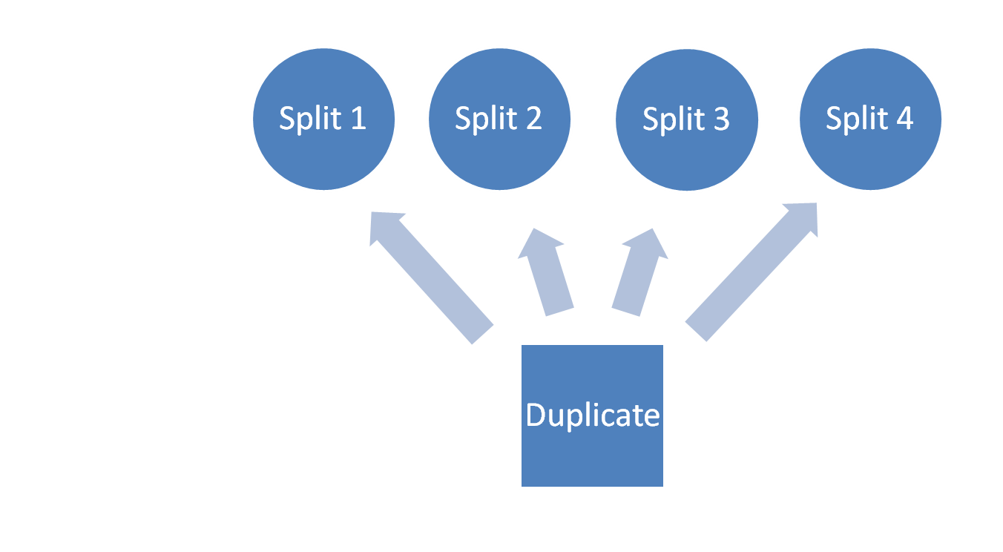
Map-side Join
Table L
Map tasks:
Table R

Slide 16
REDUCE-SIDE JOIN
input
map
shuffle
reduce
output
Pairs: (key, targeted record)
Group by join key
{(661::James…) }
X
(1::661::3::97…),
(1::661::3::97…),
(1::661::4::97…)
1::1193::5::978300760
1::661::3::978302109
1::661::3::978301968
1::661::4::978300275
1 ::1193::5::97882429
(661, …)
(661, …)
(661, …)
1193, L:1::1193::5::978300760
661, L :1::661::3::978302109
661, L :1::661::3::978301968
661, L :1::661::4::978300275
1193, L :1 ::1193::5 ::97882429
(661,
[L :1::661::3::97…],
[R:661::James…],
[L:1::661::3::978…],
[L :1::661::4::97…])
(1,Ja..,3, …)
(1,Ja..,3, …)
(1,Ja..,4, …)
(1193, …)
(1193, …)
L: ratings.dat
Buffers records into two sets according to the table tag
+
Cross-product
661::James and the Glant…
914::My Fair Lady..
1193::One Flew Over the…
2355::Bug’s Life, A…
3408::Erin Brockovich…
(661, …)
(2355, …)
(3048, …)
(2355, [R:2355::B’…])
(3408, [R:3408::Eri…])
661, R:661::James and the Gla…
914, R: 914::My Fair Lady..
1193, R: 1193::One Flew Over …
2355, R: 2355::Bug’s Life, A…
3408, R: 3408::Erin Brockovi…
(914, …)
(1193, …)
Drawback: all records may have to be buffered
R: movies.dat
Out of memory
The key cardinality is small
The data is highly skewed
Phase /Function | Improvement
Map Function | Output key is changed to a composite of the join key and the table tag.
Partitioning function | Hashcode is computed from just the join key part of the composite key
Grouping function | Records are grouped on just the join key

