Slide 1
Building Highly Flexible, High Performance query engines - Highlights from Apache Drill project
Neeraja Rentachintala
Director, Product Management
MapR Technologies

Slide 2
Agenda
Apache Drill overview
Using Drill
Under the Hood
Status and progress
Demo

Slide 3
Apache drill Overview

Slide 4
Hadoop workloads and APIs
Use case | ETL and aggregation (batch) | Predictive modeling and analytics (batch) | Interactive SQL – Data exploration, Adhoc queries & reporting | Search | Operational (user facing applications, point queries)
API | MapReduce Hive Pig Cascading | Mahout MLLib Spark | Drill Shark Impala Hive on Tez Presto | Solr Elasticsearch | HBase API Phoenix
Notes:
Lot of workloads exist for Big data, batch, machine learning, search, interactive SQL, Operational/user facing applications
Apache Drill fits into the interactive SQL category

Slide 5




Interactive SQL and Hadoop
Opens up Hadoop data to broader audience
Existing SQL skill sets
Broad eco system of tools
New and improved BI/Analytics use cases
Analysis on more raw data, new types of data and real time data
Cost savings
Enterprise users

Slide 6
Data landscape is changing
New types of applications
Social, mobile, Web, “Internet of Things”, Cloud…
Iterative/Agile in nature
More users, more data
New data models & data types
Flexible (schema-less) data
Rapidly changing
Semi-structured/Nested data
{
"data": [
"id": "X999_Y999",
"from": {
"name": "Tom Brady", "id": "X12"
},
"message": "Looking forward to 2014!",
"actions": [
{
"name": "Comment",
"link": "http://www.facebook.com/X99/posts Y999"
},
{
"name": "Like",
"link": "http://www.facebook.com/X99/posts Y999"
}
],
"type": "status",
"created_time": "2013-08-02T21:27:44+0000",
"updated_time": "2013-08-02T21:27:44+0000"
}
}
JSON

Slide 7





Hadoop evolving as central hub for analysis
Provides Cost effective, flexible way to store and and process data at scale
Traditional datasets
Comes from transactional applications
Stored for historical purposes and/or for large scale ETL/Analytics
Well defined schemas
Managed centrally by DBAs
No frequent changes to schema
Flat datasets
New datasets
Comes from new applications (Ex: Social feeds, clickstream, logs, sensor data)
Enable new use cases such as Customer Satisfaction, Product/Service optimization
Flexible data models/managed within applications
Schemas evolving rapidly
Semi-structured/Nested data

Slide 8
Existing SQL approaches will not always work for big data needs
DBA/DWH teams
Enterprise Users
Model data
Move data into traditional systems
Analyze Big data
Schema changes or
new data sources
New questions
/requirements
New data models/types don’t map well to the relational models
Many data sources do not have rigid schemas (HBase, Mongo etc)
Each record has a separate schema
Sparse and wide rows
Flattening nested data is error-prone and often impossible
Think about repeated and optional fields at every level…
A single HBase value could be a JSON document (compound nested type)
Centralized schemas are hard to manage for big data
Rapidly evolving data source schemas
Lots of new data sources
Third party data
Unknown questions

Slide 9
Apache Drill
Open Source SQL on Hadoop for Agility with Big Data exploration
Flexible schema management
Analytics on NoSQL data
Plug and play with existing tools
Analyze data with or without centralized schemas
Analyze semi structured & nested data with no modeling/ETL
Analyze data using familiar BI/Analytics and SQL based tools
… and with an architecture built ground up for Low Latency queries at Scale

Slide 10
Flexible schema management
{ “ID”: 1, “NAME”: “Fairmont San Francisco”, “DESCRIPTION”: “Historic grandeur…”, “AVG_REVIEWER_SCORE”: “4.3”, “AMENITY”: {“TYPE”: “gym”,
DESCRIPTION: “fitness center”
},
{“TYPE”: “wifi”,
“DESCRIPTION”: “free wifi”},
“RATE_TYPE”: “nightly”,
“PRICE”: “$199”,
“REVIEWS”: [“review_1”, “review_2”],
“ATTRACTIONS”: “Chinatown”, }
HotelID | AmenityID
1 | 1
1 | 2
Existing SQL solutions
X
ID | Type | Description
1 | Gym | Fitness center
2 | Wifi | Free wifi
JSON

Slide 11
Flexible schema management
HotelID | AmenityID
1 | 1
1 | 2
{ “ID”: 1, “NAME”: “Fairmont San Francisco”, “DESCRIPTION”: “Historic grandeur…”, “AVG_REVIEWER_SCORE”: “4.3”, “AMENITY”: {“TYPE”: “gym”,
DESCRIPTION: “fitness center”
},
{“TYPE”: “wifi”,
“DESCRIPTION”: “free wifi”},
“RATE_TYPE”: “nightly”,
“PRICE”: “$199”,
“REVIEWS”: [“review_1”, “review_2”],
“ATTRACTIONS”: “Chinatown”, }
ID | Type | Description
1 | Gym | Fitness center
2 | Wifi | Free wifi
Drill
Drill
JSON
Drill doesn’t require any schema definitions to query data making it faster to get insights from data for users. Drill leverages schema definitions if exists.

Slide 12
Key features
Dynamic/schema-less queries
Nested data
Apache Hive integration
ANSI SQL/BI tool integration

Slide 13
Querying files
Direct queries on a local or a distributed file system (HDFS, S3 etc)
Configure one or more directories in file system as “Workspaces”
Think of this as similar to schemas in databases
Default workspace points to “root” location
Specify a single file or a directory as ‘Table’ within query
Specify schema in query or let Drill discover it
Example:
SELECT * FROM dfs.users.`/home/mapr/sample-data/profiles.json`
dfs | File system as data source
users | Workspace (corresponds to a directory)
/home/mapr/sample-data/profiles.json | Table

Slide 14
More examples
Query on single file
SELECT * FROM dfs.logs.`AppServerLogs/2014/Jan/part0001.txt`
Query on directory
SELECT * FROM dfs.logs.`AppServerLogs/2014/Jan` where errorLevel=1;
Joins on files
SELECT c.c_custkey,sum(o.o_totalprice)
FROM
dfs.`/home/mapr/tpch/customer.parquet` c
JOIN
dfs.`/home/mapr/tpch/orders.parquet` o
ON c.c_custkey = o.o_custkey
GROUP BY c.c_custkey
LIMIT 10

Slide 15
Querying HBase
Direct queries on HBase tables
SELECT row_key, cf1.month, cf1.year FROM hbase.table1;
SELECT CONVERT_FROM(row_key, UTF-8) as HotelName from FROM HotelData
No need to define a parallel/overlay schema in Hive
Encode and Decode data from HBase using Convert functions
Convert_To and Convert_From

Slide 16
Nested data
Nested data as first class entity: Extensions to SQL for nested data types, similar to BigQuery
No upfront flattening/modeling required
Generic architecture for a broad variety of nested data types (eg:JSON, BSON, XML, AVRO, Protocol Buffers)
Performance with ground up design for nested data
Example:
SELECT
c.name, c.address, REPEATED_COUNT(c.children)
FROM(
SELECT
CONVERT_FROM(cf1.user-json-blob, JSON) AS c
FROM
hbase.table1
)
Notes:
Analytics on Semi-Structured/Nested data
Use standard SQL to query Nested data without upfront flattening/modeling
Extensions to ANSI SQL to operate on nested data
Generic architecture for a broad variety of nested data types (eg:JSON, BSON, XML, AVRO, Protocol Buffers)
Performance with ground up design for Nested data
In-memory columnar/hierarchical data model enabling SQL processing directly on Nested data
Push-down SQL functionality to HBase for query speed ups

Slide 17
Apache Hive integration
Plug and Play integration in existing Hive deployments
Use Drill to query data in Hive tables/views
Support to work with more than one Hive metastore
Support for all Hive file formats
Ability to use Hive UDFs as part of Drill queries
Hive meta
store
Hive
SQL layer
Drill
SQL layer + execution engine
MapReduce execution framework
Files
HBase

Slide 18
Cross data source queries
Combine data from Files, HBase, Hive in one query
No central metadata definitions necessary
Example:
USE HiveTest.CustomersDB
SELECT Customers.customer_name, SocialData.Tweets.Count
FROM Customers
JOIN HBaseCatalog.SocialData SocialData
ON Customers.Customer_id = Convert_From(SocialData.rowkey, UTF-8)

Slide 19
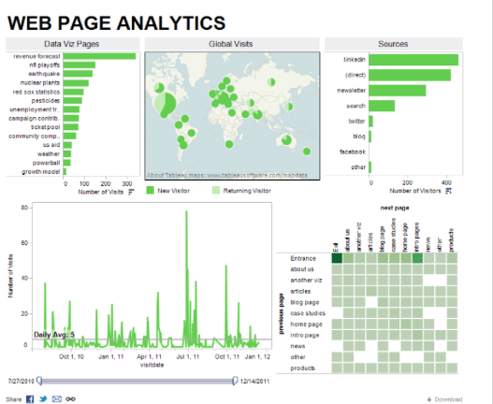
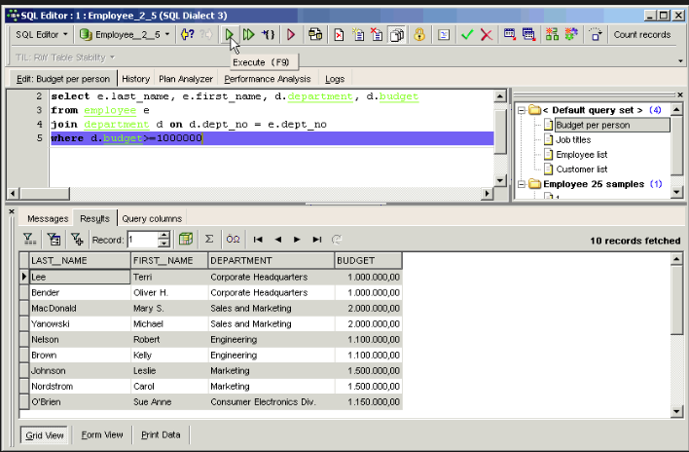
BI tool integration
Standard JDBC/ODBC drivers
Integration Tableau, Excel, Microstrategy, Toad, SQuirreL...

Slide 20
SQL support
ANSI SQL compatibility
“SQL Like” not enough
SQL data types
SMALLINT, BIGINT, TINYINT, INT, FLOAT, DOUBLE,DATE, TIMESTAMP, DECIMAL, VARCHAR, VARBINARY ….
All common SQL constructs
SELECT, GROUP BY, ORDER BY, LIMIT, JOIN, HAVING, UNION, UNION ALL, IN/NOT IN, EXISTS/NOT EXISTS,DISTINCT, BETWEEN, CREATE TABLE/VIEW AS ….
Scalar and correlated sub queries
Metadata discovery using INFORMATION_SCHEMA
Support for datasets that do not fit in memory

Slide 21
Packaging/install
Works on all Hadoop distributions
Easy ramp up with embedded/standalone mode
Try out Drill easily on your machine
No Hadoop requirement

Slide 22
Under the Hood

Slide 23
High Level Architecture
Drillbits run on each node, designed to maximize data locality
Drill includes a distributed execution environment built specifically for distributed query processing
Any Drillbit can act as endpoint for particular query.
Zookeeper maintains ephemeral cluster membership information only
Small distributed cache utilizing embedded Hazelcast maintains information about individual queue depth, cached query plans, metadata, locality information, etc.
Drillbit
Drillbit
Drillbit
Distributed Cache
Distributed Cache
Distributed Cache
Zookeeper
Storage Process
Storage Process
Storage Process

Slide 24
Basic query flow
Query
1. Query comes to any Drillbit (JDBC, ODBC, CLI)
2. Drillbit generates execution plan based on query optimization & locality
3. Fragments are farmed to individual nodes
4. Data is returned to driving node
Drillbit
Drillbit
Drillbit
Distributed Cache
Distributed Cache
Distributed Cache
Zookeeper
DFS/HBase
DFS/HBase
DFS/HBase

Slide 25
Core Modules within a Drillbit
RPC Endpoint
Distributed Cache
Logical Plan
Physical Plan
Storage Engine Interface
DFS
SQL Parser
Optimizer
Execution
HBase
Hive

Slide 26
Query Execution
Source query—what we want to do (analyst friendly)
Logical Plan— what we want to do (language agnostic, computer friendly)
Physical Plan—how we want to do it (the best way we can tell)
Execution Plan—where we want to do it

Slide 27
A Query engine that is…
Optimistic/pipelined
Columnar/Vectorized
Runtime compiled
Late binding
Extensible

Slide 28
Optimistic Execution
With a short time horizon, failures infrequent
Don’t spend energy and time creating boundaries and checkpoints to minimize recovery time
Rerun entire query in face of failure
No barriers
No persistence unless memory overflow

Slide 29
Runtime Compilation
Give JIT help
Avoid virtual method invocation
Avoid heap allocation and object overhead
Minimize memory overhead

Slide 30
Record versus Columnar Representation
Record
Column

Slide 31
Data Format Example
Donut | Price | Icing
Bacon Maple Bar | 2.19 | [Maple Frosting, Bacon]
Portland Cream | 1.79 | [Chocolate]
The Loop | 2.29 | [Vanilla, Fruitloops]
Triple Chocolate Penetration | 2.79 | [Chocolate, Cocoa Puffs]
Record Encoding
Bacon Maple Bar, 2.19, Maple Frosting, Bacon, Portland Cream, 1.79, Chocolate
The Loop, 2.29, Vanilla, Fruitloops, Triple Chocolate Penetration, 2.79, Chocolate, Cocoa Puffs
Columnar Encoding
Bacon Maple Bar, Portland Cream, The Loop, Triple Chocolate Penetration
2.19, 1.79, 2.29, 2.79
Maple Frosting, Bacon, Chocolate, Vanilla, Fruitloops, Chocolate, Cocoa Puffs

Slide 32
Example: RLE and Sum
Dataset
2, 4
8, 10
Goal
Sum all the records
Normal Work
Decompress & store: 2, 2, 2, 2, 8, 8, 8, 8, 8, 8, 8, 8, 8, 8
Add: 2 + 2 + 2 + 2 + 8 + 8 + 8 + 8 + 8 + 8 + 8 + 8 + 8 + 8
Optimized Work
2 * 4 + 8 * 10
Less Memory, less operations

Slide 33
Record Batch
RecordBatch
Drill optimizes for BOTH columnar STORAGE and Execution
Record Batch is unit of work for the query system
Operators always work on a batch of records
All values associated with a particular collection of records
Each record batch must have a single defined schema
Record batches are pipelined between operators and nodes
VV
VV
VV
VV
RecordBatch
VV
VV
VV
VV
RecordBatch
VV
VV
VV
VV

Slide 34
Strengths of RecordBatch + ValueVectors
RecordBatch clearly delineates low overhead/high performance space
Record-by-record, avoid method invocation
Batch-by-batch, trust JVM
Avoid serialization/deserialization
Off-heap means large memory footprint without GC woes
Full specification combined with off-heap and batch-level execution allows C/C++ operators as necessary
Random access: sort without copy or restructuring

Slide 35
Late Schema Binding
Schema can change over course of query
Operators are able to reconfigure themselves on schema change events

Slide 36
Integration and Extensibility points
Support UDFs
UDFs/UDAFs using high performance Java API
Not Hadoop centric
Work with other NoSQL solutions including MongoDB, Cassandra, Riak, etc.
Build one distributed query engine together than per technology
Built in classpath scanning and plugin concept to add additional storage engines, function and operators with zero configuration
Support direct execution of strongly specified JSON based logical and physical plans
Simplifies testing
Enables integration of alternative query languages

Slide 37
Comparison with MapReduce
Barriers
Map completion required before shuffle/reduce commencement
All maps must complete before reduce can start
In chained jobs, one job must finish entirely before the next one can start
Persistence and Recoverability
Data is persisted to disk between each barrier
Serialization and deserialization are required between execution phase

Slide 38
Status

Slide 39
Status
Heavy active development
Significant community momentum
~15+ contributors
400+ people in Drill mailing lists
400+ members in Bay area Drill user group
Current state : Alpha
Timeline
1.0 Beta (End of Q2, 2014)
1.0 GA (Q3, 2014)

Slide 40
Interested in Apache Drill?
Join the community
Join the Drill mailing lists
drill-user@incubator.apache.org
drill-dev@incubator.apache.org
Contribute
Use cases/Sample queries, JIRAs, code, unit tests, documentation, ...
Fork us on GitHub: http://github.com/apache/incubator-drill/
Create a JIRA: https://issues.apache.org/jira/browse/DRILL
Resources
Try out Drill in 10mins
http://incubator.apache.org/drill/
https://cwiki.apache.org/confluence/display/DRILL/Apache+Drill+Wiki

Slide 41
Demo

