Slide 1
How to Build Real-Time Streaming Analytics with an In-memory, Scale-out SQL Database
Ryan Betts, CTO
VoltDB

Slide 2

Our Speaker
Ryan Betts
CTO at VoltDB

Slide 3
agenda
Setup: Fast vs. Big
Fast data application requirements
The role of analytics
Concrete examples

Slide 4
Collect
Explore
Big Data analytic results:
Discoveries: seasonal predictions, scientific results, long-term capacity planning
Optimizations: market segmentation, fraud heuristics, optimal customer journey
Act
Analyze
Notes:
I want to start today with a brief overview of the emerging Big Data Ecosystems.
We developers, (Product Companies) are building a data management stack to accommodate a cycle of activities:
Collect
Explore
Analyze
Act
The tools that facilitate this work cycle fall into two categories, Fast and Big

Slide 5
DATA ARCHITECTURE FOR FAST + BIG DATA
FAST DATA
BIG DATA
Fast Serve
Analytics
BI Reporting
Data Warehouse
Fast Operational
Database
Columnar Analytics OLAP
Real-time Analytics
Ingest / Interactive
Decisioning
Export
Data Lake (HDFS)
Non Relational Processing
ETL
CRM
ERP
Etc.
Enterprise Apps
Notes:
The solution to this problem is not complex – but it does require distinguishing “fast” from “big.” If you think getting value from “big data” is hard – maybe that’s because you aren’t considering the important differences between “fast” and “big.”
Big data is the accumulation of vast amounts of information that are used for exploration (by data scientists), for large, historical analytics (like back testing and recommendation system calculations).
Fast data is about operationalizing the learning and insights that you derive from “big data” – and making real time, per-event decisions that have direct impact on interactions and observations in real time.
Your fast data archicture is responsible for ingesting data, processing, correlating, filtering, transforming and making optimized decisions in real time – then connecting that processed, enriched stream to your big data / OLAP infrastructure for archival and downstream OLAP.
You must combine FAST with BIG to unleash value. Modern applications deliver real time personalization, real time security, fraud and monitoring, real time operational analytics.

Slide 6
Fast (in motion)
Streaming Analytics: real time summary and aggregation
Transaction Processing: per-event decisions using context + history
Big (at rest)
Exploration: data science, investigation of large data sets
Reporting: recommendation matrices, search indexes, trend and BI
Notes:
On the big side we perform analytics to discover and report.
On the fast side we perform analytics for different reasons:
1. To inform real time decisions (optimize customer experience, pick best utilized-resource)
2. Operational monitoring in fast changing systems
In both of these cases, applications evolve to require an automated action.
In (1), the action is implicit. There is an authorization or policy evaluation occurring with each incoming event.
In (2), the action is usually an automated result to an alert. In environments that change very rapidly, human operators react to slowly (and at insufficient scale). Often monitoring begins to gain transparency and quickly is evolved to include an action when thresholds are exceeded.
These automated actions, at the technical level, are database transactions.

Slide 7
Modern oltp
Fast
Streaming Analytics
Transaction Processing
Processing streams requires integrated access to state.
Using real time analytics requires a query interface.
Reacting to incoming events requires transactions.
State + Query + Transactions = OLTP

Slide 8
Continuous Query | Transactions | Transformations
Materialized Views Capped Tables Ranking Indexes Per-event Java + SQL | ACID processing Millisecond latency responses | Loaders/Importers Export Connectors State for sessionization, enrichment
VoltDB Architecture
Commodity HW | HA + ACID | Scale-out | VM-friendly
Notes:
CEP differentiation?

Slide 9
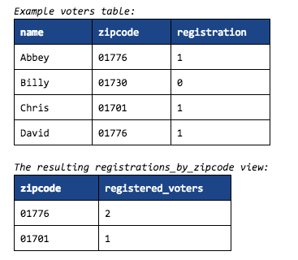
Materialized views
Declarative SQL
Fully transactional
Supports ad-hoc query
CREATE VIEW registrations_by_zipcode (
zipcode, registered_voters
) AS
SELECT zipcode, count(*) from voters where registration=1 GROUP BY zipcode;

Slide 10
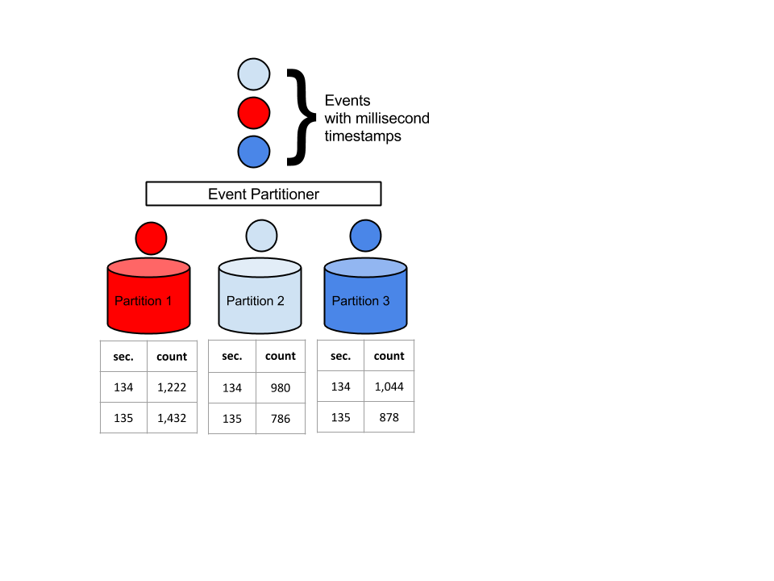
MV For streaming aggregation
Partitioned on cluster
Immediately up-to-date
Active/active HA
Global Read: SELECT sum(count) WHERE sec > 130 and sec < 140;

Slide 11
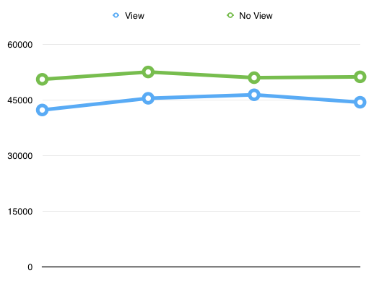
Materialized views with acid transactions
Can be queried as part of a transaction
Example: fast quota enforcement
1-partition throughput (transactions/second)
10GB of data being aggregated.

Slide 12
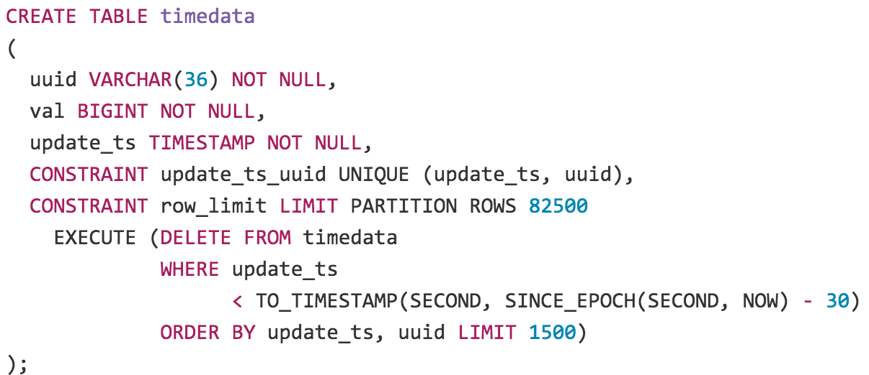
Capped collections
Simple windows
Durable, queryable
Support Mat. Views

Slide 13
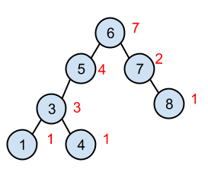
Ranking indexes for leaderboards
Sorted indexes are ordered statistic trees for O(log(n)) ranking
Quickly find overall rank
Quickly count items in range
SELECT COUNT(*) FROM scores WHERE score > 281;
SELECT COUNT(*) FROM scores WHERE score >= 10 AND score <= 200;

Slide 14
SQL support
ALTER TABLE|CONSTRAINT|COLUMN|PROCEDURE
UNIQUE, MULTI-KEY INDEXES
INDEXES ON COLUMN FUNCTIONS
SQL ONLY DDL STORED PROCEDURES
JAVA STORED PROCEDURES
AUTO-GENERATED CRUD COMMANDS + REST API
MATERIALIZED VIEWS
SUBQUERY, UPSERT|INTO, JOIN, SELF-JOIN, INSERT SELECT
~60 COLUMN FUNCTIONS
http://downloads.voltdb.com/documentation/TriFoldDevQuickRef.pdf

Slide 15
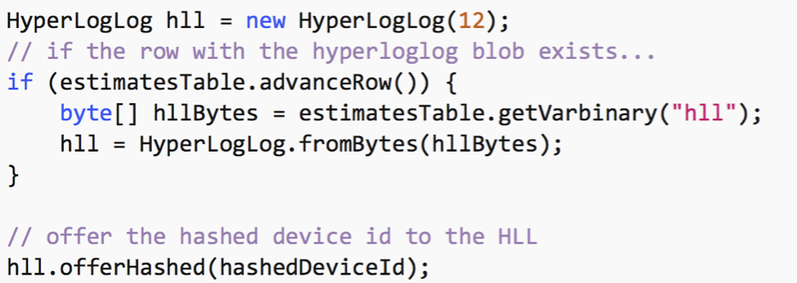
Combined java + sql
Logic + SQL
3rd party code
VoltDB architecture
Commodity HW | HA + ACID | Scale-out | VM-friendly

Slide 16
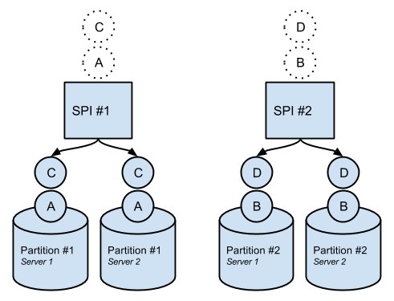
ACID processing
Sync intra-cluster replication
Replicated durability
High availability (configurable)
Serializable isolation
Atomic ad-hoc or stored procedures
Partitioned & distributed txns
Load balanced reads across replicas

Slide 17
Acid matters
Speed of development
Richness of application
Obvious for billing, policy enforcement, authorization
Equally necessary for aggregation
Update in place desirable vs. batch process for ingest
Notes:
Update in place often better than batch processing for sessionization, enrichment, aggregation, and other streaming ETL functions.
In *theory* a system could be more available than us if they were less consistent.
In practice, there are some systems that are more available, BUT many systems that give up ACID are not necessarily any more available than we are, and many are actually worse. Also, some software systems that are really good at being available, like Cassandra, could be run in less available ways, either by using features of Cassandra that compromise availability (quorum-reads/writes, CAS), by making poor choices during deployment or even by making cost-concious choices during development.
Redis, HBASE, MongoDB, RethinkDB, FoundationDB, ElasticSearch…

Slide 18
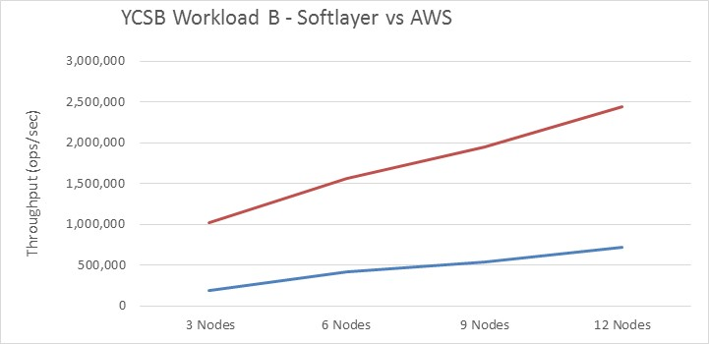
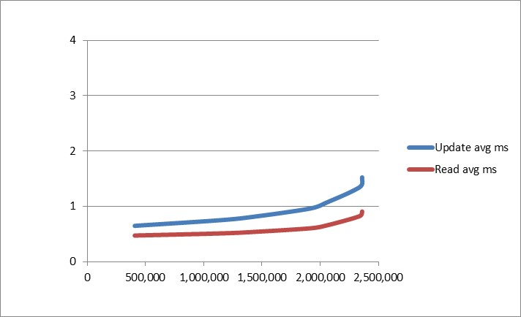
Performance – millisecond per-event responses
YCSB Workload B – SoftLayer vs AWS
SoftLayer: Update and Read Latency
SoftLayer
Latency (ms)
AWS
Throughput (ops/sec)

Slide 19
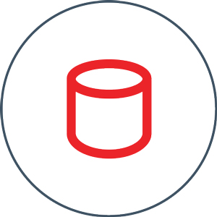


Integrating Data Sources with VoltDB
BULK LOADERS
APPLICATION INTERFACES
CSV loader
Kafka loader
JDBC loader
Vertica UDx
Extensible loader API
JDBC
ODBC
HTTP JSON
Native client drivers / SDKs

Slide 20

Voltdb export UI
ddl.sql
CREATE TABLE events (
EventID INTEGER,
time TIMESTAMP,
msg VARCHAR(128));
EXPORT TABLE events;
Application SQL
INSERT into TABLE values…
deployment.xml
<export enabled="true" target="file">

Slide 21
Integrating voltdb with export targets
Local file system export
JDBC export
Kafka export
RabbitMQ export
HDFS export
HTTP export
Extensible API

Slide 22
Extensible open source api
public void onBlockStart() throws RestartBlockException;{
}
public boolean processRow(int rowSize, byte[] rowData) throws RestartBlockException {
}
public void onBlockCompletion() throws RestartBlockException {
}
VoltDB architecture
Commodity HW | HA + ACID | Scale-out | VM-friendly

Slide 23
Review
SQL + Java transactions
JSON column values
HA in-memory processing
ACID (durable to disk)
Ranking indexes
Indexes on functions
Capped tables
Mat. views: RT aggregation
Append only export
1-5 ms @ 99% responses
Partition Replica 1
Event Sources
VoltDB
Client
Interface
Application
Partition
Replica 2
Export Destination (OLAP, HTTP)

Slide 24
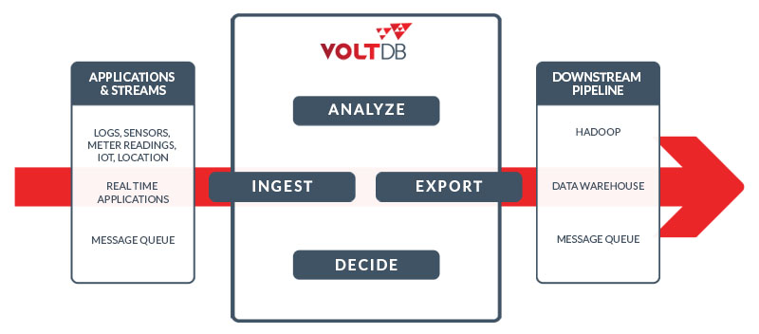

Bigger picture

Slide 25
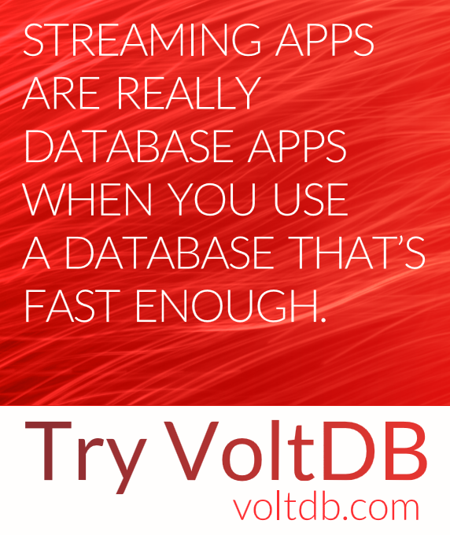

Slide 26
Questions?
Use the chat window to type in your questions
Try VoltDB yourself:
Download the Enterprise Edition:
www.voltdb.com/download
Check out our Sample Apps:
www.voltdb.com/community/applications
Open source version is available on github.com

Slide 27
Thank you!

