Slide 1
Real-Time Data Integration Best Practices and Architectures
Presented by Nelson Petracek, Informatica

Slide 2
The Need for Timely Information
Product Designers
Retail Stores
Operational
Data Hub
Data
Synchronization
Real-time
Data Quality
Operational
Data Hub
Enterprise Information System
Indirect Sales Channel
Customers
Enterprise
Data
Warehouse
Missed Opportunities
Lower Customer Service Levels
Market Share Erosion
Increased Exposure to Risk
Increased Costs
RT Data Warehouse
Sales & Marketing
Call Center

Slide 3
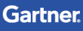
Applications created in 2012 using traditional architecture models will be an IT-constraining legacy by 2016
The leading business applications of 2016 are designed today using Nexus-enabled application architecture principles

Slide 4


Changing Perspectives on Data
It is no longer sufficient to view information “after the fact”.
Business demands information sooner, with more accuracy, in order to meet competitive and regulatory demands.
Business needs to respond to “threats” and “opportunities sooner.
Reduce decision latency.
Proactive Alerts and Notifications

Slide 5
What does “Real-Time” mean to you?
Days Performance Management Sales by Business Unit
Hour Inventory Management Compliance
Minutes Order Confirmation Operational Metrics
Second Straight-through Processing Call-center Analytics Point-of-entry Applications
Instantaneous Securities Exchange
Operational Data Integration
Analytical Data Integration

Slide 6
Traditional Integration
Custom Extracts and Interfaces
Application 1
Application 2
Application 3
Application Logic
Query/pull
Application Logic
Query/pull
Application Logic
Interfaces
Interfaces
Interfaces
Data
Data
Data
“Siloed” Applications, Embedded Interfaces and Transformation
Notes:
Growth and acquisitions often result in a series of “siloed” applications.
As more data is needed, it is pulled from other sources via additional interfaces, extracts, and batch processes.

Slide 7
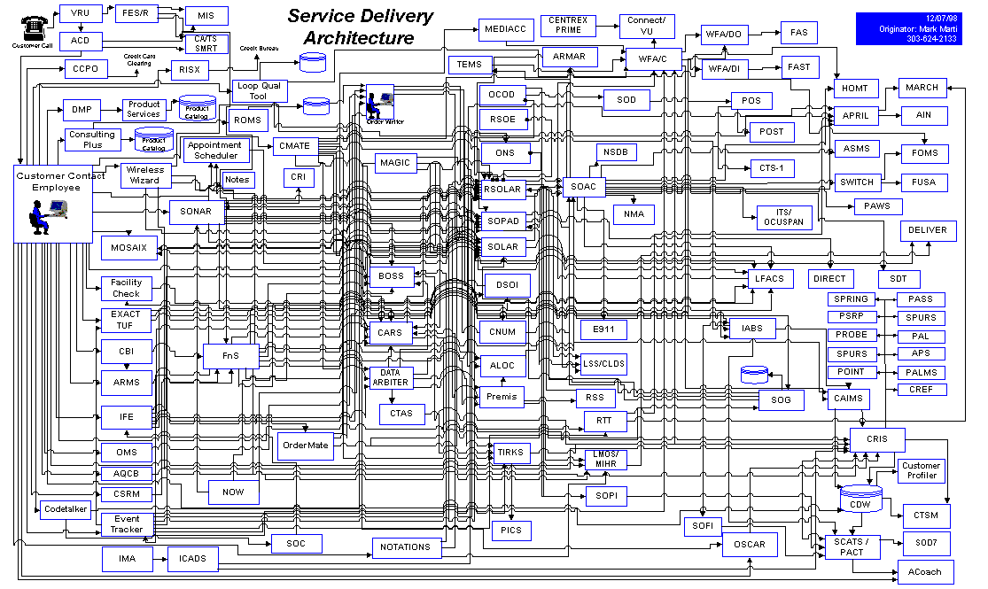
Traditional Integration: Result…

Slide 8
Critical Considerations
Complexity of source and targets.
Data formats.
Level of quality.
Availability of source/target interfaces.
Volume, velocity; and variety.
Delivery requirements.
Real-time, near real-time, batch/scheduled.
Loose coupling/reusability.
Performance/Availability.

Slide 9

Real-time Data Integration Patterns
Transactional Data Processing
Data Replication
Data Integration Hub (DIH)
Event Driven Architecture (EDA)
Data Consumers
Interaction management (Publications & subscriptions)
Location Context
(GIS)
CRM
Master Data
BI, DW,
Other Targets
Event Based Applications
Applications
Processes
BI Tools
Portals
Web Services
On-boarding
Data Transformation & Enrichment
Monitoring & Auditing
Data Governance
Real Time Web Content Delivery
Planning
Big Data
(Analytics)
Event Processing
Batch
Trickle Feed
Real Time
Catalog Service
Validation & Quality Rules
Data & Event Monitoring
Real Time Event Transport / Delivery
Cloud
App (HR)
Data
Warehouse
PWC/ PX
IDR
Data Receipt / Transformation & Mapping
Persistence
Communication “Cloud”
Applications
Databases
Messages
Flat Files
XML
Unstructured
Data
Mainframe
POS App
Hub Management
Delivery & Schedule
Archiving
Finance
Source Applications/ Technologies
Operational Data (Field Devices, Applications, etc.)
Data Sources

Slide 10
Transactional Data Processing
1
Merge/Apply,
Reports & Queries
Operational BI & Real-Time DW Provide freshest information to business w/o impact, off-load reporting, & do high volume updates (ODS/OLTP/DW/Appliance)
Source System
Target Systems
Transactional/Production
Applications
ODS/OLTP/ DW/Appliance
2
Merge/Apply,
Reports & Queries
Operational (Sync) Ensure all users are seeing the same, trusted, up-to-date data that is synchronized across the organization.
Source System
Target Systems
Transactional
Applications
ODS/OLTP/DW

Slide 11









Transactional Data Processing
Console
SQL Apply Merge Apply Audit Apply
Source System
Intermediate Files
Target System
EXTRACT
APPLY
Committed
Checkpoint
High Speed Extraction
Checkpoint
High Speed Parallel Apply
SERVER
MANAGER
http://
SERVER
MANAGER
JMS*

Slide 12
In-Memory Cache Synchronization
Cache Node
Cache Node
Cache Node
Data Sources
Real Time Data Replication
In Memory Grid
Consuming Applications

Slide 13
Data Integration Hub
Data Integration Hub
(Publish/ Subscribe)
Define Topic
Define Subscribers (Connection properties, Mode, Frequency)
Define Publishers (Connection properties, Mode, Frequency)
Define Transformation and validation rules
Define Security & Access Policies
Deploy (Instantiate persistence and data integration flows)
Monitor, Govern, Alert & Audit
Master
Data
CRM
Planning
Big Data
(Analytics)
Cloud
App (HR)
Data
Warehouse
POS
App
Finance

Slide 14

Data Integration Hub
Applications
Enterprise Scheduler
Command Interface
File Manager
Applications
Prompt:$
Transfer Interface
Pub. Identification
XML Normalization
Data Quality Firewall
Sub. Identification
Sub. Transformation
Sync-up Control
Sub. Delivery
Sub.
Acknowledgement
Transfer Interface
Connector
State logging, Error handling
Connector
Enterprise Monitor
Monitor and Alert Interface
Prompt:$
SNMP
Notes:
One Approach, One Platform for Application Data Exchanges.
In-Process Data Certification.
Supports any style of integration.
Batch/Bulk orientation (File, RDBMS, Applications)
Message orientation (JMS and other MOM)
Service Orientation (Web Services)
Manage any hand shake pattern.
Point 2 Point, Pub/Sub, Request/Response, Event based, Push, Pull,
Any integration latency.
Batch, Near RT and RT
Any format/conversion.
Proprietary, native, industry standards.
Office Documents
Administration.
End to end Traceability
Error management
Declarative configuration

Slide 15
Event Driven Architecture
Event Sources (Producers)
Integration/Direct
Pre-Process
Integration/Direct
Detected Situations (Consumers)
Devices
Patterns
Systems
Alerts
Process
Applications
Event Streams
People
Actions
Post-Process
An architecture in which the activity is driven by changes in state within an environment.
Events drive the execution of logic.

Slide 16

Sample EDA Reference Architecture
BI, DW,
Other Targets
Event Based Applications
Location Context
(GIS)
Real Time Web Content Delivery
Event Processing
Real Time Delivery
Transformation & Mapping
Connectivity & Data Replication
Operational Data (Field Devices, Applications, etc.)

Slide 17
Event Enablement and Transformation
Transformation & Mapping
Connectivity & Data Replication
Event-enable and collect events from underlying systems and applications.
Data Replication
PowerExchange/PowerCenter
Transform events to normalized format for downstream processing.
B2B Data Transformation
Enrich events as needed.

Slide 18
Event Transport
Real Time Delivery
Deliver transformed events to downstream applications, systems, and event processors.
Ultra Messaging
Dynamic Routing
Parallel Persistence
Guarantees delivery, and decouples event producers from event consumers.

Slide 19
Event Rules and Delivery
Real Time Web Content Delivery
Event Processing
Processes events, applies user/business defined rules, and generates responses.
RulePoint
Rules may be applied across events and over time/space.
Alerts/notifications may be sent to BI environments, web applications, etc.

Slide 20
Architectural Implications
Shift to modeling events as enterprise assets. Incorporate the processing of immediate, individual events.
Deliver quality data as it is needed by the business.
Information and Data Architecture
Complement existing SOA strategies with event driven applications.
Move to a single environment that supports different integration delivery models.
Application Architecture and Development
Shift from centralized, database-centric client-server applications to distributed systems.
Deploy infrastructure that can support data delivery over different latencies.
Infrastructure Architecture

Slide 21
Summary
Augment traditional integration solutions with real-time data integration to:
Reduce decision latency.
Improve decision making and responsiveness.
Increase visibility.
Build upon the principles of SOA and an event-driven architecture (EDA).
Informatica provides the capabilities for adding real-time data integration to your environment.

Slide 22

1
Join our exclusive Potential at Work Communities. Visit the kiosk.
2
Get a PowerCenter Express demo! Visit the Pavilion kiosk.
3
Tell us what you think. Click on Evaluations in the IW13 Mobile App.
Notes:
Did you hear about our exclusive new Potential at Work Communities? When you join, you’ll get access to strategic insights and best practices to help you in your role today and your career ahead. They focus on the power and potential of information and will transform the way you think about the role of data in today’s world. Visit our Potential at Work Kiosk in the Pavilion or visit www.informatica.com/potential-at-work
And don’t forget, as an IW13 attendee you will be receiving an email with a link to your free download of PowerCenter Express, our new entry-level data integration product. But in the meantime, why not get yourself a demo by visiting the PowerCenter Express Kiosk in the Pavilion.
It would mean a lot to me if you shared your feedback about this session. Please take out your mobile app right now. Click on evaluations. There are three short questions. It should take you less than 2 minutes to complete.
Thank you.

