Slide 1
Recent Advances in Light Transport Simulation some Theory & a lot of practice
Jaroslav Křivánek
Charles University in Prague
Alexander Keller
NVIDIA
Iliyan Georgiev
Solid Angle, Saarland University
Anton Kaplanyan
KIT
Marcos Fajardo
Solid Angle
Mark Meyer
PIXAR Animation Studios
Jean-Daniel Nahmias
PIXAR Animation Studios
Odřej Karlík
Render Legion
Juan Cañada
Next Limit Technologies
Notes:
Good afternoon everyone, welcome to the course entitled “Recent advances in light transport simulation, Some theory & A lot of practice”.

Slide 2
INTRODUCTION
Jaroslav Křivánek
Charles University in Prague
Notes:
My name is Jaroslav Křivánek and I’ll give a short into to the course.

Slide 3
Course evolution
Last year:
“Recent advances in LTS: Theory and practice”
This year:
“Recent advances in LTS: Some theory and a lot of practice”
Notes:
This course is an evolution of a course that we presented last year, which was mostly about the theory with only a marginal focus on the practical aspects.
This year, based on the feedback we got, we decided to shift the focus a bit away from the theory toward the practical side of things.

Slide 4
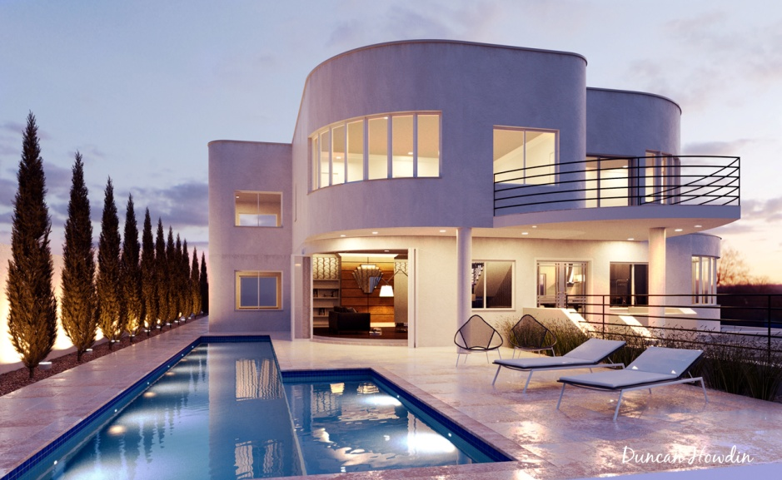
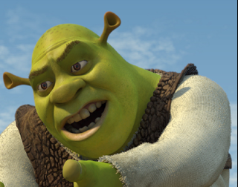

Light transport – Global illumination
Archviz
Movies
PDI DreamWorks 2006
© Duncan Howdin
Sony Pictures Imageworks, 2006
Image courtesy of Columbia Pictures. © 2006 Columbia Pictures Industries, Inc.
Notes:
Before we start, let me give a bit of a motivation for the topic of the course.
Physically-based light transport simulation is an essential component of rendering realistic images with global illumination.
It’s been a standard tool in architectural and product visualization for many years now.
It has now picked up in the movie industry too and the entire industry is now shifting to physically based light transport.
This shift really underlines the importance of research and development in this area. It is also one of the important motivations behind this course.

Slide 5
Recent research advances
Too numerous to mention all of them
This SIGGRAPH
Light Transport (technical papers), Wed 10:45 – 12:15
Sampling (talks), Tue, 10:45 - 12:15
Scattering (talks), Thu, 9:00 - 10:30
Notes:
And indeed, recently there have been some significant research advances on improving light transport simulation algorithms.
In fact, the recent results are too numerous to list them all, so I’ll just point to some of the sessions here at SIGGRAPH.
We will also review some of the recent advances in this course.

Slide 6
Common denominator
Path integral formulation of light transport [Veach and Guibas 1995], [Veach 1997]
Notes:
But the important thing is that common to most of these techniques is the view of light transport as an integral over a space of light paths.
This is why we will put a significant emphasis on this view of light transport in the theory part of the course.

Slide 7
Issues in light transport simulation
Efficiency
Robustness
Usability
Notes:
The presentations in this course revolve around three main topics.
Next to the overall efficiency, one of the important aspects to focus on is the algorithm robustness, the ability to handle many different scenes.
Last but not least, physically based rendering presents the users with a new type of work-flow, new controls and new constraints that they may not be used to.
For this reason, the usability aspects are just as important as the raw performance of the underlying algorithms.

Slide 8
Course outline
2:05 … Path integral formulation of light transport (Jaroslav Křivánek)
2:25 … Combining bidirectional path tracing and photon mapping (Iliyan Georgiev)
2:45 … Path space filtering (Alexander Keller)
3:05 … Comparison of light transport methods (Anton Kaplanyan)
3:30 … Break (15 minutes)

Slide 9
Course outline
3:45 … Efficiency = Good importance sampling (Marcos Fajardo)
4:05 … PIXAR’s fast lighting preview (Danny Nahmias)
4:25 … Corona Renderer: It’s all about usability (Ondra Karlík)
4:45 … Advanced light transport in the VFX/archiviz industry (Juan Cañada)
5:05 … Q & A (All)

